Slide 1



INTELLIGENT SYSTEM FOR INVENTORY DEMAND FORECASTING
SREEJA PASUPULETI
MADHUMITHA GANNAVARAM
SRI SAI LAHARI GANDRAPU

Slide 2
01.
PROBLEM AND SOLUTION
02.
EXPLORATORY DATA ANALYSIS
03.
DATA PREPROCESSING
04.
MODELING
05.
TABLE OF
CONTENT
EVALUATION AND RESULTS

Slide 3
SOLUTION
Building an AI powered system, that helps in stock optimization, forecasting demand that aligns with customer needs, and retrieval of information about goods.
PROBLEM
Challenges in Inventory management, wastage of perishable goods and cost savings at IU Dining.

Slide 4
FLOW MODEL
EDA & DATA PREPROCESSING
DATA
MODEL BUILDING
User prompt/output
LLM (LLaMA)
trained on historic and predicted data
PREDICTION BASED ON HISTORIC VALUES

Slide 5
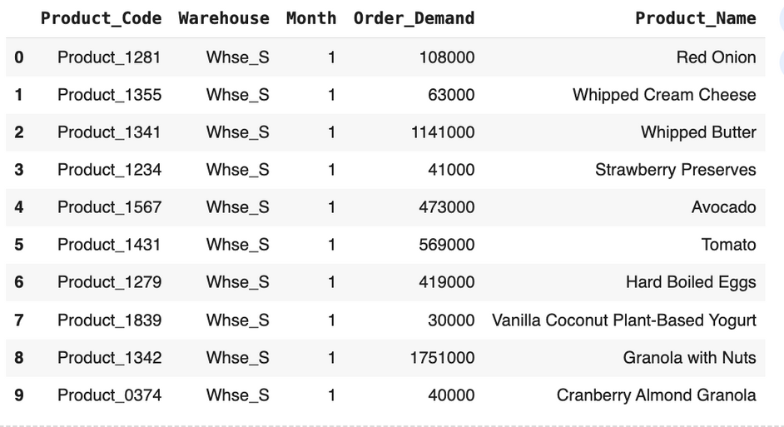
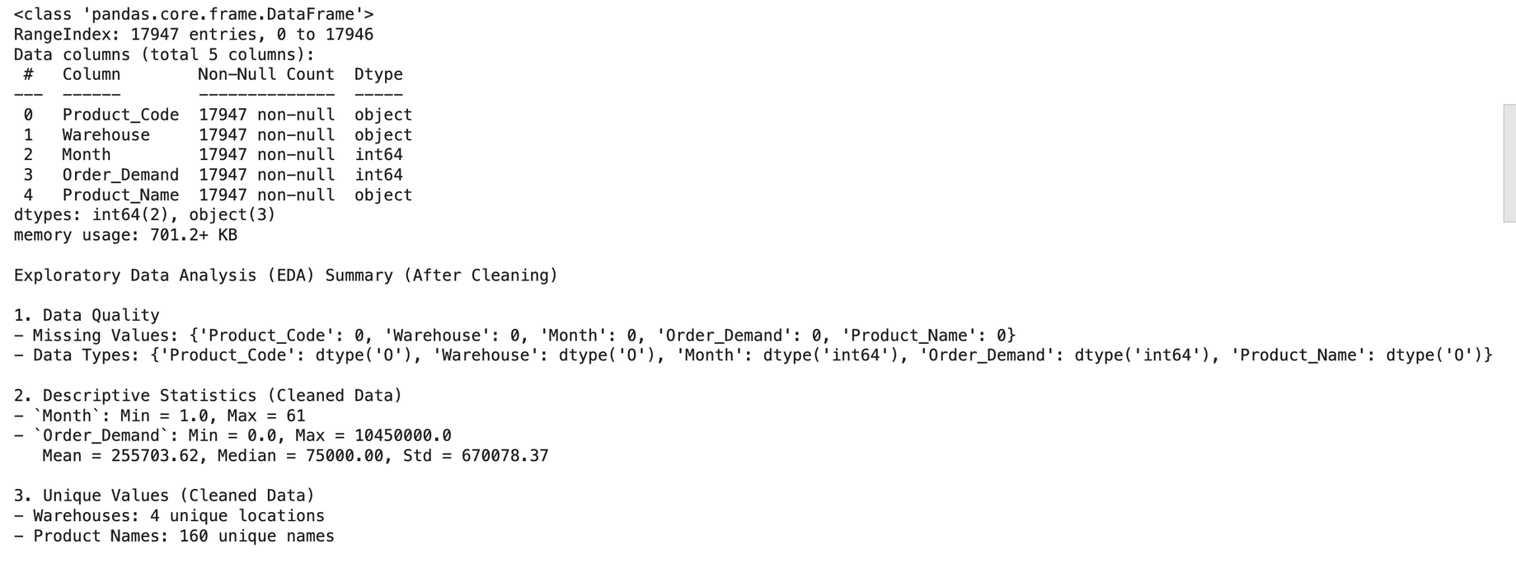
EXPLORATORY DATA ANALYSIS

Slide 6
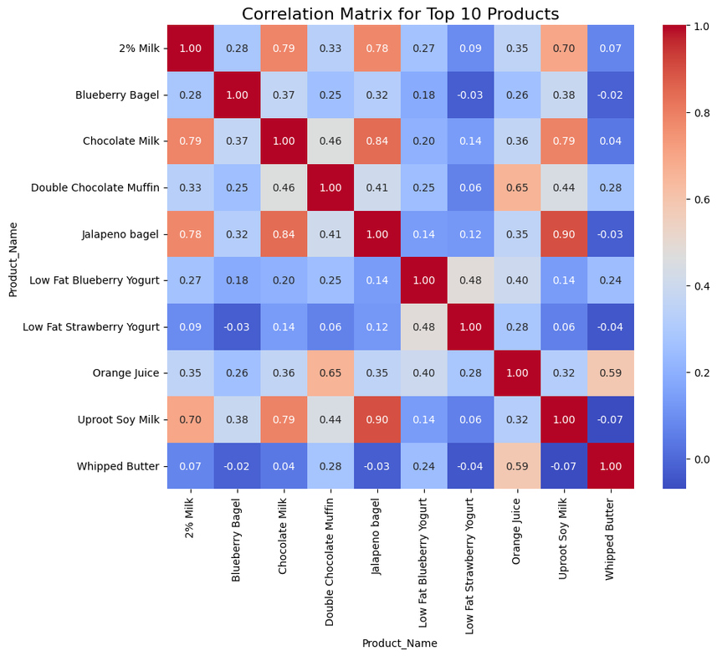
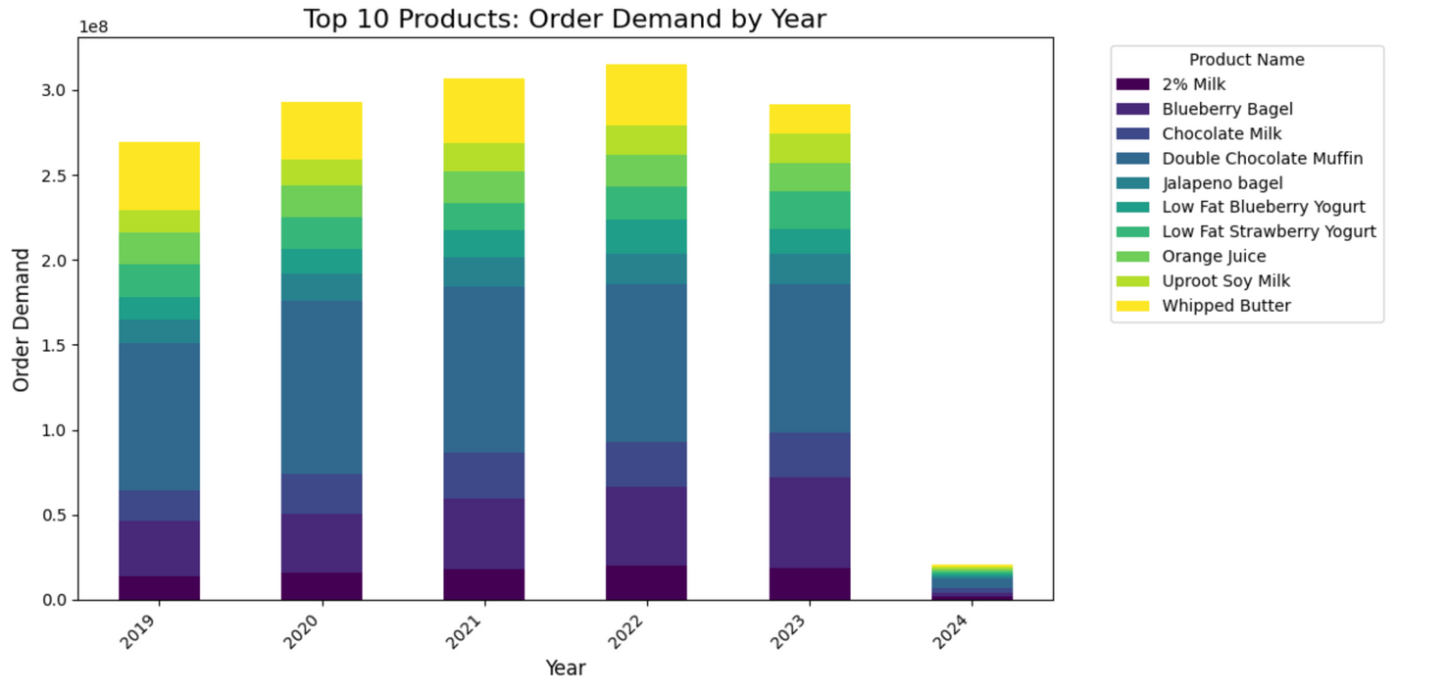
EXPLORATORY DATA ANALYSIS

Slide 7
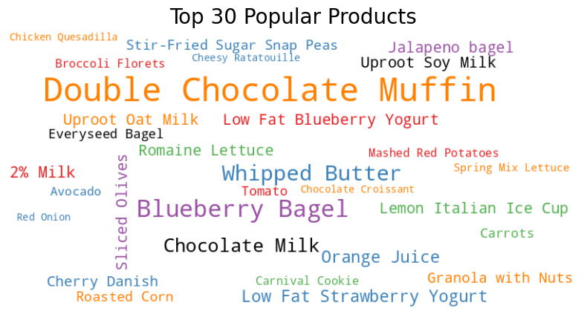

Slide 8
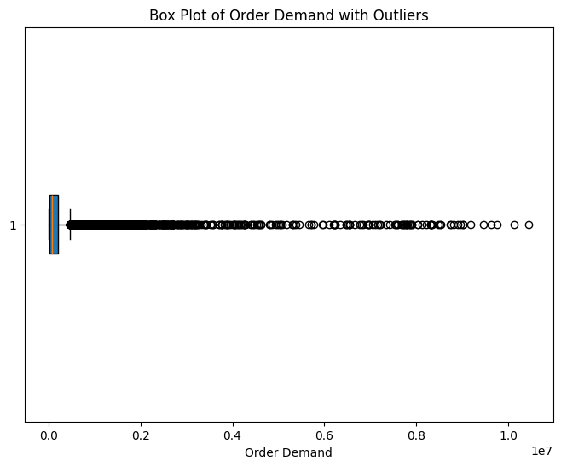
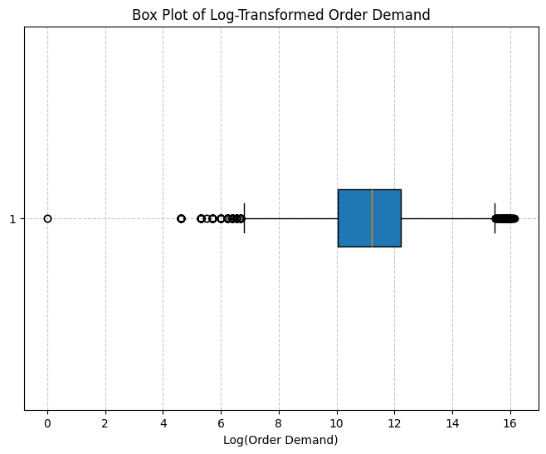
EXPLORATORY DATA ANALYSIS
Identification of outliers in the Order_Demand column using the Interquartile Range (IQR) method through three main steps:
IQR Calculation
Q1 represents the 25th percentile of the data
Q3 represents the 75th percentile of the data
IQR is calculated as Q3 - Q1, measuring the spread of the middle 50% of the data
Outlier Detection
The method flags data points as outliers if they fall outside these boundaries:
Lower bound: Q1−1.5×IQR
Upper bound: Q3+1.5×IQR
Outlier Flag
The code creates a new column called Outlier_Flag with binary values

Slide 9
DATA PREPROCESSING
Categorical Data Transformation
Categorical data represents qualitative characteristics. By converting it into numerical format using Label Encoding (e.g., for Product_Code and Warehouse), we allow models to process and analyze patterns effectively.
Standardization
Data often varies in scale, impacting model effectiveness. We standardized the Order_Demand column using StandardScaler, ensuring all features contribute equally by bringing them to a comparable scale.
Temporal Data Representation
Time-related data is cyclical (e.g., months repeat annually). Using sine and cosine transformations for the Month column preserves its periodic nature, helping models capture seasonal trends more accurately.
Feature Engineering
Aggregating and summarizing information highlights underlying patterns. For instance, we calculated the mean and median of Order_Demand for each Product_Name and merged these statistics back into the dataset, enriching it with meaningful insights.

Slide 10
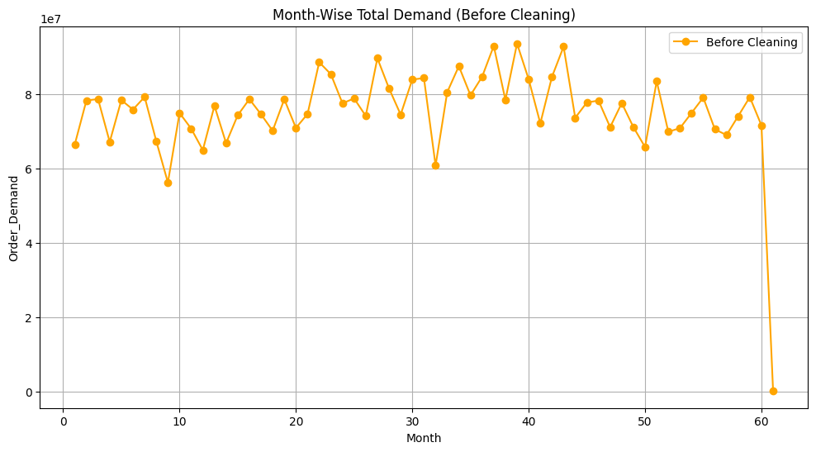
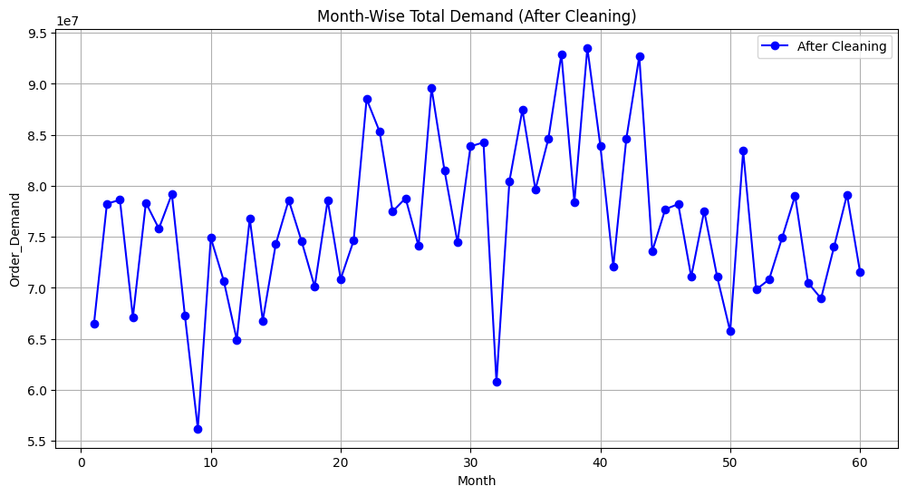
DATA CLEANING

Slide 11
MODELING

Slide 12
Holt-Winters | Autoregressive Integrated Moving Average (ARIMA) Prediction Model | Multilayer Perceptron
Holt-Winters Exponential Smoothing is a time series forecasting method that models trend, seasonality, and noise reduction through exponential weighting of past observations. | Time series forecasting model that combines autoregression, differencing, and moving average components | Artificial neural network with multiple layers for learning complex patterns in data
Suitable when data exhibits both upward/downward trends and seasonal patterns (e.g., monthly sales, demand) | ARIMA is used to forecast time series data with trends when there are no strong seasonal patterns. | It can learn complex patterns and use multiple factors to make accurate predictions
Performs ADF test to check for seasonality
Uses auto_arima to find the best suited parameters and predicts the order demand for the next 12 months
trend = add
seasonal = add
seasonal_periods = 12
Creates lagged features to capture patterns and prepare the data for training.
It is trained with a time-series-aware split to predict future demand.

Slide 13
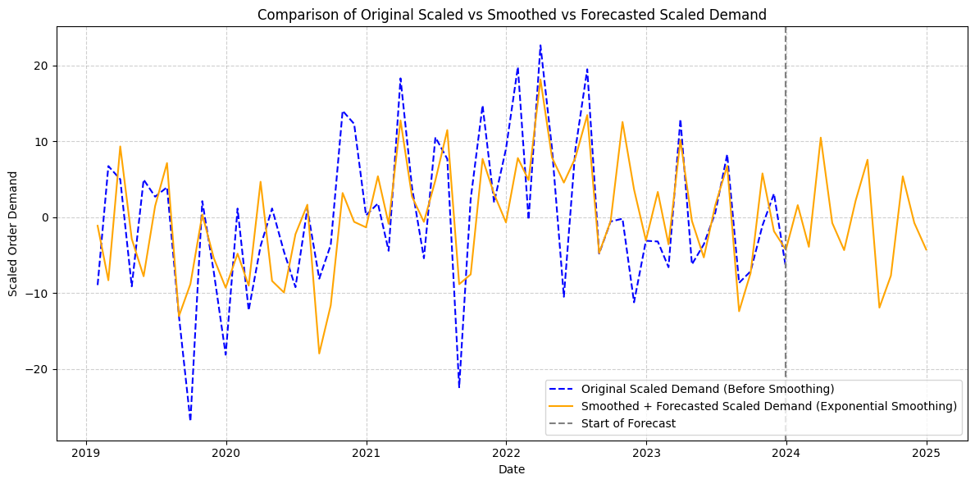
HOLT-WINTERS

Slide 14
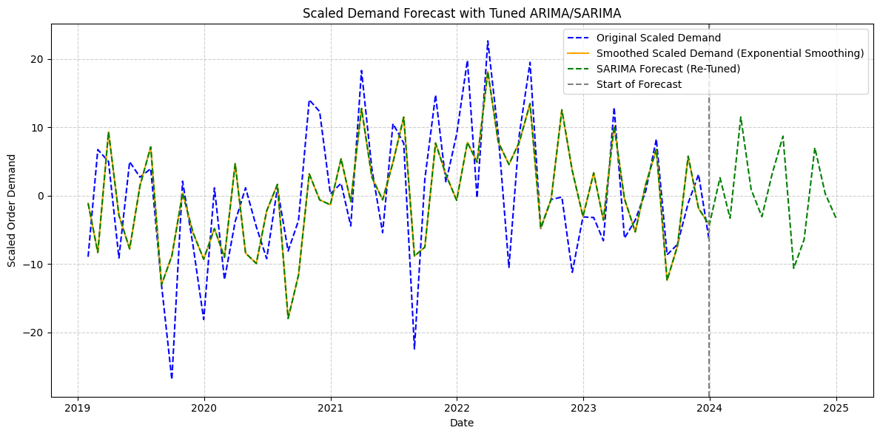
ARIMA

Slide 15
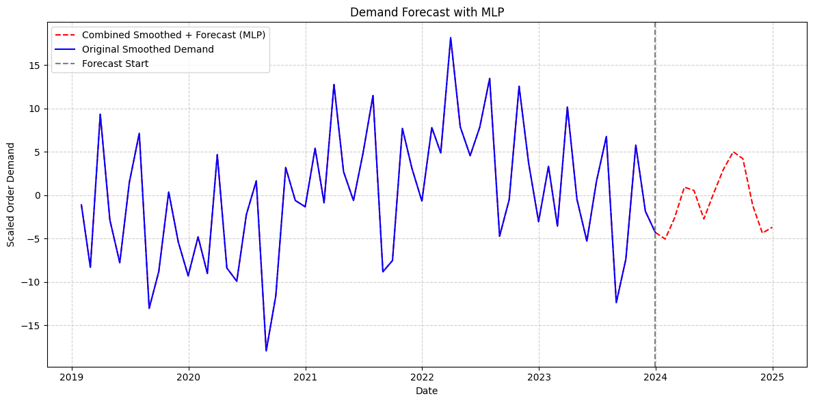
MLP

Slide 16
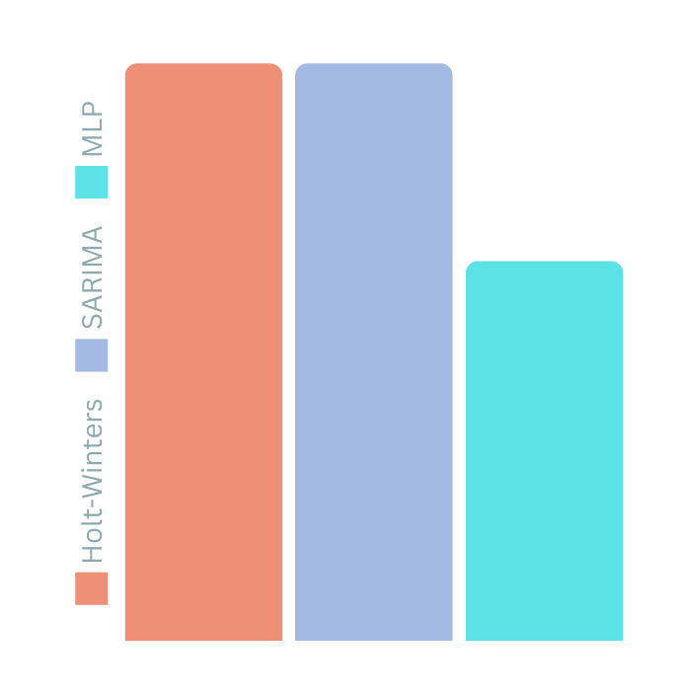
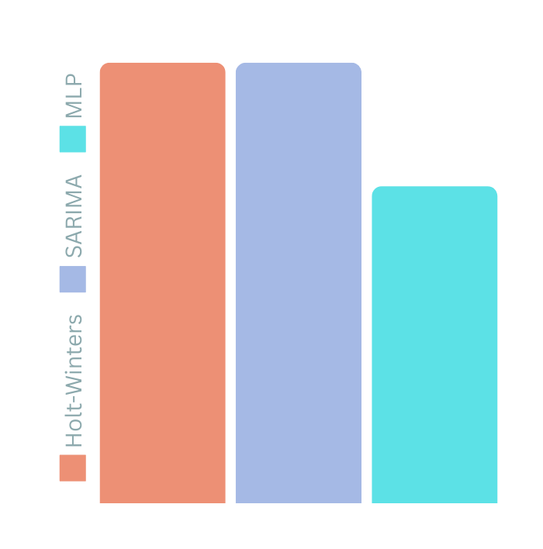
METRICS
458K
Root mean squared error
Mean Absolute Errorr
People use our product
Error evaluaion is done using RMSE and MAE
SALES
$752,000
Less the error, better the model
Total revenue in 2022
MARKET
MLP performs better of all
Market share in global

Slide 17

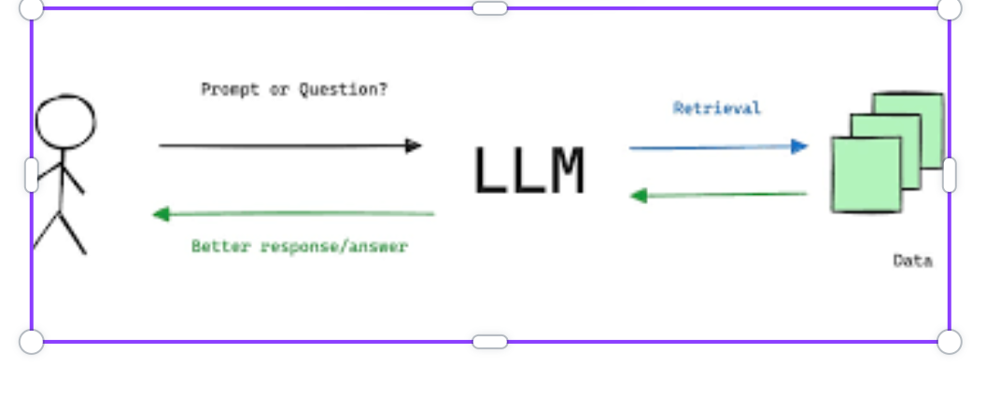
LLM for Data Retreival
Utilized Ollama, interface to run LLaMA model locally.
LLM enables intelligent insights and conversational responses for inventory management.
Helps users (staff and managers) to retrieve information about items that are on demand using simple prompts.

Slide 18
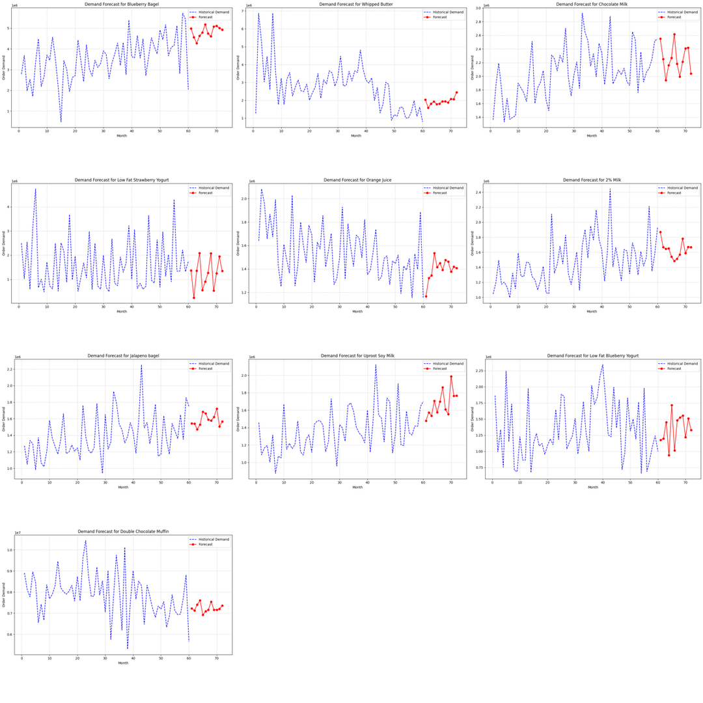
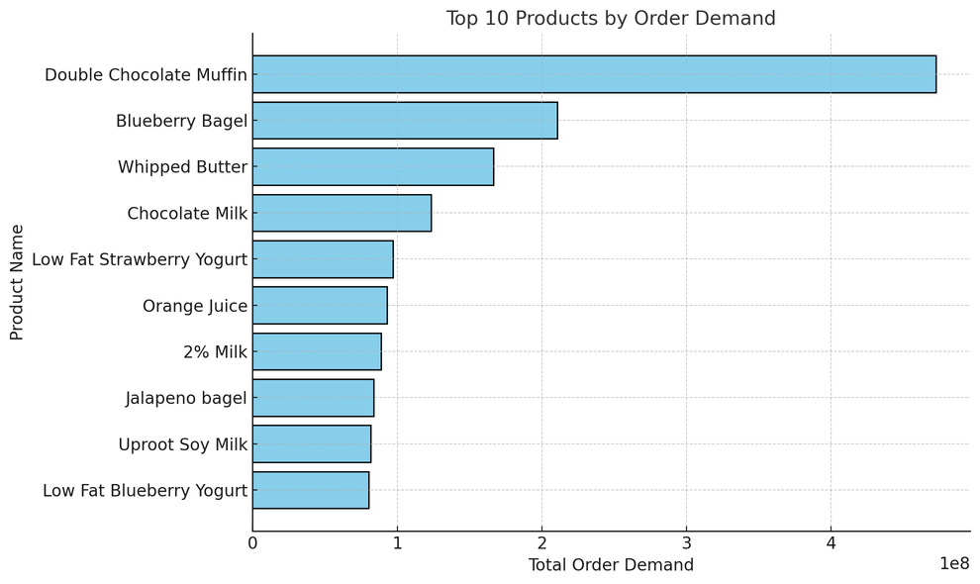
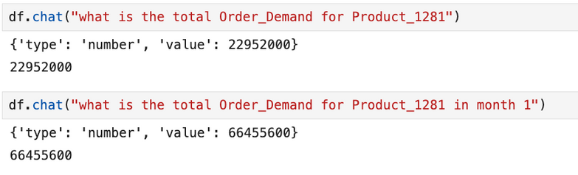
RESULTS
LLM output

Slide 19
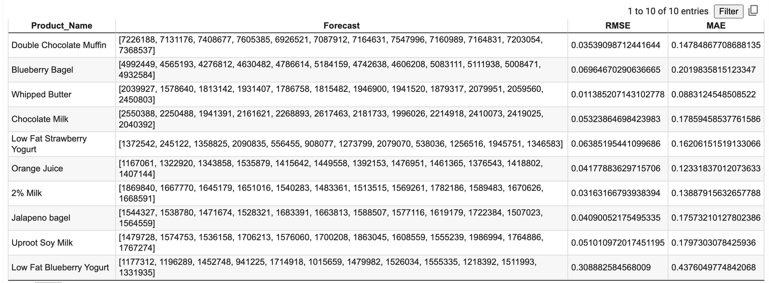
RESULTS
19

Slide 20
NEXT STEPS
Building interactive and adaptive UI for the present use case
Training and fine tuning LLM with the inventory data of IU Dining Halls
.
Integrating sales data into this model for prediction of sales and seasonal trends

Slide 21
THANK YOU
Do you have any questions?

