Slide 1


SCRIBLYST
Meeting Intelligence Research Agent
Presented by: Madhumitha R
Event: Global AI Hackathon

Slide 2
Why SCRIBLYST?
The name comes from the words SCRIBBLE + CATALYST
SCRIBBLE - Capturing ideas, thoughts, information and meeting context—even when they are unstructured.
CATALYST - Turning those scattered inputs into meaningful insights that drive informed decisions and action.
From scattered thoughts to structured insights. From insights to meaningful action.

Slide 3
An AI-powered platform that transforms company and people research into actionable, source-backed meeting briefings.
It helps users:
  Research companies and people before meetings.
  Discover relevant information and recent developments.
  Generate structured insights and potential discussion questions.
  Ask follow-up questions using the generated research.
  Connect meeting preparation with Google Calendar, Google Meet and Google Docs.

Slide 4






FEATURES
WEB SEARCH VIA
TAVILY ENGINE
MULTI-FORMAT SWITCHER AND CONCISE BRIEFING
SOURCE ATTRIBUTION AND OPEN QUESTION
INTERACTIVE
Q&A BOT
ONE-CLICK DOCS
EXPORT
BIFROST INTEGRATION & CALENDAR

Slide 5
HOW TAVILY AND BIFROST ARE INTEGRATED?
TAVILY (SEARCHES)
Finds information from the web
BIFROST (THINKS)
Analyzes and generates insights
SCRIBLYST (ACTIONABLE BRIEFING)
Source-backed meeting intelligence

Slide 6
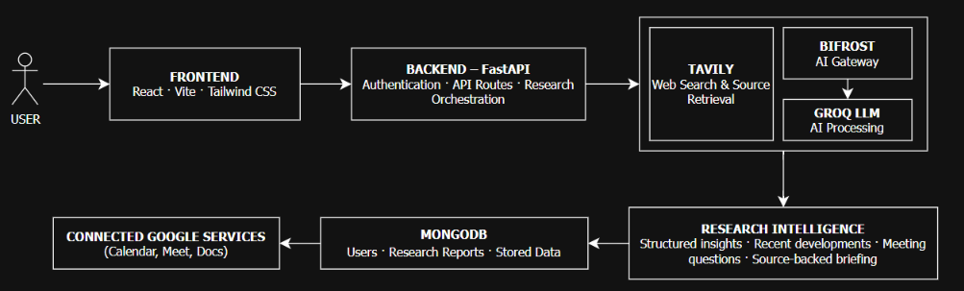
ARCHITECTURE

Slide 7
TECHNOLOGY USED
Component | Responsibility
React + Vite | User interface
FastAPI | Backend and orchestration
Tavily | Web search and source retrieval
Bifrost | AI model gateway
Groq | LLM inference
MongoDB | User and research data storage
RAG | Context retrieval for follow-up questions
Google APIs | Calendar, Meet and Docs
Docker | Local container deployment

Slide 8
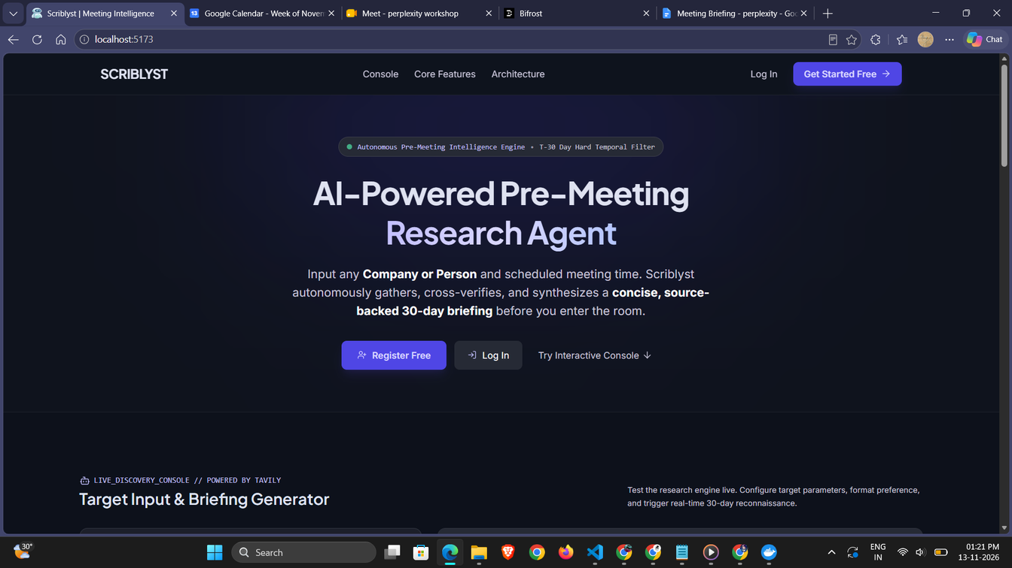
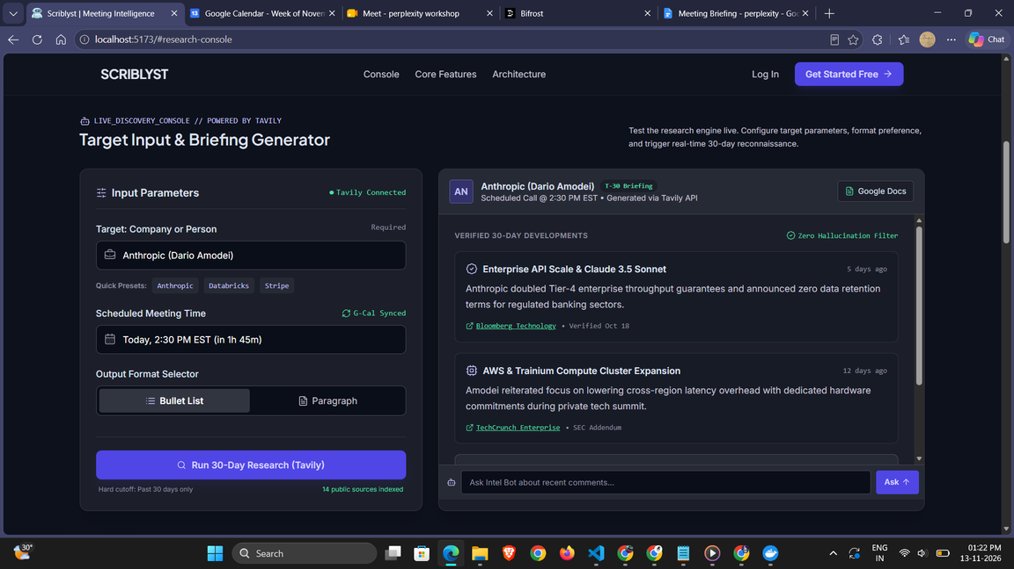
SCREENSHOTS

Slide 9
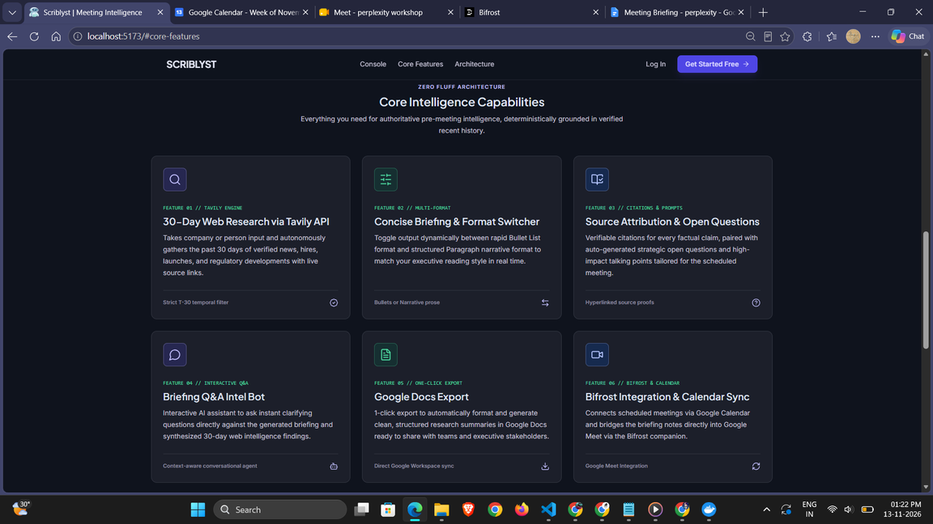
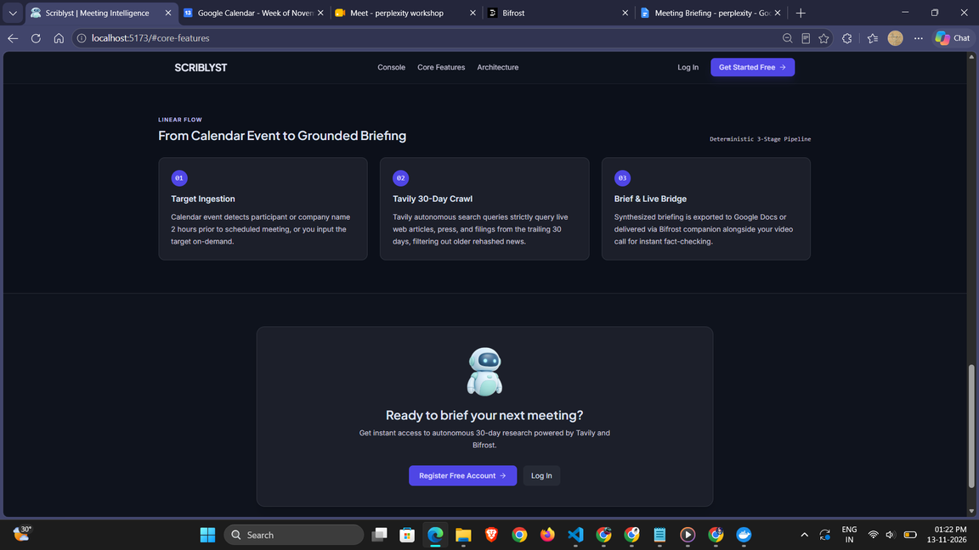
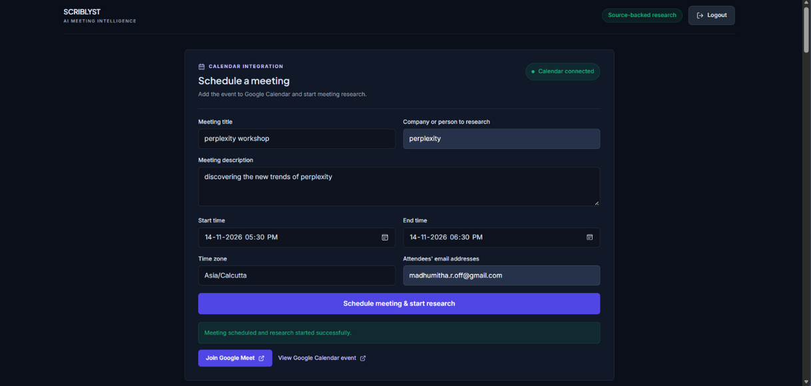
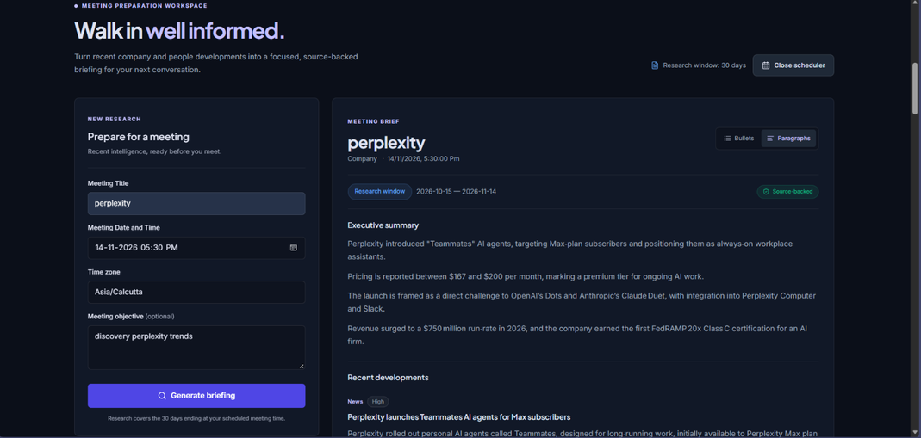

Slide 10
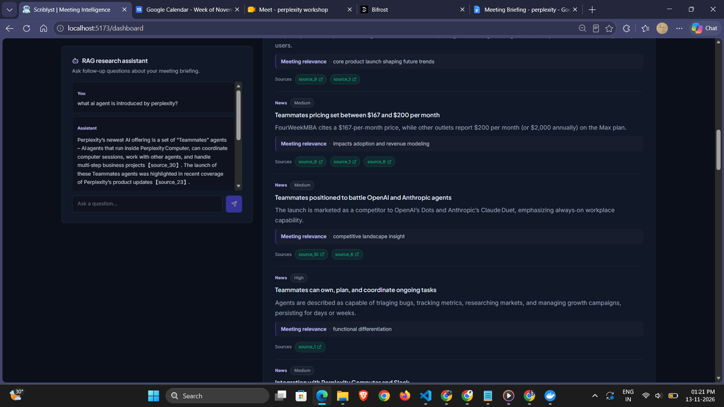
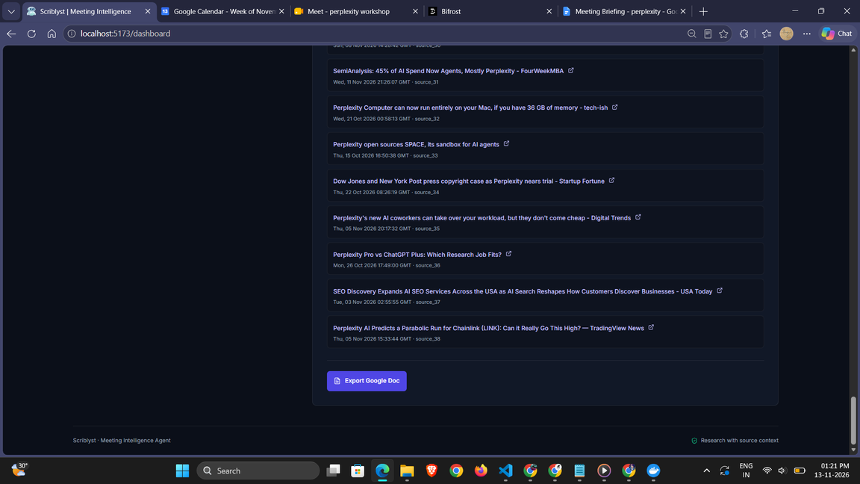

Slide 11
FUTURE ENHANCEMENTS
  Automated meeting transcription with real-time meeting assistance.
  Automatic meeting summaries and action items.
  Personalized research recommendations.
  Slack, Microsoft Teams, and other integrations.
  Automated pre-meeting research based on calendar events.

Slide 12
LINKS
  GitHub Repository:
  https://github.com/madhumitha-r26/Scriblyst-Meeting-Intelligence-Research-Agent

