Slide 1

WAREHOUSE SUPPLY CHAIN
Made by: Madhumitha R
USN: 1NH16CS745

Slide 2
CONTENTS
Introduction
Objective
Functionalities Provided
Functional Requirements
Entity Relationship Diagram
Schema Diagram
Modules of the System
Triggers used
Conclusion

Slide 3
INTRODUCTION
The WAREHOUSE SUPPLYCHAIN is designed for a production sector, which gives information related to the customers and the product details they ordered. This product develops a system that can be used by the company management to keep track of all the sales, vendors and its customers. It automates the communication between all these 3 sectors.

Slide 4
OBJECTIVE
The main objective of the project is to find out the supply chain management system. Supply chain is a lengthy process. Basically their supply chain is totally ware-house based. In supply chain, at first they store the entire product from different manufacturer in their warehouse. The transportation cost is totally taken care by the warehouse company. Then the stored products are distributed through their own vehicles to its several outlets. There is no intermediary between warehouse and manufacturing company. No product directly comes to the outlet without the hands of warehouse.

Slide 5
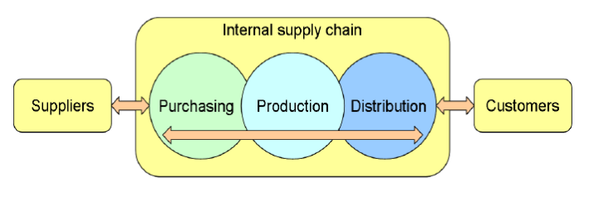
Pictorial View of the Supply chain

Slide 6
The other objectives include:
To gather practical knowledge of supply chain management.
Reduce manpower and manual paper works for maintaining the records offline.
Maintain the accuracy, integrity and consistency of the data.
To maintain all the products, customers, employees, vendors and orders details in one database.
Manage end to end supply chain management from one portal.

Slide 7
FUNCTIONALITIES PROVIDED
Provides the searching facilities based on various factors such as customers, product company, orders, shipments.
It manages the delivery details for order details and shipment details.
Manages the information of the products.
Shows the details of the customers, vendors and transporters.
Keeps track of the available quantities.
Supports any number of product addition.
Can support the access of multiple vendors and customers at one instant.
All the update and delete operations are recorded for audit purposes.

Slide 8
FUNCTIONAL REQUIREMENTS
The system runs on apache server. So it’s needed that the server must have an apache server version 2.0 available.
MySQL database has been used for storing the data of the website.
HTML has been used for creating the layout of the web application.
CSS has been used for creating and designing of the webpage.

Slide 9
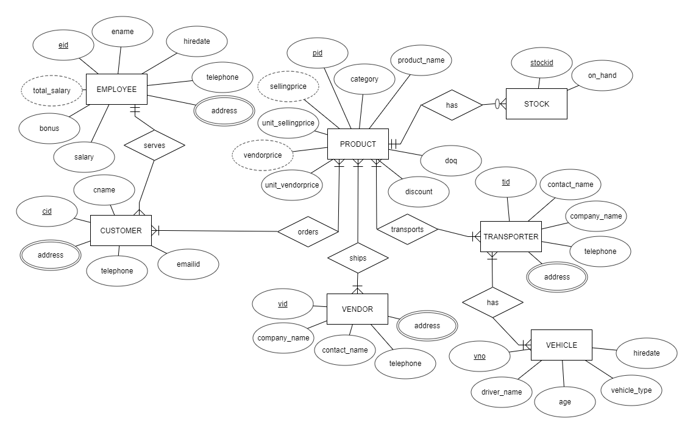
Entity Relationship Diagram

Slide 10
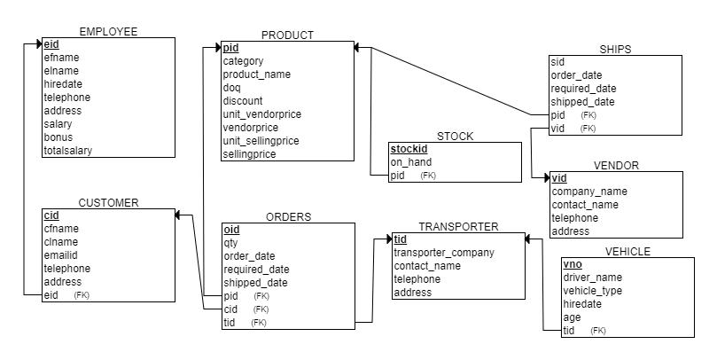
Schema Diagram

Slide 11
MODULES OF THE SYSTEM
CUSTOMER- Used for storing the customer information.
PRODUCT- Used for storing the product details along with its stock.
STOCK- Stores the number of products available in hand.
ORDERS- Used for ordering the products along with the customer id who ordered.
VENDOR- Used for storing the information of the sellers who are providing the products to the warehouse.
TRANSPORTER- Stores the transporter information.
VEHICLE- Stores the vehicle and the driver information who are entitled to deliver the product to the customer.

Slide 12
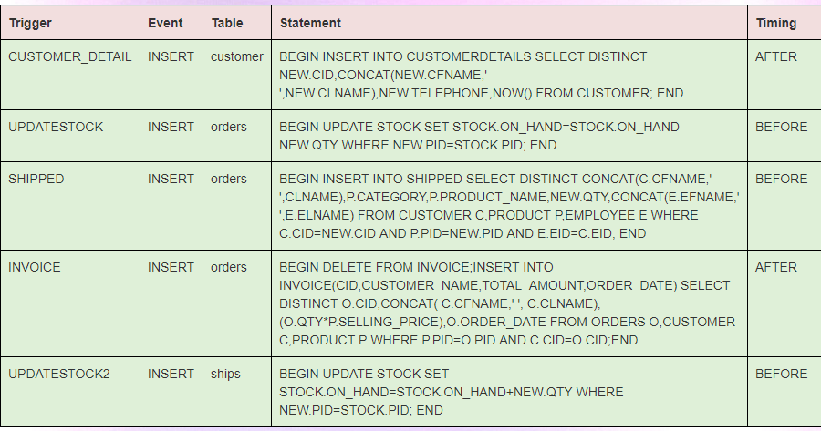
TRIGGERS USED

Slide 13
CONCLUSION
This project has more scope in the future and can be integrated further.
This project is successfully implemented with all the features mentioned earlier.
Deployment of this application will help the user to reduce the unnecessary wastage of time in going and ordering the product manually.
Therefore, we are successfully able o reach the goals and target of the project.

Slide 14
THANK YOU

