Slide 1
CS6611 – CREATIVE AND INNOVATIVE PROJECT FIRST REVIEW – TEAM NO. 37 ANALYSIS OF THE SPATIOTEMPORAL FLUCTUATIONS IN MANGROVES USING MACHINE LEARNING FOR HEALTH ASSESSMENT
TEAM MEMBERS: MADHUMITHA P S (2021503520) ACHYUT PRASAD D C (2021503002) SANDHIYA S (2021503552) | SUPERVISOR: DR. R. KATHIROLI

Slide 2
EXPECTATIONS FOR THE FIRST REVIEW
What analysis?
Tracking variations in the mangrove extent over time
Classification of mangrove health status within the study area.
Number of years for dataset?
35 year span: Analyzing the data between 1990 and 2024
What technologies?
Machine Learning Algorithms for mapping Mangrove dynamics
Neural Networks for assessing Mangrove Health

Slide 3
EXPECTATIONS FOR THE FIRST REVIEW
What images?
TIME PERIOD | TYPE OF SATELLITE IMAGE
1990 – 1999 | Landsat 5 TM (Thematic Mapper)
2000 – 2012 | Landsat 7 ETM+ (Enhanced Thematic Mapper)
2013 – 2016 | Landsat 8 OLI (Operational Land Imager)
2017 - 2024 | Sentinel – 2 MSI (Multispectral Instrument) Level 2A

Slide 4
PROBLEM STATEMENT
Mangrove forests face threats from rising water levels and climate change.
Understanding mangrove evolution and health is crucial for preservation.
Traditional monitoring methods for large areas like Pichavaram are inadequate.
Satellite imagery combined with machine learning enables efficient monitoring.

Slide 5
OBJECTIVE
To utilize satellite imageries from different sources and assess the temporal dynamics and health of mangrove ecosystems.
To develop a robust model utilizing machine learning algorithms to accurately differentiate and map mangroves, non-mangroves, and water bodies.
To quantify the temporal changes in mangrove extent from 1990 to 2024 spanning over 35 years.
To estimate mangrove density and investigate the relationships between NDVI values and established density classes for each year in the specified timeframe.

Slide 6
LITERATURE SURVEY
S. No. | TITLE | JOURNAL/ YEAR | PROPOSED WORK | LIMITATIONS
1 | Mapping Mangrove Using a Red-Edge Mangrove Index (REMI) Based on Sentinel-2 Multispectral Images | IEEE Transactions on Geoscience and Remote Sensing 2023 | Introduces REMI method for mangrove identification. Utilizes specific satellite bands to capture mangrove characteristics. | The REMI index can misclassify some non-mangrove trees as mangroves and is not stable for non-vegetation areas.
2 | High-Resolution Mapping of Mangrove Species Height in Fujian Zhangjiangkou National Mangrove Nature Reserve Combined GF-2, GF-3, and UAV-LiDAR | MDPI Journal in Remote Sensing 2023 | Integrate GF-2, GF-3, and UAV-LiDAR data. Apply random forest regression for height retrieval. | The study solely focused on spectral, texture, and SAR features, ignoring cloud cover resulting in inaccuracies in health assessment.

Slide 7
LITERATURE SURVEY
S. No. | TITLE | JOURNAL/ YEAR | PROPOSED WORK | LIMITATIONS
3 | Mangrove forests mapping using Sentinel‐1 and Sentinel‐2 satellite images | Arabian Journal of Geosciences 2022 | Evaluate Random Forest for mangrove mapping. Compares scenarios: Sentinel-1, Sentinel-2 (with red-edge bands), and combined data. | Landsat images with 30m resolution were not effective in identifying and monitoring isolated mangrove forest patches smaller than 1 ha.
4 | Generalized Composite Mangrove Index for Mapping Mangroves Using Sentinel-2 Time Series Data | IEEE Journal of Selected Topics in Applied Earth Observations and Remote Sensing 2022 | Introduces Generalized Composite Mangrove Index (GCMI) and utilizes Sentinel-2 time series data. Composites vegetation and water indices for enhanced mangrove separability. | This work uses time series data directly without fully exploring the phenological information it contains.

Slide 8
LITERATURE SURVEY
S. No. | TITLE | JOURNAL/ YEAR | PROPOSED WORK | LIMITATIONS
5 | Combined Use of Sentinel-1 and Sentinel-2 for Glacier Mapping: An Application Over Central East Alps | IEEE Journal of Selected Topics in Applied Earth Observations and Remote Sensing. 2022 | Utilizes Sentinel-1 and Sentinel-2 data for glacier delineation. Integrates Sentinel-1's structural and Sentinel-2's spectral information. | Persistent cloud cover can compromise the reconstruction of minimum snow cover using optical data (Sentinel-2) and hinder accurate glacier detection.
6 | Mangrove Ecosystem Mapping Using Sentinel-1 and Sentinel – 2 Satellite Images and Random Forest Algorithm in GEE | International Journal of Remote Sensing 2021 | Mangrove ecosystem mapping with Sentinel-1 and Sentinel-2 data. Random Forest algorithm in Google Earth Engine for accuracy and efficiency. | The study acknowledges limited accuracy for the aerial roots class.

Slide 9
LITERATURE SURVEY
S. No. | TITLE | JOURNAL/ YEAR | PROPOSED WORK | LIMITATIONS
7 | A Comparison of Gaofen-2 and Sentinel-2 Imagery for Mapping Mangrove Forests Using Object-Oriented Analysis and Random Forest | IEEE Journal in Applied Earth Observations and Remote Sensing 2021 | Integrate OBIA and RF for mangrove mapping using GF-2 and S2. Compare dataset efficiency and accuracy. | Limited scalability and unsuitable for regions covering small mangrove forests.
8 | The Google Earth Engine Mangrove Mapping Methodology (GEEMMM) | MDPI Journal in Remote Sensing. 2020 | Introduce GEEMMM for global mangrove mapping. Leverage coastal expertise and tidal calibration. | GEEMMM faces hurdles in mapping larger areas and no usage of Sentinel -2 imagery

Slide 10
LITERATURE SURVEY
S. No. | TITLE | JOURNAL/ YEAR | PROPOSED WORK | LIMITATIONS
9 | Support Vector Machine Versus Random Forest for Remote Sensing Image Classification | IEEE Journal in Applied Earth Observations and Remote Sensing 2020 | Enhance meta-analysis of RF and SVM. Incorporate temporal trends for refinement. | RF’s popularity cannot be concluded because of the low available number of published papers.
10 | Estimating and Mapping Mangrove Biomass Dynamic Change Using WorldView-2 Images and Digital Surface Models | IEEE Journal in Applied Earth Observations and Remote Sensing 2020 | Provide insights into dynamic changes of land cover in disturbed and recovering mangrove areas. . | WorldView- 2 images have limited spectral resolution and atmospheric corrections

Slide 11
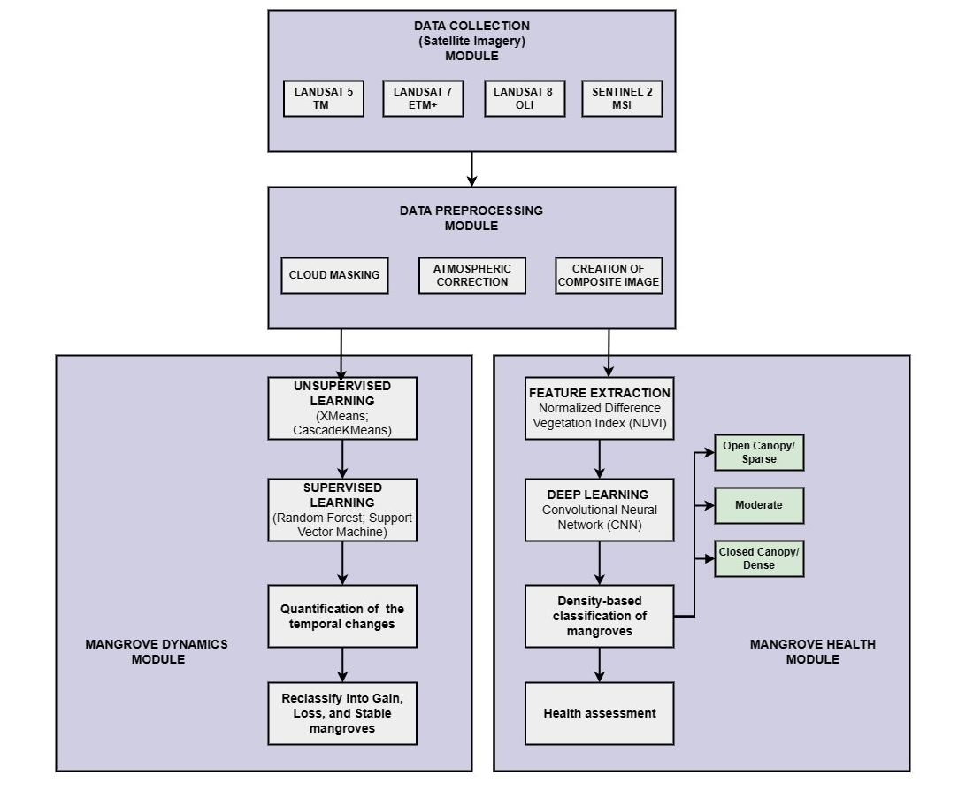
BLOCK DIAGRAM OF THE PROPOSED WORK

Slide 12
LIST OF MODULES
Data Collection Module
Data Preprocessing Module
Mangrove Dynamics Module
Mangrove Health Module

Slide 13
CONTRIBUTIONS
Composite images integrate multiple satellite images, enhancing mangrove ecosystem analysis.
Employ hybrid unsupervised-supervised learning for more accurate classification.

Slide 14
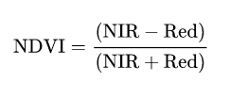
DETAILED ALGORITHM FOR MANGROVE HEALTH MODULE
Step 1: Calculate the Normalized Difference Vegetation Index (NDVI) pixel values from the preprocessed satellite imagery.
Step 2: Label the NDVI images with specific mangrove health categories (e.g., sparse, moderate, dense) and split the labeled NDVI images into training and validation datasets.
Step 3: Train the CNN model using the training dataset and validate it using the validation dataset.

Slide 15
DETAILED ALGORITHM FOR MANGROVE HEALTH MODULE
Step 4: Use the trained CNN model to classify NDVI images into mangrove health categories (e.g., sparse, moderate, dense) and generate predictions for the entire dataset.
NDVI range vs Classes:
RANGE | CLASSES
<= 0 | Water
<= 0.1 | Shallow Region
<= 0.3 | Open Canopy (Sparse)
<= 0.5 | Moderate
> 0.5 to 1 | Closed Canopy (Dense)

Slide 16
EVALUATION METRICS
F1-Score:
F1-Score balances precision (correctly identified mangroves) and recall (identified all actual mangroves) and provides a single score summarizing model performance, making comparison between different models easier. This helps choose the most effective model for mangrove health assessment.

Slide 17
EVALUATION METRICS
Cohen’s Kappa Coefficient:
This metric measures the agreement between predicted and observed classifications, providing insights into the reliability of the model's assessments of mangrove health dynamics.
Intersection over Union (IoU):
It measures the overlap between the model's predicted mangrove extent and the ground truth.

Slide 18
REFERENCES
[1] Z. Chen, M. Zhang, H. Zhang, and Y. Liu, "Mapping Mangrove Using a Red-Edge Mangrove Index (REMI) Based on Sentinel-2 Multispectral Images," in IEEE Transactions on Geoscience and Remote Sensing, vol. 61, pp. 1-11, 2023, Art no. 4409511, doi: 10.1109/TGRS.2023.3323741.
[2] Chen, R.; Zhang, R.; Zhao, C.; Wang, Z.; Jia, M. High-Resolution Mapping of Mangrove Species Height in Fujian Zhangjiangkou National Mangrove Nature Reserve Combined GF-2, GF-3, and UAV-LiDAR. Remote Sens. 2023, 15, 5645. https://doi.org/10.3390/rs15245645
[3] Sharifi, A., Felegari, S. & Tariq, A. Mangrove forests mapping using Sentinel-1 and Sentinel-2 satellite images. Arab J Geosci 15, 1593 (2022). https://doi.org/10.1007/s12517-022-10867-z
[4] Z. Xue and S. Qian, "Generalized Composite Mangrove Index for Mapping Mangroves Using Sentinel-2 Time Series Data," in IEEE Journal of Selected Topics in Applied Earth Observations and Remote Sensing, vol. 15, pp. 5131-5146, 2022, doi: 10.1109/JSTARS.2022.3185078.
[5] R. Barella et al., "Combined Use of Sentinel-1 and Sentinel-2 for Glacier Mapping: An Application Over Central East Alps," in IEEE Journal of Selected Topics in Applied Earth Observations and Remote Sensing, vol. 15, pp. 4824-4834, 2022, doi: 10.1109/JSTARS.2022.3179050.

Slide 19
REFERENCES
[6] Ghorbanian, A.; Zaghian, S.; Asiyabi, R.M.; Amani, M.; Mohammadzadeh, A.; Jamali, S. Mangrove Ecosystem Mapping Using Sentinel-1 and Sentinel-2 Satellite Images and Random Forest Algorithm in Google Earth Engine. Remote Sens. 2021, 13, 2565. https://doi.org/10.3390/rs13132565
[7] R. Zhang et al., "A Comparison of Gaofen-2 and Sentinel-2 Imagery for Mapping Mangrove Forests Using Object-Oriented Analysis and Random Forest," in IEEE Journal of Selected Topics in Applied Earth Observations and Remote Sensing, vol. 14, pp. 4185-4193, 2021, doi: 10.1109/JSTARS.2021.3070810.
[8] Yancho, J.M.M.; Jones, T.G.; Gandhi, S.R.; Ferster, C.; Lin, A.; Glass, L. The Google Earth Engine Mangrove Mapping Methodology (GEEMMM). Remote Sens. 2020, 12, 3758. https://doi.org/10.3390/rs12223758
[9] M. Sheykhmousa, M. Mahdianpari, H. Ghanbari, F. Mohammadimanesh, P. Ghamisi and S. Homayouni, "Support Vector Machine Versus Random Forest for Remote Sensing Image Classification: A Meta-Analysis and Systematic Review," in IEEE Journal of Selected Topics in Applied Earth Observations and Remote Sensing, vol. 13, pp. 6308-6325, 2020, doi: 10.1109/JSTARS.2020.3026724.
[10] Y. Zhu et al., "Estimating and Mapping Mangrove Biomass Dynamic Change Using WorldView-2 Images and Digital Surface Models," in IEEE Journal of Selected Topics in Applied Earth Observations and Remote Sensing, vol. 13, pp. 2123-2134, 2020, doi: 10.1109/JSTARS.2020.2989500.

Slide 20
THANK YOU

