Slide 1
CS6611 – Creative and Innovative Project Second review – Team No. 37 ANALYSIS OF THE SPATIOTEMPORAL FLUCTUATIONS IN MANGROVES USING MACHINE LEARNING FOR HEALTH ASSESSMENT
Supervisor: Dr. R. Kathiroli
Team Members:
Madhumitha P S (2021503520)
Achyut Prasad D C (2021503002)
Sandhiya S (2021503552)

Slide 2
Expectations from the First Review
Missing Slide numbers in the presentation.
Changes in the Architecture diagram.

Slide 3
Project Overview - Objectives
To utilize satellite imageries from different sources and assess mangrove ecosystems' temporal dynamics and health.
To develop a robust model utilizing object-based image analysis to differentiate accurately and map mangroves, non-mangroves, and water bodies.
To quantify the temporal changes in mangrove extent from 1990 to 2024 spanning over 35 years.
To estimate mangrove density and classify it into different density classes for each year in the specified timeframe.

Slide 4
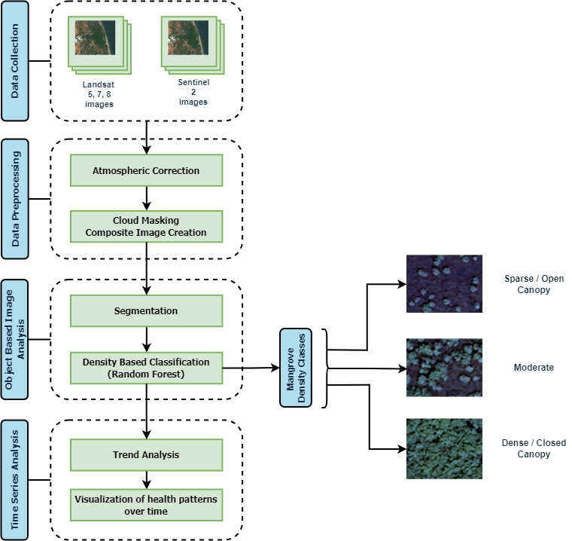
Architecture Diagram
List of Modules:
Data Collection
Data Preprocessing
Object-based Image Analysis
Time Series Analysis

Slide 5
Module 1 – Data Collection
Properties of the Satellite Imagery:
Optical: Captures data using reflected sunlight in visible and near-infrared wavelengths
Multispectral: Data collected in multiple spectral bands
Medium Resolution: Pixel resolution of 10-30 meters
Satellites Utilized: Landsat and Sentinel

Slide 6
Module 1 – Data Collection
TIME PERIOD | SATELLITE IMAGE USED
1990 – 1999 | Landsat 5 TM (Thematic Mapper)
2000 - 2012 | Landsat 7 ETM+ (Enhanced Thematic Mapper)
2013 – 2016 | Landsat 8 OLI (Operational Land Imager)
2017 - 2024 | Sentinel – 2 MSI (Multispectral Instrument) Level 2A

Slide 7
Clouds Obscure
Clouds inevitably contaminate optical satellite images due to the physical limitations of sensor imaging systems.
The presence of clouds impedes optical satellites from acquiring useful information about the Earth’s surface and affects the usability of images in different degrees.
Shadows projected by clouds on the ground surface also contaminate images.
The missing information in images caused by clouds and their shadows leads to spatial and temporal gaps in satellite Earth observation data, impacting image usability in various analyses.

Slide 8
Module 2 – Data Preprocessing
Cloud Masking: Cloud masking is a technique that identifies and removes clouds from satellite images to create a cloud-free image.
Composite Satellite Image:
The process of combining multiple satellite images captured over a period of time to create a single, more complete image.
By identifying and removing clouds from individual images, composite image creation can produce a clearer and more representative image of the land below.

Slide 9
Module 2 – Data Preprocessing
Breakdown of the process of creating a composite satellite image:
Collect satellite images taken at different times for the desired region of interest (ROI).
Perform cloud masking by identifying and removing clouds and cloud shadows.
Combine the information from the cloud-masked images to create the composite image.

Slide 10
Module 2 – Data Preprocessing
Quality (QA) Bands:
To extract information about cloudy pixels and mask them.
The information contained in QA bands is stored as Bitwise Flags.
Satellite | QA Band
Landsat 5, 7 | Surface Reflectance Cloud Quality Assessment Band (SR_Cloud_QA)
Landsat 8 | Pixel Quality Assessment Band (QA_PIXEL)
Sentinel 2 | QA60

Slide 11
Module 2 – Data Preprocessing
Bitmask for Surface Reflectance Cloud Quality Assessment Band (SR_Cloud_QA):
Bit 1: Cloud
Bit 2: Cloud Shadow
Bitmask for QA_PIXEL:
Bit 3: Cloud
Bit 4: Cloud Shadow

Slide 12
Module 2 – Data Preprocessing
Bitmask for QA60:
Bit 10: Opaque Clouds
Bit 0: No Opaque Clouds
Bit 1: Opaque Clouds Present
Bit 11: Cirrus Clouds
Bit 0: No Cirrus Clouds
Bit 1: Cirrus Clouds Present

Slide 13
Module 2 – Data Preprocessing
Simulating Masking Process:
Original pixel value (single band, B4) = I = 15000
QA_value (for this pixel) = 768
CloudBitMask = 1024 (binary representation: 10000000000) - Targets 10th bit for cloud information
Perform bitwise AND between QA_value and CloudBitMask

Slide 14
Module 2 – Data Preprocessing
Decimal | Binary Representation
QA_Value | 0 | 1 | 1 | 0 | 0 | 0 | 0 | 0 | 0 | 0 | 0
CloudBitMask | 1 | 0 | 0 | 0 | 0 | 0 | 0 | 0 | 0 | 0 | 0
Bitwise AND | 0 | 0 | 0 | 0 | 0 | 0 | 0 | 0 | 0 | 0 | 0
The 10th bit is 0, indicating a clear pixel (no cloud)
The above pixel is usable and is clear of the clouds.

Slide 15
Module 2 – Data Preprocessing
Detailed Algorithm for Composite Image Creation:
Step 1: Access the image’s cloud-quality band.
Step 2: Use bitwise AND operations on specific bits to identify cloudy pixels based on the sensor's masking scheme.
Step 3: Create and update the image mask to exclude cloudy pixels.
Step 4: Apply the cloud masking function to each image in the collection.
Step 5: Reduce the image collection using the median to create the composite image.

Slide 16
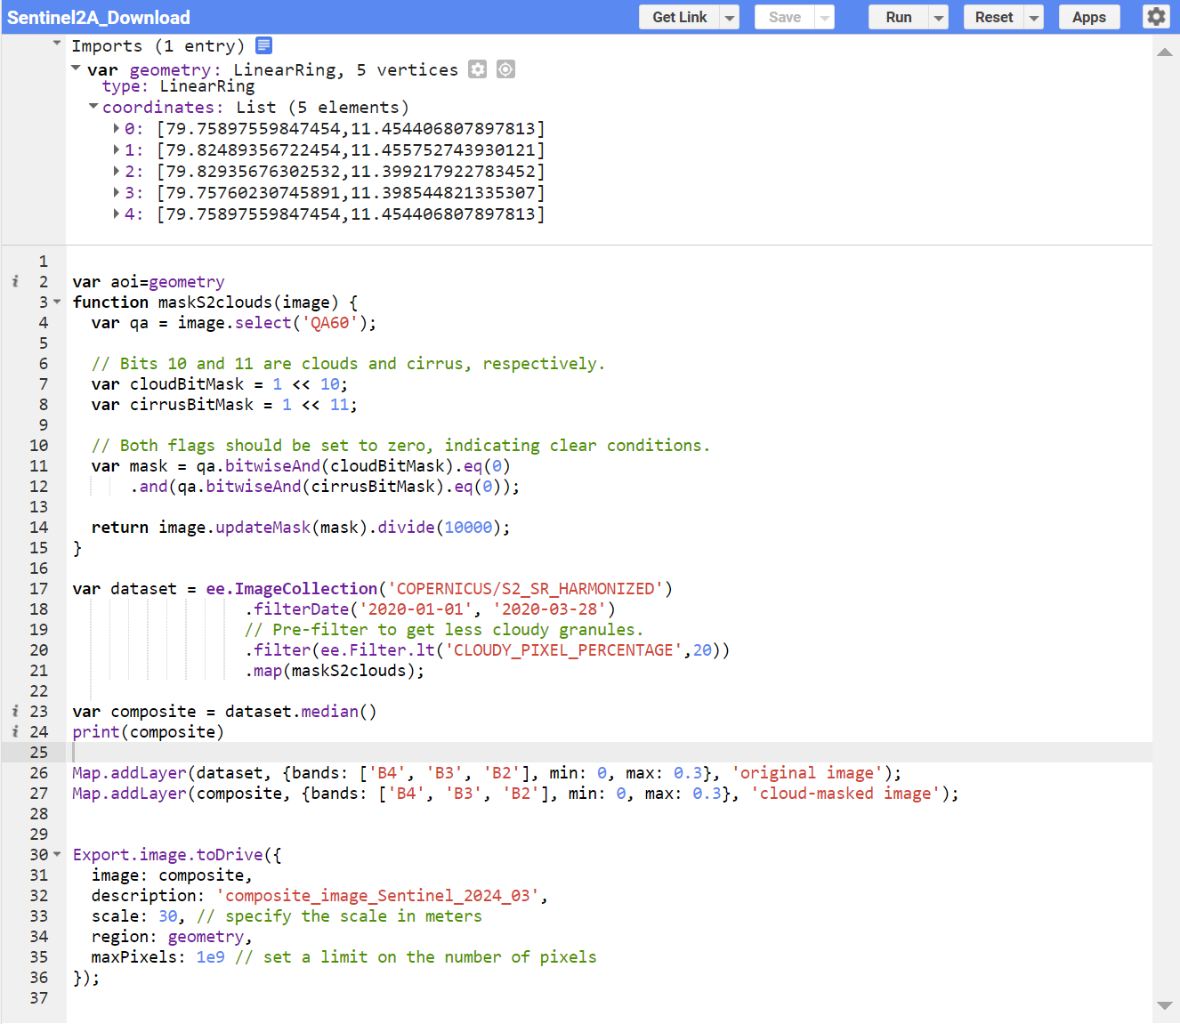
Module 2 – Data Preprocessing
Composite Image Creation:
(Sentinel 2 images)

Slide 17
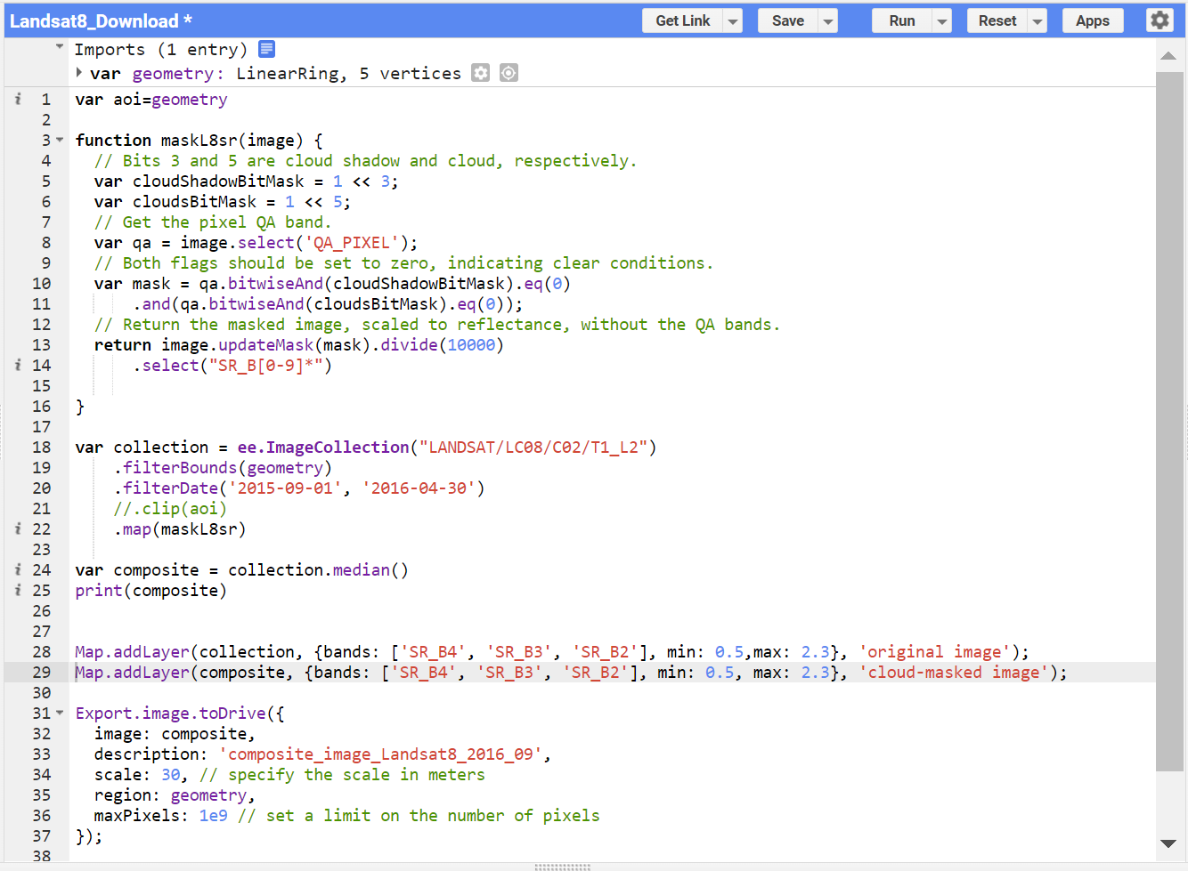
Module 2 – Data Preprocessing
Composite Image Creation:
(Landsat 8 images)

Slide 18
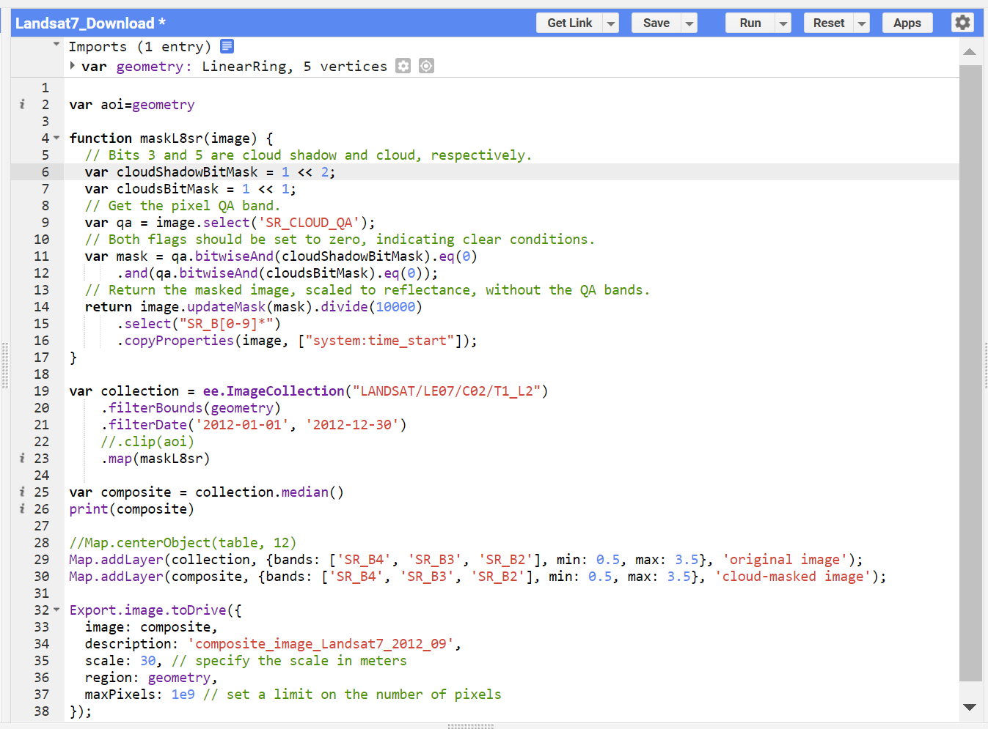
Module 2 – Data Preprocessing
Composite Image Creation:
(Landsat 7 images)

Slide 19
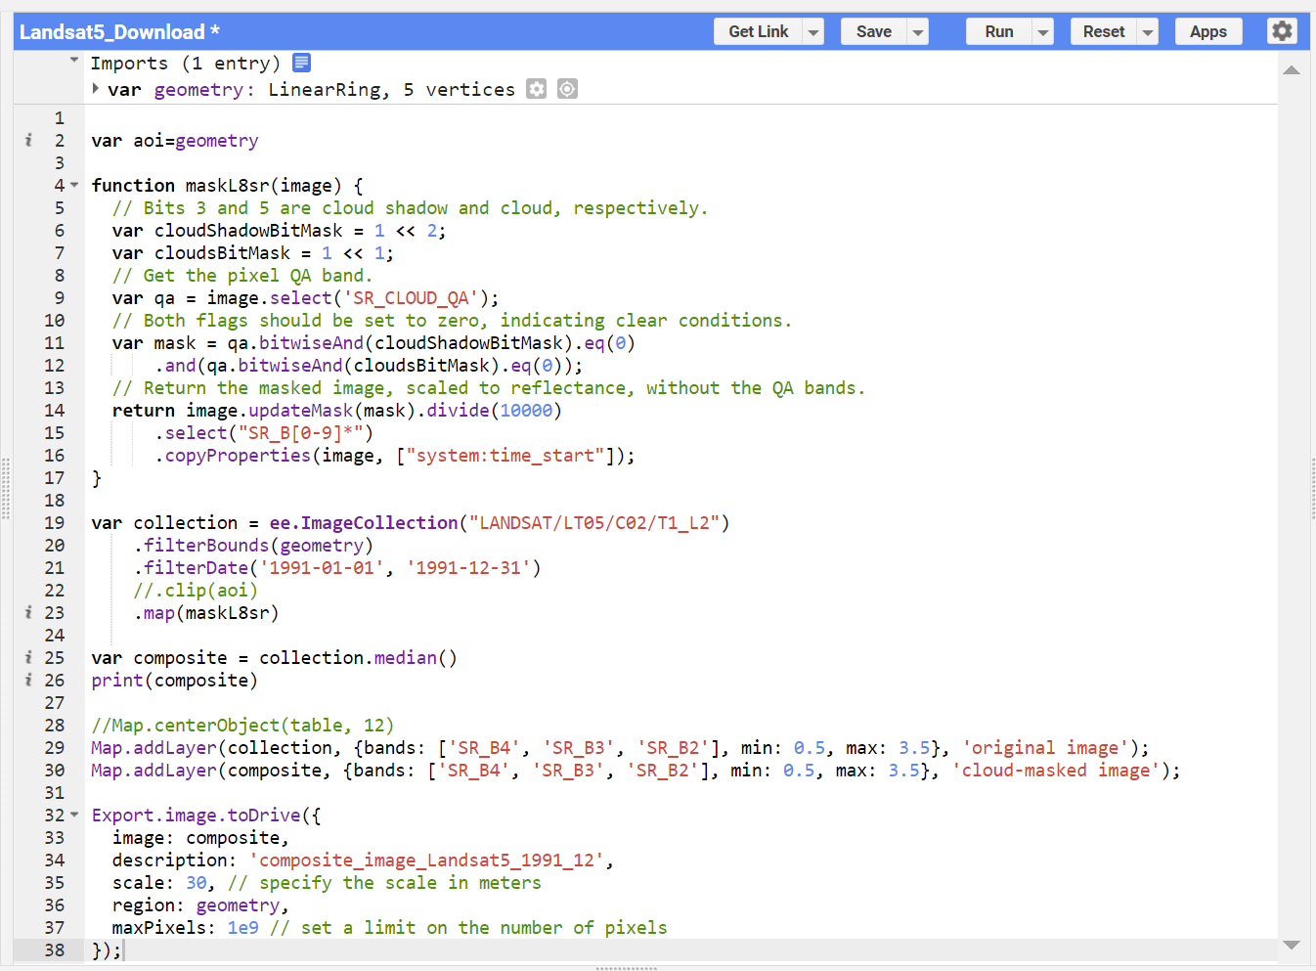
Module 2 – Data Preprocessing
Composite Image Creation:
(Landsat 5 images)

Slide 20
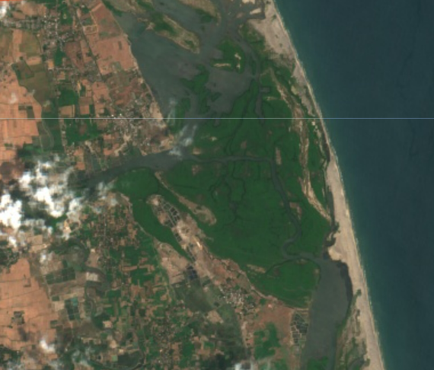
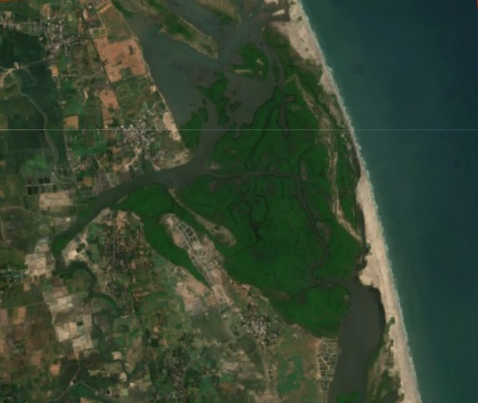
Module 2 – Data Preprocessing
Clouds
Original Image
(Before Cloud Masking)
Composite Image (After Cloud Masking)

Slide 21
Module 3 – Object-based Image Analysis
Object-based Image Analysis:
Segments satellite imagery into coherent objects based on spectral and spatial attributes.
Simplifies interpretation by grouping similar pixels into meaningful objects.
Facilitates accurate analysis and classification of land cover or land use classes.

Slide 22
Module 3 – Object-based Image Analysis
Segmentation:
Groups pixels with similar characteristics into objects.
Considers all bands and time instances for each pixel.
Creates a high-dimensional attribute space.
Probability Estimation:
Classifies a subset of time series within each segment.
Estimates the likelihood of each class for each time series.

Slide 23
Module 3 – Object-based Image Analysis
Labeling:
Assign a class label to each segment based on probability estimates.
Uses the median probability of the time series within the segment.
Choose the class with the highest median probability.

Slide 24
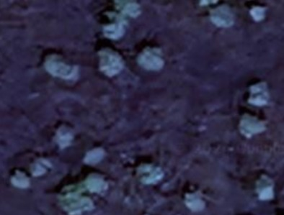
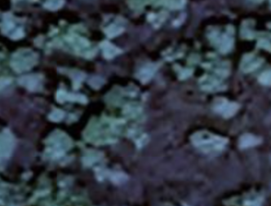
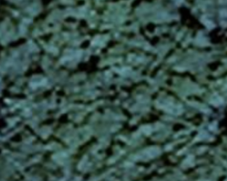
Module 3 – Object-based Image Analysis
Density-based Mangrove Classes:
Sparse / Open Canopy | Moderate | Dense / Closed Canopy

Slide 25
Module 4 – Time Series Analysis
Time series analysis:
The process of analyzing changes in mangrove cover over a period of time using satellite imagery.
Analyzes data points collected at regular intervals to understand how land coverage changes over time.
Explores data across different time periods to reveal trends and recurring patterns in the data.
Examines past changes to predict potential future behavior of the data.

Slide 26
Module 4 – Time Series Analysis
Quantify the extent of each density class for all the years in the specified timeframe.
By analyzing the extent of each class across the years, identify the trend of each class as increasing, decreasing, and stable.
Calculate the net change in extent for each density class between the first and last year of the time series.

Slide 27
References
[1] Z. Chen, M. Zhang, H. Zhang, and Y. Liu, "Mapping Mangrove Using a Red-Edge Mangrove Index (REMI) Based on Sentinel-2 Multispectral Images," in IEEE Transactions on Geoscience and Remote Sensing, vol. 61, pp. 1-11, 2023, Art no. 4409511, doi: 10.1109/TGRS.2023.3323741.
[2] Chen, R.; Zhang, R.; Zhao, C.; Wang, Z.; Jia, M. High-Resolution Mapping of Mangrove Species Height in Fujian Zhangjiangkou National Mangrove Nature Reserve Combined GF-2, GF-3, and UAV-LiDAR. Remote Sens. 2023, 15, 5645. https://doi.org/10.3390/rs15245645
[3] Sharifi, A., Felegari, S. & Tariq, A. Mangrove forests mapping using Sentinel-1 and Sentinel-2 satellite images. Arab J Geosci 15, 1593 (2022). https://doi.org/10.1007/s12517-022-10867-z
[4] Z. Xue and S. Qian, "Generalized Composite Mangrove Index for Mapping Mangroves Using Sentinel-2 Time Series Data," in IEEE Journal of Selected Topics in Applied Earth Observations and Remote Sensing, vol. 15, pp. 5131-5146, 2022, doi: 10.1109/JSTARS.2022.3185078.
[5] R. Barella et al., "Combined Use of Sentinel-1 and Sentinel-2 for Glacier Mapping: An Application Over Central East Alps," in IEEE Journal of Selected Topics in Applied Earth Observations and Remote Sensing, vol. 15, pp. 4824-4834, 2022, doi: 10.1109/JSTARS.2022.3179050.

Slide 28
References
[6] Ghorbanian, A.; Zaghian, S.; Asiyabi, R.M.; Amani, M.; Mohammadzadeh, A.; Jamali, S. Mangrove Ecosystem Mapping Using Sentinel-1 and Sentinel-2 Satellite Images and Random Forest Algorithm in Google Earth Engine. Remote Sens. 2021, 13, 2565. https://doi.org/10.3390/rs13132565
[7] R. Zhang et al., "A Comparison of Gaofen-2 and Sentinel-2 Imagery for Mapping Mangrove Forests Using Object-Oriented Analysis and Random Forest," in IEEE Journal of Selected Topics in Applied Earth Observations and Remote Sensing, vol. 14, pp. 4185-4193, 2021, doi: 10.1109/JSTARS.2021.3070810.
[8] Yancho, J.M.M.; Jones, T.G.; Gandhi, S.R.; Ferster, C.; Lin, A.; Glass, L. The Google Earth Engine Mangrove Mapping Methodology (GEEMMM). Remote Sens. 2020, 12, 3758. https://doi.org/10.3390/rs12223758
[9] M. Sheykhmousa, M. Mahdianpari, H. Ghanbari, F. Mohammadimanesh, P. Ghamisi and S. Homayouni, "Support Vector Machine Versus Random Forest for Remote Sensing Image Classification: A Meta-Analysis and Systematic Review," in IEEE Journal of Selected Topics in Applied Earth Observations and Remote Sensing, vol. 13, pp. 6308-6325, 2020, doi: 10.1109/JSTARS.2020.3026724.
[10] Y. Zhu et al., "Estimating and Mapping Mangrove Biomass Dynamic Change Using WorldView-2 Images and Digital Surface Models," in IEEE Journal of Selected Topics in Applied Earth Observations and Remote Sensing, vol. 13, pp. 2123-2134, 2020, doi: 10.1109/JSTARS.2020.2989500.

