Slide 1
PREDICTING SOLAR POWER GENERATION USING NEURAL NETWORK
NAAN MUDHALVAN
GENERATIVE AI FOR ENGINEERING (E2324)
MADHUMITHA PS - 2021503520 DEPARTMENT OF COMPUTER TECHNOLOGY
MADRAS INSTITUTE OF TECHNOLOGY

Slide 2
OUTLINE :
Introduction
Problem Statement
Objective
System Development Approach
Proposed Work
Algorithm
Result
References

Slide 3
Introduction :
Solar power generation is the process of converting sunlight into electricity using solar panels.
When sunlight hits a solar panel, the energy from the sunlight is absorbed by the PV cells in the panel, creating electrical charges that move in response to an internal electrical field, causing electricity to flow.
This electricity can be used immediately, stored in batteries for later use, or fed into the electrical grid.

Slide 4
Problem statement :
Solar power is a rapidly growing renewable energy source, but its variability presents challenges for grid integration and efficient utilization.
Accurate prediction of solar power generation is crucial for optimizing energy management systems, ensuring grid stability, and facilitating the integration of larger shares of solar energy into the power grid.

Slide 5
Objectives:
Design and implement a neural network model (SPFnet) specifically tailored for predicting solar power generation.
Generate accurate and reliable forecasts of future solar power generation.
Evaluate the trained SPFnet model can effectively predict solar power generation for scenarios beyond the training data

Slide 6
System development approach :
SOFTWARE REQUIREMENTS:
Language Used: Python
Tool : Google Colab
Libraries used: Tensor Flow, keras, Matplotlib, Pandas, Numpy, Seaborn.
HARDWARE REQUIREMENTS:
CPU: A multicore CPU is sufficient for running the code
Memory: Atleast 8GB of RAM is recommended
Internet Connection: To download and run the code.

Slide 7
Proposed solution :
This project proposes using a neural network model, specifically a variant potentially named SPFnet, to address the limitations of traditional forecasting methods.
Neural networks have the ability to learn complex relationships from data, making them well-suited for tasks like solar power generation prediction.
List of Modules
1. Data Collection
2.Model Training
3.Model Evaluation

Slide 8
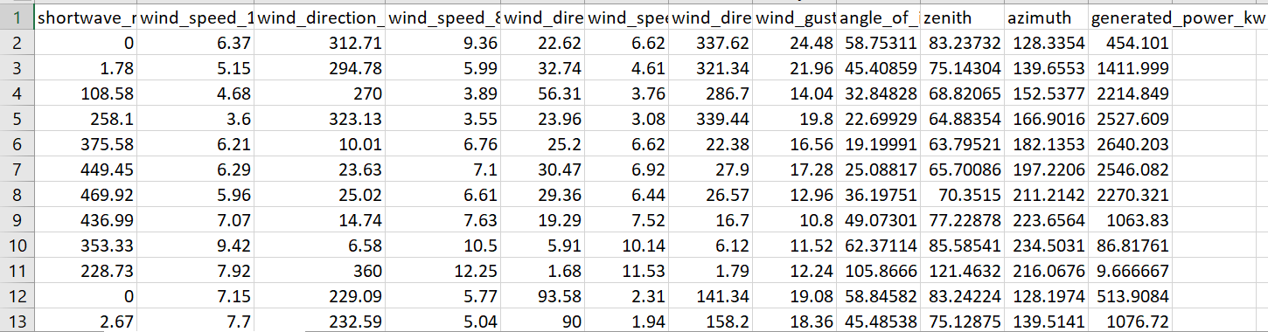
Data Collection
Gather historical data on solar power generation and potentially relevant influencing factors (features) like weather data, time of day, season, etc.

Slide 9
Model training : Building the MODEL:
Split the dataset into training set (75%) and test set(25%) and scale the features and target.
Create the model with 2 hidden layers with 1st layer with 32 neurons and 2nd layer with 64 neurons.
Iterate through the number of layers to add a dense layer with specified number of neurons, activation function and weights.

Slide 10
Model training : Building the model
Add a single output neuron with linear activation function to predict the continuous solar power value.
Then the model is compiled by specifying Loss function, optimizer, Root mean Squared Error.
Return the compiled neural network model.

Slide 11
Model training : Training the model
Train the spfnet model for solar power prediction using the provided training in batches of 32 samples.
Train the data for 150 epochs and providing detailed information about the training progress and validate the test data.
Store information about the training process, such as the loss and metrics (RMSE) values for both training and validation data at each epoch.

Slide 12
Model evaluation:
The training is used to analyze the learning process.
Calculate metrics like RMSE and R-squared on the test set.
Visualize the predictions compared to the actual values on the test data using scatter plots.

Slide 13
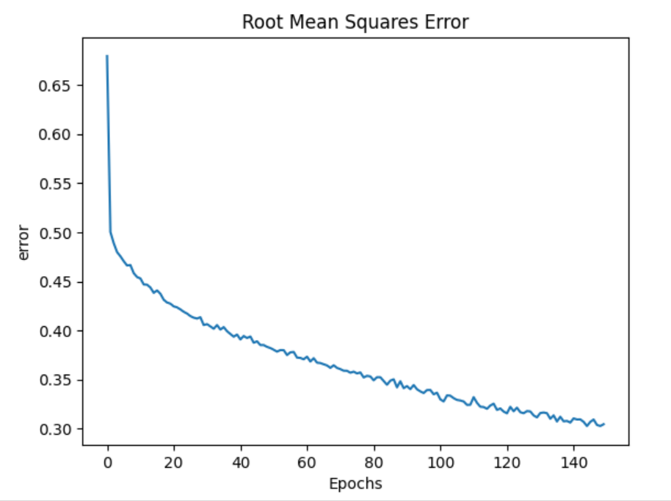
results:

Slide 14
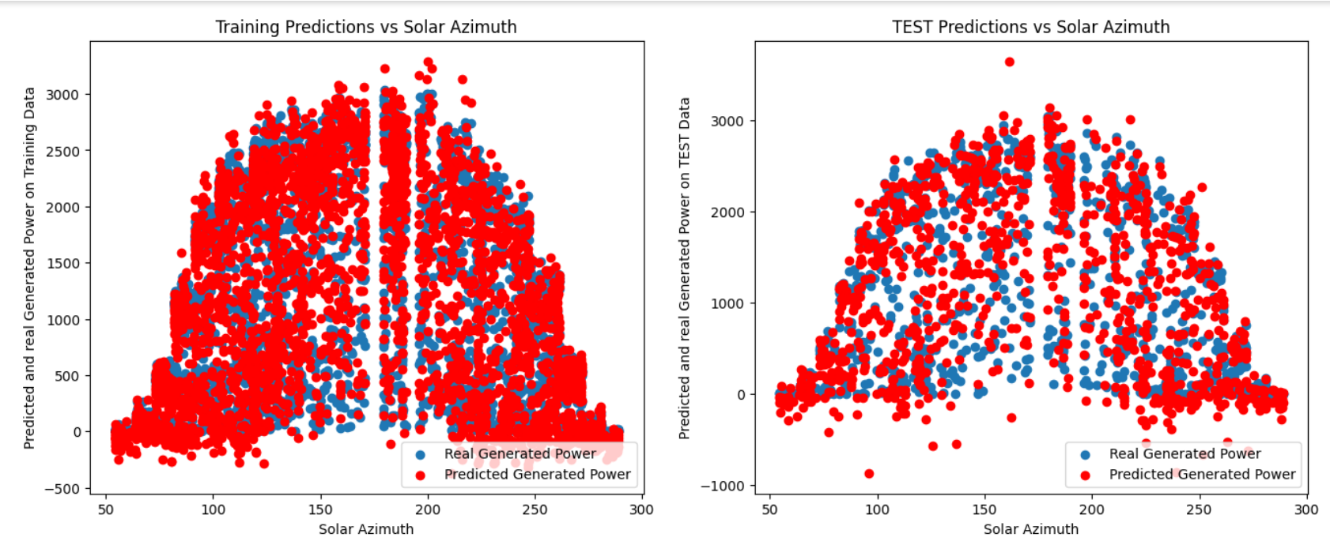
results:

Slide 15
Conclusion:
This project developed and trained a neural network model to predict solar power generation. The model architecture consisted of a sequential network with multiple hidden layers using ReLU activation functions. The model was trained on historical data of solar power generation and potentially relevant influencing factors. The training process minimized the mean squared error between the predicted and actual solar power values.

Slide 16
REFERENCES:
https://www.tensorflow.org/
pandas - Python Data Analysis Library (pydata.org)
NumPy –
Find Open Datasets and Machine Learning Projects | Kaggle
1.17. Neural network models (supervised) — scikit-learn 1.4.2 documentation

Slide 17
THANK YOU

