Slide 1
Aws Cloud Service Adoption Journey for customer
Phase1: Cloud Native Foundation
Phase2: Resilience and Disaster Recovery Expansion
By,
K R Madhumitha

Slide 2
Phase1: Cloud Native Foundation
Introduction:
Welcome to the AWS Cloud Service Adoption Journey, where we embark on a transformational voyage to leverage the power of Amazon Web Services. In this presentation, we shall explore "Cloud-Native Foundation," as we address critical challenges and lay the groundwork for a resilient, high-performing, and cost-effective cloud environment.
Problem Statement:
Our customer currently runs a Multi-Tier (4 Tier) Application on-premise, and they anticipate significant, rapid growth of traffic in the near future. The challenge is to ensure high availability, security, recoverability, and scalability while maintaining business continuity.

Slide 3
Alignment of AWS Resources with Key Technology Requirements
1. Scalability:
Resource: Elastic Beanstalk, Auto Scaling Group.
Achievement: These resources allow for automatic scaling of web and app servers based on traffic demands, ensuring the system can handle significant visitor volume.
2. Availability:
Resource: Multi-AZ RDS (MySQL Database), Elastic Beanstalk.
Achievement: Multi-AZ RDS ensures database availability by automatically failing over to a standby replica in case of a failure. Elastic Beanstalk ensures high availability of web servers by distributing them across multiple Availability Zones (AZs).
3. Recoverability:
Resource: Multi-AZ RDS (MySQL Database), DNS Failover.
Achievement: Multi-AZ RDS provides automatic failover in case of database issues. DNS failover enables seamless disaster recovery by directing traffic to a secondary environment during a disaster.

Slide 4
Alignment of AWS Resources with Key Technology Requirements
4. Performance:
Resource: Elastic Beanstalk, ElastiCache (Cache Tier).
Achievement: Elastic Beanstalk scales the app tier for performance. ElastiCache caches frequently accessed data, reducing the load on the database and improving overall system performance.
5. Storage:
Resource: Amazon S3 (Shared Storage).
Achievement: Amazon S3 provides shared storage for contents among servers, ensuring high performance and low-latency access to shared data.
6. Latency:
Resource: Amazon CloudFront (CDN & Caching).
Achievement: Amazon CloudFront optimizes content delivery by distributing it to edge locations, reducing latency and improving user experience.
7. Self-Healing:
Resource: Elastic Beanstalk, Auto Scaling Group.
Achievement: Elastic Beanstalk and Auto Scaling Group automatically handle hardware and software faults by replacing failed instances, ensuring system resilience.

Slide 5
Alignment of AWS Resources with Key Technology Requirements
8. Security:
Resource: IAM Roles, KMS (Key Management Service), SSL.
Achievement: IAM Roles grant temporary credentials securely. KMS ensures encryption of data at rest. SSL provides secure data in transit.
9. Maintainability:
Resource: Elastic Beanstalk, AWS CloudFormation.
Achievement: Elastic Beanstalk simplifies application management and updates. AWS CloudFormation allows for infrastructure as code, making it easier to maintain and expand.
10. Operability & Accessibility:
Resource: AWS CloudWatch.
Achievement: AWS CloudWatch provides monitoring and operational insights, ensuring ease of operations and allowing secure access from on-premise to cloud infrastructure.

Slide 6
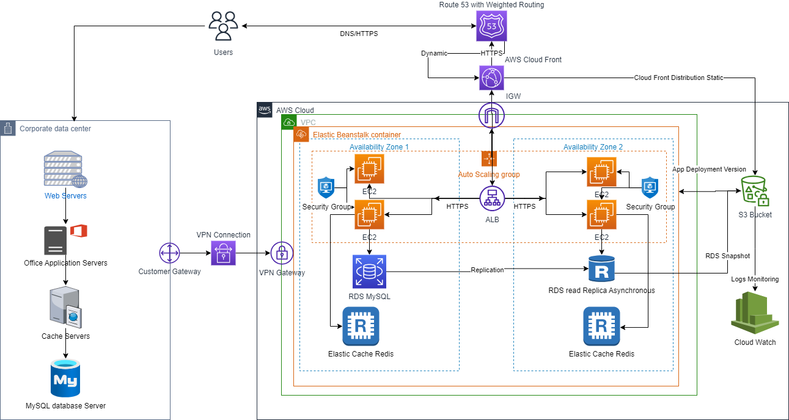
Phase 1 Architecture: “Cloud Native Foundation”

Slide 7
Migration Overview
Assessment and Planning-Assess architecture, dependencies and data, detailed plan including Timelines, resource allocation and rollback strategy
Set Up AWS Infrastructure
Data Migration - AWS Database Migration Service (DMS)
Application Deployment- Elastic Beanstalk and ASG, IAM roles
Traffic Routing- Route 53 with weighted Routing policies
Testing and Validation-Data Integrity, App functionality, Performance and load test to ensure scalability
Monitoring and Optimization- Cloud Watch and Cloud Trail
Rollback Plan-Adjust the weighted routing policy in Amazon Route 53 to redirect traffic back to the on-premises environment.
Documentation and Training
Transition to Cloud-Native- With traffic fully routed to AWS, continue to enhance and optimize the environment for cloud-native capabilities in preparation for Phase 2.

Slide 8
On-Premises Resources in Phase 1
Key resources in our on-premises setup include:
Web Servers: These servers handle user requests and form the front-end of our application.
App Servers: App servers execute application logic and interact with the database.
Cache Servers: Cache servers optimize data retrieval by storing frequently accessed information.
DB Server (MySQL): Our MySQL database server stores and manages application data.

Slide 9
AWS Services Used in Phase 1:
Elastic Beanstalk: Platform as a Service (PaaS) solution simplifies the deployment and management of web applications. It dynamically scales web servers based on traffic, ensuring high availability and performance.
Auto Scaling Group: Used for the App Tier, Auto Scaling Groups automatically adjust the number of instances to handle varying workloads, enhancing system scalability and fault tolerance.
Amazon RDS (MySQL Database): RDS is employed for database management, providing a Multi-AZ configuration for high availability and automatic failover. Data integrity and security are maintained through encryption.
ElastiCache (Cache Tier): ElastiCache enhances system performance by caching frequently accessed data, reducing the load on the database and improving overall responsiveness.
Amazon Route 53 (Weighted Routing): Route 53 is responsible for intelligent traffic routing. Weighted routing policies distribute traffic between on-premises and AWS cloud environments, facilitating a seamless transition.
Amazon S3 (Shared Storage): S3 serves as shared storage, ensuring high performance and low-latency access to common resources among servers.
Amazon CloudWatch (Monitoring): CloudWatch provides robust monitoring and alerting capabilities, allowing us to keep a close eye on system health and performance.
Security Measures (IAM, KMS, SSL): Identity and Access Management (IAM) roles grant secure access to AWS resources. Key Management Service (KMS) ensures data encryption. SSL secures data in transit.

Slide 10
AWS Services Used in Phase 1:
Amazon CloudFront (CDN): It distributes content to edge locations around the world, reducing latency by serving content from the nearest edge location to the user. This minimizes the time it takes for content to reach the user's device, resulting in a faster and more responsive application. Faster content delivery leads to an improved user experience. CloudFront is highly available, with multiple edge locations in various regions reducing the risk of downtime. automatically scales to handle increased demand. This scalability is crucial for accommodating the significant visitor volume expected in the next 1-3 months. By caching and delivering content from edge locations, CloudFront helps reduce the load on the origin server (Elastic Beanstalk in this case) and minimizes data transfer costs. This cost efficiency is essential for a cost-optimized solution. CloudFront provides Distributed Denial of Service (DDoS) protection by absorbing and mitigating DDoS attacks at the edge locations. This ensures the application remains accessible and secure during attacks. CloudFront supports SSL/TLS encryption, ensuring secure data transmission between users and the application. This aligns with the security requirement for data protection in transit.

Slide 11
Phase 1 Architecture
Benefits of all the Services used:
Each service in our Phase 1 architecture fulfills a specific role, contributing to the following benefits:
High Availability: Multi-AZ configurations and traffic routing ensure continuous service availability.
Scalability: Elastic Beanstalk and Auto Scaling adapt resources to varying workloads.
Performance: ElastiCache and traffic distribution optimize system responsiveness.
Security: IAM, KMS, and SSL guarantee data integrity and protection.
Monitoring: CloudWatch allows real-time system monitoring and proactive issue resolution.
Operational Efficiency: Elastic Beanstalk simplifies application management.
Cost Optimization: Resources scale dynamically, optimizing cost-efficiency.

Slide 12
Phase 2 - Multi-Site Approach for Disaster Recovery
Introduction:
In Phase 2 of our AWS Cloud Service Adoption Journey, we enhance our architecture to ensure business continuity even in the face of disasters or regional outages. This phase leverages a multi-region deployment strategy and robust disaster recovery measures.
Key Technology Decisions and Implementations:
Multi-Region Deployment: AWS Regions (Primary and Secondary) & VPC peering
We adopt a multi-region approach, deploying our application and infrastructure in two separate AWS regions and establish VPC peering between them to ensure redundancy and resilience.
Data Replication: AWS Database Replication Services (AWS Database Migration Service, Amazon RDS Multi-AZ)
We implement data replication mechanisms to synchronize data between the primary and secondary AWS regions in near real-time. This guarantees data consistency and availability.
Disaster Recovery Plan: Amazon Route 53 (DNS Switchover), AWS Auto Scaling Groups (Resource Failover), CloudFormation (Infrastructure as Code)
Our comprehensive disaster recovery plan includes the use of Amazon Route 53 for DNS switchover to redirect traffic to the secondary region in case of a disaster. AWS Auto Scaling Groups are configured to manage resource failover. CloudFormation templates are used to define infrastructure as code for disaster recovery processes.

Slide 13
Phase 2 - Multi-Site Approach for Disaster Recovery
Monitoring and Alerting: Amazon CloudWatch, CloudTrail
We enhance our monitoring and alerting capabilities using Amazon CloudWatch and CloudTrail. CloudWatch provides real-time monitoring and alerting, while CloudTrail offers detailed audit logs for security and compliance monitoring.
Security Measures: IAM Roles, KMS (Key Management Service), SSL Certificates, Security Groups, Network ACLs
Security remains paramount. We continue to employ IAM roles, KMS encryption, and SSL for data protection. Security groups and network ACLs are configured to control access.
Traffic Routing: Amazon Route 53 (Traffic Routing Policies)
We refine our traffic routing strategies, ensuring that traffic is distributed between the primary and secondary AWS regions based on disaster recovery needs.
Testing and Simulations: AWS Resources (EC2 instances, RDS instances), AWS CloudFormation (for Infrastructure as Code)
Rigorous testing and simulation scenarios are conducted using various AWS resources, including EC2 instances and RDS instances. AWS CloudFormation is used for defining and provisioning resources as code to simulate failover and recovery processes
Storage and Backup: Amazon S3 Bucket
An Amazon S3 bucket is used for storing critical backups and disaster recovery data, ensuring data durability and availability.

Slide 14
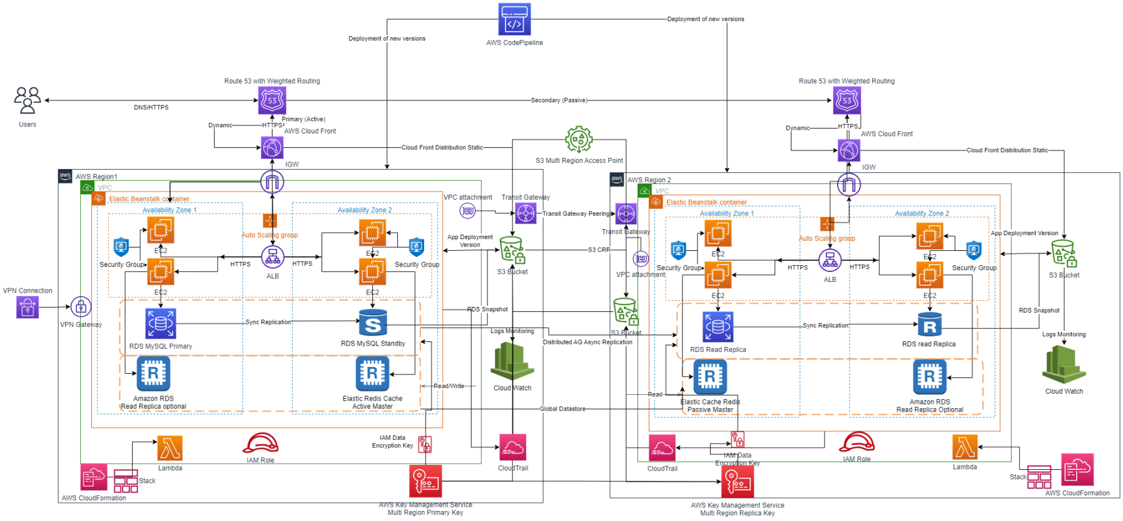
Phase 2 Architecture: “Resilience and Disaster Recovery Expansion”

Slide 15
Resilience through Multi-Site Deployment
Phase 2 Architecture:
This architecture leverages a multi-site approach, data replication, and disaster recovery measures.
Key components:
AWS Regions (Primary and Secondary): Our application and infrastructure are deployed across two separate AWS regions to ensure redundancy and resilience.
VPC Peering: VPC peering connects the VPCs in the primary and secondary regions, enabling secure communication and resource access.
Data Replication (AWS Database Services): Data replication mechanisms, such as AWS Database Migration Service and Amazon RDS Multi-AZ, synchronize data between regions in near real-time, ensuring data consistency and availability.
Amazon Route 53 (DNS Routing): Route 53 is used for DNS routing and failover. It dynamically directs traffic between regions based on disaster recovery needs.
Amazon CloudWatch: CloudWatch provides real-time monitoring and alerting, allowing us to proactively address issues and maintain system health.

Slide 16
Resilience through Multi-Site Deployment
IAM Roles and Security Groups: IAM roles grant secure access to AWS resources, while security groups and network ACLs control access and security configurations.
KMS (Key Management Service): KMS ensures data encryption, securing sensitive information and meeting compliance requirements.
Amazon S3 (Backup and Storage): An Amazon S3 bucket is used for storing critical backups and disaster recovery data, ensuring data durability and availability.
AWS CloudTrail (Audit and Compliance): CloudTrail delivers detailed audit logs, enabling security and compliance monitoring and also captures API calls. Aids in Disaster recovery by providing audit logs for resource changes during failover scenarios. We can refer to CloudTrail logs to understand any changes that occurred during DNS switchover and regional failovers, helping us assess the impact on our environment. We can configure custom CloudWatch alarms based on CloudTrail events, allowing us to respond quickly to specific events that may impact compliance.
AWS CloudFormation: CloudFormation templates define infrastructure as code, facilitating resource provisioning and management.

Slide 17
Role of Transit Gateway Peering in Phase 2
Transit Gateway peering plays a crucial role in Phase 2 of our AWS Cloud Service Adoption Journey. It enhances our network connectivity across AWS regions, enabling secure and efficient communication between resources deployed in different regions.
Enhanced Network Connectivity:
Multi-Region Deployment: In Phase 2, our architecture spans multiple AWS regions for redundancy and disaster recovery. Each region hosts critical resources.
Isolated VPCs: To maintain network isolation, VPCs are often deployed independently in each region, isolating resources and improving security.
Transit Gateway: Transit Gateway is a highly scalable and centralized hub for routing traffic between VPCs. It simplifies network management by providing a single entry and exit point for traffic.
Transit Gateway Peering Benefits:
Transit Gateway provides centralized control over network routing, reducing the complexity of managing VPC-to-VPC connections, especially in multi-region architectures.
Inter-Region Communication: Transit Gateway peering enables VPCs in one region to communicate directly with VPCs in another region, bypassing the public internet. This reduces latency and enhances security.

Slide 18
Role of Transit Gateway Peering in Phase 2
Simplified Routing: Transit Gateway handles routing between peered VPCs, eliminating the need to set up and manage complex VPC peering connections individually.
Scalability: As our architecture scales, Transit Gateway efficiently routes traffic, ensuring high performance without the need for manual configuration adjustments.
Security: Traffic between peered VPCs remains within the AWS network, enhancing security by avoiding exposure to the public internet.
Disaster Recovery Scenarios:
Failover between Regions: In disaster recovery scenarios, Transit Gateway peering ensures that resources in the secondary region can seamlessly communicate with those in the primary region. This is essential for maintaining business continuity.
DNS Switchover: Combined with DNS switchover strategies, Transit Gateway peering supports the rerouting of traffic to the secondary region during regional outages, ensuring uninterrupted service.

Slide 19
Phase 2 Architecture Benefits
Phase 2 introduces a resilient and disaster-ready architecture, providing the following benefits:
High Availability: Multi-region deployment guarantees high availability, even in the face of regional outages.
Data Redundancy: Data replication mechanisms synchronize data between regions, preventing data loss.
Business Continuity: The disaster recovery plan ensures operational functionality during and after disasters, minimizing downtime.
Proactive Monitoring: Enhanced monitoring using CloudWatch enables real-time issue detection and resolution.
Security: IAM roles, KMS encryption, and security groups maintain robust security measures.
Traffic Control: Amazon Route 53 routes traffic intelligently, ensuring the right data center handles requests.
Data Durability: Amazon S3 provides a reliable repository for backups and disaster recovery data.
Audit Trails: CloudTrail delivers detailed audit logs for security and compliance monitoring.

Slide 20
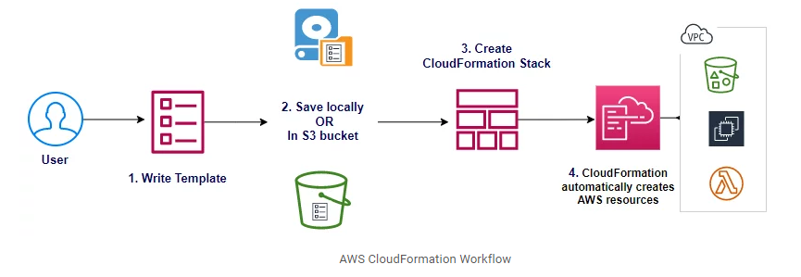
Streamlined Infrastructure Provisioning
Role of AWS CloudFormation in Phase 2:
AWS CloudFormation plays a pivotal role in Phase 2 of our AWS Cloud Service Adoption Journey. It is our Infrastructure as Code (IAC) tool, enabling us to efficiently manage and provision AWS resources to support our multi-site architecture and disaster recovery strategy.

Slide 21
Uses of CloudFormation Templates
Definition of Infrastructure as Code (IAC): CloudFormation templates are written in YAML or JSON and serve as blueprints for our AWS infrastructure.
Resource Provisioning: Automating the creation and management of AWS resources ensuring consistency and repeatability.
Multi-Site Deployment: In Phase 2, we deploy our application and infrastructure across two AWS regions. CloudFormation allows us to define VPCs, subnets, security groups, IAM roles, and other resources needed for our multi-site architecture.
Disaster Recovery Scenarios: CloudFormation templates are used to define disaster recovery scenarios and resource configurations for failover. These templates are essential for executing our disaster recovery plan.
Version Control: CloudFormation templates are version-controlled, providing a history of changes and the ability to roll back to previous configurations if needed.
Infrastructure Updates: As our architecture evolves, CloudFormation templates facilitate updates and modifications to resources. We can modify templates to reflect changes and apply updates seamlessly.

Slide 22
Continuous Integration and Continuous Delivery
AWS CodePipeline, a continuous integration and continuous delivery (CI/CD) service, is integrated with CloudFormation to automate the deployment process.
Phase2 has leveraged Elastic Beanstalk's simplicity for application deployment while using CodePipeline to automate and manage the overall deployment process, including testing, approvals, and coordination with other AWS services.
In Phase2, created a streamlined and automated deployment process benefiting from the ease of use and scalability of Elastic Beanstalk for hosting web application. This approach ensures that your application is deployed consistently and reliably across environments while allowing for customization and control through the CI/CD pipeline.
By using AWS CodePipeline, one deploy stage within the pipeline will deploy the stack to the primary Region. After that, the same stack is copied to the secondary Region.
The workloads in the primary and secondary Regions will be treated as two different environments. However, they will run the same version of our application for consistency and availability in event of a failure.

Slide 23
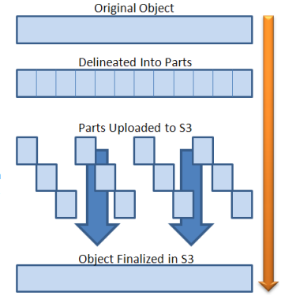
Amazon S3: Multipart Upload
Phase 2 uses this new feature, we can break a 5 GB upload (the current limit on the size of an S3 object) into as many as 1024 separate parts and upload each one independently, as long as each part has a size of 5 megabytes (MB) or more. If an upload of a part fails it can be restarted without affecting any of the other parts. Once you have uploaded all of the parts you ask S3 to assemble the full object with another call to S3.

Slide 24
Best Practices for Disaster Recovery on AWS
1. Define Clear Recovery Objectives
Recovery Time Objective (RTO): This metric defines the maximum acceptable downtime for your applications or systems after a disaster.
Recovery Point Objective (RPO): RPO represents the acceptable amount of data loss in case of a disaster. It determines how frequently data must be backed up to minimize potential loss.
These metrics help quantify how quickly you need to recover and how much data loss your organization can tolerate.
2. Regular Testing and Simulation
Simulated exercises ensure that your recovery plan is effective and that your team can execute it efficiently when needed.
3. Leverage Automation
Automation plays a pivotal role in disaster recovery by streamlining processes and reducing recovery times. AWS CloudFormation is one tool that can help in this regard.
Infrastructure as Code (IaC): Use AWS CloudFormation to define your infrastructure as code. This ensures consistent infrastructure deployment and simplifies the recovery process by accurately recreating your environment.
Automated Recovery Workflows: Design automated workflows using CloudFormation templates that outline the steps needed to recover different infrastructure components.
Version Control: Maintain version control for your CloudFormation templates to track changes and ensure you have a reliable snapshot of your infrastructure.

Slide 25
Best Practices for Disaster Recovery on AWS
4. Implement Data Replication
Multi-Region Replication: Replicate data across multiple AWS regions to ensure redundancy. This approach enhances availability and mitigates the risk of data loss in a single region failure.
Cross-Availability Zone Replication: Replicate data across different availability zones within the same region for intra-region redundancy.
Real-Time or Near-Real-Time: Choose replication mechanisms that enable real-time or near-real-time data consistency between source and target environments, depending on your RPO.
5. Robust Monitoring and Alerting
Monitoring and alerting are proactive measures that help you detect issues before they escalate into disasters.
CloudWatch for Monitoring: Utilize Amazon CloudWatch to monitor your infrastructure’s health, performance, and metrics. Set up custom alarms based on predefined thresholds.
Event-Driven Alerts: Implement event-driven alerts that notify you of critical changes or anomalies, enabling timely responses.
Automated Responses: Integrate monitoring tools with automated response mechanisms that trigger predefined actions based on specific alerts.

Slide 26
Conclusion- Achieving Resilience and Growth
Our AWS Cloud Service Adoption journey has been a transformative experience, resulting in significant achievements and benefits
Enhanced Scalability, Availability, and Disaster Recovery:
Scalability: Our system is prepared to handle significant visitor volume, adapting seamlessly to changing demands.
Availability: Through a multi-region approach and Transit Gateway peering, we've minimized single points of failure, ensuring high availability.
Disaster Recovery: Our comprehensive disaster recovery plan, including DNS switchover and multi-region failover, guarantees system functionality even in the face of adversity.
Our AWS Cloud Service Adoption journey has not only met but exceeded our key technology requirements, setting the stage for continued growth, security, and resilience. We're well-prepared to navigate the challenges of the future while delivering a secure and reliable experience to our users.

