Slide 1
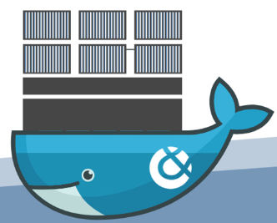
Dockers / Containers
By,
K R Madhumitha

Slide 2
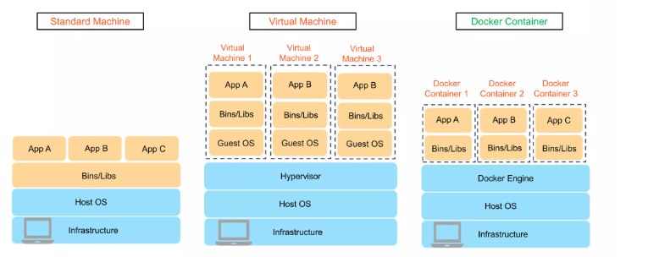
Hypervisor based versus container based virtualization
Difference Between Standard, Docker and Virtual machines:

Slide 3
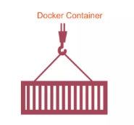
What is docker?
Docker is an open source platform that helps a user to package an application and it’s dependencies into a docker container for the development and deployment of software.

Slide 4
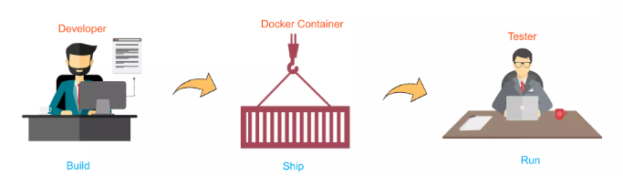
What is docker?
It provides tooling a platform to manage lifecycle of our containers.
It shares the same OS kernel.

Slide 5
Containers
Containers are created from images.
Docker container image includes everything needed to run an application: code, runtime system libraries etc.
Container only contains the application and the required binaries and libraries that support that particular application. So that application runs quickly and reliably from one computing environment to another.
Container images become containers at runtime. Runtime is the software that executes the container which means telling the kernel to assign resource limits, create isolation layers(for processes, networking and filesystem), and so on.
Containers are lightweight and portable encapsulations of an environment in which to run applications.

Slide 6
Images
An image is a collection of read-only files and some metadata that includes executable code (system libraries, system tools, other platforms settings a software program to run) so it can run an isolated process.
These images are made of layers that are conceptually stacked on one another with each layer being able to add, change or remove files.
A container is a running instance of an image. We can have many running containers of the same image.
Images are stored in a Docker registry ex: Docker Hub

Slide 7
Docker file
For increased automation, the set of layers can be described by the user in a Dockerfile and these are assembled into the image when the image is built.
A Dockerfile is a series of commands or operations that define how to build an image.
Image is built up of read-only layers, with each instruction in the Dockerfile resulting in a new read-only layer based on the previous layer. Resulting image is also read-only template.
Some of the components used in Dockerfile: FROM, WORKDIR, COPY, RUN, ENV, EXPOSE, VOLUME, USER, WOR, CMD, ENTRYPOINT

Slide 8
Docker file components
FROM: for base image, this command must be on the top of the dockerfile.
RUN: to execute commands, it will create a layer in image
MAINTAINER: author/ owner/ description
COPY: copy files from local system (docker vm) we need to provide source, destination (we can’t download file from internet and any remote repo.)
ADD: similar to copy but it provides a feature to download files from internet, also extract file at docker image side.
EXPOSE: to expose ports such as port 8080 for tomcat , port 80 for nginx etc.
CMD: execute commands but during container creation.
ENTRYPOINT: similar to CMD but has higher priority over CMD, first commands will be
executed by ENTRYPOIN only.
ENV: environment variables

Slide 9
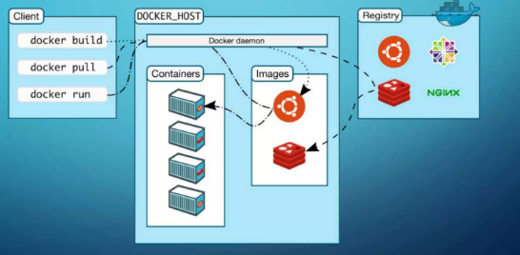
Docker architecture

Slide 10
Ways of creating Docker Image
Pulling from Docker Hub
Creating image from running container
Creating image from Dockerfile

Slide 11
Pulling docker image from docker hub
docker search ubuntu → To find out images in docker hub
docker pull ubuntu → To download image from dockerhub to local machine
docker run -it --name madhu ubuntu → To give a name to container
ctrl+p & ctrl+q → To exit from the container
docker run -t -d --name madhu ubuntu
docker attach madhu → To go inside container
docker ps / docker container ls → To see running containers
docker ps –a / docker container ls -a → To see all comtainers
docker images → To see all images present in your local repo
docker stop [container_id or name]
docker kill [container_id or name]
docker rm container_name → To delete a container
docker rmi image_name/ docker image remove <image name> → To delete a docker image
docker exec -it madhu /bin/bash → creates a new process in the container’s environment
docker service status → To check service start or not (status)
To start: #docker service start, To stop: # docker service stop
docker start container_name → To start container
docker stop container_name → To stop container

Slide 12
Creating image from running container
#docker run -it –name container_name image_name /bin/bash
#cd tmp/
Now create one file inside this tmp directory
# touch myfile
Now if you want to see the difference between the basic image and the changes on it
# docker diff container_name image_name (C-Change, A-Append, D-Delete)
Now create image of this container
# docker commit newcontainer_name image_name
# docker images
Now create container from this image
# docker run -it --name newcontanier_name image_name /bin/bash
# ls# cd tmp
# ls (you will get all of your files)

Slide 13
Creating image from Dockerfile
To create image out of Dockerfile
Create a Dockerfile (Custom file to give instructions to build an image)
FROM ubuntu
WORKDIR /tmp
RUN echo “thank you” > /tmp/testfile
ENV myname madhu
COPY testfile1 /tmp
ADD test.tar.gz /tmp
# docker build -t myimage .
# docker images
Now create container from the above image
#docker run -it --name mycont myimage /bin/bash

Slide 14
Docker Volume
Docker Volume:
Volume is simply a directory inside our container.
Finally, we have to declare this directory as a volume and then share volume.
Even if we stop the container still, we can access volume.
Volume will be created in one container.
You can declare a directory as a volume only while creating container.
You can’t create volume from existing container.
You can share one volume across any number of containers.
Volume will not be included when you update an image.
You can map volume in two ways:
a. Container to container
b. Host to container

Slide 15
Docker volume example
Creating Volume from Dockerfile:
Create a Dockerfile and write
#nano Dockerfile
FROM ubuntu
VOLUME “myvolume”
Then create image from this Dockerfile
#docker build -t myimage
Now create a container from this image and run
# docker run -it --name container1 myimage /bin/bash
Now do ls, you can see myvolume.
Now share volume with another container

Slide 16
push docker image in docker hub
Go to AWS account
#sudo su
#yum update -y
#yum install docker -y
#service docker start
#docker run -it ubuntu /bin/bash
Now create some files inside container, now create image of this container
#docker commit container1 image1

Slide 17
push docker image in docker hub
Now create an account in dockerhub.com
Go to AWS account
#docker login
Enter your username and password
Now give tag to your image
#docker tag image1 dockerid/newimage
#docker push dockerid/newimage
Now you can see this image in docker hub account

Slide 18
Conclusion
Docker is a revolutionary technology that simplifies isolation and provides environment independency.

Slide 19
references
Google Search
https://docs.docker.com/get-started/overview/

