Slide 1
Classification of Parallel Computers

Slide 2
Types of Classification
Classification based on
Instruction and data stream
Structure of Computers
How memory is accessed
Grain size
Flynn’s Classification
Instruction cycle=opcode + operand (addressing mode+operand address)

Slide 3
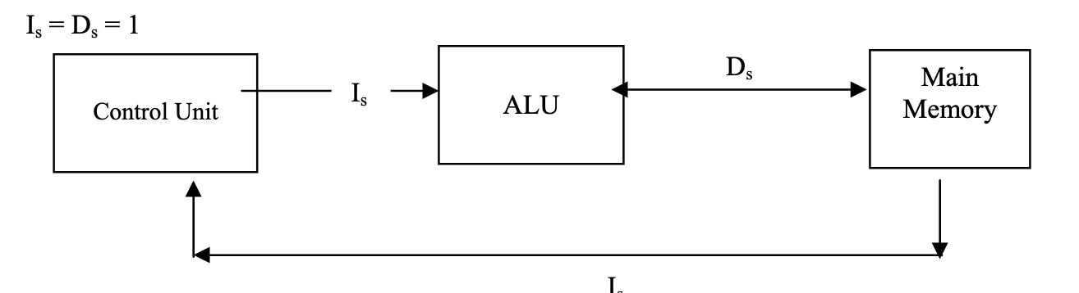
SISD
Examples of SISD machines include:
CDC 6600 which is unpipelined but has multiple functional units.
CDC 7600 which has a pipelined arithmetic unit.
Amdhal 470/6 which has pipelined instruction processing.
Cray-1 which supports vector processing.

Slide 4
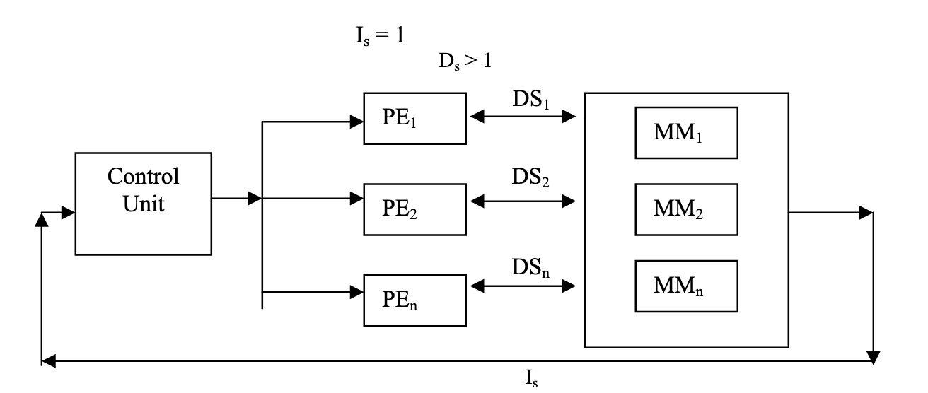
SIMD
Examples of SIMD organization are ILLIAC-IV, PEPE, BSP, STARAN, MPP, DAP and the Connection Machine (CM-1)

Slide 5
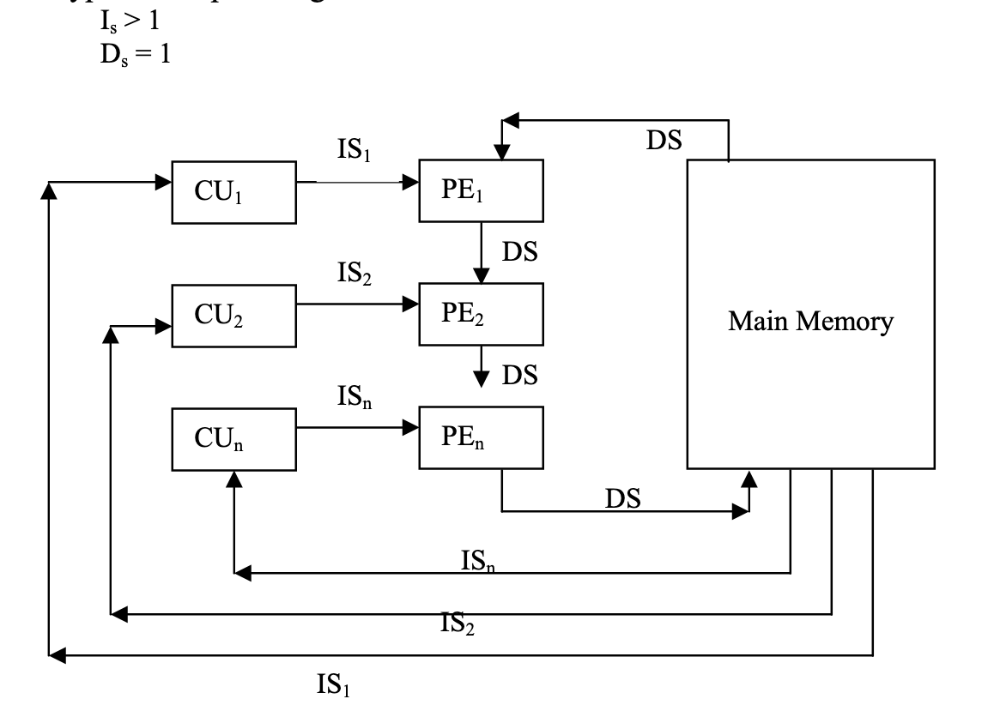
MISD
The only known example of a computer capable of MISD operation is the C.mmp built byCarnegie-Mellon University
MISD machines can be applied to fault tolerant real time computers

Slide 6
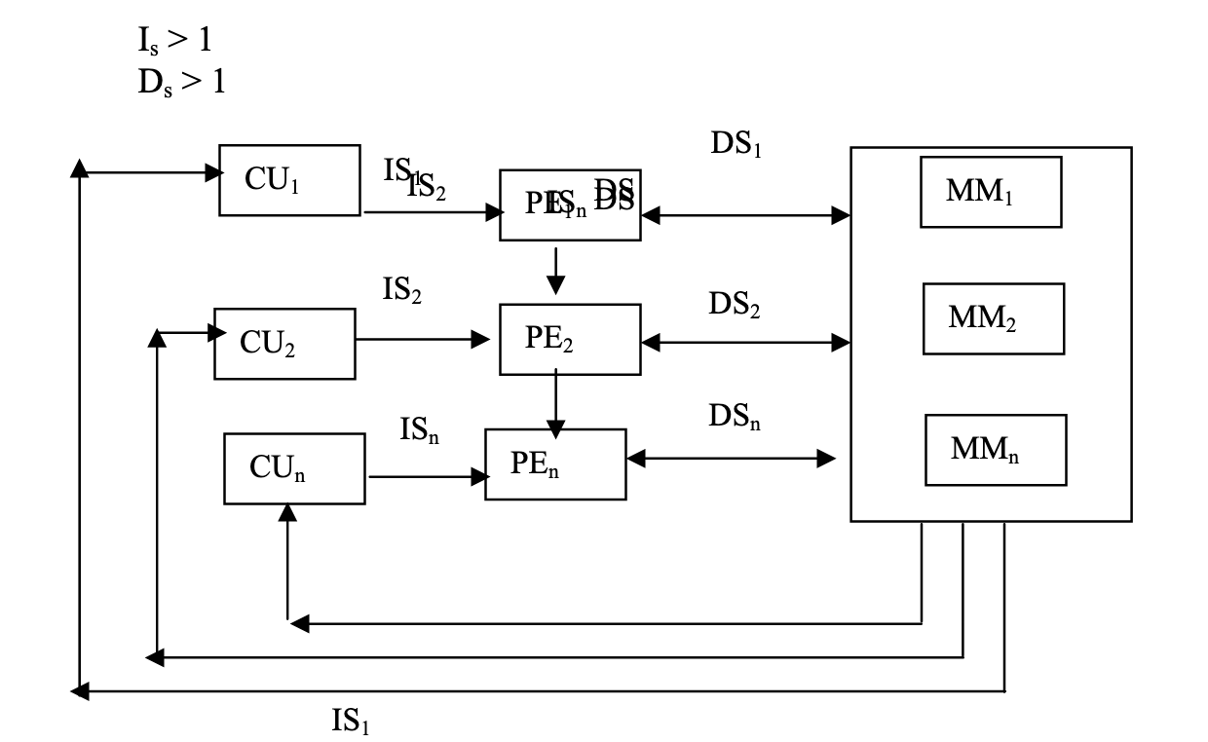
MIMD
All multiprocessor systems fall under this classification
Examples include; C.mmp, Burroughs D825, Cray-2, S1, Cray X-MP, HEP, Pluribus, IBM 370/168 MP, Univac 1100/80, Tandem/16, IBM 3081/3084, C.m*, BBN Butterfly, Meiko Computing Surface (CS-1), FPS T/40000, iPSC

Slide 7
Structural Classification
Two types:
Shared memory computer/Tightly coupled systems
Distributed memory computer/Loosely coupled systems

Slide 8
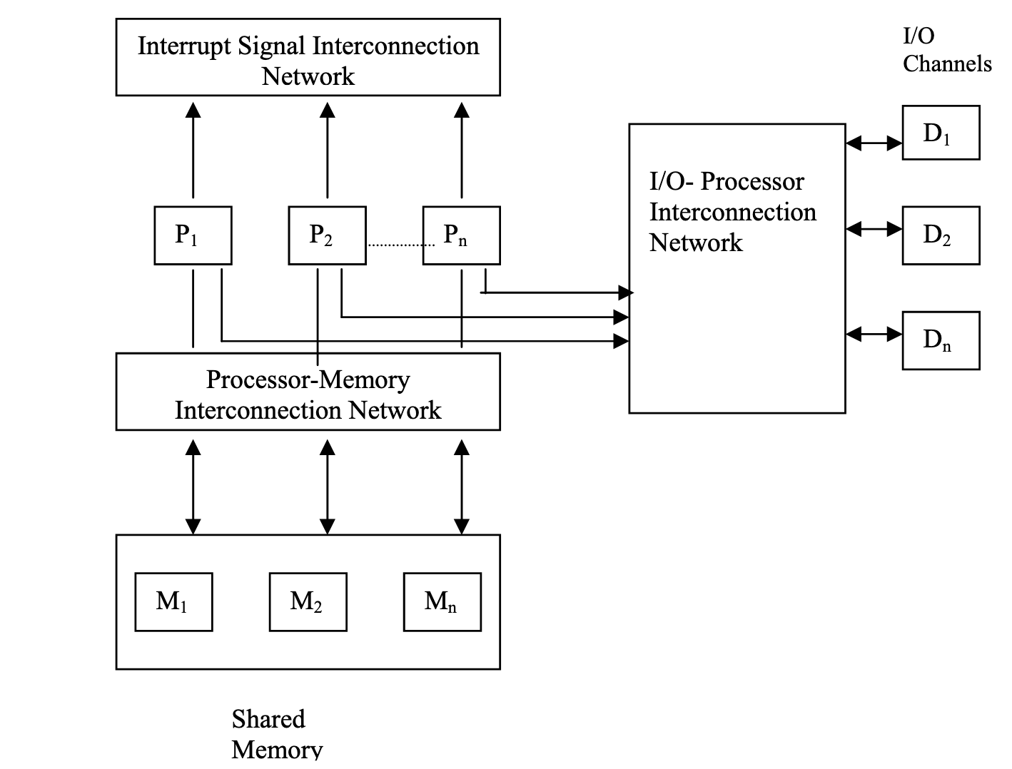
Shared memory computer/Tightly coupled systems
Various implementations of inter-communication:
Processor-Memory Interconnection Network (PMIN)
Input-Output-Processor Interconnection Network (IOPIN)
Interrupt Signal Interconnection Network (ISIN)

Slide 9
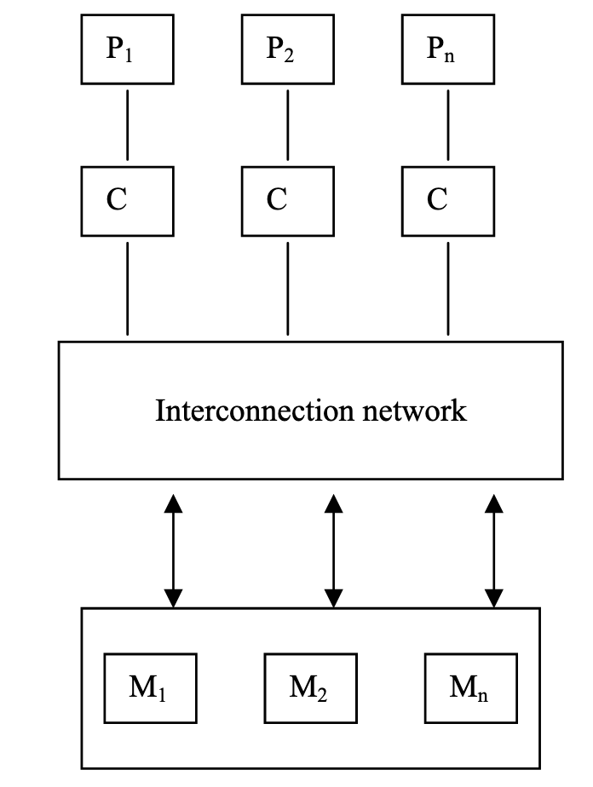
Shared memory computer/Tightly coupled systems
Three modes of systems
UMA
used for time-sharing applications in a multi user environment
NUMA
Local memories access varies for other processors
COMA
in NUMA model, if we use cache memories instead of local memories, then it becomes COMA model
The collection of cache memories form a global memory space
The remote cache access is also non-uniform in this model

Slide 10
Distributed memory computer/Loosely coupled systems
To solve memory conflicts in shared memory systems
Each processor is having a large local memory (LM), which is not shared by any other processor
Such systems have multiple processors with their own local memory and a set of I/O devices
This set of processor, memory and I/O devices makes a computer system, also called multi-computer systems
Connected together via message passing interconnection network
As they have a separate memory, they are called distributed multicomputer systems
Because of little coupling, they are called loosely coupled systems

Slide 11
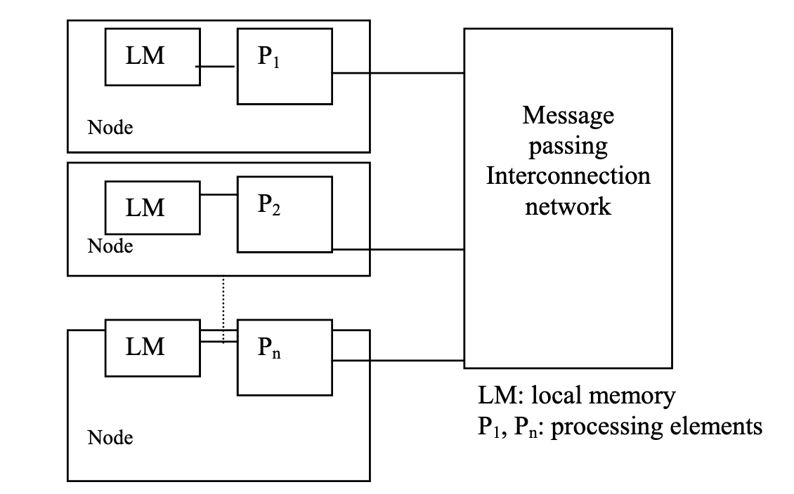
Distributed memory computer/Loosely coupled systems
Since local memories are accessible to the attached processor only, no processor can access remote memory
Hence called no-remote memory access (NORMA) systems
Message passing interconnection network provides connection to every node and inter-node communication with message depends on the type of interconnection network
Example, interconnection network for a non-hierarchical system can be shared bus.

Slide 12
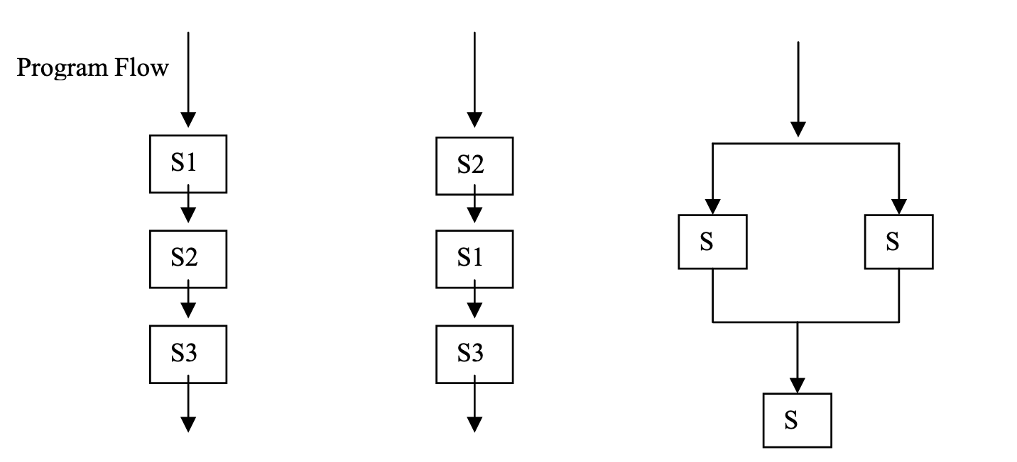
Classification based on Grain Size
The decision of parallelism also depends on the following factors:
Number and types of processors available, i.e., architectural features of host computer
Memory organization
Dependency of data, control and resources

Slide 13
Classification based on Grain Size
Parallelism Conditions: Three types of dependency conditions between segments
Data Dependency
Control Dependency
Resource Dependency
Types of grain sizes
Fine Grain: This type contains approximately less than 20 instructions
Medium Grain: This type contains approximately less than 500 instructions
Coarse Grain: This type contains approximately greater than or equal to one thousand instructions.

Slide 14
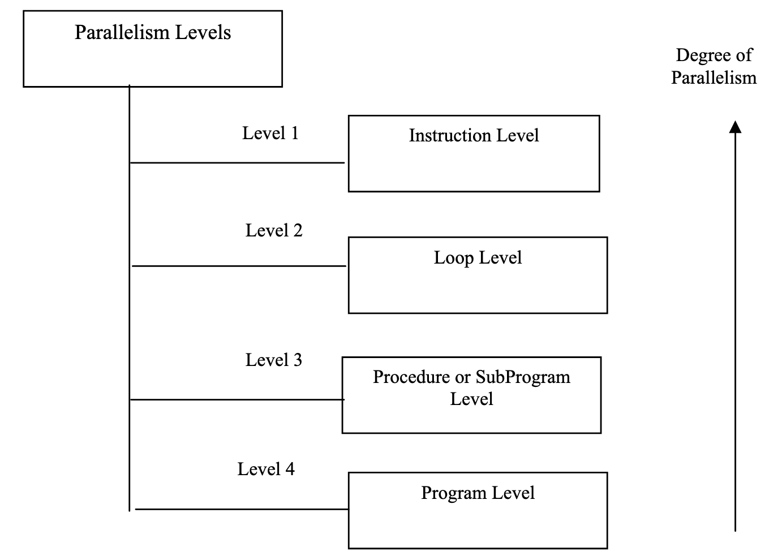
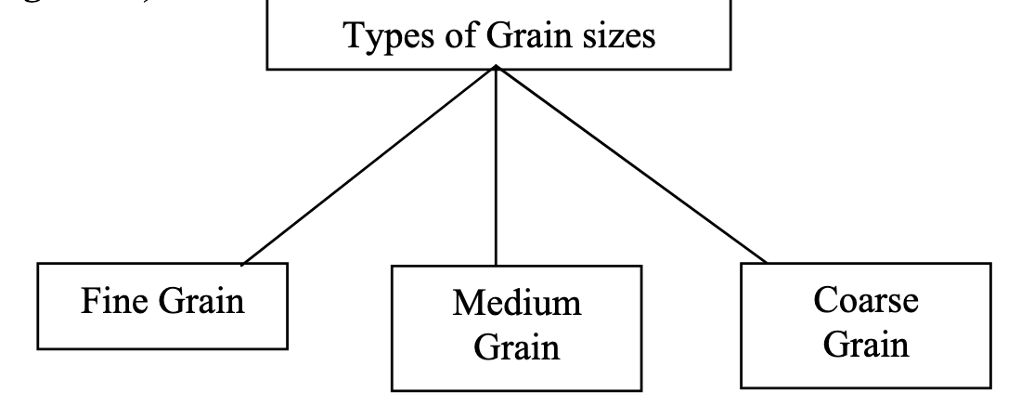
Classification based on Grain Size

Slide 15
Classification based on Grain Size
Coarse grain parallelism is traditionally implemented in tightly coupled or shared memory multiprocessors like the Cray Y-MP
Loosely coupled systems are used to execute medium grain program segments
Fine grain parallelism has been observed in SIMD organization of computers
Grain Size | Parallelism Level
Fine Grain | Instruction or Loop Level
Medium Grain | Procedure or SubProgram Level
Coarse Grain | Program Level
Relation between grain size and parallelism

Slide 16
ccNUMA Cache Coherent Non-Uniform Memory Access

Slide 17
Computer Architecture Classification Flynn’s Taxanomy
SISD: Uniprocessors
SIMD: Vector and Array Processors
MISD: Commercially not implemented
MIMD: Shared Memory (tightly Coupled) and Multicomputer (Loosely Coupled)
Multiprocessor: Create power computers by connecting many smaller ones
Computational speed increases
Parallel Processing Program is a single program that runs on multiple processors simultaneously

Slide 18
Shared Memory Multiprocessor
Unified Memory Access (UMA):
Time to access main memory is same for all processors
Machines that use UMA are called Symmetric Multiprocessors (SMPs)
All memory access are posted to the same shared bus
Contention on bus decreases performance, hence scalability is limited to 32 processors
Non-Uniform Memory Access (NUMA):
Memory is physically distributed and called local and non-local memory
Access to local is faster
Reduces memory contention on bus
Designed to surpass the limits of scalability of SMPs

Slide 19
Communication and Connection Options for Multiprocessors
Category | Choice |  | Number of processors
Communication Model | Message passing |  | 8-256
 | Shred Address | UMA | 2-64
 |  | NUMA | 8-256
Physical connection | Network |  | 8-256
 | Bus |  | 2-36

Slide 20
Cache
Bus and Network configurations
Modern Processors use a faster, smaller cache memory to act as a buffer for slower, larger memory
Caches exploit the principal of locality in memory accesses
Temporal locality: the data referred is tend to be referenced again
Spatial locality: data near the just referenced data is more tend to be referenced
Caches hold recently referred and the near-by data
This tends to increase performance

Slide 21
ccNUMA
NUMA systems that maintain cache coherence are called ccNUMA
When more than one processor tries to access the same shared data, cache coherence problem occurs
Cache coherence is maintained by software, special purpose hardware or both

Slide 22
Cache Coherency Protocols
Snooping protocol: A bus-based method in which cache controllers monitor the bus for activity and update or invalidate cache entries as necessary
2-types:
Write-invalidate: changes only local cache and sends invalidate signal over bus
Write-update: all values (main memory and cache) are updated simultaneously
Commercial machines use write-invalidate to save bandwidth
New values appear sooner in cache if write-update is used

Slide 23
Cache Coherency Protocols
Directory-based protocols:
A central directory maintains the information about which memory locations are being shared in multiple caches and which are contained in just one processor’s cache
On any memory access, it knows the caches that need to be updated or invalidated
It is used by all software –based implementations of shared memory
It is a scalable scheme that is suitable for a network configuration

Slide 24
Side-effects of Cache Coherency
False Sharing:
Caches are organized into blocks of contiguous memory locations
Usually this is shared by more than one processor
When one processor invalidates its memory, the entire block gets invalidated
Unnecessary invalidations can affect performance

Slide 25
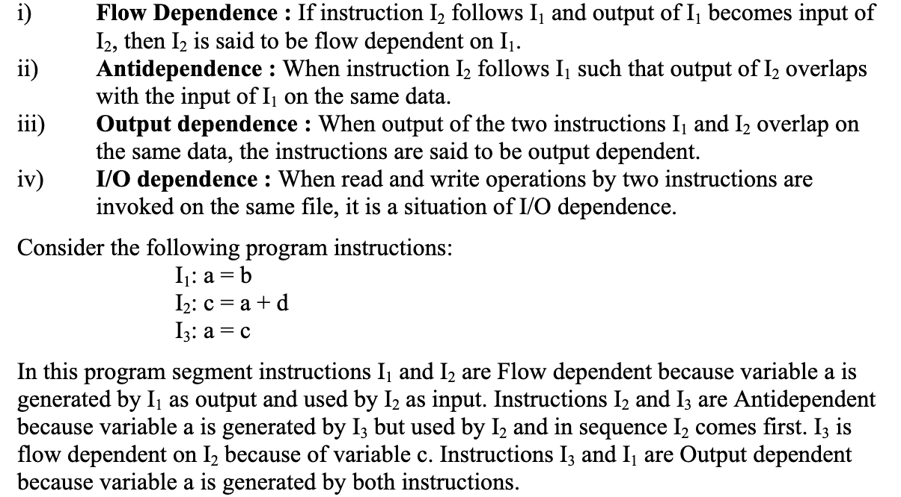
Data Dependency

Slide 26
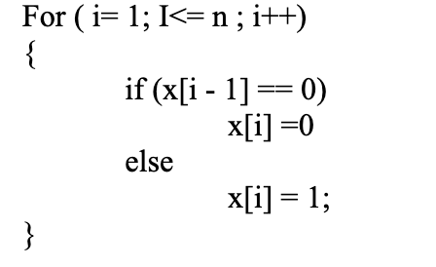
Control Dependence
Dependency in control structure sis not known until run-time
Hence dependency need to be analyzed

Slide 27
Resource Dependency
Shared resources
ALU dependency or Storage dependency

Slide 28
Bernstein Conditions for Detection of Parallelism
Conditions for detecting data dependency by A. J. Bernstein
Bernstein conditions are based on the following two sets of variables:
The Read set or input set R_{I} that consists of memory locations read by the statement of instruction I_{I}
The Write set or output set W_{I} that consists of memory locations written into by instruction I_{I}.
The sets R_{I} and W_{I} are not disjoint as the same locations are used for reading and writing by S_{I}

Slide 29
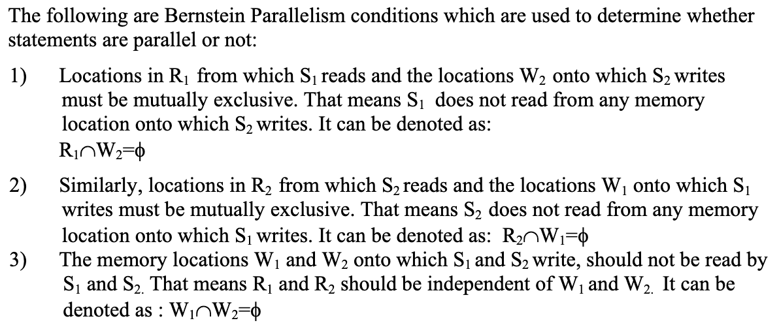
Bernstein Conditions for Detection of Parallelism

Slide 30
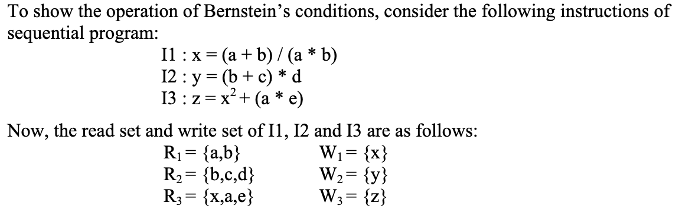
Bernstein Conditions for Detection of Parallelism

Slide 31
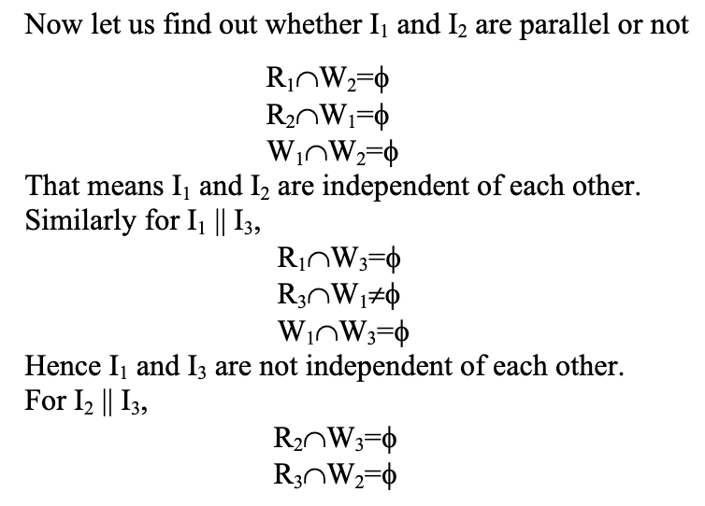
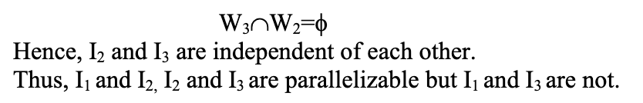
Bernstein Conditions for Detection of Parallelism

