Slide 1
COMMANDS

Slide 2
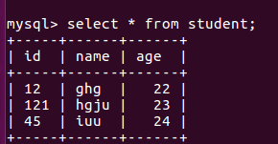
Student Table

Slide 3
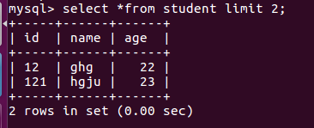
LIMIT

Slide 4
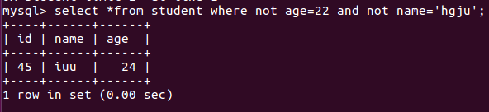
Using AND and NOT

Slide 5
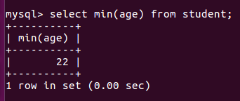
MIN

Slide 6
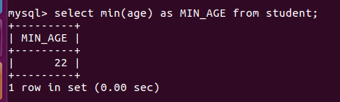
RENAME(AS CLAUSE)

Slide 7
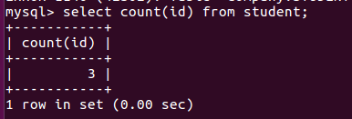
COUNT

Slide 8
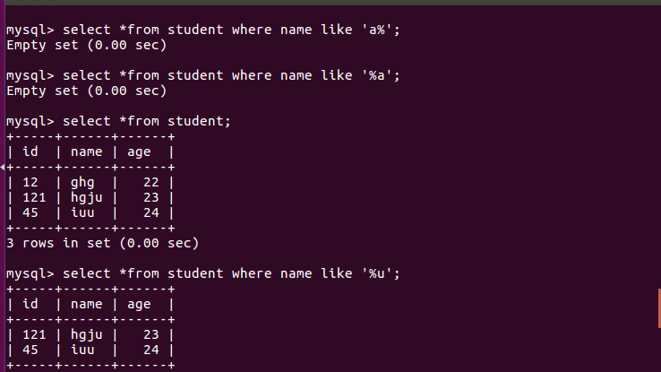
LIKE(%)

Slide 9
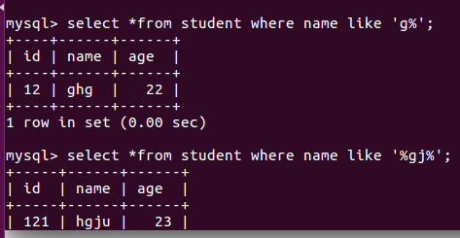
LIKE(%)

Slide 10
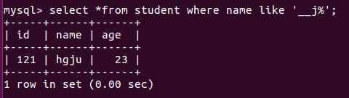
LIKE( _ AND %)

Slide 11
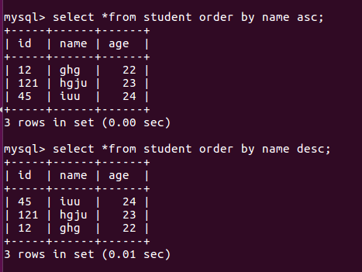
ORDER BY

