Slide 1
SQL COMMANDS
SQL - Like Clause
SQL - Top Clause
SQL - Order By
SQL - Group By
SQL - Distinct Keyword
SQL - Sorting Results
SQL- CONSTRAINTS
ARITHMETIC OPERATORS
AS CLAUSE

Slide 2
SQL-LIKE CLAUSE
The SQL LIKE clause is used to compare a value to similar values using wildcard operators. There are two wildcards used in conjunction with the LIKE operator:
  The percent sign (%)
  The underscore (_)

Slide 3
Syntax:
The basic syntax of % and _ is as follows:
SELECT FROM table_name WHERE column LIKE 'XXXX%'
or
SELECT FROM table_name WHERE column LIKE '%XXXX%'
or
SELECT FROM table_name WHERE column LIKE '_XXXX%'

Slide 4
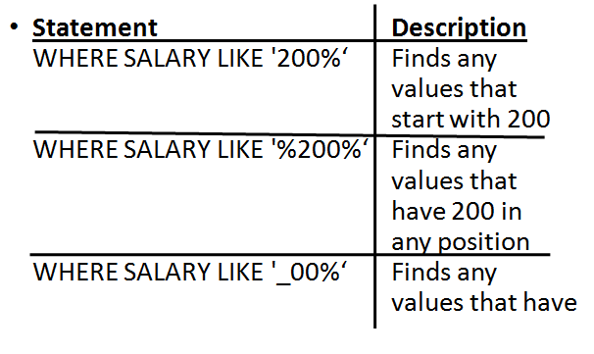
Continued….

Slide 5
TOP CLAUSE
The SQL TOP clause is used to fetch a TOP N number records from a table.
Note: All the databases do not support TOP clause.
  For example MySQL supports LIMIT clause to fetch limited number of records and
  Oracle uses ROWNUM to fetch limited number of records.

Slide 6
Syntax:
SELECT TOP number column_name(s) FROM table_name WHERE [condition]

Slide 7
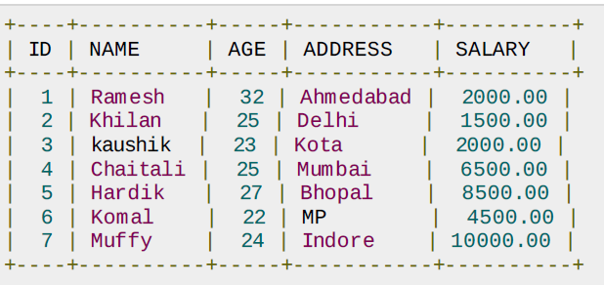
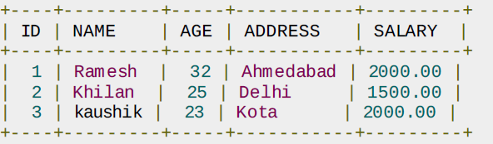
Example

Slide 8
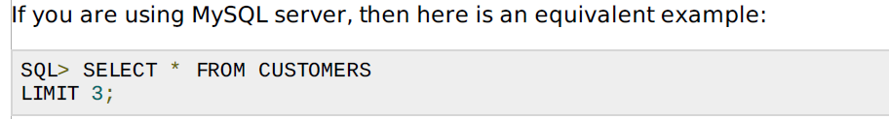
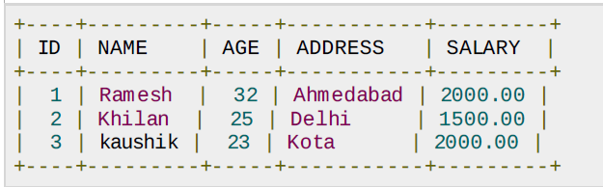
Continued…..

Slide 9
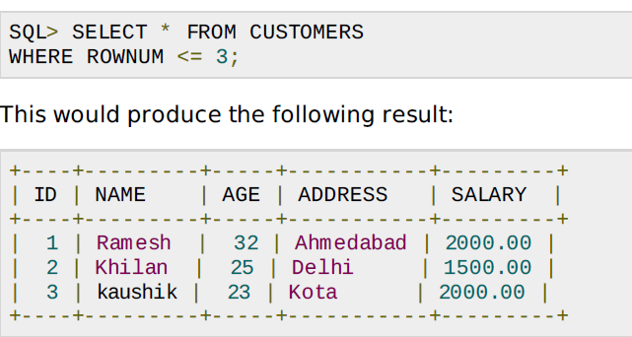
Continued….
In Oracle Server,

Slide 10
SQL ORDER BY clause
The SQL ORDER BY clause is used to sort the data in ascending or descending order, based on one or more columns. Some database sorts query results in ascending order by default.
Syntax:
The basic syntax of ORDER BY clause is as follows:
SELECT column-list FROM table_name [WHERE condition] ORDER BY [column1, column2, .. columnN] [ASC | DESC];

Slide 11
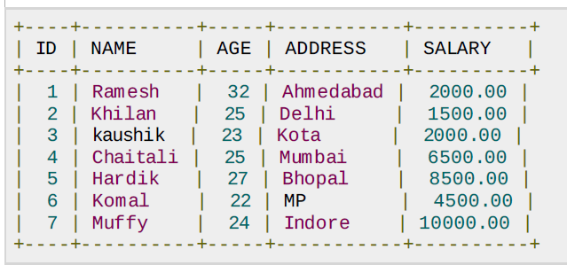

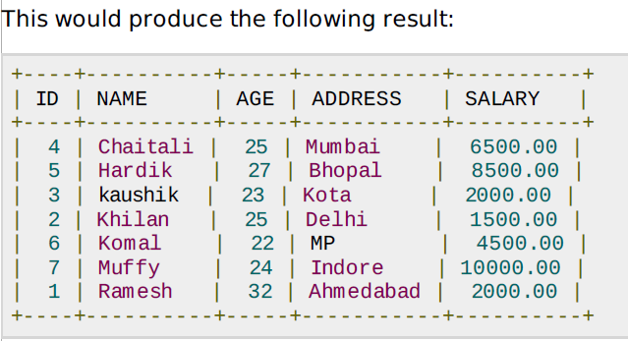
Continued….

Slide 12


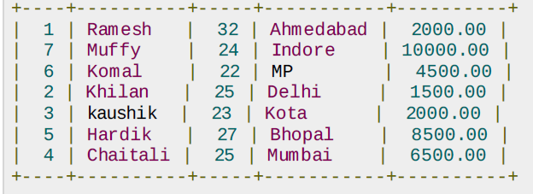
Continued….

Slide 13
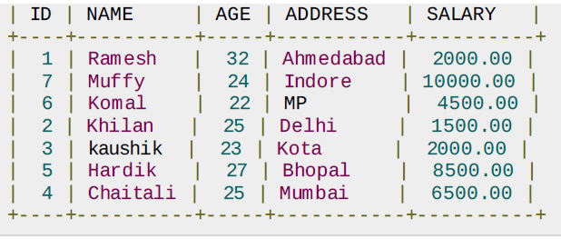
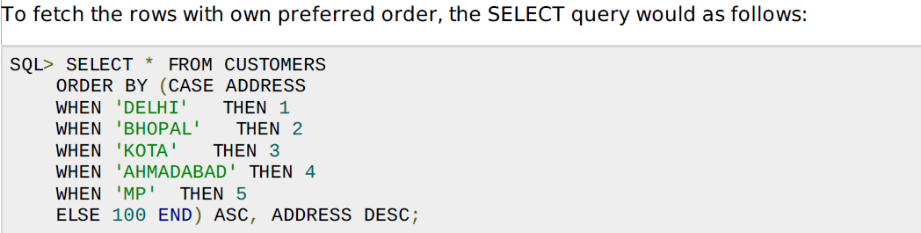

Slide 14
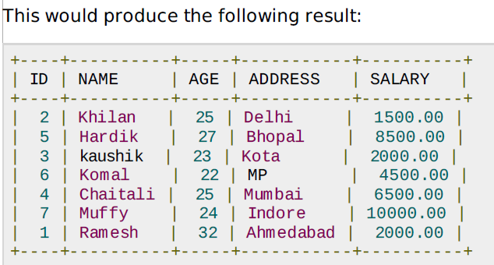

Slide 15
SQL GROUP BY clause
The SQL GROUP BY clause is used in collaboration with the SELECT statement to arrange identical data into groups.
The GROUP BY clause follows the WHERE clause in a SELECT statement and precedes the ORDER BY clause.

Slide 16
Syntax:
SELECT column1, column2 FROM table_name WHERE [ conditions ] GROUP BY column1, column2 ORDER BY column1, column2

Slide 17
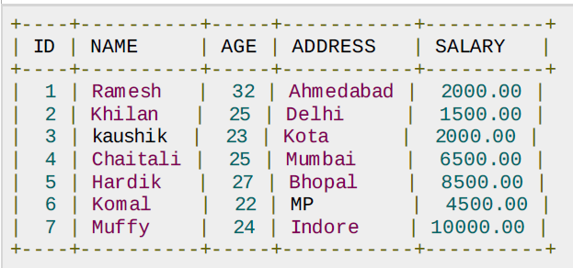

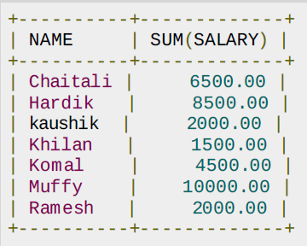

Slide 18
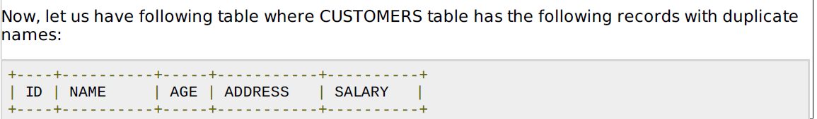
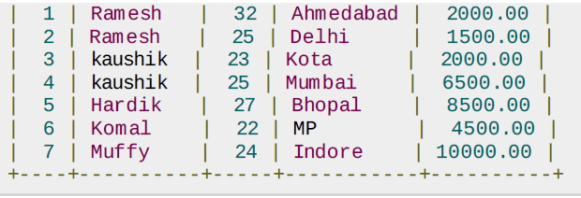
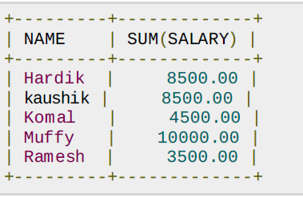

Slide 19
SQL DISTINCT keyword
The SQL DISTINCT keyword is used in conjunction with SELECT statement to eliminate all the duplicate records and fetching only unique records.
There may be a situation when you have multiple duplicate records in a table. While fetching such records, it makes more sense to fetch only unique records instead of fetching duplicate records.

Slide 20
Syntax:
SELECT DISTINCT column1, column2,.....columnN FROM table_name WHERE [condition]

Slide 21
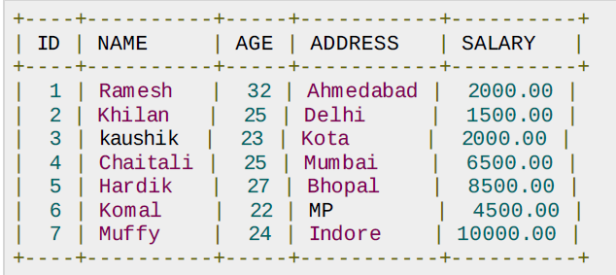

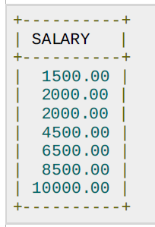

Slide 22
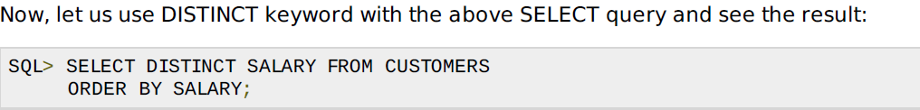

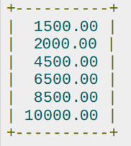

Slide 23
SQL - Constraints
Constraints are the rules enforced on data columns on table.
These are used to limit the type of data that can go into a table.

Slide 24
NOT NULL Constraint: Ensures that a column cannot have NULL value.
DEFAULT Constraint: Provides a default value for a column when none is specified.
UNIQUE Constraint: Ensures that all values in a column are different.
PRIMARY Key: Uniquely identified each rows/records in a database table.

Slide 25
Continued……
FOREIGN Key: Uniquely identified a rows/records in any another database table.
CHECK Constraint: The CHECK constraint ensures that all values in a column satisfy certain conditions.

Slide 26
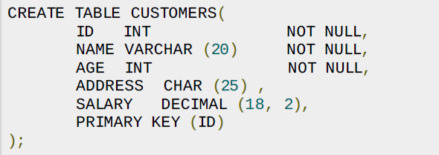
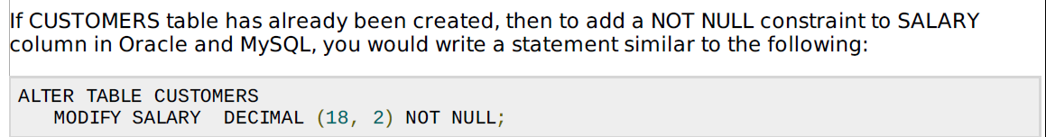
Null constraint

Slide 27
SQL - DEFAULT Constraint
The DEFAULT constraint provides a default value to a column when the INSERT INTO statement does not provide a specific value.

Slide 28
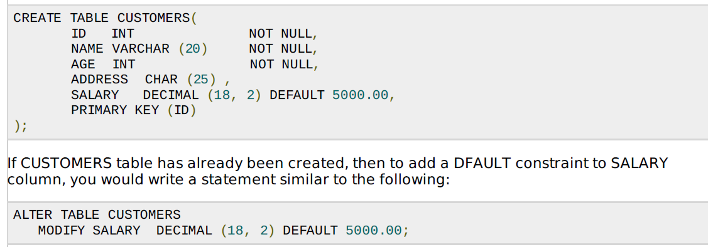

Slide 29
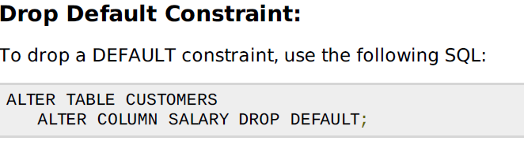

Slide 30
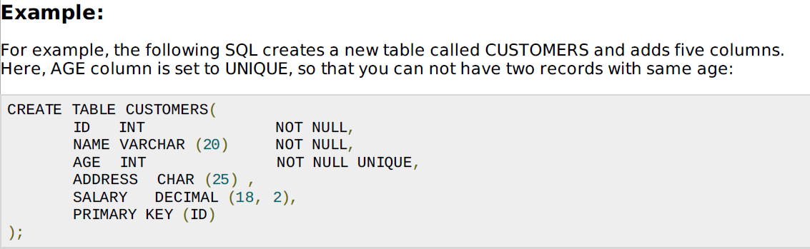
UNIQUE Constraint

Slide 31
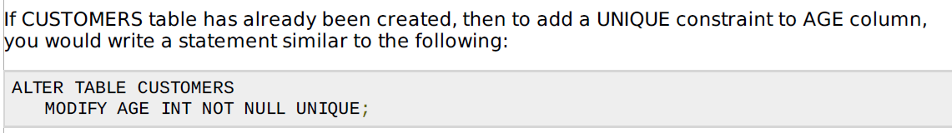
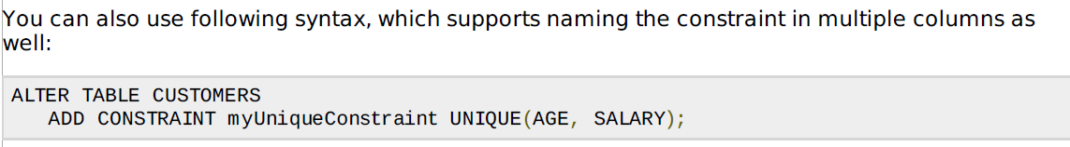
Continued….

Slide 32
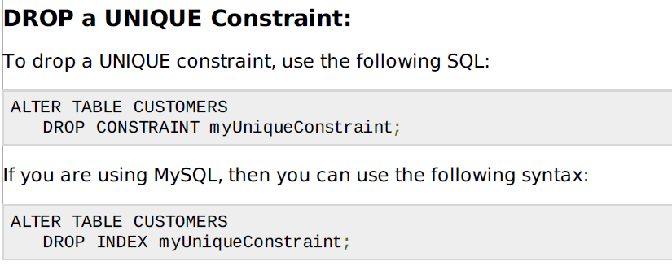

Slide 33
Create Primary Key:
Here is the syntax to define ID attribute as a primary key in a CUSTOMERS table.
CREATE TABLE CUSTOMERS( ID INT NOT NULL, NAME VARCHAR (20) NOT NULL,
AGE INT NOT NULL,
ADDRESS CHAR (25) ,
SALARY DECIMAL (18, 2), PRIMARY KEY (ID) );

Slide 34
To create a PRIMARY KEY constraint on the "ID" column
when CUSTOMERS table already exists, use the
following SQL syntax:
ALTER TABLE CUSTOMER ADD PRIMARY KEY (ID);

Slide 35
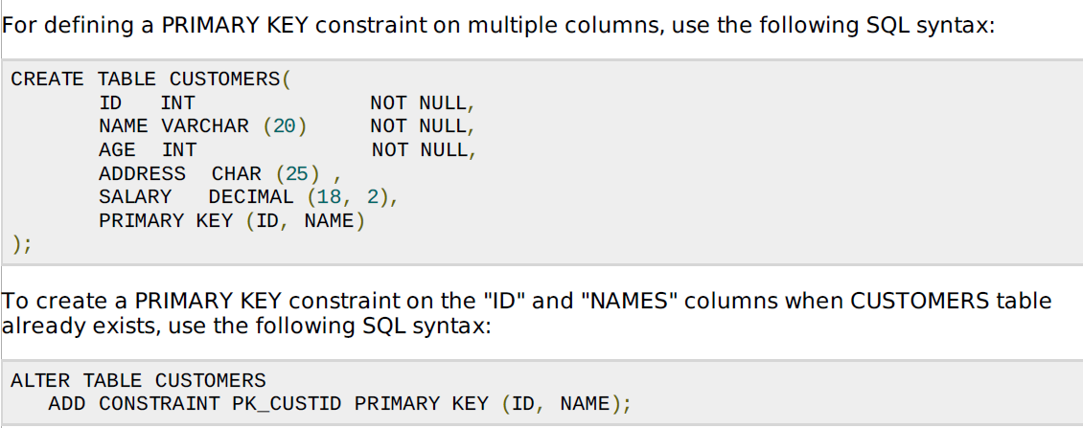

Slide 36
Delete Primary Key:
You can clear the primary key constraints from the table, Use Syntax:
ALTER TABLE CUSTOMERS DROP PRIMARY KEY ;

Slide 37
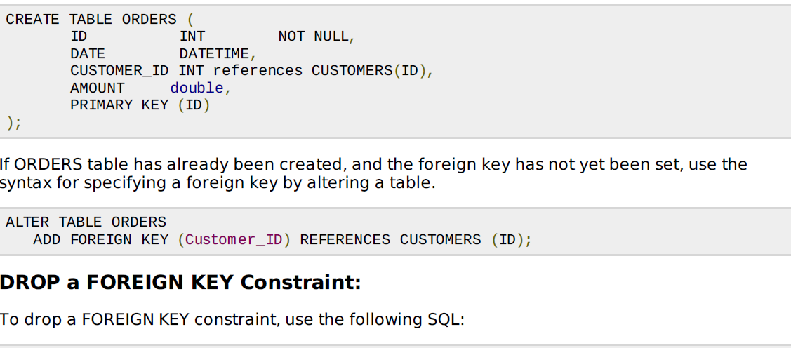
ALTER TABLE ORDERS DROP FORIGN KEY

Slide 38
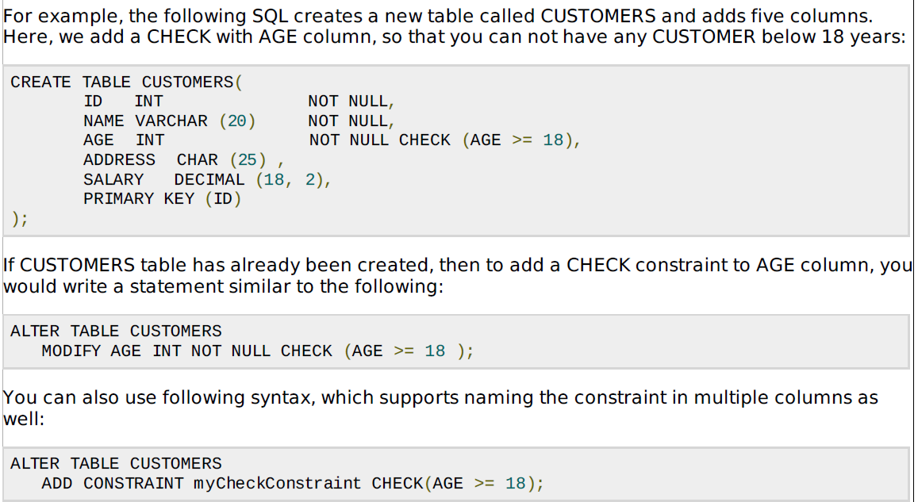

Slide 39
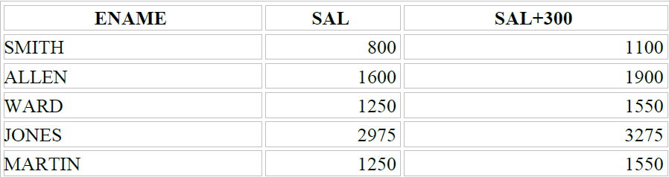
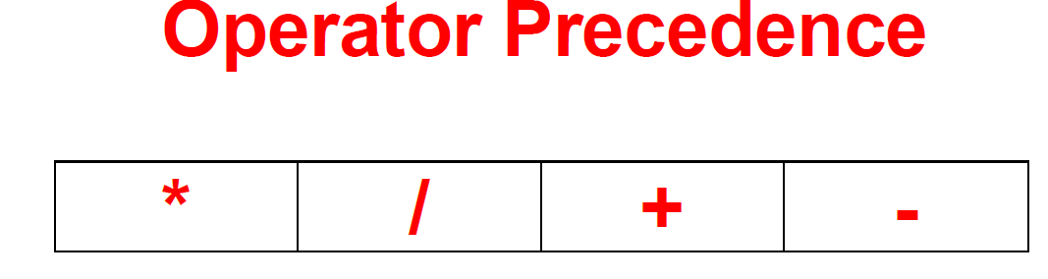
Using Arithmetic Operators
SELECT ename, sal, sal+300 FROM emp;

Slide 40
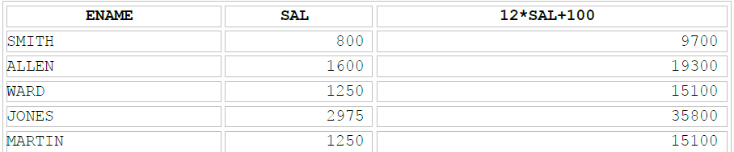
Using operator precedence
SELECT ename, sal, 12 * sal + 100 FROM emp ;

Slide 41
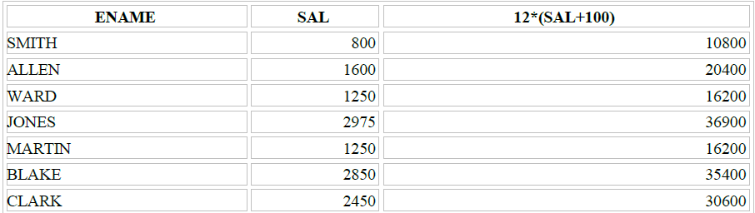
Using Paranthesis
SELECT ename, sal, 12 * (sal + 100) FROM emp;

Slide 42
Null Values in Arithmetic Expressions
Arithmetic expressions containing a null value evaluate to null.
SELECT ename, 12 * sal + comm
FROM emp
WHERE ename ='KING'

Slide 43
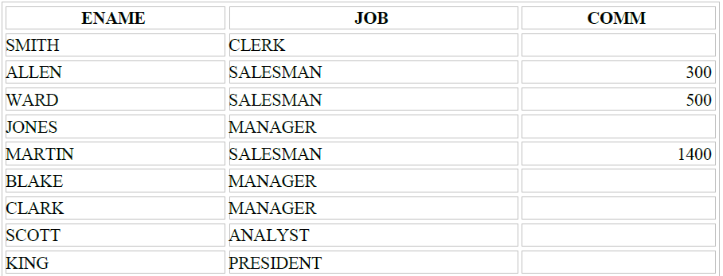
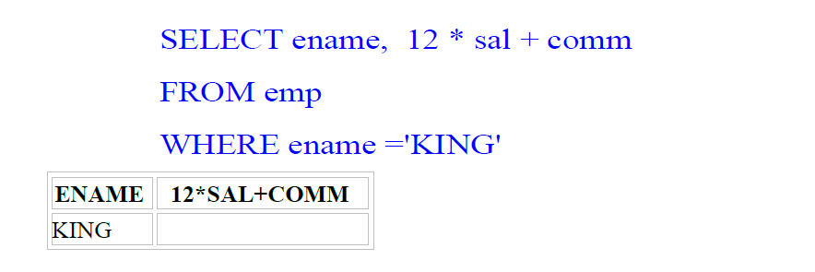

Slide 44
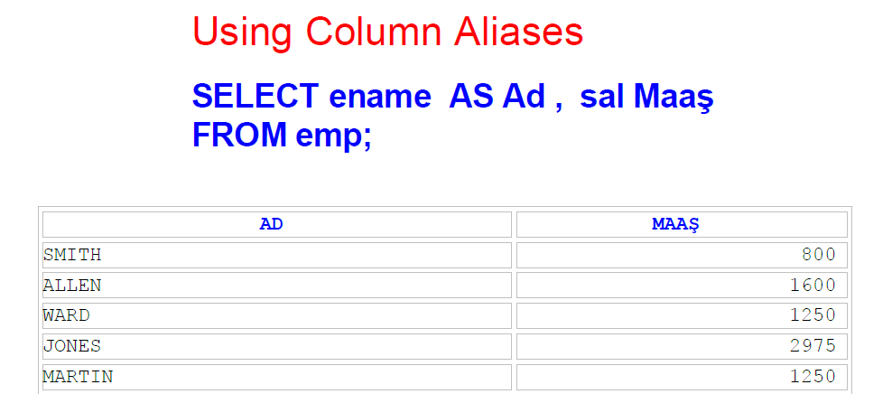

Slide 45
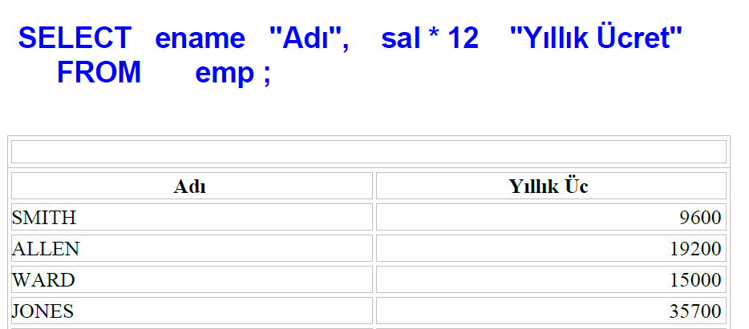

Slide 46
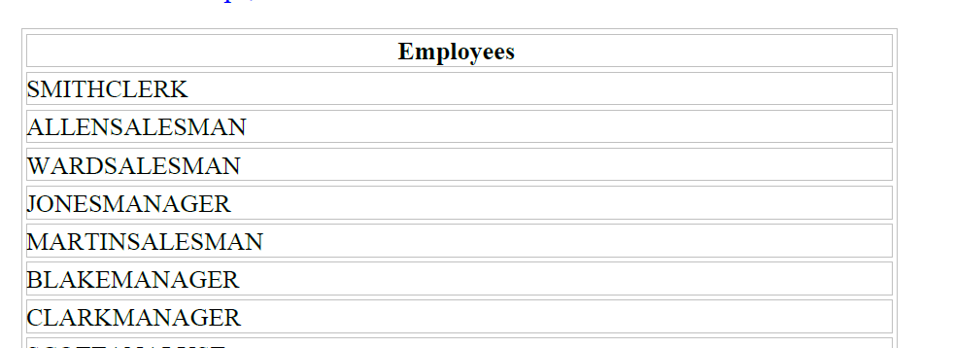
Using the Concatenation Operator
SELECT CONCAT(ename, job) AS Employees FROM emp ;

Slide 47
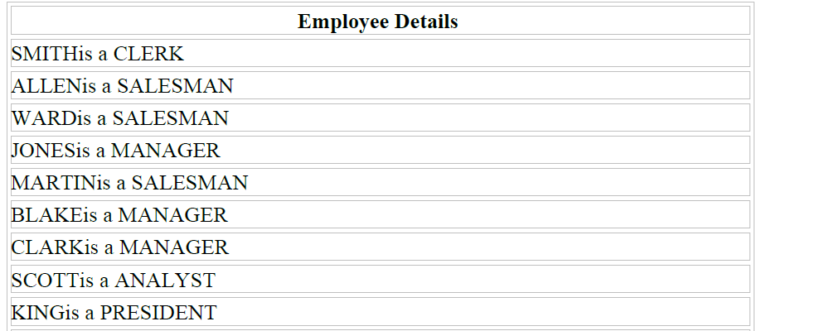
Using Literal Character Strings
SELECT CONCAT(ename 'is a' ' ' job) AS Employee Details FROM emp ;

Slide 48
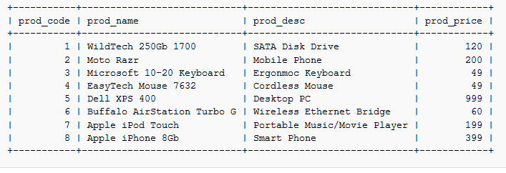
Using the Aggregate Functions

Slide 49
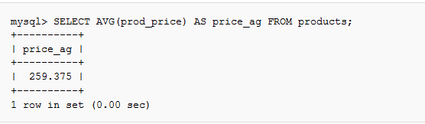
Using AVG() Function

Slide 50
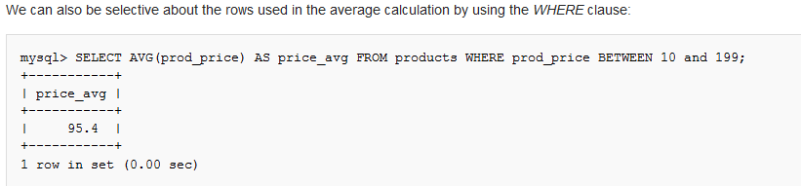
Continued…

Slide 51
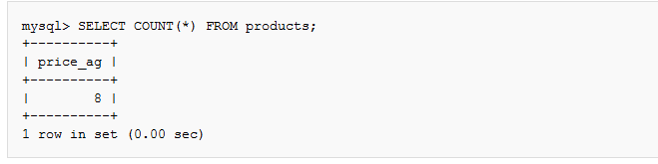
Using COUNT()

Slide 52
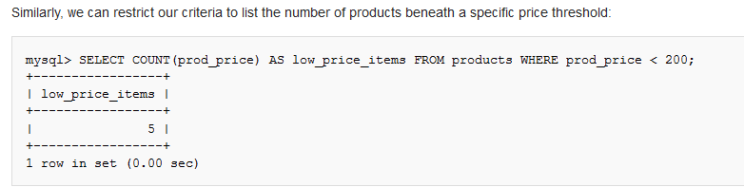
Continued…

Slide 53
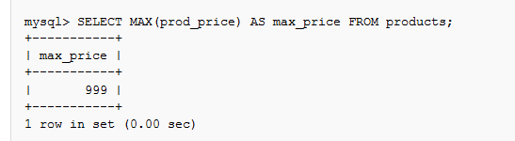
Using MAX()

Slide 54
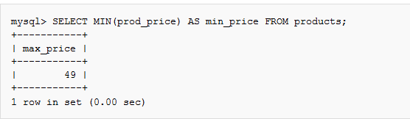
MIN()

Slide 55
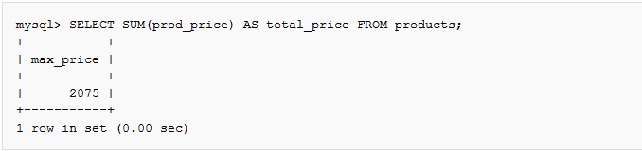
SUM()

Slide 56

Using Multiple Aggregate Functions

