Slide 1

PS Id. - NM372-ISRO
Team No.: T20
Team Name: Wildhunt
Team Leader: Chetan Agarwal
Team Members: Shubham Agrawal, Chaitany Pandiya,
Siddharth Singh, Madhumitha Nara,
Harsh Prakash Gupta

Slide 2
Table of contents
Dataset Analysis
Multispectral and Multitemporal
NDVI
Image Processing
Results
Conclusions and Future Work

Slide 3
What is our dataset?
Our dataset is 48 multispectral and multi-temporal images that are captured through AWiFS(The Advanced Wide Field Sensor). It has two images for every month from Jan 2017 to Dec 2018. One image of each month represents NIR(Near Infrared) and the other RED.

Slide 4
What is multispectral and multitemporal?
Multispectral images are involved in many regions of electromagnetic spectrum.
Multitemporal data refers to time series data of some component.

Slide 5
What is NDVI ?
Normalized Difference Vegetation Index (NDVI) quantifies vegetation by measuring the difference between near-infrared (which vegetation strongly reflects) and red light (which vegetation absorbs). NDVI always ranges from -1 to +1.
When you have negative values, it’s highly likely that it’s water. On the other hand, if you have a NDVI value close to +1, there’s a high possibility that it’s dense green leaves. But when NDVI is close to zero, there isn’t green leaves and it could even be an urbanized area.

Slide 6
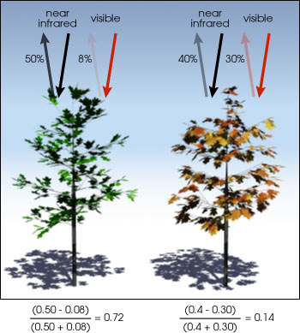
How do you calculate NDVI ?
Normalized Difference Vegetation Index (NDVI) uses the NIR and red channels in its formula.
NDVI = (NIR - Red)/(NIR + Red)
Healthy vegetation (chlorophyll) reflects more near-infrared (NIR) and green light compared to other wavelengths. But it absorbs more red and blue light.
This is why our eyes see vegetation as the color green. If you could see near-infrared, then it would be strong for vegetation too.

Slide 7

Image Processing Implemented
A new NDVI image (.tiff file) was generated for every month using the formula,
for each pixel of the image.

Slide 8
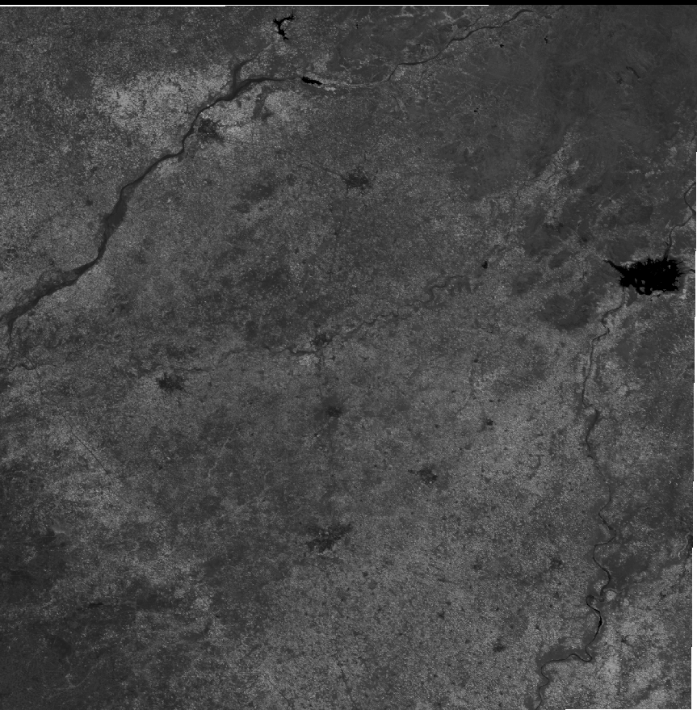
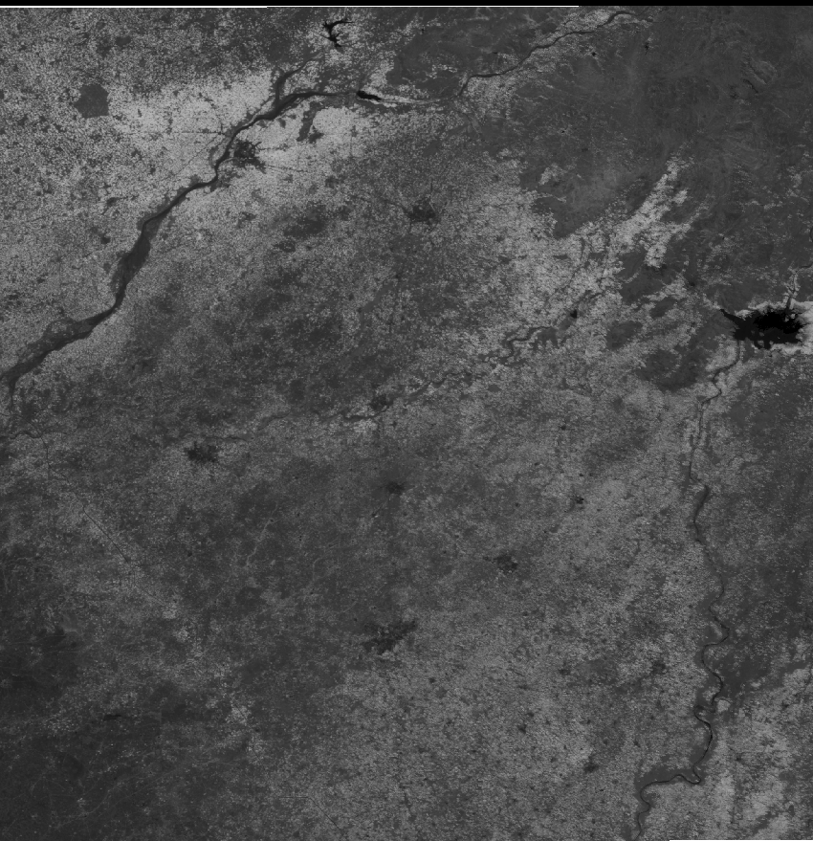
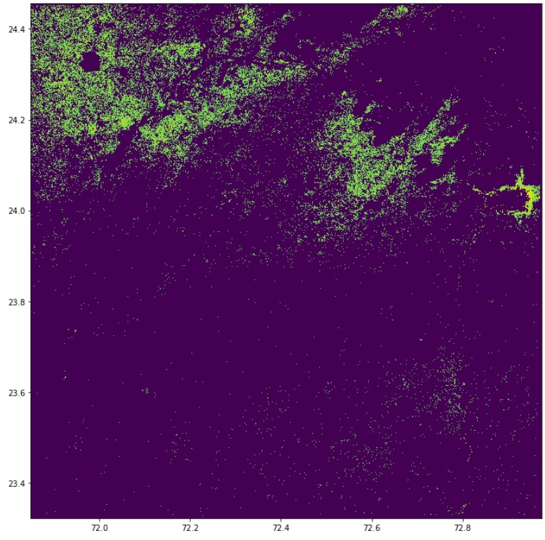
Image Processing Example (April 2017)
Red
Near IR

Slide 9
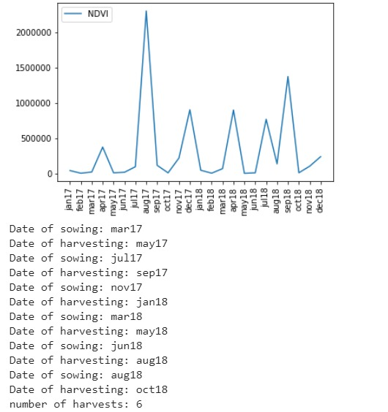
NDVI Deviations & Information Extraction

Slide 10
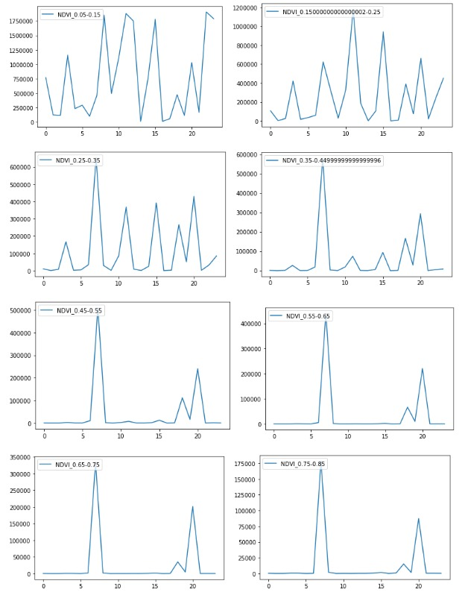
Variation of pixel counts wrt to NDVI values per month
X-axis: Month (numbered 1-24)
Y-axis: Pixel Count of given NDVI at specific month.

Slide 11
Estimated NDVI values of Different Seasonal Crops
 | NDVI |  |  | EVI2
 | Kharif | Rabi | Zaid | Kharif | Rabi | Zaid
Min | 0.45 | 0.23 | 0.32 | 0.84 | 0.37 | 0.49
Max | 0.62 | 0.45 | 0.57 | 1.22 | 0.7 | 0.98
Mean | 0.52 | 0.34 | 0.45 | 1.07 | 0.58 | 0.75

Slide 12
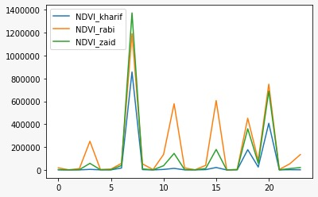
Seasonal Crop Division
 | Season Starts | Harvest
Kharif | June | November
Rabi | November | March
Zaid | August-September (or) February-March | December-January (or) April-May

Slide 13
Conclusions and Future Work
What we achieved
Processed images to evaluate NDVI and EVI2 for each month
Time series analysis to determine date of sowing and harvest
Innovation: Classified vegetation as Kharif, Rabi and Zaid
Innovation: NDVI values to visualize growth rate of crops
Future Work
Gaussian Filter to normalize and smoothen plots
Disease and Pest Control
Rainfall Detection and Prediction

Slide 14
Thank you.

Slide 15


