Slide 1
Digital Portfolio
STUDENT NAME: Madhumitha S
REGISTER NO AND NMID:24131210500122021 AND asanm121anm12124213021
DEPARTMENT: BCA
COLLEGE: Immaculate college for women / Annamalai university

Slide 2
PROJECT TITLE
Student Portfolio developed with HTML, CSS and JavaScript

Slide 3


AGENDA
Problem Statement
Project Overview
End Users
Tools and Technologies
Portfolio design and Layout
Features and Functionality
Results and Screenshots
Conclusion
Github Link
3/21/2024 Annual Review

Slide 4

The lack of a personalized platform to showcase academic achievements, skills, and projects creates a challenge for students during internships, job applications, and academic evaluations. Traditional resumes provide limited interactivity and fail to demonstrate technical skills effectively. Hence, a digital portfolio is required to present information in a structured, engaging, and accessible format.
PROBLEM STATEMENT

Slide 5

This project focuses on creating a responsive student portfolio website using HTML, CSS, and JavaScript. The portfolio is designed to professionally showcase personal information, academic qualifications, and skills. The main goal is to develop a visually engaging, user-friendly, and device-responsive platform.
Project Overview

Slide 6

• Students – to showcase their academic and technical profile • Recruiters – to evaluate student skills, achievements, and projects • Faculty – to assess student progress and provide academic references • General Audience – to gain an overview of the student’s background and expertise
End Users

Slide 7

• HTML – for content structure. • CSS – for styling and layout. • JavaScript – for interactivity and dynamic features. • CodePen – as the development environment. • GitHub – for version control and deployment
Tools and Technologies

Slide 8
Portfolio design and Layout
The portfolio features a clean, minimalist design to emphasize clarity and professionalism.
It includes a homepage with a personal introduction, along with dedicated sections for academic background, skills, and a contact page.
The responsive layout ensures optimal accessibility on both desktop and mobile devices while maintaining consistent visual aesthetics.
8

Slide 9
Features and Functionality
Clearly defined sections for About Me, Education, Skills, and Resume.
A contact form with link integration for easy communication.
GitHub integration to display and access project repositories.
A user-friendly interface featuring clean typography and an organized layout.

Slide 10
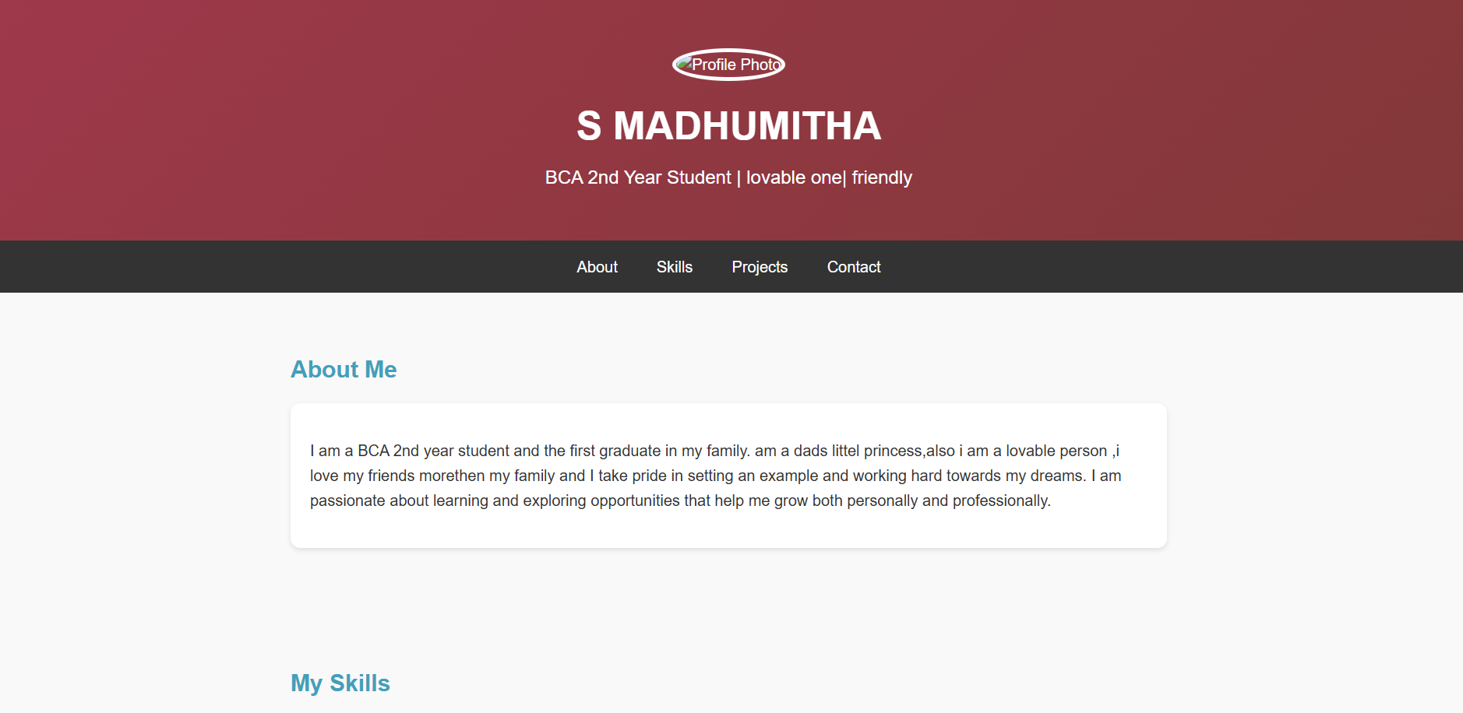

RESULTS AND SCREENSHOTS
3/21/2024 Annual Review
10

Slide 11
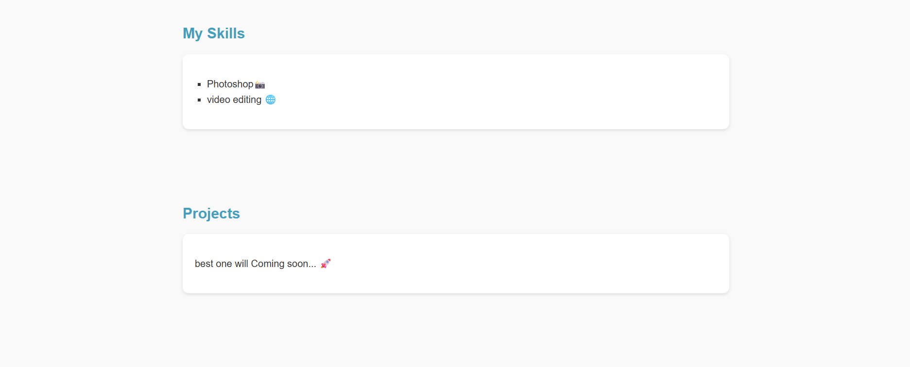
RESULTS AND SCREENSHOTS
3/21/2024 Annual Review
11

Slide 12
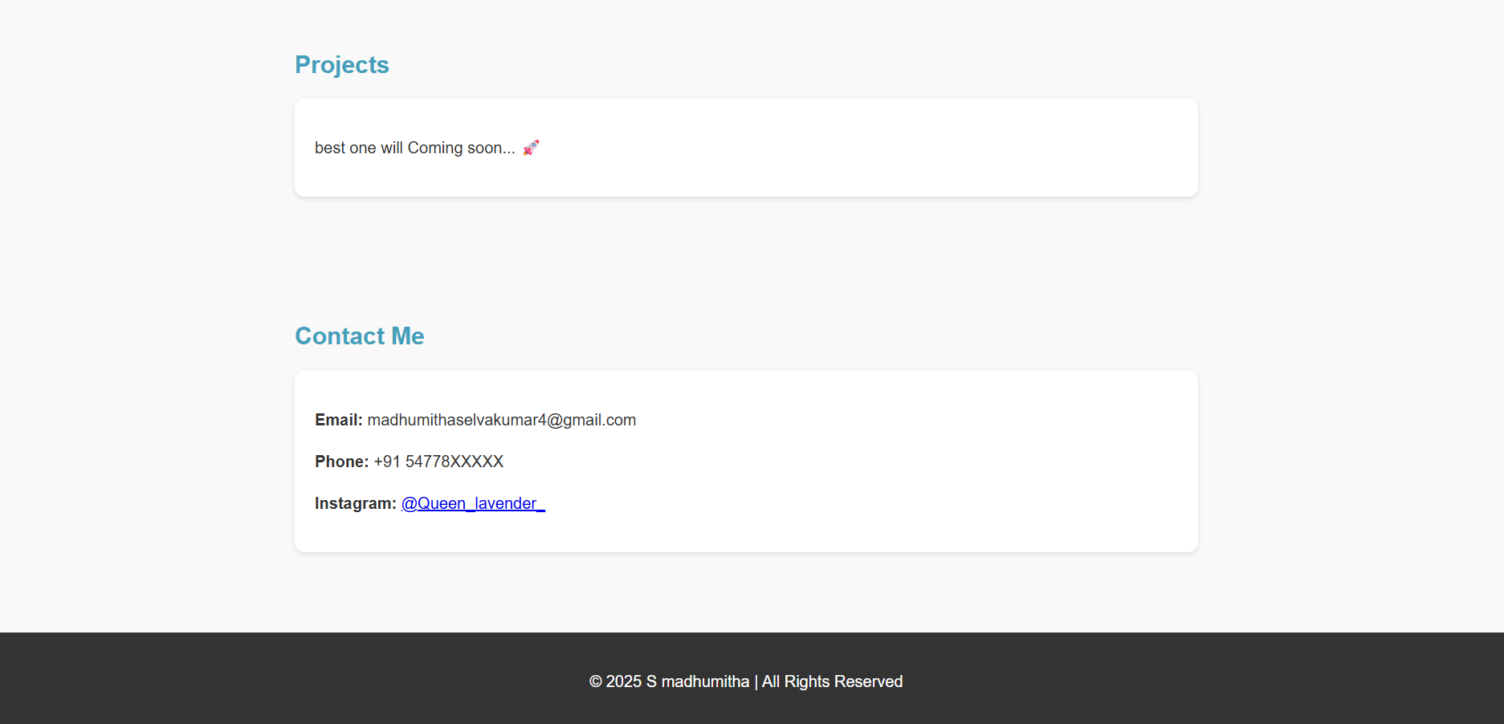
RESULTS AND SCREENSHOTS
3/21/2024 Annual Review
12

Slide 13
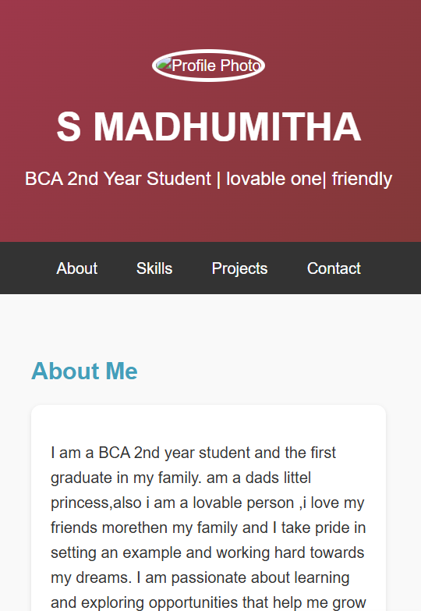
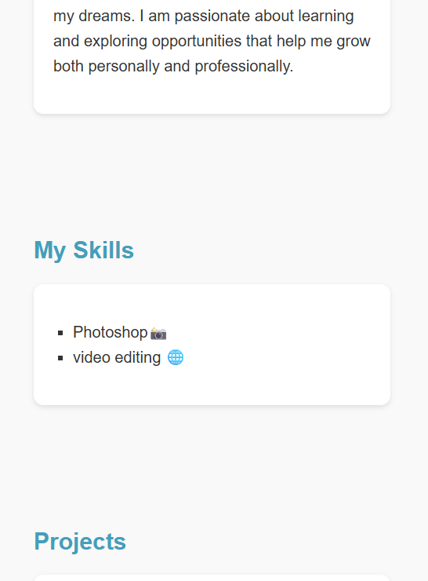
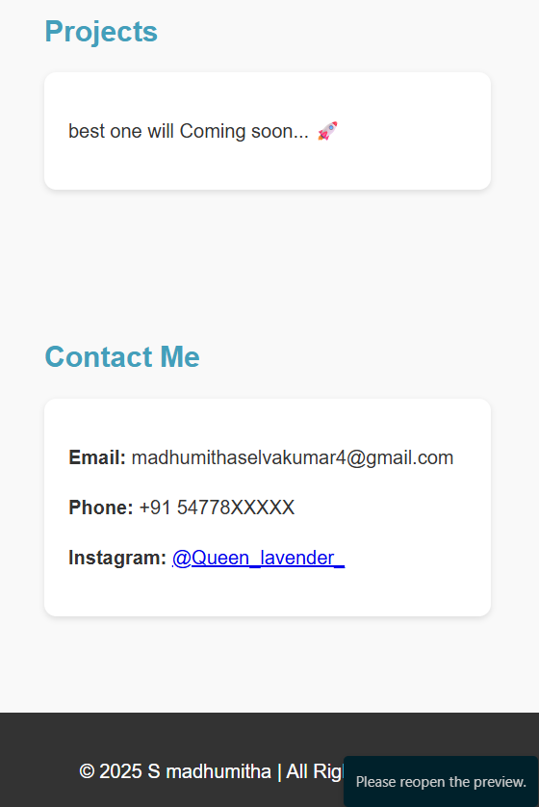
RESULTS AND SCREENSHOTS
3/21/2024 Annual Review
13

Slide 14
The portfolio website successfully addresses the limitations of traditional resumes by providing an interactive, accessible, and professional platform to represent academic and technical accomplishments. It serves as a valuable tool for students to enhance their digital presence and for recruiters to evaluate candidates effectively.
Conclusion
14

