Slide 1

Predictive Maintenance using Machine Learning
B.Tech Internship Project — Week 1 & Week 2 Progress Report
INTERNSHIP PROJECT
WEEKS 1–2

Slide 2

What is Predictive Maintenance?
Predictive maintenance uses historical and real-time sensor data to anticipate equipment failures before they occur, shifting from reactive repairs to proactive intervention.
The Problem
The Approach
Unexpected machine breakdowns cause costly downtime, safety risks, and production losses.
Machine learning models analyze sensor data patterns to detect early warning signs of failure.
The Goal
Reduce unplanned downtime by predicting equipment failure with high accuracy in advance.

Slide 3


Problem Statement
The Challenge
Industries lose significant revenue each year due to unexpected machine failures. Traditional maintenance schedules are either too frequent (costly) or too late (damaging).
Unplanned Downtime
Data Is Underutilized
Need for ML-Based Solution
Machines fail without warning, halting production lines and causing revenue loss.
Sensor data exists but is rarely leveraged for proactive failure prediction.
A data-driven model can learn from historical patterns to forecast failures early.

Slide 4
Project Objectives
This project aims to build an end-to-end machine learning pipeline that transforms raw sensor data into actionable failure predictions.
01
02
Understand & Explore the Data
Preprocess & Engineer Features
Collect and thoroughly analyze machine sensor datasets to understand feature distributions and data quality.
Clean, encode, and scale the data to prepare it for effective model training.
03
04
Build & Evaluate ML Models
Deliver Actionable Predictions
Train multiple classifiers and evaluate their ability to predict equipment failure accurately.
Produce a reliable model that can forecast failures in advance, enabling timely maintenance decisions.

Slide 5
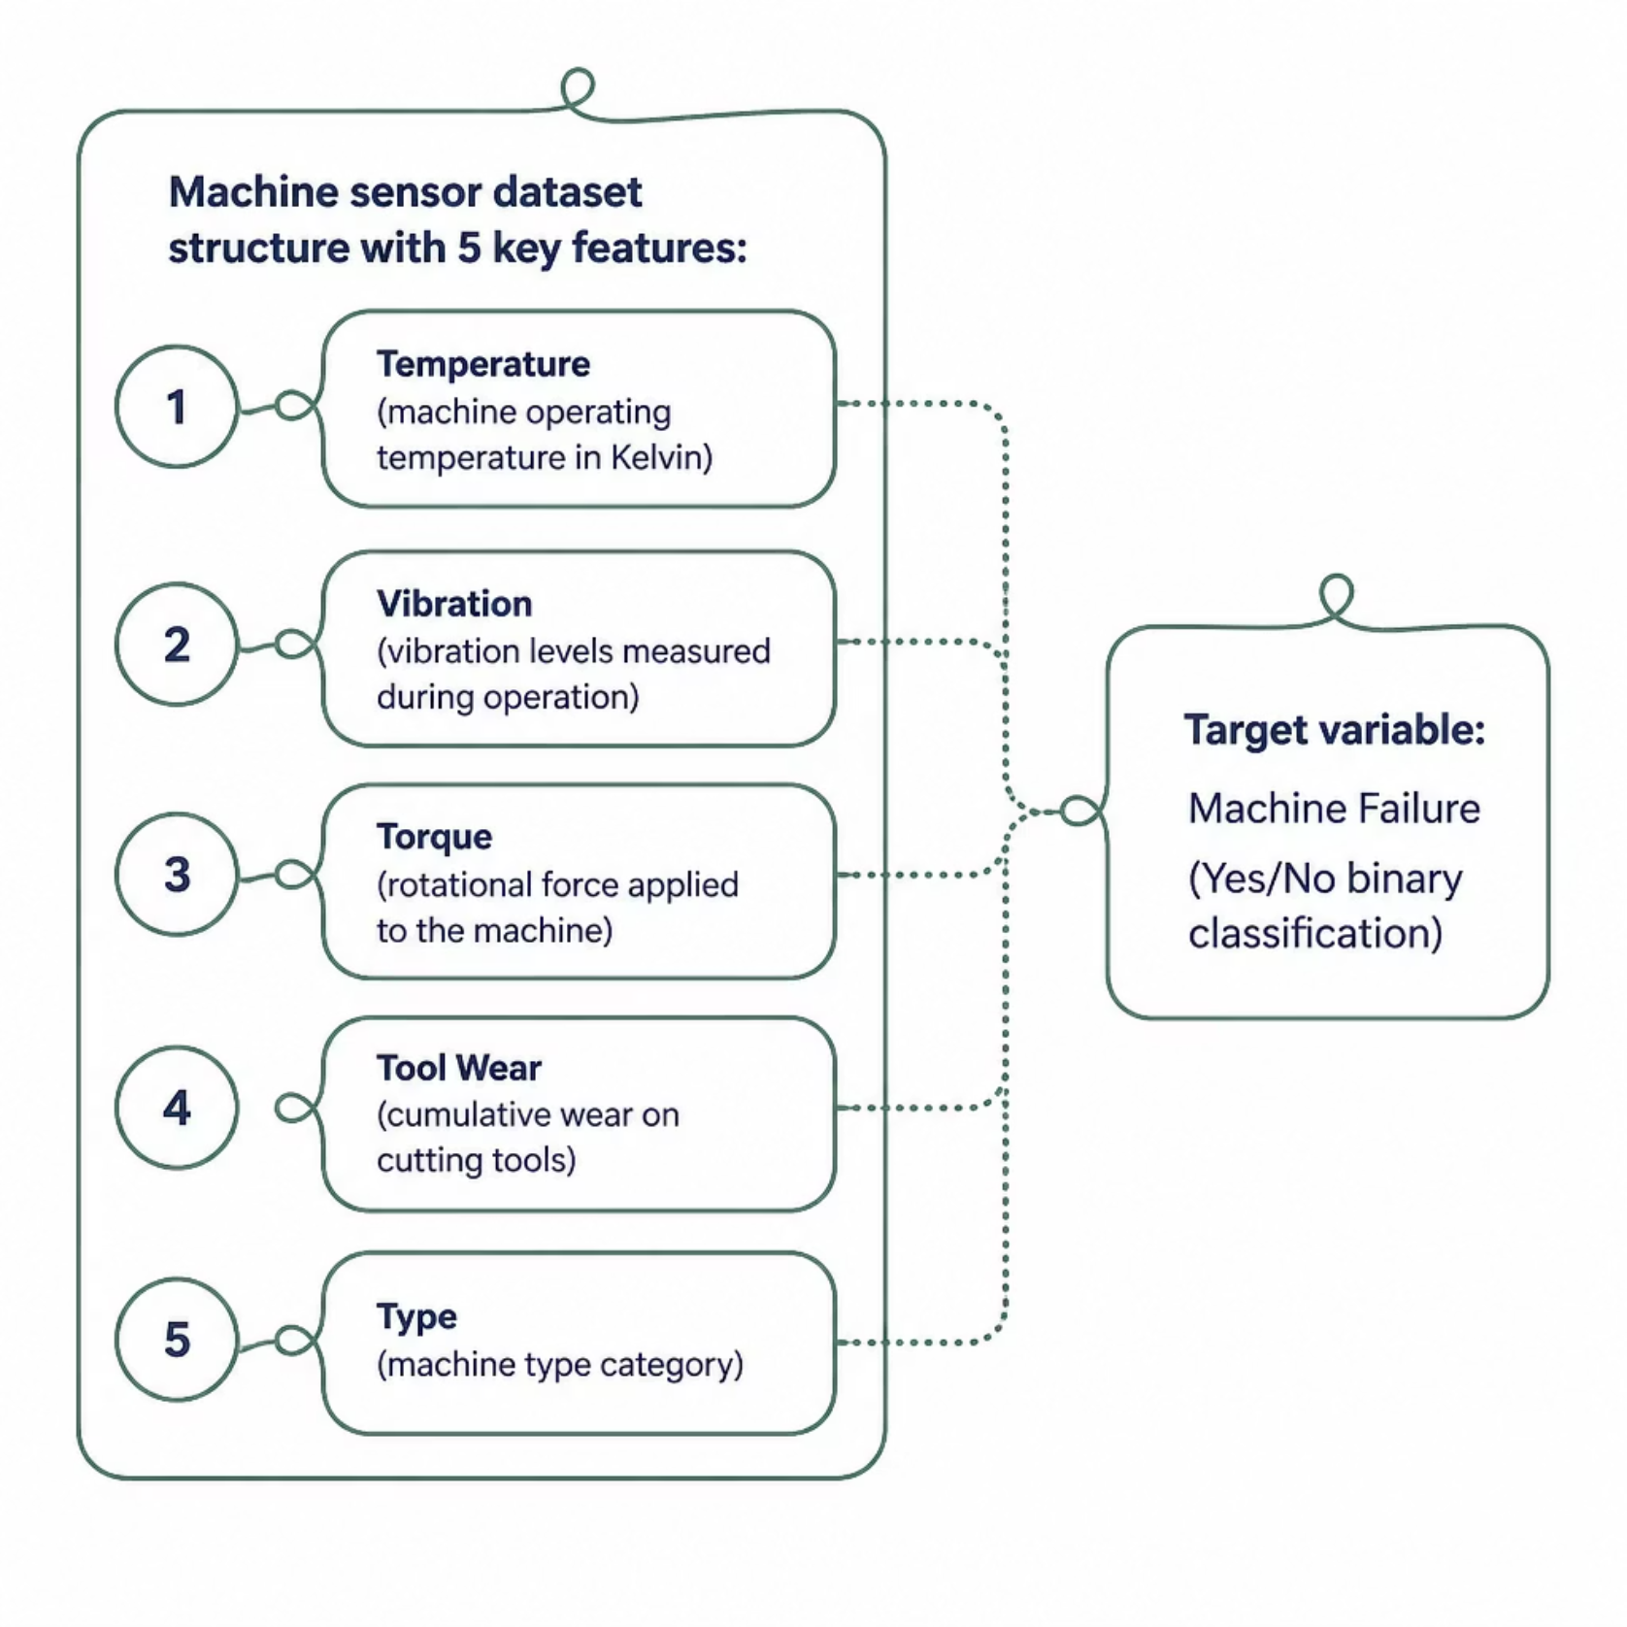
Dataset Overview
Dataset at a Glance
The dataset contains real-world machine sensor readings collected during normal and failure conditions, designed for binary classification of equipment failure.
Input Features
Target Variable
Data Type
Temperature, Vibration, Torque, Tool Wear, Machine Type
Binary label: Machine Failure (Yes / No)
Tabular sensor data with numeric and categorical columns

Slide 6





Week 1 — Work Completed
Problem Definition
Understood project scope, reviewed literature on predictive maintenance, and formalized the problem statement.
Data Collection
Sourced the machine sensor dataset and loaded it into the analysis environment for initial inspection.
Data Cleaning
Performed basic cleaning — checked for nulls, duplicates, and verified data types across all columns.
EDA Started
Began exploratory data analysis to understand feature distributions, correlations, and class imbalance.

Slide 7

Week 1 — Key Insights from EDA
What the Data Revealed
Initial exploration uncovered important characteristics of the dataset that will guide preprocessing and modeling decisions.
Data Quality
Feature Distributions
Class Imbalance
Minimal missing values detected; data types were validated and corrected where necessary.
Temperature and torque showed normal distributions; tool wear was right-skewed, indicating progressive degradation patterns.
Failure events are rare — the dataset is imbalanced, which will require special handling during model training.

Slide 8
Week 2 — Preprocessing & Initial Modeling
Preprocessing Pipeline
01
02
Categorical Encoding
Feature Scaling
Machine type and other categorical features were one-hot encoded for model compatibility.
Numeric features were standardized to ensure equal contribution across all variables.
03
04
Train-Test Split
Baseline Models
Data was split 80/20 to enable unbiased evaluation of model performance.
Logistic Regression and Decision Tree classifiers were trained and evaluated on initial accuracy.

Slide 9





Tools & Technologies Used
The project leverages a modern Python-based data science stack for data manipulation, visualization, and machine learning.
Python
Pandas & NumPy
Scikit-learn
Core programming language for all data processing and modeling tasks.
Data manipulation, transformation, and numerical computation.
ML algorithms, preprocessing utilities, and model evaluation metrics.
Matplotlib & Seaborn
Jupyter Notebook
Statistical visualizations and exploratory data analysis plots.
Interactive development environment for iterative experimentation and reporting.

Slide 10


Summary & Next Steps
✅ Week 1 Complete
✅ Week 2 Complete
Problem defined, dataset explored, EDA completed, and class imbalance identified.
Preprocessing pipeline built, baseline models trained, and initial accuracy evaluated.
🔜 Coming Up
Hyperparameter tuning, handling class imbalance, advanced models (Random Forest, XGBoost), and detailed evaluation.
Questions and feedback are welcome. Thank you for your time and attention!

