Slide 1
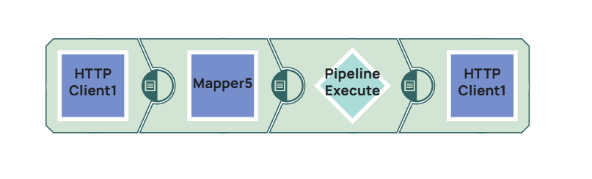
Overall Architecture
Parent Pipeline orchestrates batch
Child Pipeline handles encryption
KMS provides keys
Notes:
Explain high-level architecture

Slide 2
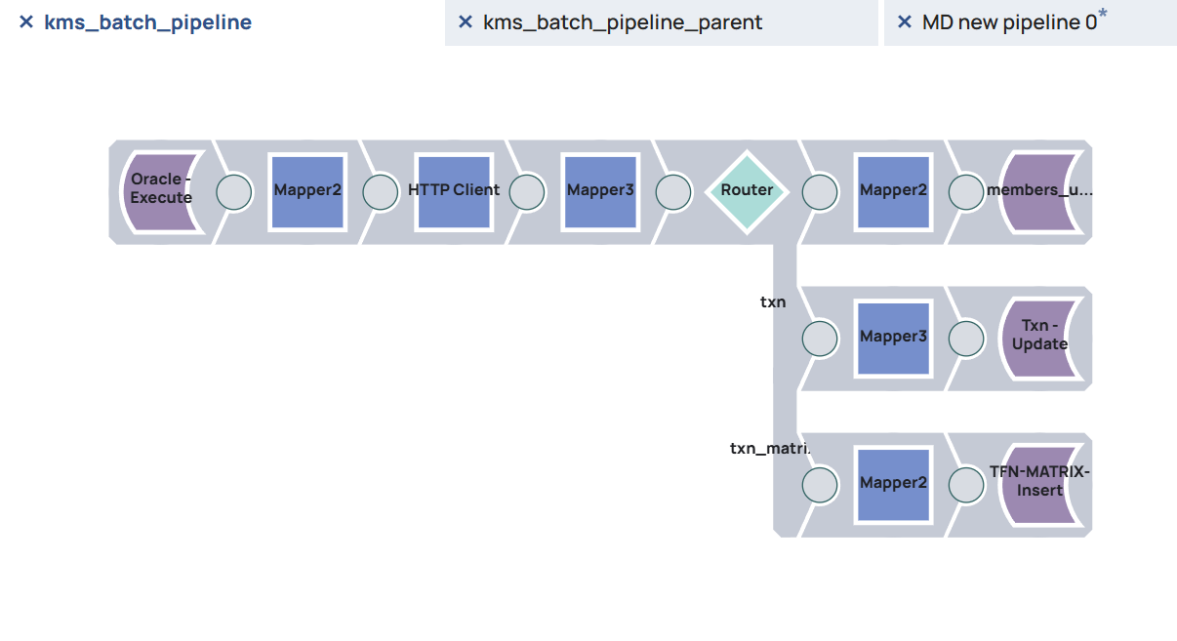
Child Pipeline Execution
Pipeline Execute Snap calls child
KeyId passed as parameter
Batch controlled execution
Notes:
Explain how child pipeline is triggered

Slide 3
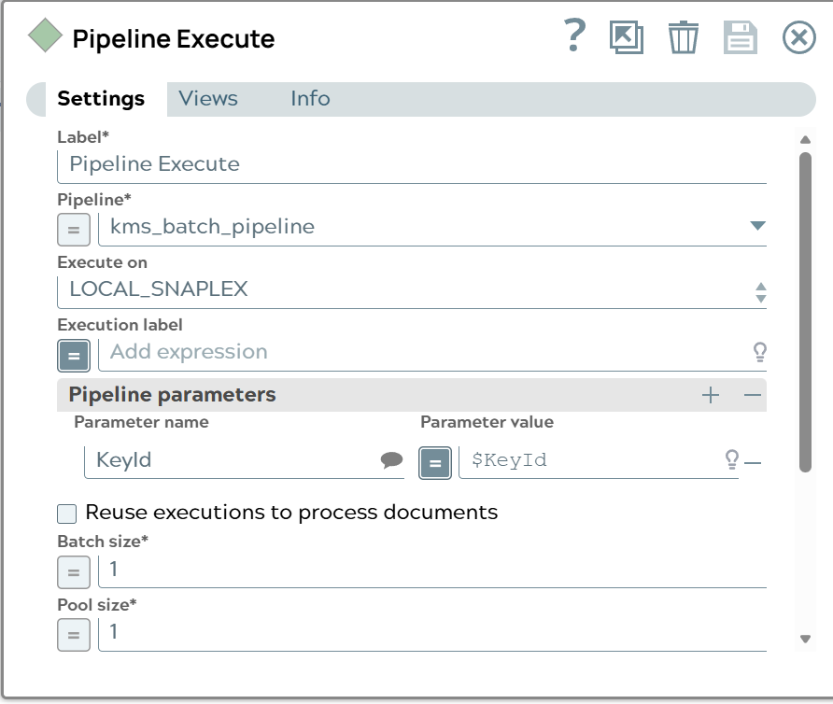
Passing KeyId
KeyId passed using pipeline parameters
Ensures consistent encryption key
Notes:
Critical for deterministic encryption

Slide 4
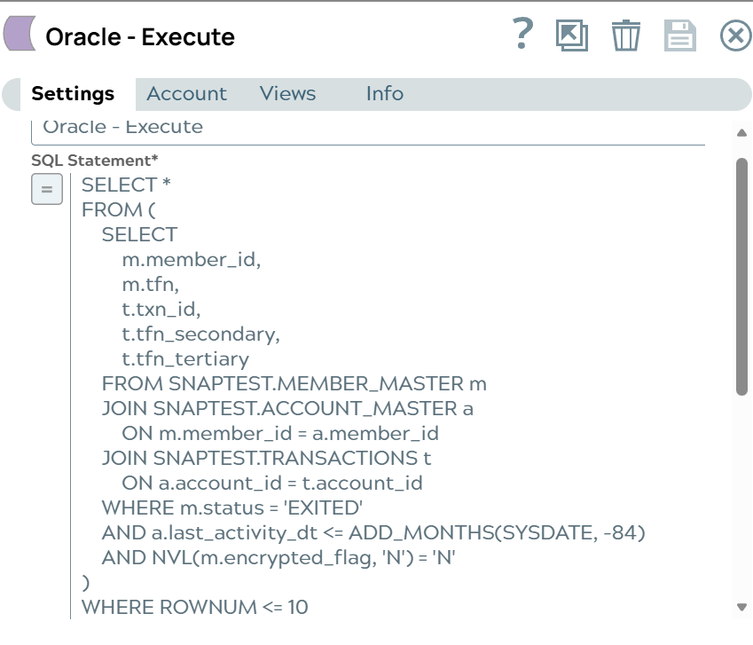
Oracle Data Fetch
Fetch member + transaction data
Filter eligible records
Notes:
Explain SQL logic

Slide 5
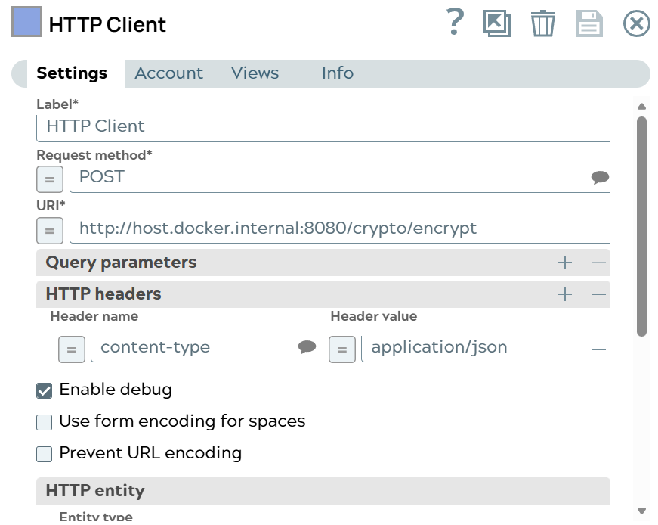
HTTP Encryption Call
POST /crypto/encrypt
JSON payload with TFNs
Notes:
Explain REST call structure

Slide 6
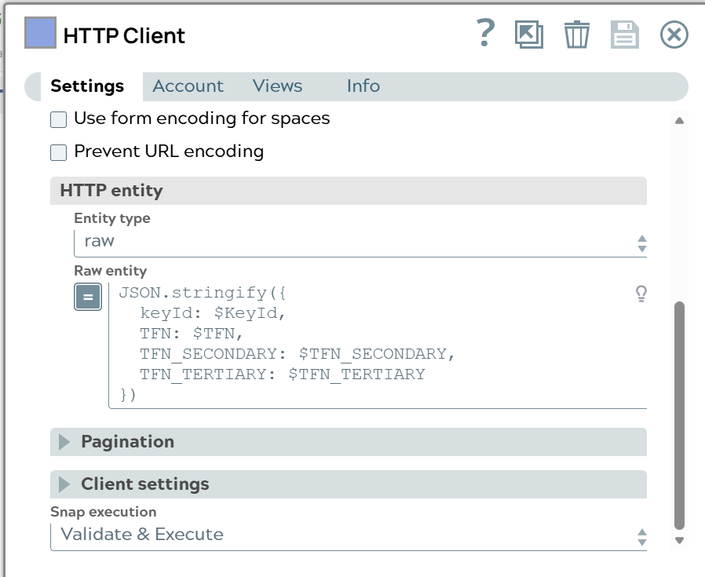
HTTP Payload
keyId + TFN fields
Format preserved encryption
Notes:
Show request body

Slide 7
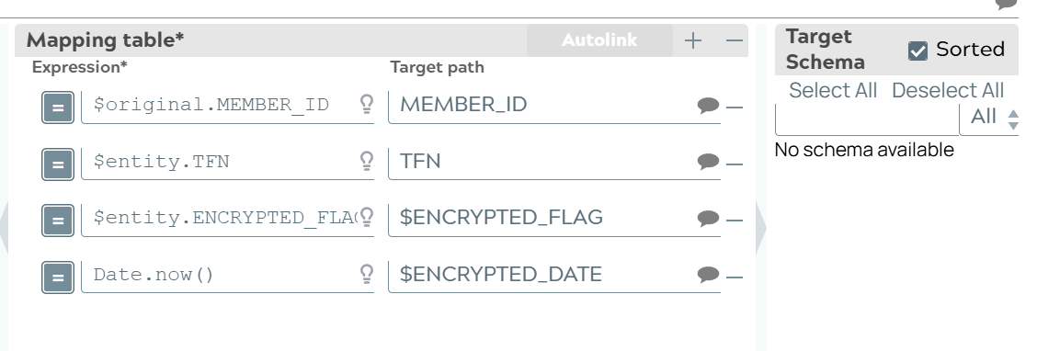
Mapper Transformation
Maps encrypted values
Prepares DB updates
Notes:
Explain mapping

Slide 8
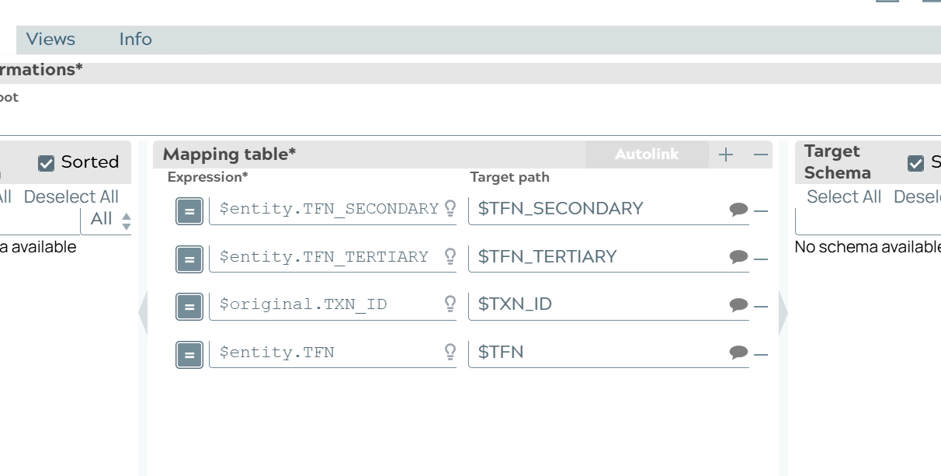
Transaction Update
Updates transaction table
Stores encrypted TFNs
Notes:
Explain txn update

Slide 9
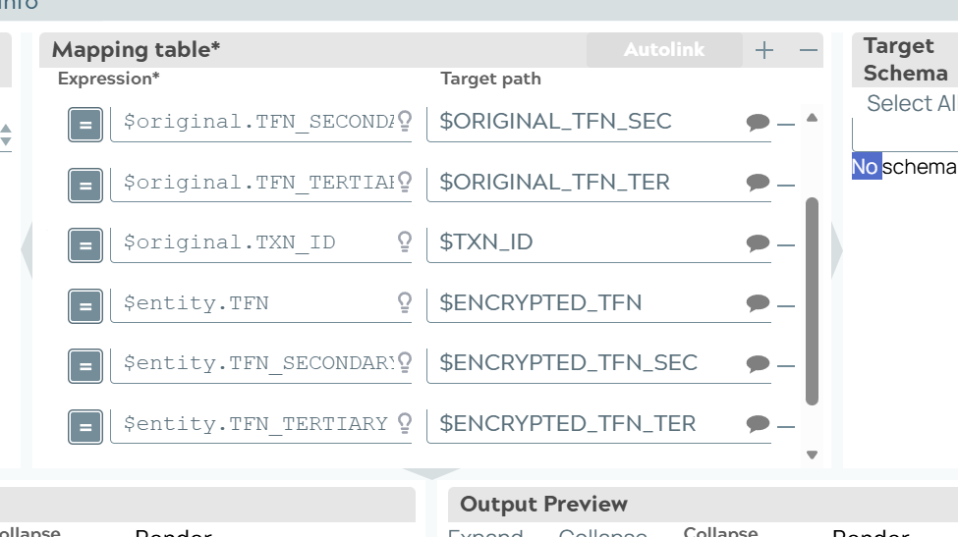
Matrix Insert
Stores original + encrypted values
Audit trail
Notes:
Explain matrix table

Slide 10
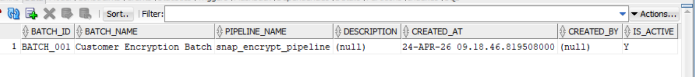
Batch Tables
Batch Master
Batch Run
Key Registry
Notes:
Explain tracking

Slide 11
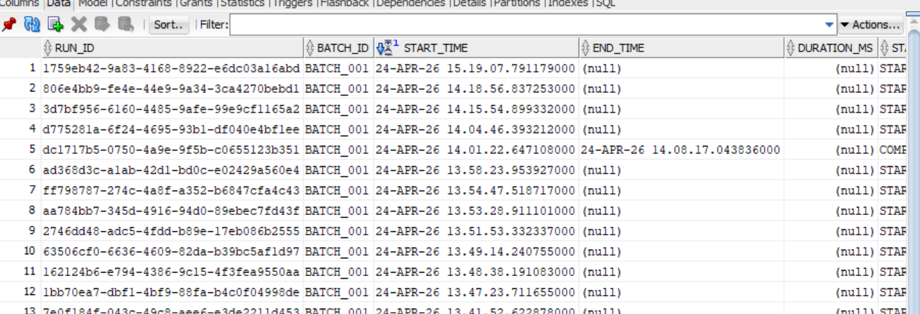
Batch Run Tracking
Tracks execution status
Start & End timestamps
Notes:
Explain lifecycle

Slide 12
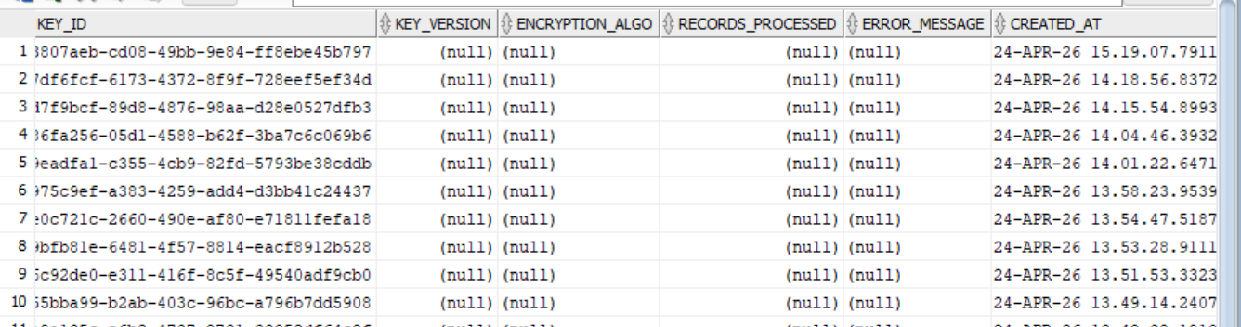
Key Registry
Stores encrypted keys
Used by KMS
Notes:
Explain key storage

Slide 13
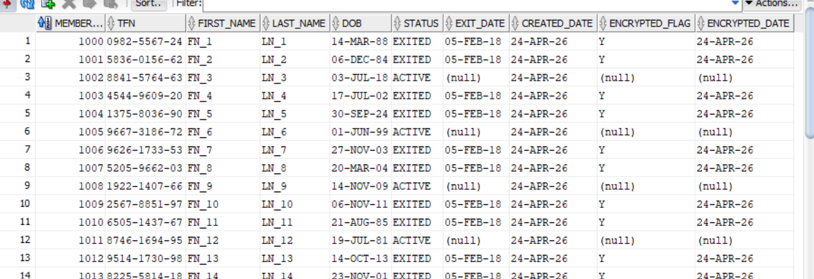
Member Master Update
Updates encrypted flag
Stores encrypted TFN
Notes:
Explain member table

Slide 14
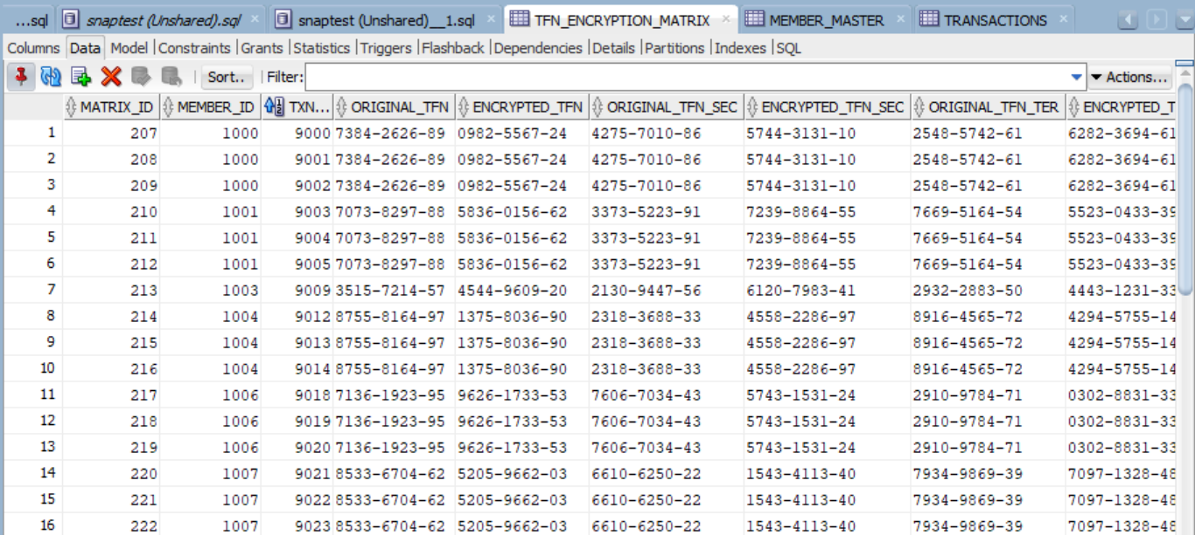
TFN Matrix Data
Original vs Encrypted TFNs
Notes:
Show actual data

