Slide 1
Loan approval analysis for Lending Club
Case Study By Jayshree and madhu

Slide 2
Problem Statement
Analyze a real Business Problem using EDA
The lending club lends money to borrower when it receives a loan application
The Company needs to make decision based on user's profile.
There are two type of risk:
The User may pay
The User may not pay
We need to Analyze variables from given the dataset and find the driving variable to make right decision on weather to approve the loan application or not.

Slide 3
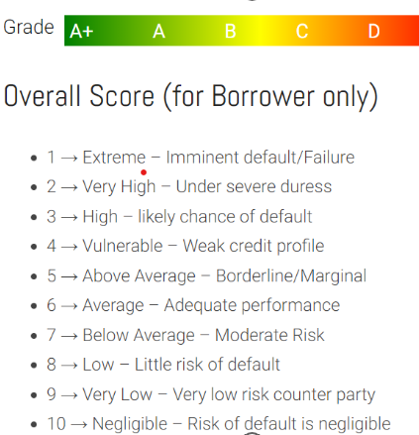
Assumptions
As per given records, analysis will be done only on the basis of Loan Status “Fully Paid” and “Charged off”.
Loan status with value “Current” are running loans and it is not possible to identify if the borrower will pay the loan or not; hence it is not a good idea to include this data.
On the basis of data given it is also identified that some of the columns are not at all useful/having null records/same records/ very less records. Hence all those columns will be dropped during the process
If columns having maximum correlation, then one of the column will be dropped off
For analyzing data on the basis of grades/subgrades , website https://www.marlo.online/loan-grades has been referred
Grade and Subgrade Scale

Slide 4
DATA Cleanup and splitting dataset
Initially there were 111 Columns. Dataset: ‘df’
Below Columns has been deleted:
In which almost 55 columns had 80-90% of Null values.
Columns related to Customer behavior is deleted as it reflect only after approving loans.
Rows containing loan_status= Current.
After all cleanups we left with 25 Columns, in data set: ‘df_noncurrent’
Two new dataset created for more deeper analysis
Data splitted on loan status 1. for fully paid: ‘df_fully_paid’ 2.for Charged off: ‘df_charged_off’.

Slide 5
Data Analysis

Slide 6
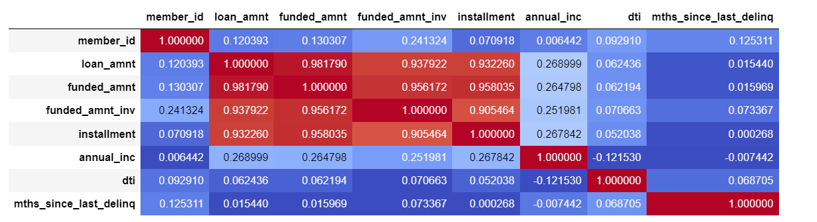
Analysis 1: Data correlation
After data clean up , following is the correlation of data:
Looking at above correlation data we can see, 1. strong correlation between funded_amnt and funded_amnt_inv and 2. Negative correlation between dti and annual inc

Slide 7
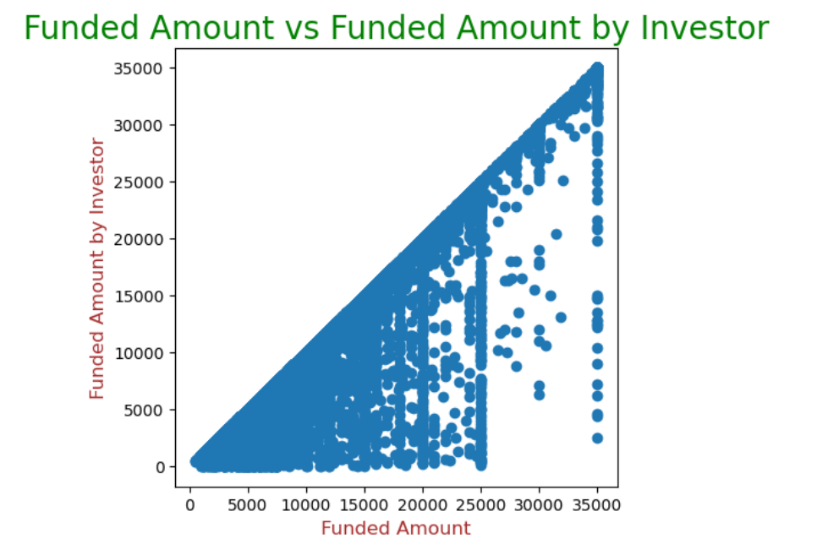
Analysis 2: Direct proportion on funded amount
Funded amount by investor is directly proportion with Funded amount by lending club, hence one of the columns can be removed

Slide 8
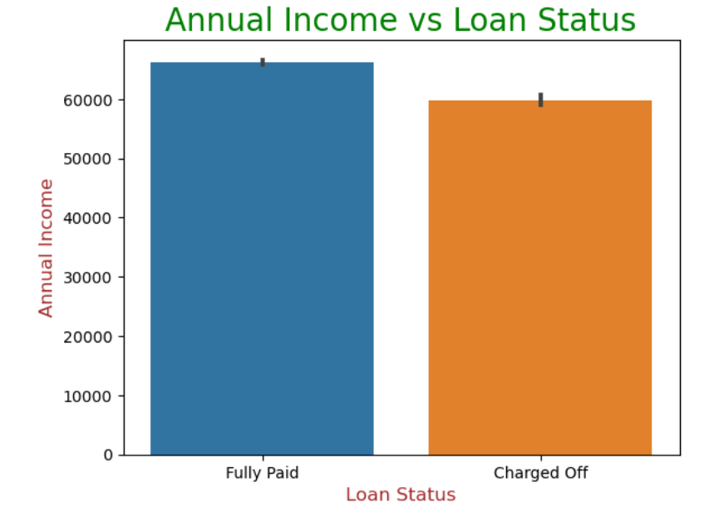
Analysis 3: Annual income vs loan status
Observation: If annual income is less then 58000 - 60000 then there is more probability of having defaulter as below Orange bar:

Slide 9
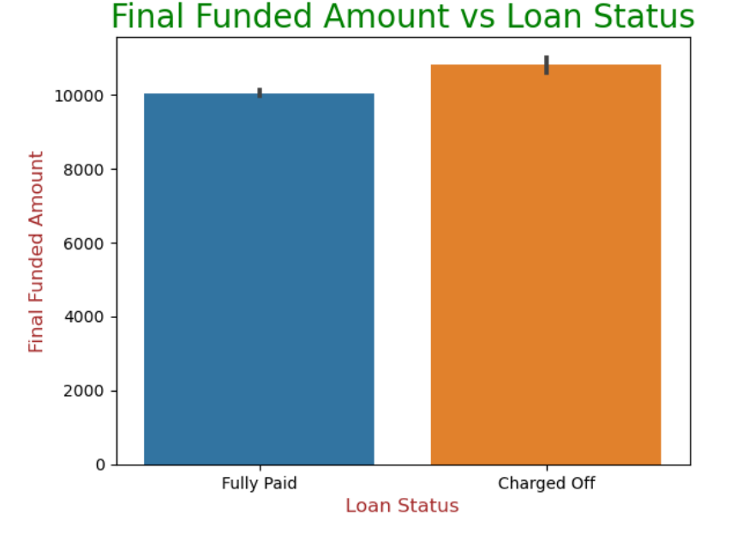
Analysis 4: Final Funded amount vs loan status
Observation: If Loan amount greater then 10000/-, it is risky as it mostly may go into the bucket of defaulters :

Slide 10
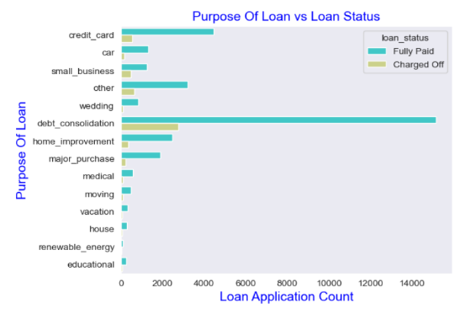
Analysis 5: BiVariate Analysis: purpose of loan vs loan status
Observation: Maximum number of loans were taken and number of fully paid too is for debt_consolidation and credit_card bills.

Slide 11
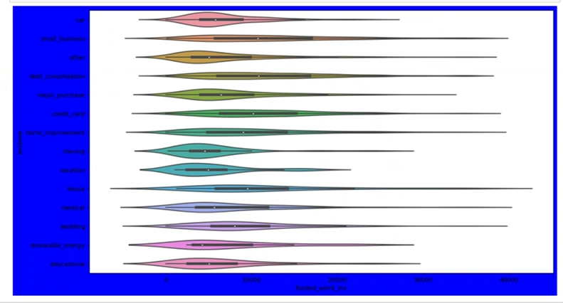
Analysis 6: Purpose vs loan amount (Charged Off data set)
Bivariate Analysis Observation: Loan taken for small business are risky as they are maximum median for charged off data set:

Slide 12
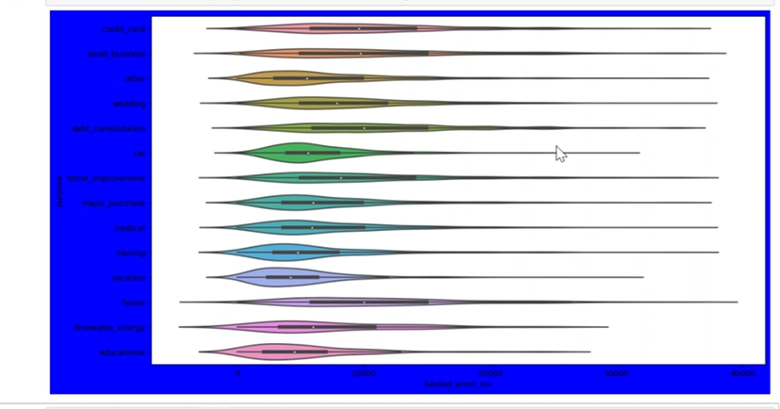
Analysis 7: Purpose vs loan amount (Fully Paid data set)
Bivariate Analysis Observation: Loan taken for small business are risky as they are maximum median for charged off data set:

Slide 13
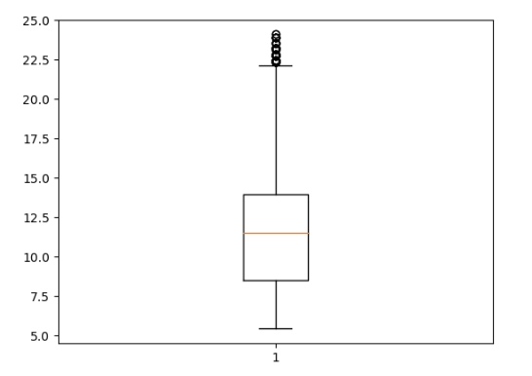
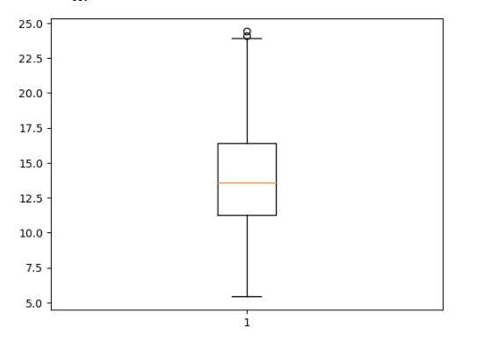
Analysis 8: Interest rates
If interest rate is high then there will be more defaulter,
If Fully paid then Interest rates is less then 15 %, If Charged off then interest rate more then 15%
Fully Paid
Charged Off

Slide 14
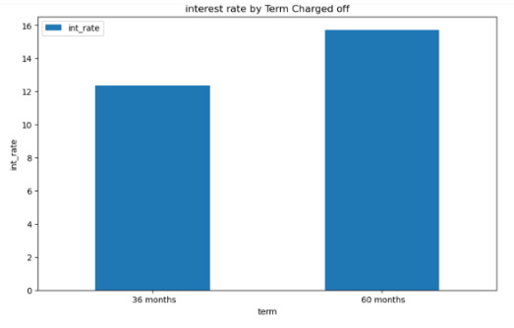
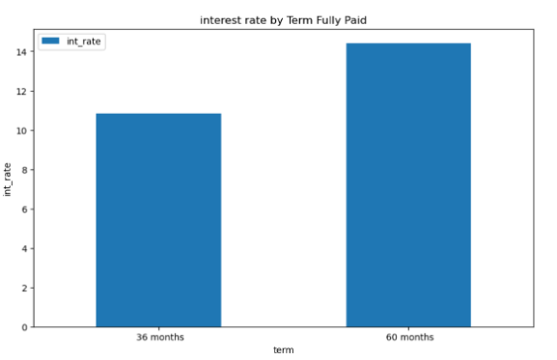
Analysis 9: Interest rate vs Term
In both cases lowered interest rates will help to get paid off , in charged off more then 12% with 36 month is defaulter and for same duration if interest rate is between 10 – 12 % then loans are paid of more:

Slide 15
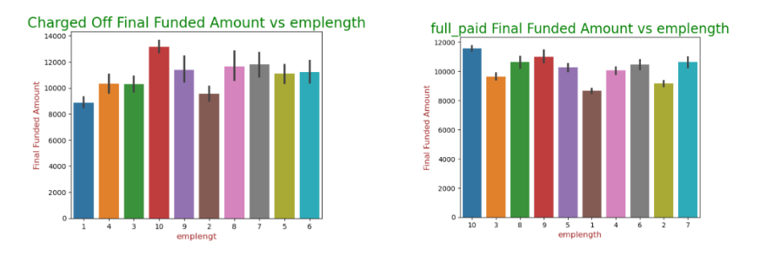
Analysis 10:Employee length vs Final funded amount
Observation: Employees having more then 10 years of experience should be approved with loan below 12000 and will more tend to fully pay, however if loan more then 12000 is given then it may be charged off.

Slide 16
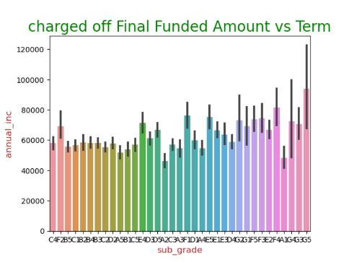
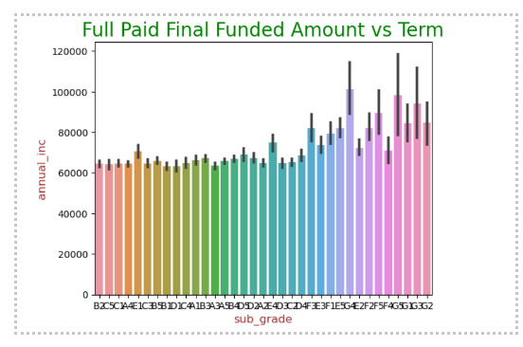
Analysis11: Subgrade vs Annual Income On Fully paid dataset and Charged off dataset
Observation: Subgrade with G5 will be most likely default the loan

Slide 17
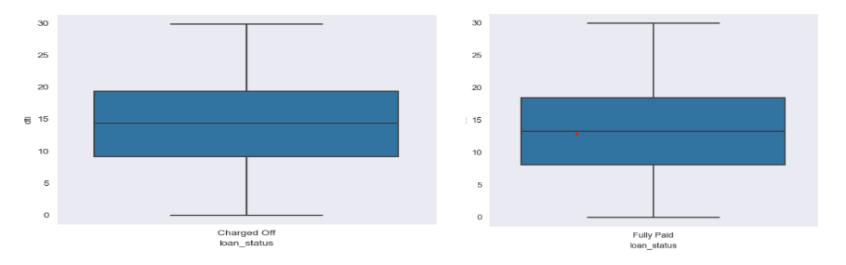
Analyses 12: dti vs loan status on different loan status dataset.
Observation: There is slight difference in dti in both scenario. In charged off its little more, meaning if dti is more, it tends to charged off more.

Slide 18
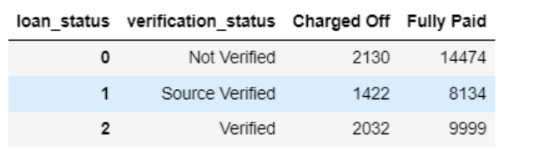
Analysis 13: Verification status and loan status. On a dataset created by grouping the verification status and loan status
Observation: Charged Off numbers is low with all the verification status, and so is the fully paid number is high in all of the verification status. Hence this variable is not giving much insights.

Slide 19
Driver variables to analyze defaulters/fully paid
Term
Grade
Subgrade
Emp length
Home ownership
Interest rate
Annual income
DTI
Purpose
Loan date
Verification status

Slide 20
Conclusion
Strong correlation between funded_amnt and funded_amnt_inv
Negative correlation between dti and annual inc, that means if there is higher income then debt to income will be less and also these candidates will be paying loan
Funded amount by investor is directly proportion with Funded amount by lending club, hence one of the columns can be removed.
If annual income is less then 58000 - 60000 then there is more probability of having defaulter
If Loan amount greater then 10000/-, it is risky as it mostly may go into the bucket of defaulters.
Subgrade with G5 will be most likely default the loan.

Slide 21
Conclusion
Maximum number of loans were taken and number of fully paid too is for debt_consolidation and credit_card bills.
Loan taken for small business are risky as they are maximum median for charged off data set.
Lowered interest rates will help to get paid off , in charged off data set more then 12% with 36 month is defaulter and for same duration if interest rate is between 10 – 12 % then loans are paid of more in Fully paid data set .
Employees having more then 10 years of experience should be approved with loan below 12000 and will more tend to fully pay, however if loan more then 12000 is given then it may be charged off.
Charged Off numbers is low with all the verification status, and so is the fully paid number is high in all of the verification status. Hence this variable is not giving much insights.

