Slide 1
MOVIEIQ
Predictive Analytics on Film Success
Turning planning-stage movie data into a data-backed greenlight signal
Business Summary & Key Insights • 7-Minute Presentation
Data Science Project | Python · scikit-learn · Streamlit
Notes:
TIMING 0:00-0:25. Open with energy. "Every year, studios pour millions into films before they know if audiences will show up. MovieIQ is an end-to-end analytics project that turns planning-stage data -- budget, genre, expected popularity -- into a predictive signal studios can use before a single ticket is sold." State this is a 7-minute walkthrough of the business problem, what the data revealed, and what the model can (and can't) do.

Slide 2
THE BUSINESS PROBLEM
Not every movie earns back its budget
A movie is labeled successful when its revenue exceeds its production budget. Greenlighting happens before any of that revenue is known — making it a high-stakes, capital-intensive bet.
SUCCESS RULE
Revenue > Budget
Studios
Decide which scripts to greenlight and how to size the budget
Why this is a classification problem
The target only takes two values — Success (1) or Failure (0) — so the goal is to predict a category, not an exact revenue figure. That's exactly what binary classification models are built for.
Investors
Assess financial risk before committing capital
Producers
Benchmark a project against similar past films
2
Notes:
TIMING 0:25-1:05. "We define success simply: revenue greater than budget. Three groups care about getting this right ahead of time -- studios deciding what to fund, investors sizing risk, and producers benchmarking a project. Because the outcome is binary -- did it succeed or not -- this is a classification problem, not a revenue-forecasting problem. That distinction shapes every choice we make downstream."

Slide 3
METHODOLOGY
A five-stage, reproducible pipeline
01
02
03
04
05
Data Prep
EDA
Statistical Testing
Machine Learning
Dashboard
Clean 2,000 movies; remove invalid budget/revenue; build the target label
Explore how budget, genre, popularity & ratings relate to success
T-test and Chi-Square confirm which patterns are real, not noise
Random Forest classifier trained on planning-stage features only
Interactive Streamlit app for exploration and live prediction
3
Notes:
TIMING 1:05-1:35. "The project follows five stages: clean and label the data, explore it, statistically validate what we see, train a model on only the features known before release, and ship it behind a live dashboard. Every chart and number in this deck comes directly out of that pipeline -- nothing here is hand-picked after the fact."

Slide 4
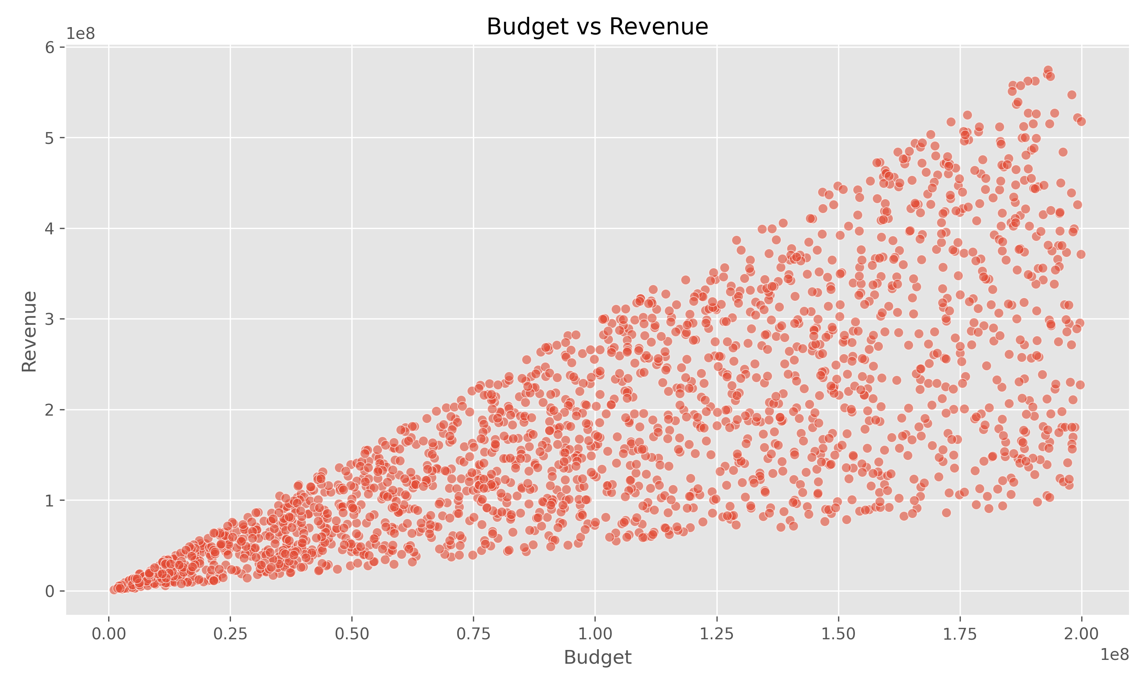
THE DATASET
2,000 movies, four KPIs at a glance
2,000
80.7%
$101.9M
$178.1M
Movies analyzed
Labeled successful
Average budget
Average revenue
Budget vs. Revenue
Correlation: 0.76 — a real relationship, but far from a guarantee.
Bigger budgets raise the revenue ceiling — but plenty of high-budget films still land below the break-even line.
Several low-budget movies land above it, proving budget alone doesn't decide the outcome.
This is the core reason the model needs more than one input feature.
4
Notes:
TIMING 1:35-2:20. "Here's the dataset: 2,000 movies, roughly 81% of them successful by our definition, averaging about $102 million in budget against $178 million in revenue. Budget and revenue do correlate -- 0.76 -- but look at the scatter plot: plenty of big-budget films still land below the break-even line, and small-budget films land above it. Budget raises the ceiling, it doesn't decide the outcome -- which is exactly why we need more than one signal."

Slide 5
VALIDATING THE SIGNAL
Which patterns are real — and which aren't
SIGNIFICANT
NOT SIGNIFICANT
Independent T-Test
Chi-Square Test
Popularity: Successful vs. Unsuccessful Movies
Genre vs. Success
p = 0.0397
p = 0.9946
Below the 0.05 threshold — we reject the null hypothesis. Popularity genuinely differs between successful and unsuccessful movies.
Far above 0.05 — we fail to reject the null hypothesis. Genre and success are statistically independent in this data.
Takeaway: popularity earns its place as a model feature — it's not just a visual hunch.
Takeaway: small differences in per-genre success rate are noise, not a real effect — a corrective finding worth stating plainly.
5
Notes:
TIMING 2:20-3:10. "Before trusting any pattern, we test it. The t-test says popularity really is different between hits and misses -- p equals 0.04, statistically significant. But the chi-square test on genre comes back at p equals 0.99 -- essentially no association. That's an important, honest finding: genre looks like it matters in a bar chart, but statistically, in this dataset, it doesn't. We let the data correct our intuition instead of the other way around."

Slide 6
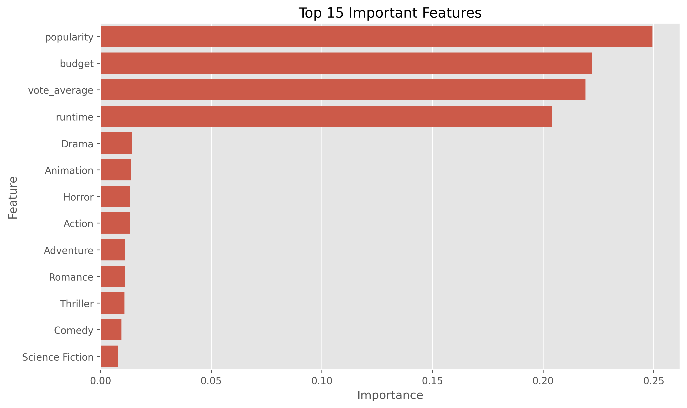
THE MODEL
Random Forest: what it gets right
69%
81%
80.5%
80.7%
Accuracy
Precision
Recall
F1 Score
What actually drives the prediction
Popularity, budget, vote average, and runtime carry roughly equal, moderate weight — no single feature dominates.
Individual genres each contribute far less — consistent with the Chi-Square result on the previous slide.
Balanced-class training trades a little raw accuracy for a model that actually attempts to flag failures, not just default to “success.”
6
Notes:
TIMING 3:10-4:10. "We trained a Random Forest on only planning-stage features -- budget, popularity, runtime, rating, and genre -- deliberately excluding revenue itself, which would leak the answer. On held-out data it lands at 69% accuracy, 81% precision, and roughly 80% recall and F1. Feature importance confirms the four numeric features do the heavy lifting; genre contributes comparatively little, matching the chi-square result. We also tuned the model to actually try to catch failures rather than just predicting success every time, which cost us a bit of raw accuracy but makes the model genuinely useful rather than trivially correct 81% of the time by just guessing the majority class."

Slide 7
BRINGING IT TO LIFE
An interactive dashboard, not just a notebook
🎬 MovieIQ — Predictive Analytics on Film Success
Sidebar Filters
Genre & minimum rating, updating every chart live
2,000
80.7%
$101.9M
$178.1M
Live Statistical Tests
Movies
Success Rate
Avg. Budget
Avg. Revenue
T-test & Chi-Square results, recalculated in-app
🔮 Predict a Movie's Success
Instant Prediction
Budget · Popularity · Runtime · Vote Average · Genre → input fields
Enter a hypothetical film, get a probability in real time
✅ SUCCESS — 78.3% confidence
Deployed on Streamlit Community Cloud — accessible from any browser, no install required.
7
Notes:
TIMING 4:10-4:50. "All of this ships behind a live Streamlit dashboard -- not just a static notebook. A studio analyst can filter by genre, watch the statistical tests recompute live, and type in a hypothetical film's budget, runtime, and genre to get an instant success probability. It's deployed to the cloud, so there's nothing to install -- just a browser tab." (If you have a real screen recording of the app, cut to it here instead of this mockup slide.)

Slide 8
BEING HONEST ABOUT THE MODEL
What MovieIQ can't see — yet
No marketing data
No release timing
Advertising spend is often as decisive as production budget, and isn't in this dataset.
Seasonality and competing releases in the same window aren't captured.
No cast or franchise signal
Weak feature correlations
Star power, director track record, and sequel/franchise status are missing.
Every available numeric feature correlates with success at only ±0.03–0.05 — a real ceiling on accuracy.
8
Notes:
TIMING 4:50-5:30. "No model presentation is complete without limitations. MovieIQ has never seen a marketing budget, a release calendar, a cast list, or a franchise flag -- all of which meaningfully move real box office outcomes. And structurally, every feature we do have correlates with success only weakly. That's not a modeling failure to hide -- it's an honest ceiling set by the data, and it tells us exactly where the next investment in this project should go."

Slide 9
WHERE THIS GOES NEXT
From proof-of-concept to production signal
1
2
3
4
Enrich the data
Upgrade the model
Add explainability
Put it in the workflow
Add marketing spend, release date, franchise flag, and cast/director history
Benchmark against gradient-boosted trees (XGBoost/LightGBM) with cross-validation
Layer in SHAP values so each prediction shows exactly why
Embed the dashboard's prediction step into the greenlight review process
9
Notes:
TIMING 5:30-6:15. "So where does this go next? Four concrete steps: enrich the dataset with marketing and release-timing data, benchmark stronger models like XGBoost, add SHAP-based explainability so every prediction comes with a reason, and -- most importantly -- actually embed this into the greenlight review workflow rather than leaving it as a standalone dashboard. That last step is what turns a class project into a business tool."

Slide 10
THE TAKEAWAY
MovieIQ won't tell a studio
what to greenlight.
It gives them a statistically grounded second opinion before the money is spent —
and a clear map of what data to collect next to make that opinion sharper.
Thank you
Questions welcome | Dashboard, notebook, and code available on request
Notes:
TIMING 6:15-7:00. "To close: MovieIQ isn't meant to replace a greenlight committee -- it's meant to give them a statistically grounded second opinion before money moves, and a clear, specific list of what data would sharpen that opinion further. Thank you -- happy to take questions, or walk through the live dashboard." Pause for 2-3 seconds on this slide before cutting the recording.

