Slide 1
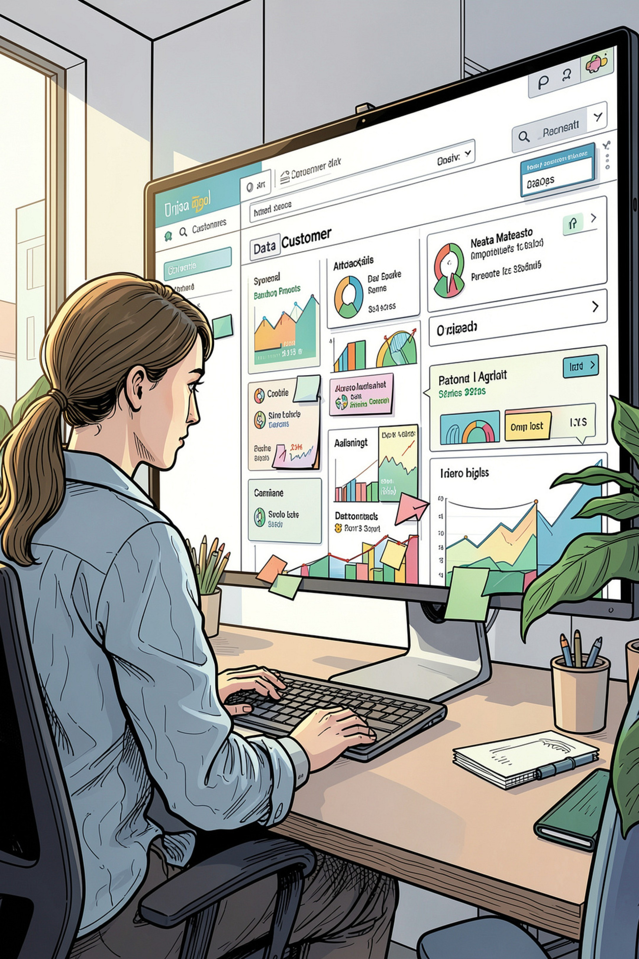
Customer Shopping Behavior Analysis
3,900 purchases — 18 columns — goal: uncover spending, segments, preferences, subscriptions

Slide 2

Dataset Snapshot
Rows & Columns
Key Features
Rows: 3,900 · Columns: 18
Demographics, Purchase details, Behavior, Shipping, Discounts
Missing Data
37 missing values in Review Rating

Slide 3
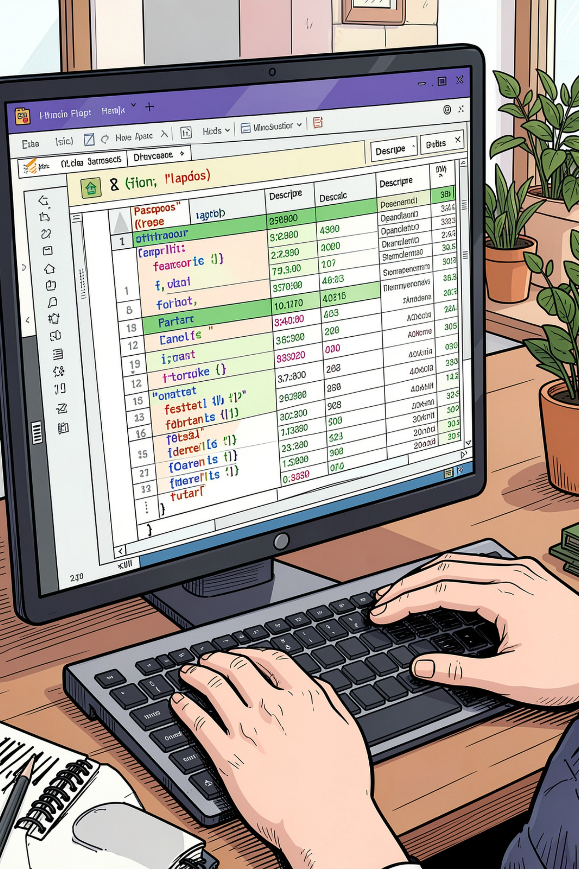
Exploratory Data Analysis (Python)
Loading & Inspect
Missing & Impute
Imputed Review Rating by product-category median
Imported with pandas · df.info() · .describe()
Standardize
Renamed columns to snake_case

Slide 4
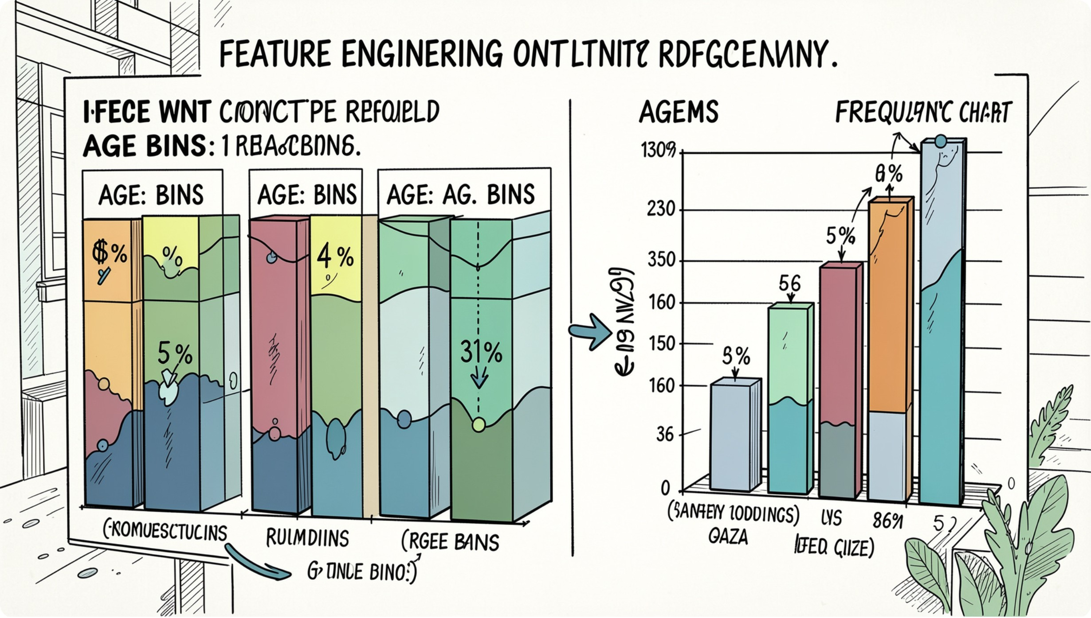
Feature Engineering
Age Groups
Frequency
Created age_group by binning ages
Derived purchase_frequency_days
Redundancy Check
Dropped promo_code_used (redundant with discount_applied)

Slide 5

Database Integration & SQL Analysis
Loaded cleaned DataFrame into PostgreSQL for business queries

Slide 6
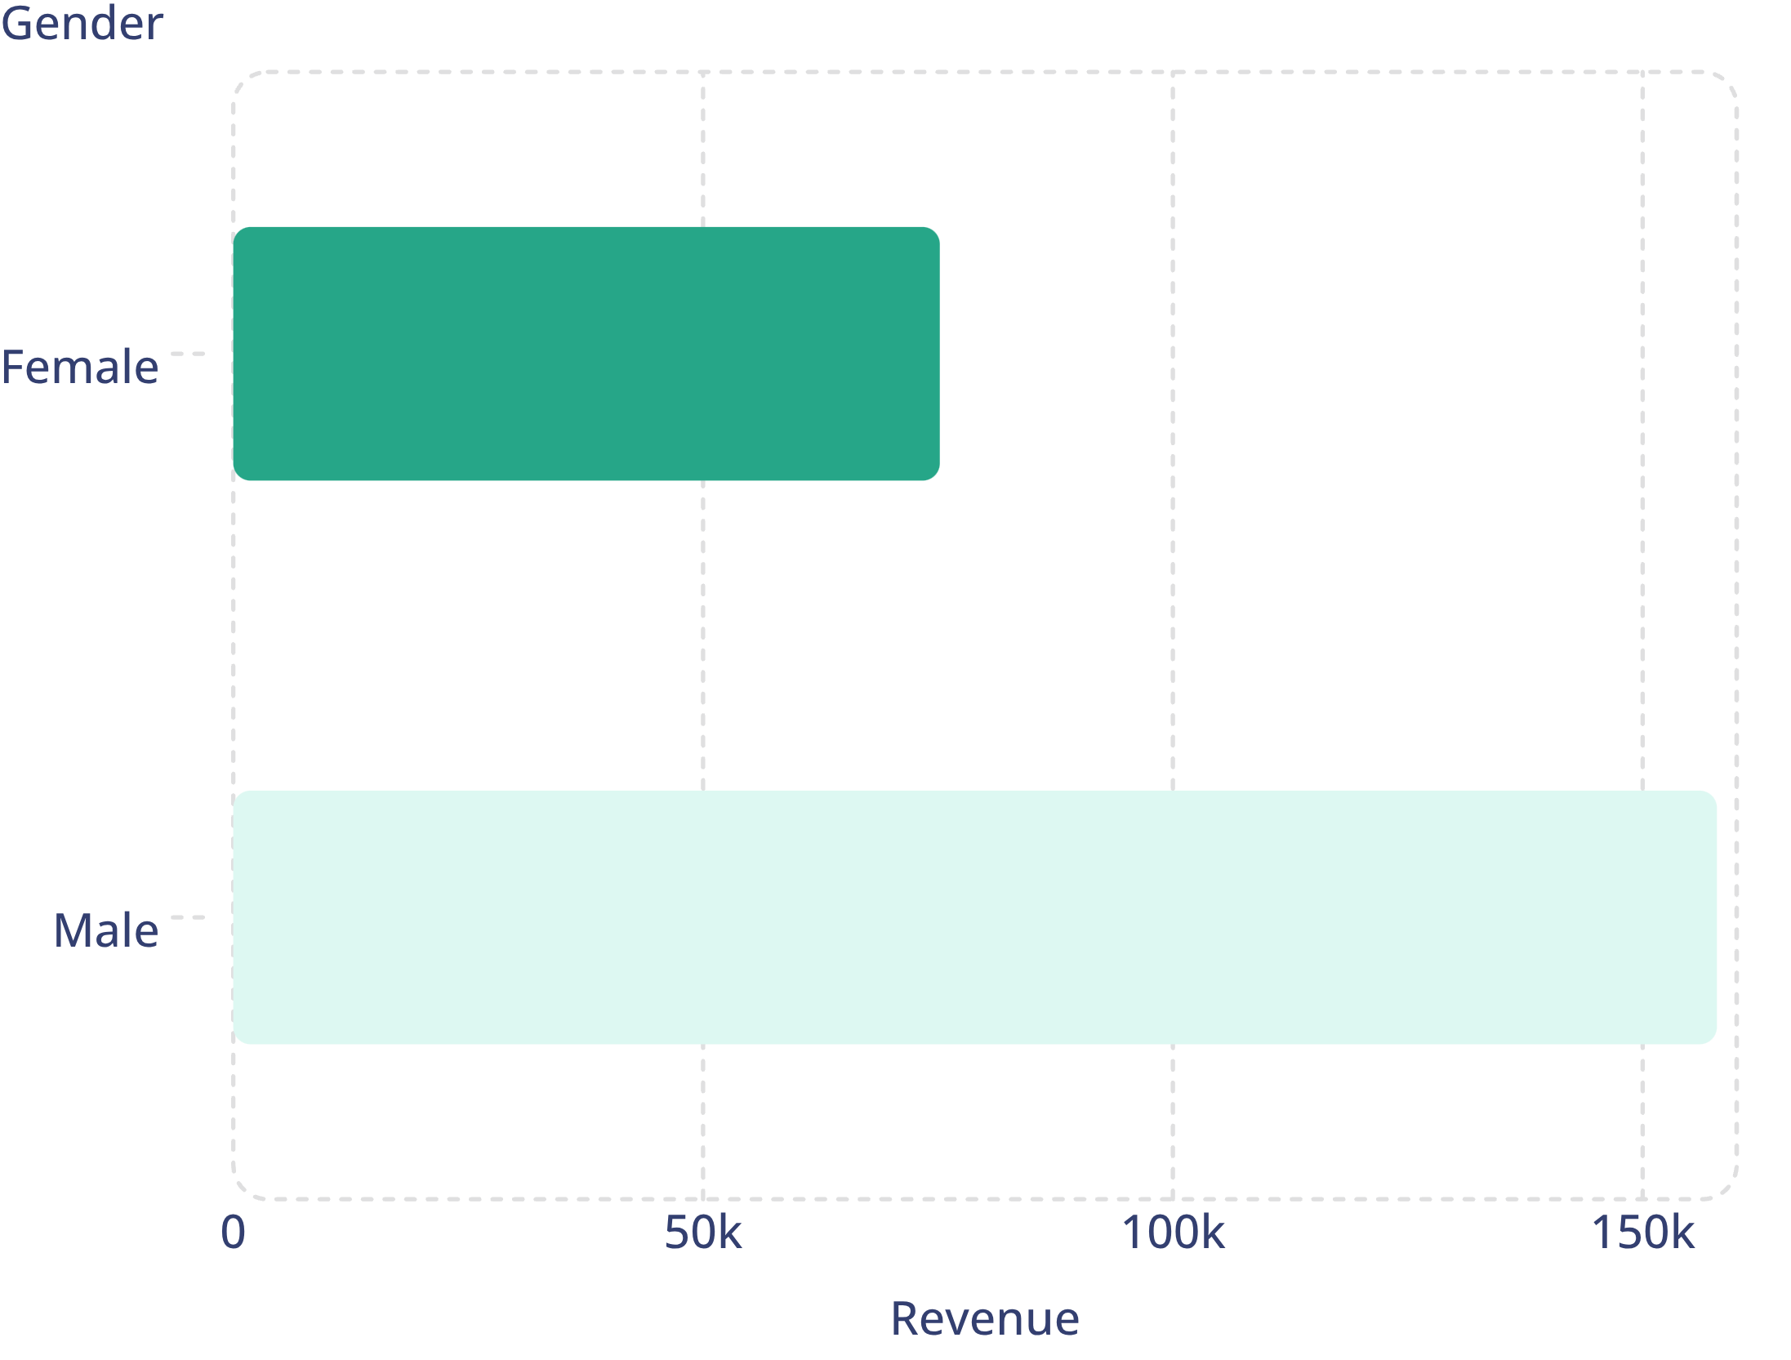

Revenue by Gender
Male: 157,890 · Female: 75,191
Insight: male customers generated higher total revenue

Slide 7
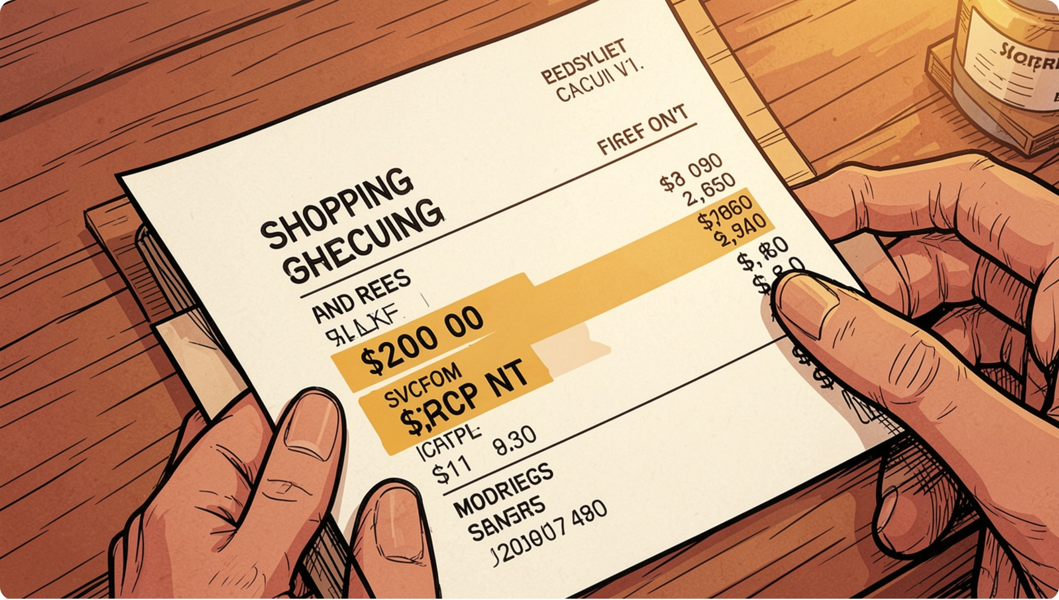
Discounts & High-Spenders
High-Spending Discount Users
839 rows identified — customers who used discounts but spent above average
Discount-Dependent Items
Top: Hat 50.00% · Sneakers 49.66% · Coat 49.07% · Sweater 48.17% · Pants 47.37%

Slide 8
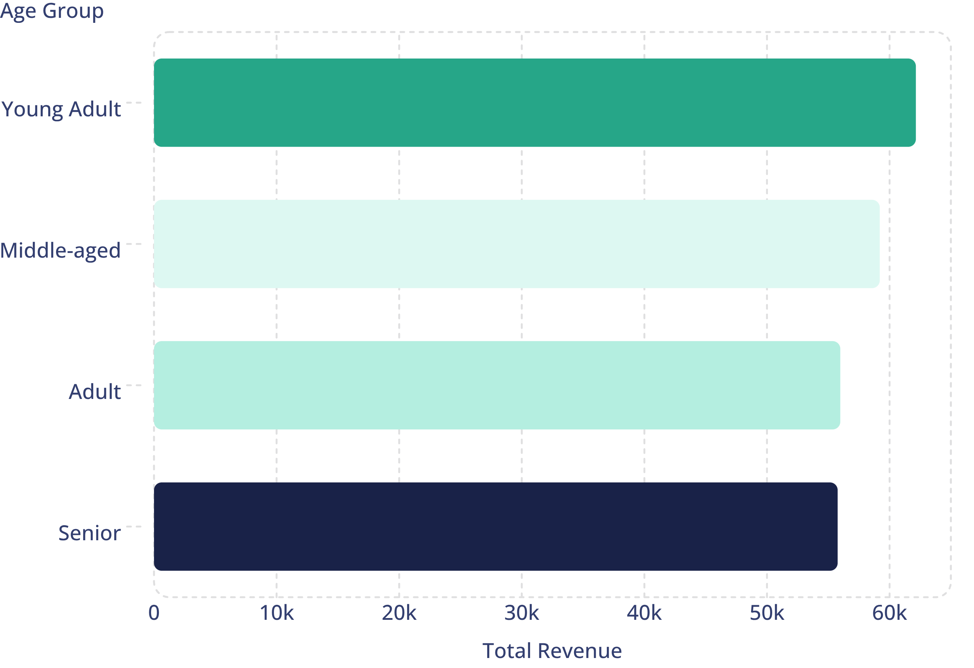
Revenue by Age Group
Focus marketing on Young Adult & Middle-aged segments
Subscribers vs Non-Subscribers
Yes: 1,053 customers · Avg spend 59.49 · Total revenue 62,645
No: 2,847 customers · Avg spend 59.87 · Total revenue 170,436

Slide 9
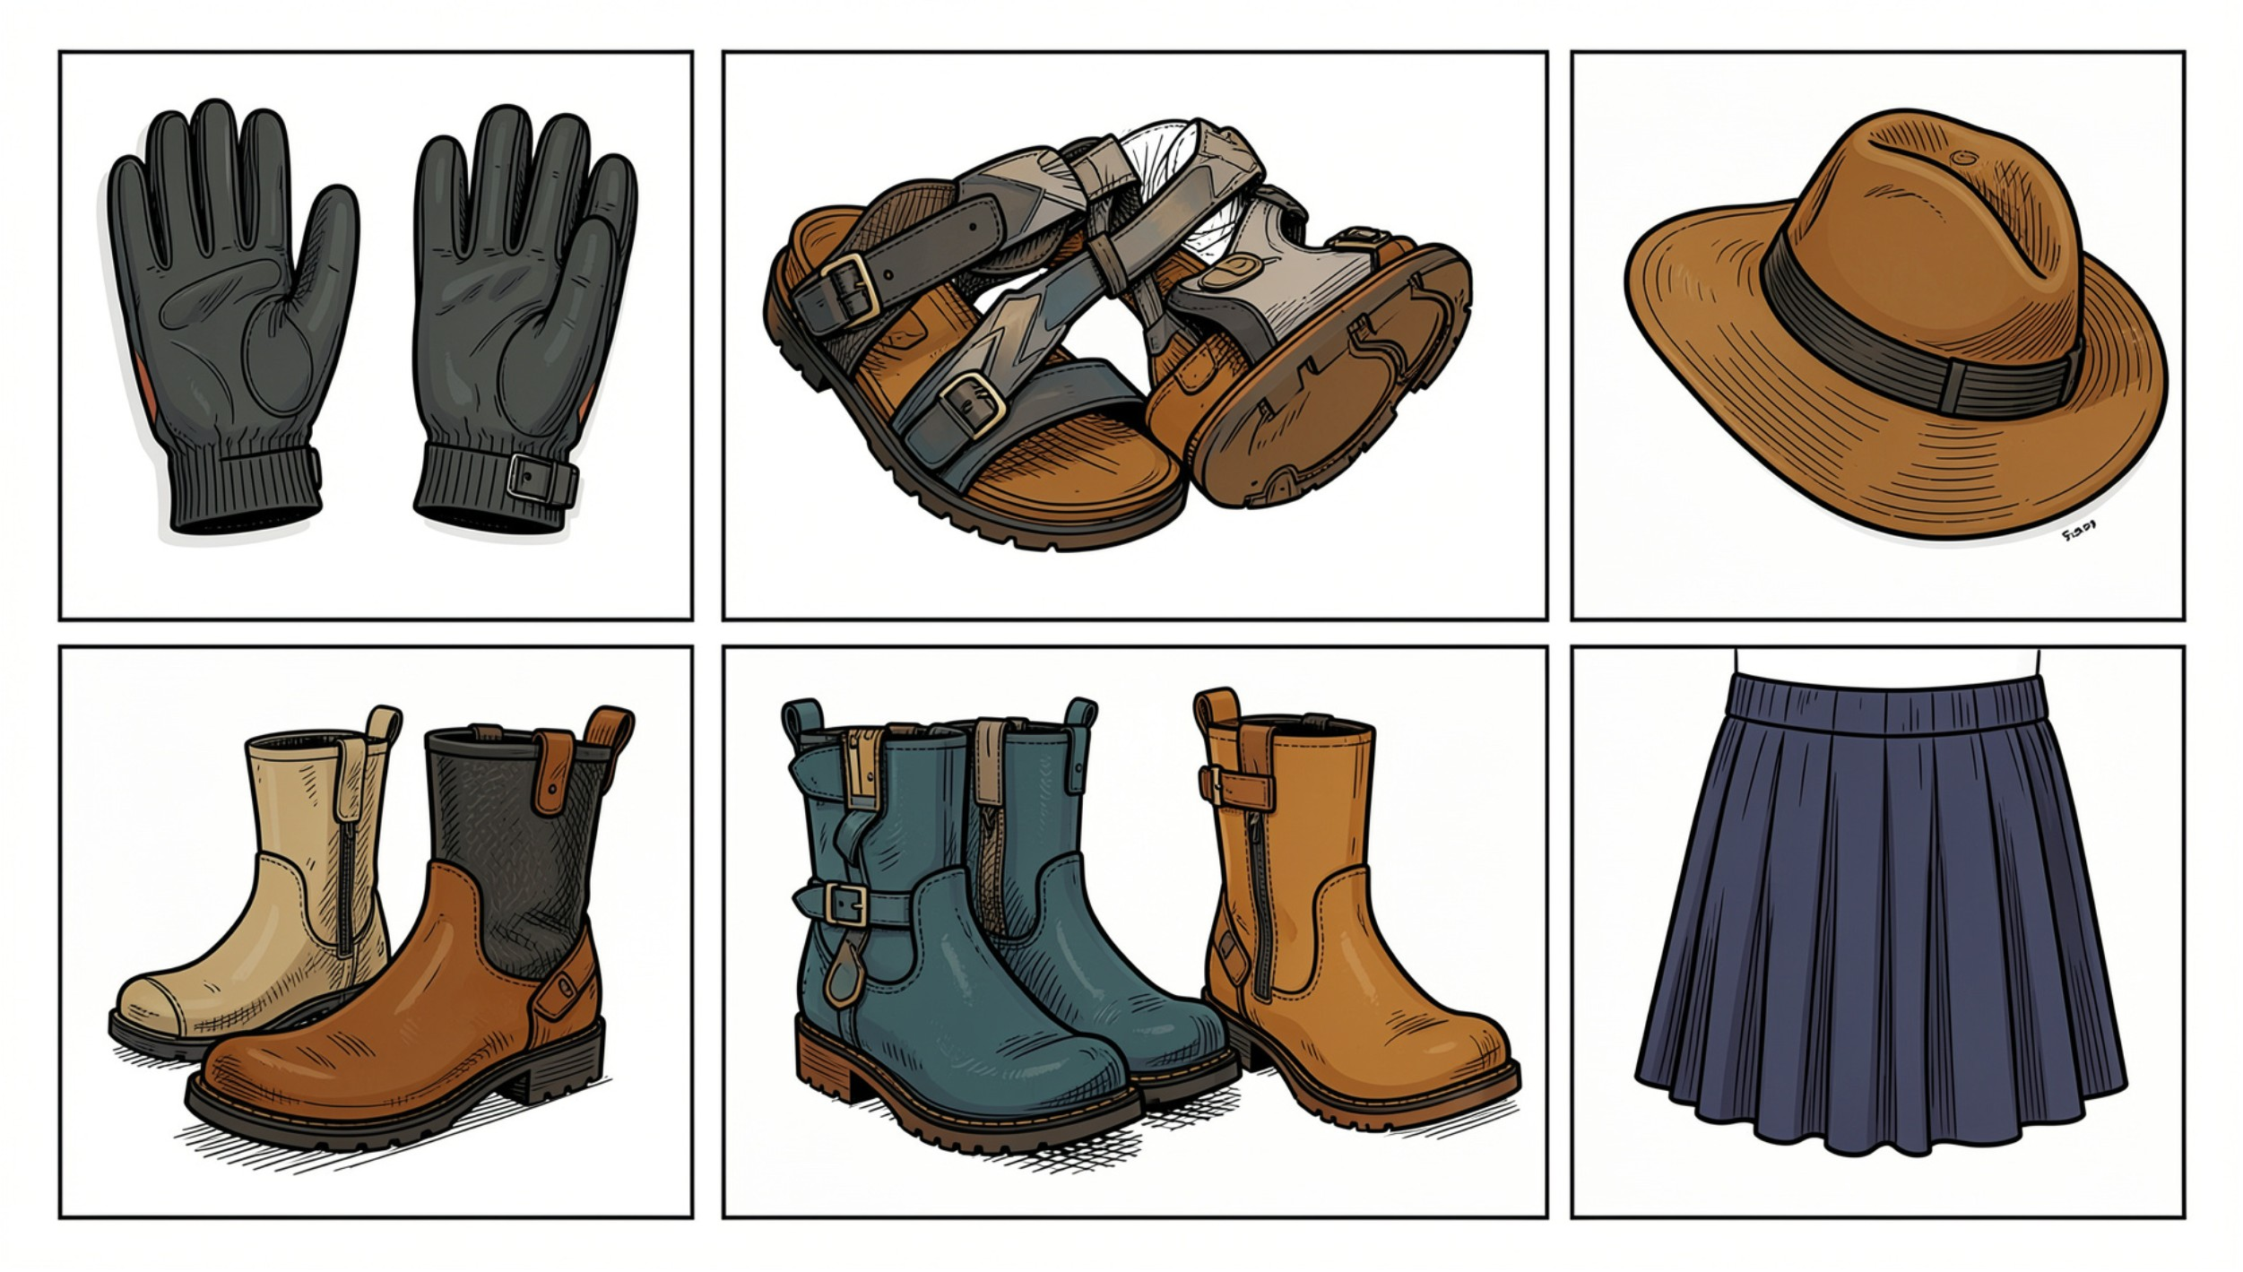

Top Products & Ratings
Gloves
Avg rating 3.86
Sandals
Avg rating 3.84
Boots
Avg rating 3.82
Hat
Avg rating 3.80
Skirt
Avg rating 3.78
Use top-rated items for spotlight campaigns

Slide 10

Dashboard & Recommendations
Power BI
Key Actions
Interactive dashboard: 3.9K customers · Avg purchase $59.76 · Avg rating 3.75
Boost subscriptions · Loyalty programs · Review discount policy · Highlight top-rated products · Target high-revenue age groups
Next Steps
Deploy targeted campaigns · Monitor discount ROI · Expand dashboard filters for stakeholders

