Slide 1
FrameGrabber

Slide 2
Project Abstract
There is always reason, curiosity and ambition that lead to development of new things.
The idea behind this project is to process and grab frames from streaming video input in a faster and easier way

Slide 3
Today most of the softwares available are mainly dedicated to capturing video whereas only very few of them exist which are dedicated to grab frames and store them as image files.
The few types of software available that exist for this purpose are generally expensive and are not available for everyone to use because of copyright restrictions.
These above mentioned constraints were the main reasons that prompted us to develop this project.

Slide 4
Introduction
Our project takes streaming video input and captures frames from it and stores them as .BMP files.
The project also has features such as image capturing , edge detection viewer.
Stores files as .BMP

Slide 5
The BMP File Format
BMP is a fairly simple file format, its structure
pretty straightforward. Each bitmap file contains:
a bitmap-file header
a bitmap-information header
a color table
an array of bytes that defines the bitmap bits
BMP files contain RGB data.

Slide 6
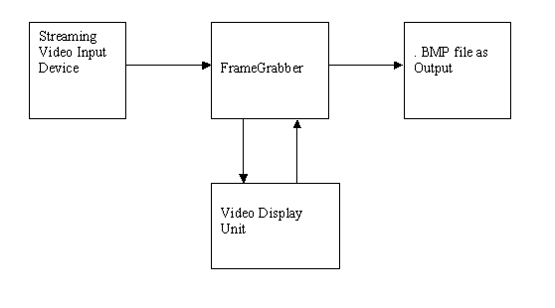
Block Diagram for FrameGrabber

Slide 7
Feature Set
Hardware
Processors: Intel 80386(minimum), 80486, Pentium or compatible CPU.
RAM: At least 32Mb, although 64Mb or more is recommended.
Hard Disk: at least 350Mb of hard disk space is needed for installation.1.5Gb of hard disk space for typical work station installation. Or at least 1Gb of space for server installation.

Slide 8
Streaming Video Input Device: Web-cam /TV tuner card.
USB port for web cam /TV tuner card.

Slide 9
Feature Set
Software:
Operating System: Windows 98/NT/XP/2000
Visual Studio 6.0
Video Input device drivers.

Slide 10
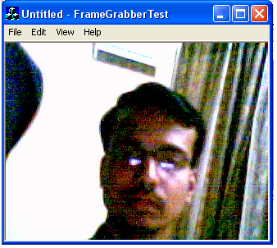
Interface Screens

Slide 11
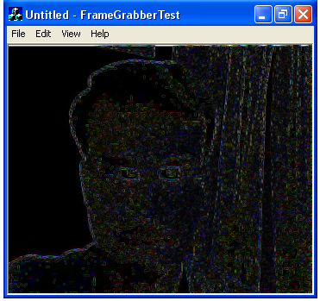
Interface Screens

Slide 12
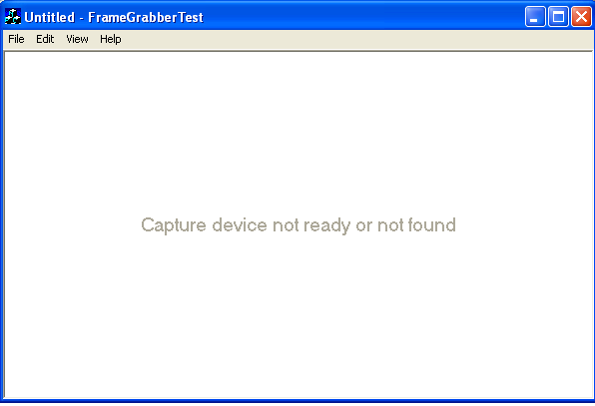
Interface Screens

Slide 13
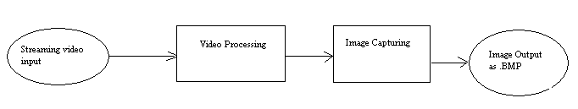
Data Flow Diagrams
Level-0 DFD

Slide 14
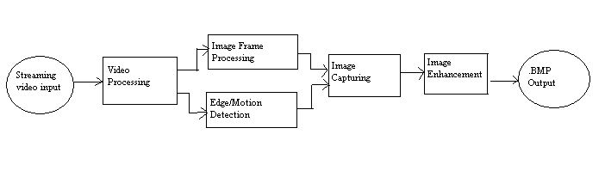
Data Flow Diagrams
Level -1 DFD

Slide 15
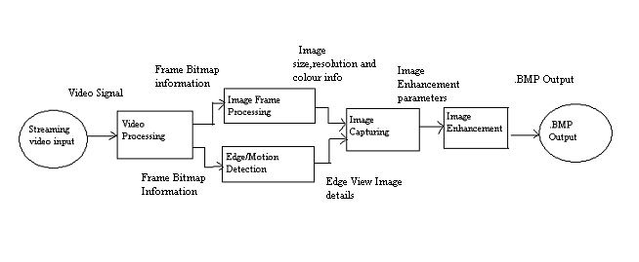
Data Flow Diagrams
Level -2 DFD

Slide 16
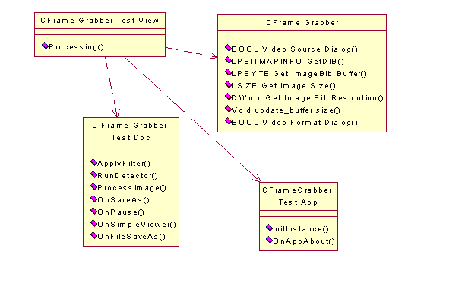
Class Diagram

Slide 17
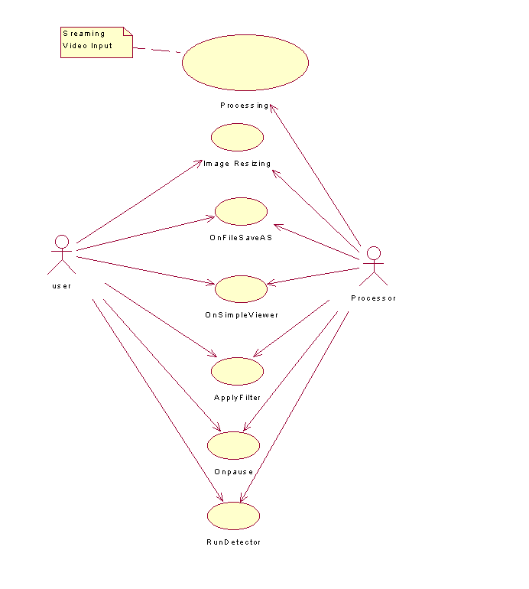
Use Case Diagram

Slide 18
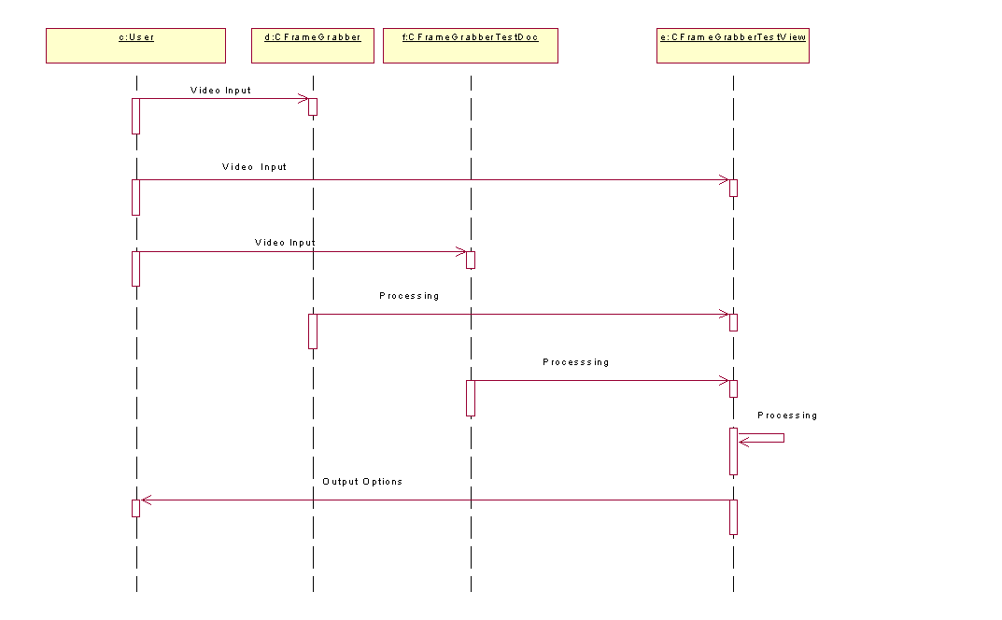
Sequence Diagram

Slide 19
Future Prospects
Currently softwares are not very easily available for capturing frames from streaming video input devices such as TV tuner card and with certain more developments in image enhancements and better storage formats such as .JPG, .GIF, .TIFF etc this software has a bright future ahead of it.
Some more advantages of this software are that it works on all Windows OS, is very small in size and has a very user friendly and simple interface.

Slide 20
One of the most important futuristic applications of this software will come into use in the field of security. This can be illustrated by the following application:
Consider there is a Closed Circuit Monitoring Station at some facility where the CCTV’s are used for video monitoring of the facility
Now as the CCTV’s are provided streaming video input this software can be used with an enhancement.
This enhancement can be provision of image capturing every 5 seconds by putting a timer in the code.
This will capture the images every 5 seconds and store them on a hardware device.

Slide 21
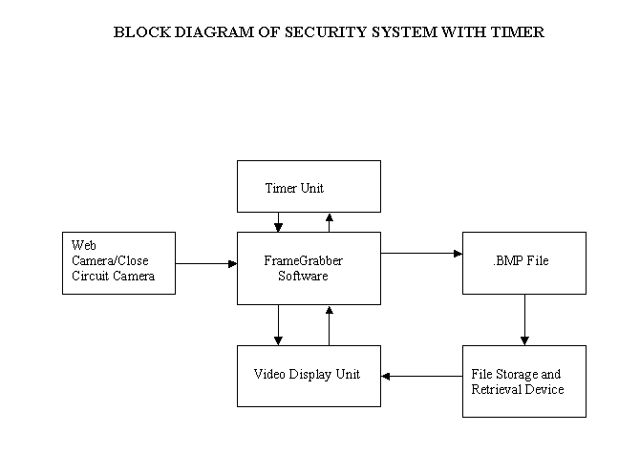

Slide 22
The End
Have a good day!!

