Slide 1
Ultrawideband
Contents
Introduction
Why Ultrawideband
UWB Specifications
Why is UWB unique
Data Rates over range
How it works
UWB Characteristics
Advantages of UWB
Comparison with other technologies
Applications
Wireless USB
Challenges
Conclusion

Slide 2
Introduction
Technology for short range Wireless radio communications
Bandwidth more than 25% of a center frequency or more than 1.5 GHz
Different from conventional narrowband and wideband systems
Notes:
1 Ultra Wideband (UWB) is a wireless technology for transmitting digital data at very high rates, using very low power. UWB is ideally suited for short-range and high-speed data transmissions for wireless personal area network (WPAN) applications.
To give examples
* A mobile computer user could wirelessly connect to a digital
projector in a conference room
* Digital pictures could be transferred to a computer from digital camera without the need of a cable
While it has been used for a while by the military, UWB is now going through the necessary authorizations and developments for public and commercial use .
2 USB is technically defined as any radio technology having a spectrum that occupies a bandwidth greater than 20 percent of the center frequency, or a bandwidth of at least 500 MHz. As we’ll see later bandwidth assigned to UWB is much greater than defined by this definition.
3 There have been 2 systems in use for wireless technology : traditional “narrowband” systems as well as newer “wideband” systems . There are two main differences between UWB and other “narrowband” or “wideband” systems.
To give examples, our radio transmission takes place through narrowband transmission while newer technologies like bluetooth and wifi use wideband transmission.
* First, the bandwidth of UWB systems, is more than 1.5GHz. Clearly, this bandwidth is much greater than the bandwidth used by any current technology for communication like radio technology, cellular technology etc.
* Second, UWB is typically implemented in a carrierless fashion. Conventional “narrowband” and “wideband” systems use Radio Frequency (RF) carriers to move the signal.

Slide 3
Why Ultrawideband
Crunch in RF spectrum availability
Variations in RF spectrum from one country to next
Devices using RF Spectrum are more complex, cost more, and consume more power
Notes:
0 Intro to RF Spectrum
1 . Cell phones loose and can not obtain signal in environments where there are too many cellular users in close proximity, wireless technologies such as Bluetooth, Wi-Fi and interfere with one another and cause signal loss if used in close proximity to one another, etc. The competing groups of companies supporting Wi-Fi and Home RF are already fighting over Spectrum allocation.
2 There are variations in RF spectrum assignments from one country to the other. This prohibits the possibility of global interoperability of RF based devices. Without such RF limitations, UWB offers the promise of global interoperability.
3 RF spectrum based devices require considerable components and power to process the frequency signal and analog to digital/digital to analog conversions. UWB can operate on microwatts, literally as little as 1/1000 the power of RF based devices.

Slide 4
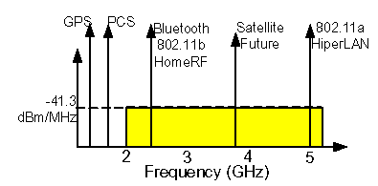
UWB Specifications
3.1 -10.6 GHz assigned by FCC
200 Mbps upto 10 meters
Limited transmit power of -41dbm/Mhz
Notes:
The FCC regulates all use of radio-emitting devices within the United States. It has the authority to prohibit operation of any device that interferes with the operation of any device that the FCC has approved .
These are the technical specifications of the UWB.
The frequency band of 3.1 - 10.6 GHz has been assigned by FCC.
As seen in the figure there is such a wide band assigned to the UWB rather than the narrow bands of frequency assigned to the technologies like Bluetooth, 802.11.

Slide 5
Why is UWB unique?
Simultaneously low power, low cost high data-rate wireless communications
7.5 Ghz of “free spectrum”
Simple CMOS transmitters at very low power
“Moore’s Law Radio”
Notes:
1 UWB enables wireless connectivity with consistent high data rates across multiple devices and PCs. UWB systems also consume very little power, The power consumption of UWB is one ten-thousandth of that of cell phones
2 UWB radios can use frequencies from 3.1 GHz to 10.6 GHz—a band more than 7 GHz wide. To allow for such a large bandwidth, the FCC put in some power restrictions. By doing so, UWB devices can make use of an extremely wide frequency band while not emitting enough energy to be noticed by narrowband devices nearby, such as 802.11a/g radios.
3 , UWB—unlike other RF technologies—does not require components such as mixers, filters, RF/IF converters, and local oscillators, because it does not modulate and demodulate a complex carrier waveform Therefore, UWB consumes less power, resulting in longer battery life and a shorter path to integrated CMOS.
4 Since the UWB devices will be built using CMOS, UWB performance will scale up as improvements to the semiconductor technology are made.

Slide 6
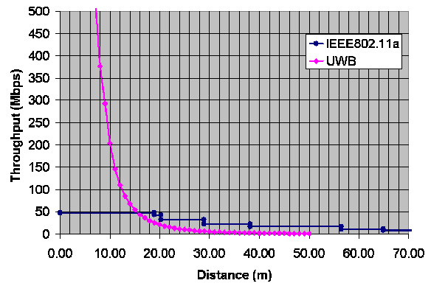
Theoretical Data Rates Over Range
UWB shows significant throughput potential at short range
Notes:
under current FCC regulations, 10 meters, depending on the desired data rate.
The technology (currently) works best at short distances, which means its first applications will probably be home networking for PCs, stereos, TVs, etc., where it can operate at 40 MB/second .

Slide 7
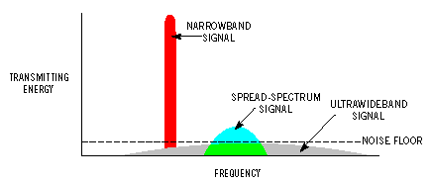
How it works
  Generation of extremely short digital pulses in the subnanosecond range.
  Uses and extremely wide band of RF spectrum to transmit data
Notes:
UWB technology is based on the generation of extremely short digital pulses in the nanosecond range. Although, such pulse trains can be modulated any number of ways, including time, phase, amplitude but they are modulated directly by the baseband signal — instead of using a high-frequency carrier — this gives UWB radios their simplicity of design.
2 . UWB uses an extremely wide band of RF spectrum to transmit data. This has 2 significant advantages
I ) UWB is able to transmit more data in a given period of time than the more traditional technologies.
II) By dividing the power of the signal across a range of frequencies, the affect upon any frequency is below the acceptable noise floor. For example, 1W of power spread across 1 GHz of spectrum puts only 1 nW of power into each hertz band of frequency. Thus, UWB can coexist with other RF technologies, because it appears only as noise.
3 Explain the image

Slide 8
UWB Characteristics
Extremely low transmission energy
Extremely difficult to intercept
Multipath immunity to fading
Follows Shannon’s channel capacity theorem
Notes:
1 UWB signals have very low transmission energy. There are 2 reasons for this :
Firstly it sends data as short pulses instead of a continuous stream.
Secondly It operates in the noise area of the spectrum.
3 There are various reasons why the
since UWB signals are transmitted below the noise floor, UWB signals are virtually impossible to detect,
since the data is divided over wide range of frequency, the complete data cannot be found at one particular frequency.
The data is transmitted as very short pulses, it is very difficult to determine the time when the data will be transmitted.
* makes UWB perhaps the most secure means of wireless transmission ever previously available.
4 Another key advantage of UWB is its robustness to fading and interference. Multipath fading occurs when a strong reflected wave – e.g., off of a wall, ceiling, vehicle, building, etc. – arrives partially or totally out of phase with the direct path signal, causing a reduced amplitude response in the receiver. However with UWB due to very short pulses, the direct path has come and processed before the reflected path arrives and no cancellation occurs
However, another important advantage with UWB technology is that multipath components can be resolved and used to actually improve signal reception.
5 Shannon’s capacity limit equation shows capacity increasing as a function of BW (bandwidth) faster than as a function of SNR.
Shannon’s equation shows that increasing channel capacity requires linear increases in Bandwidth while similar channel capacity increases would require exponential increases in power. This is why UWB technology is capable of transmitting very high data rates using very low power.

Slide 9
Advantages of UWB
Does not use the traditional radio frequency carriers
UWB is not line-of-sight
Reduced Cost vs. Current Wireless Technology
Channelization: Frequency sharing with other applications
Transmission of data in large bursts
Can trade-off throughput for distance
Notes:
1 UWB does not use the traditional radio carriers employed by cellular, satellite, television, cable or other communications technologies. Frequency based technologies must operate in specific slices of an increasingly crowded radio spectrum, otherwise they would interfere with one another
2 Since the UWB signals are wide they can penetrate obstacles like walls. That is why UWB technology is also used for things like "through-the-wall" imaging devices
3 One of the advantages of UWB is that it eliminates many of the analog components of traditional carrier wave based radios. It is an "all digital" radio. Once it is fully developed, it is destined to become a very low cost solution.
4 channelization refers to the mechanisms used to share the channel between multiple independent sets of networking devices, allowing those different systems to operate within the same space without interference
. Here again, there are several different ways to implement multiple access. Besides the traditional Frequency Division Multiplexing (FDM) or Time Division Multiplexing (TDM).

Slide 10
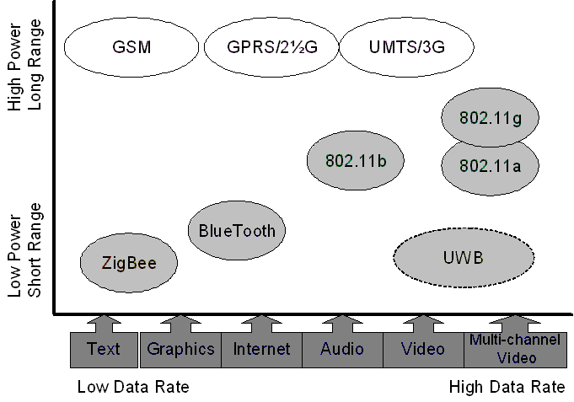
Comparison with other technologies
Faster than Bluetooth, Wi Fi
Data rate of 450Mbps instead of 1Mbps
Complementary to existing radio technologies like 802.11
Notes:
Comparing with Bluetooth and wifi
=======================
1 The next generation of PC, consumer electronics, and mobile applications demand connectivity speeds beyond the 1 Mbps peak data rate of Bluetooth Technology,. While Wi-Fi is much faster than Bluetooth Technology, it still does not deliver sufficient performance to effectively allow streaming of multiple simultaneous high-quality video streams. UWB technology provides the throughput required by the next generation of converged devices.
Comparing with 802.11 i.e. wireless lan
=======================
2 802.11 defines a local area network with a range of up to 100m. Ultra-Wideband is suitable for short-range connectivity (less than 10 meters). Under current FCC regulations, UWB signals used for commercial communications are capable of delivering very high data rates but only over short ranges . UWB is suitable for high data rate communications over short distances but lacks the power required to support local area networking.
3 As seen from the image, the market of UWB lies in the Low power, short range area. This means that UWB is not going to replace existing technologies, instead it is complementary to existing technologies.

Slide 11
UWB Applications
Replacing IEEE 1394 cables with wireless connectivity
No. 1 High quality wireless video
Accurate Ranging information
Radar and Imaging
Notes:
2 Right now the best killer application for UWB is home multimedia networking systems, where high bandwidth is crucial. UWB can support multiple channel multimedia streaming of broadcast quality video, making it the preferred technology to use when setting up a wireless home multimedia network.
3 application is ranging.With a single receiver, you can determine the range of a transmitter; with three receivers you can use triangulation to determine position with a much higher degree of accuracy than a GPS (global positioning system). Examples of ranging products include proximity-detection devices, such as collision detectors in cars, and tracking devices.
4 A third application class is radar and imaging. Because UWB uses a wide band of spectrum, the signal can more easily penetrate walls than can a narrowband frequency transmitter. Using ranging, a receiver can determine whether an object is moving.

Slide 12
Wireless USB
Wireless USB Promoter Group – define specifications
Backward Compatible
Targeted bandwidth – 480 Mbps
Connection-level security
Notes:
we know the USB is now a de facto standard for connection of devices such as mobiles to the PC. The next step for USB technology is wireless USB. Wireless USB will be high speed wireless interconnect technology to take advantages of UWB. Building on the success of wired USB, it will bring USB technology into the wireless world.
With WUSB, a user can bring a hard disk in proximity to a PC, laptop and, once authentication and authorization are complete, files can be transferred onto the PC.
1 Wireless USB Promoter Group, is group which will be defining the specifications that will eventually provide standards for the technology.
2 In addition to providing wireless connectivity, WUSB will be backwards compatible with wired USB. This will ensure that wireless USB devices can be used on existing platforms like Windows and linux.
3 This bandwidth of WUSB is comparable to the current wired USB 2.0 standard
A typical HDTV video stream consumes bandwidth of 4-7 Mbps. With wireless USB with an effective bandwidth of 480 Mbps, it is possible to manage manage multiple HDTV streams.
4 WUSB security will ensure the same level of security as wired USB. Connection-level security between devices will ensure that the appropriate device is associated and authenticated before operation of the device is permitted. Higher levels of security involving encryption should be implemented at the application level.

Slide 13
Challenges
Interference with other licensed bands
Tradeoffs with noise
Notes:
1 The Federal Communications Commission (FCC) is in the process of determining the legality of Ultra-Wideband (UWB) transmissions. Due to the wideband nature of UWB emissions, it could potentially interfere with other licensed bands in the frequency domain if left unregulated.
2 As we have seen, UWB is an RF wireless technology, and as such is still subject to the same laws of physics as every other RF technology. Thus, there are obvious tradeoffs to be made in signal-to-noise ratio versus bandwidth.

Slide 14
Conclusion
Well suited for high speed, short range WPAN
Supports multimedia data rates, and offers inherent data security.
Dominant player if FCC lightens the limitations
Notes:
UWB has the potential for very high data rates using very low power, however only at very limited range. This will lead to applications well suited for WPAN (Wireless Personal Area Networking). UWB will not be suitable for applications such as WLAN (Wireless Local Area Networking) or WWAN (Wireless Wide Area Networking, cell phone radios), both of which having greater range expectations.
UWB is a promising technology well suited for high speed, short range, wireless personal area connectivity for PC, CE and mobile devices
UWB is appealing because it looks like noise to other RF technologies, supports multimedia data rates, and offers inherent data security.
As far as WLANs are concerned, UWB is not in an immediate position to take over. This has to so with the power limitations imposed by the FCC, but even if the limitations are lightened some say that it could take at least five years before UWB will become a dominant player in the wireless LAN market.
There's a possibility that UWB will become the "next best" technology for all types of wireless networks, including wireless LANs.

