Slide 1
Lecture 14
Backtracking

Slide 2


Backtracking
Backtracking is a technique used to solve problems with a large search space, by systematically trying and eliminating possibilities.
Example : Going through a maze?
Which direction to go?
Junction
Portion B
Portion A

Slide 3

Backtracking
One strategy would be to try going through Portion A of the
maze.
If you get stuck before you find your way out, then you
"backtrack" to the junction.
At this point in time you know that Portion A will NOT lead
you out of the maze, so you then start searching in Portion B.

Slide 4
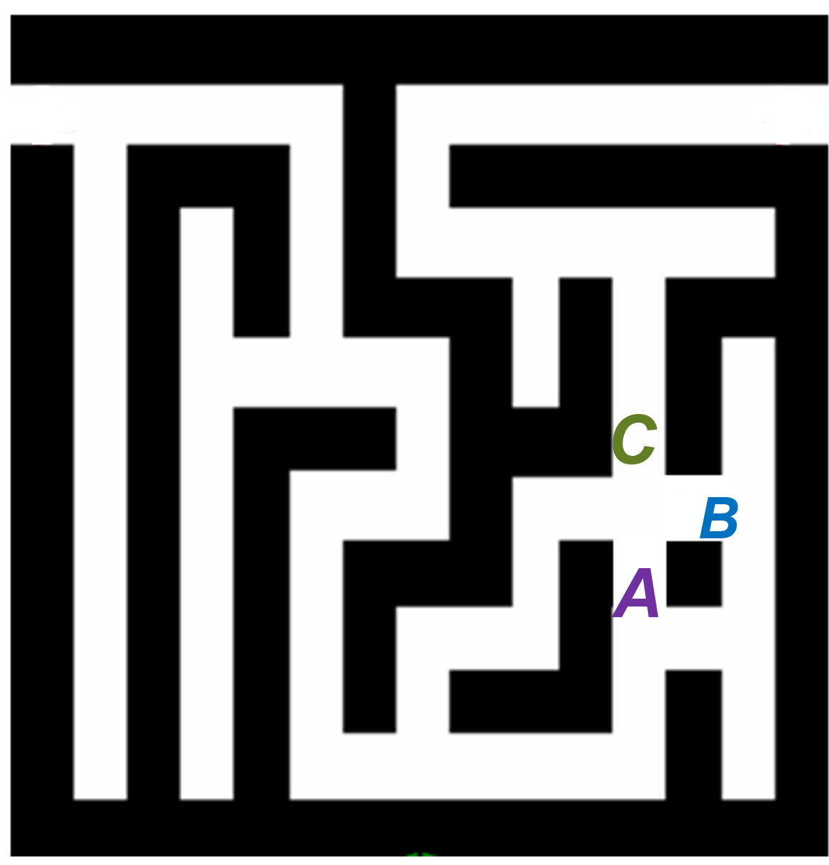

Backtracking
Clearly, at a single junction you could have even more than 2 choices.
The backtracking strategy says to try each choice, one
after the other, if you ever get stuck, "backtrack" to the
Junction and try the next choice.
If you try all choices and never found a way out,
then there is no solution to the maze.
Junction

Slide 5
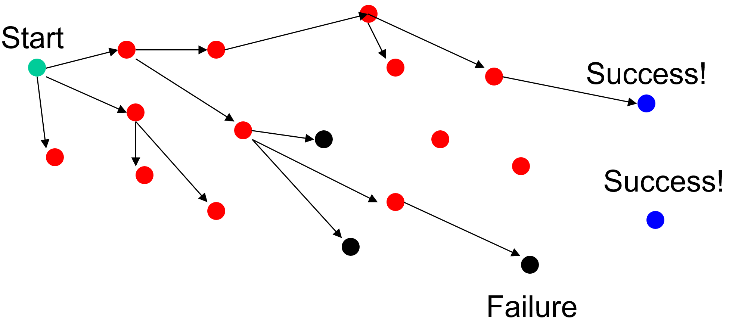
Backtracking
Problem space consists of states (nodes) and actions (paths that lead to new states)
Backtracking as a solution:
If a node only leads to failure go back to its "parent“ node.
Try other alternatives.
If these all lead to failure then more backtracking may be necessary.

Slide 6
Example
Problem: Find out all 3-bit binary numbers for which the sum of the 1's is greater than or equal to 2.
The only way to solve this problem is to check all the possibilities: (000, 001, 010, ....,111)
The 8 possibilities are called the search space of the problem.
They can be organized into a tree.

Slide 7
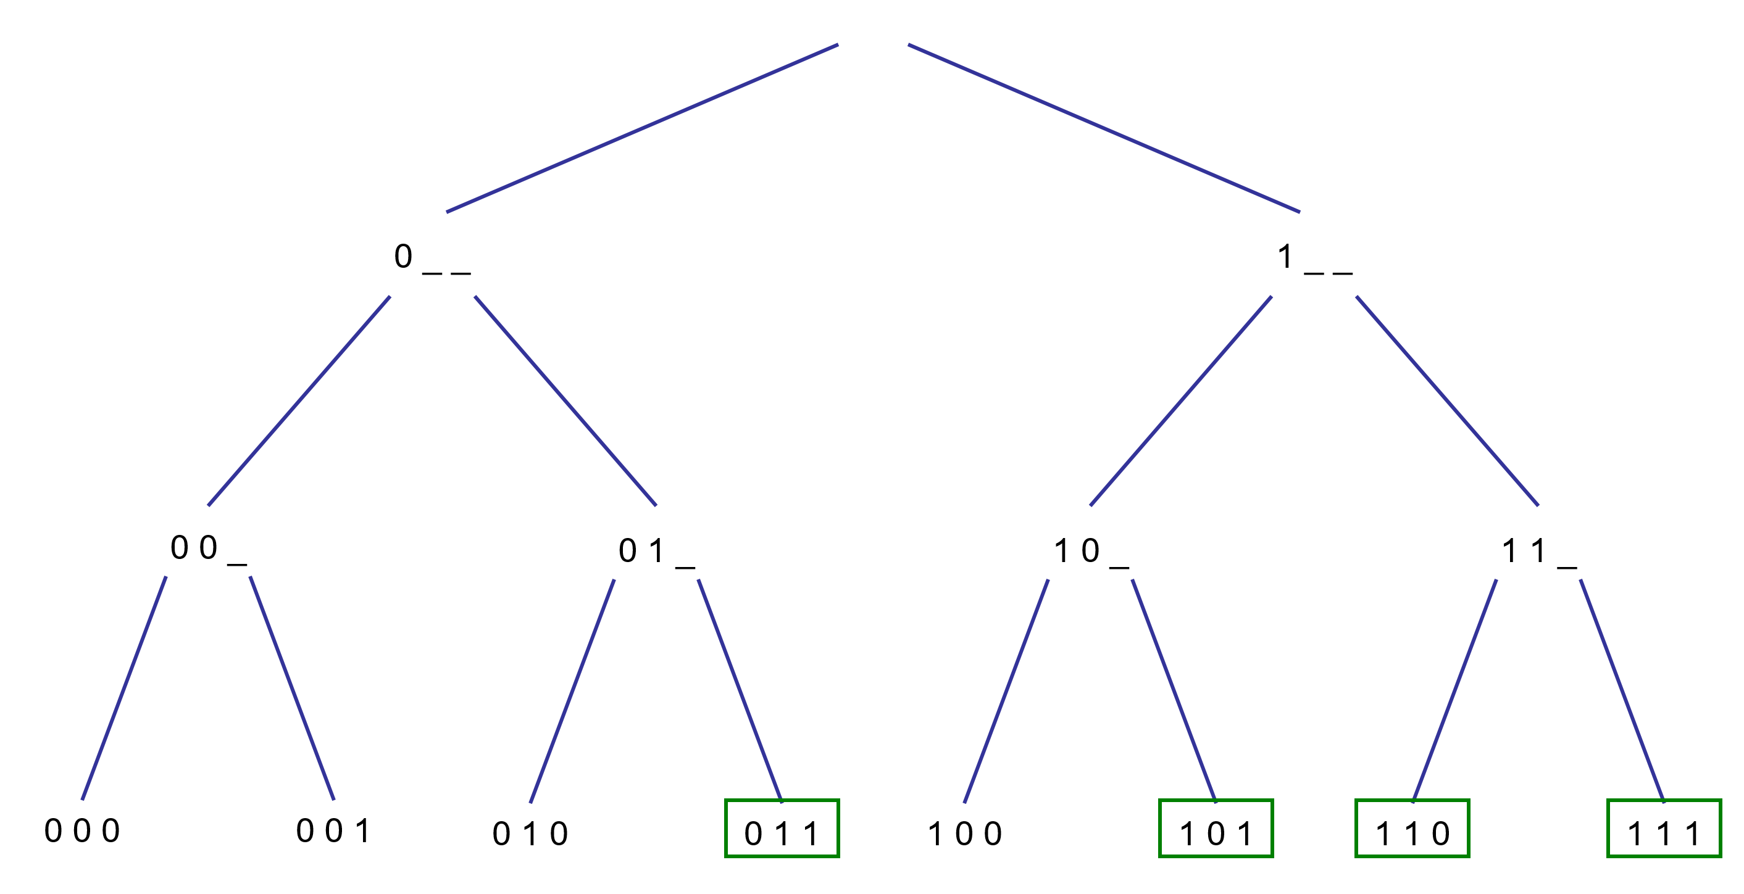
Search Space Tree

Slide 8
Building a solution: Backtracking
For some problems, the only way to solve is to check all possibilities.
Backtracking is a systematic way to go through all the possible configurations of a search space.
We assume our solution is a vector (a(1),a(2), a(3), ..a(n)) where each element a(i) is selected from a finite ordered set S.

Slide 9

Building a solution: Backtracking
We build a partial solution v = (a(1), a(2),..., a(k)), extend it and test it.
If the partial solution is still a candidate solution,
proceed.
else
delete a(k) and try another possible choice for a(k).
If possible choices of a(k) are exhausted,
backtrack and try the next choice for a(k-1).

Slide 10
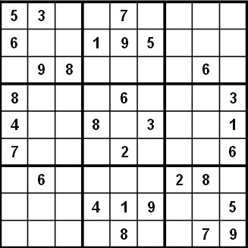
Example 2: Sudoku
Given: 9 by 9 matrix with some numbers filled in.
All numbers must be between 1 and 9
Goal: Each row, each column, and each mini matrix must
contain the numbers between 1 and 9 once each.
No duplicates in rows, columns, or mini matrices

Slide 11



Solving Sudoku : Brute Force
Brute force Sudoku Solution
if not open cells, solved
scan cells from left to right, top to bottom for first open cell
When an open cell is found start cycling through digits 1 to 9.
When a digit is placed check that the set up is legal
now solve the board.
A brute force algorithm is a simple but general approach
Try all combinations until you find one that works
This approach isn’t clever, but computers are fast
Then try and improve on the brute force results

Slide 12

Solving Sudoku: Later Steps
1
1
2
1
2
4
1
2
4
8
1
2
4
8
9
6
Uhh-Oh!!!!

Slide 13
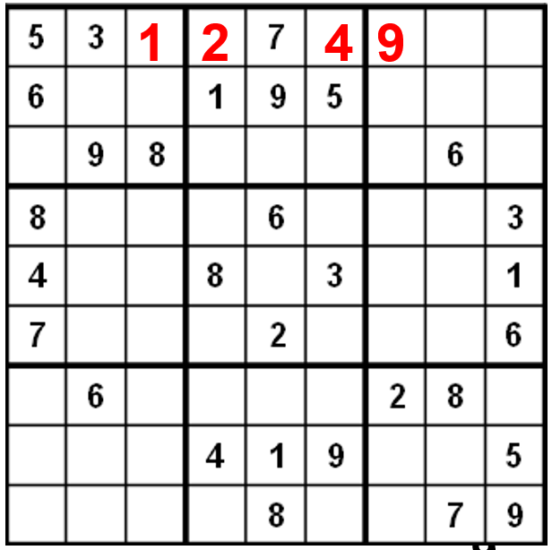
Sudoku : A Dead End
We have reached a dead end in our search.
With the current set up none of the nine digits work in
the top right corner.
When the search reaches a dead end in backs up to the
previous cell it was trying to fill and goes onto to the next
digit.
We would back up to the cell with a 9 and that turns out to be
a dead end as well so we back up again.
So the algorithm needs to remember what digit to try next.
Now in the cell with the 8. We try and 9 and move forward again.

Slide 14
Brute Force Vs. Backtracking
Brute force algorithms are slow.
The don't employ a lot of logic.
For example we know a 6 can't go in the last 3 columns of the first row, but the brute force algorithm will plow ahead any way.
But, brute force algorithms are fairly easy to implement as a first pass solution.
Backtracking is a form of a brute force algorithm.

Slide 15
Backtracking and Recursion
Backtracking is easily implemented with recursion because:
The run-time stack takes care of keeping track of the choices that got us to a given point.
Upon failure we can get to the previous choice simply by returning a failure code from the recursive call.

Slide 16
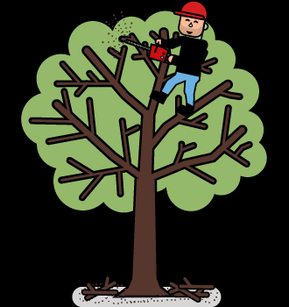
Improving Backtracking: Search Pruning
Search pruning will help us to reduce the search space and hence get a solution faster.
The idea is to a void those paths that may not lead to a
solutions as early as possible by finding contradictions
so that we can backtrack immediately without the need
to build a hopeless solution vector.

