Slide 1
Lecture 18
Branch and bound

Slide 2
Branch and Bound
A method to systematically search a solution space.
It is a state space search method in which all the children of a node are generated before expanding any of its children.
Like backtracking, it uses bounding functions instead of generating subtrees that do not contain an answer node.
Used in discrete and combinatorial optimization problems.

Slide 3
Backtracking Vs. Branch and Bound
Branch and bound uses a branching function, which can be a depth first search, breadth first search or based on bounding function.
It has a bounding function, which goes far beyond the feasibility test to prune the search tree.
Branch and Bound is the generalisation of both graph search strategies, BFS and DFS.

Slide 4
Search strategies in branch and bound
First-In-First Out (FIFO) search
Last-In-First-Out (LIFO) search
Least-Count search (LC)

Slide 5
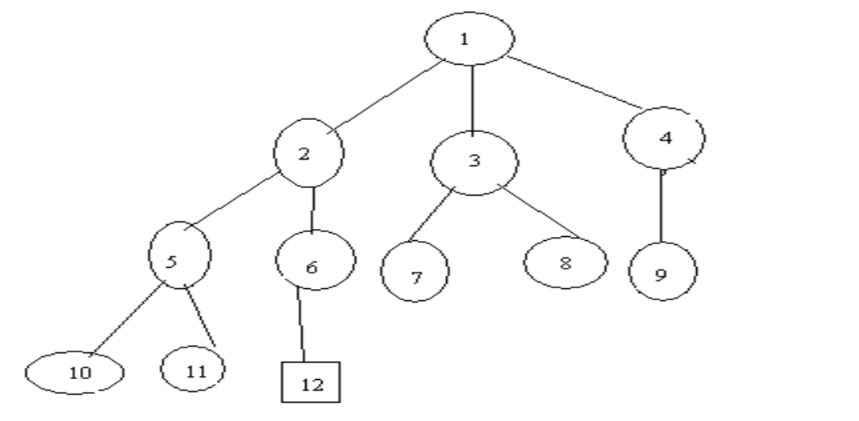
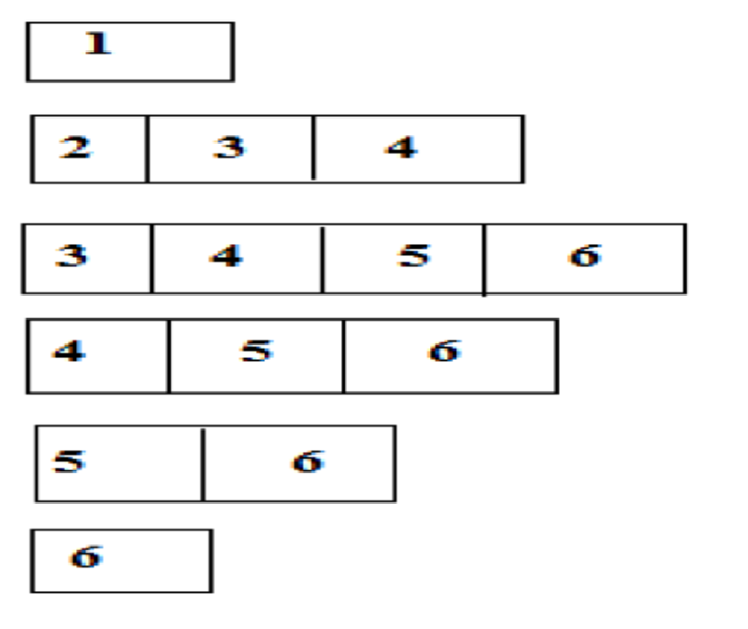
FIFO Search
FIFO Branch and Bound uses BFS.
Children of E-Node (or Live nodes) are inserted in a queue.
Implementation of list of live nodes as a queue
Least() Removes the head of the Queue
Add() Adds the node to the end of the Queue
Assume the node 12 is an answer node (solution)

Slide 6
LIFO Branch and bound
LIFO Branch and Bound is a D-search (or DFS).
In LIFO Branch and Bound children of E-node (live nodes) are inserted in a stack
Implementation of List of live nodes as a stack
Least() Removes the top of the stack
ADD() Adds the node to the top of the stack

Slide 7
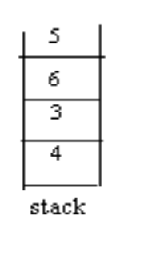
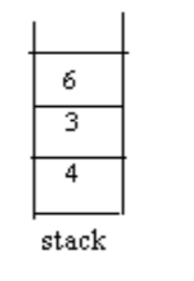
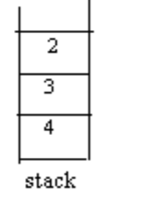
Example: LIFO
………

Slide 8
LC (Least Cost) Branch and Bound Search
In both FIFO and LIFO Branch and Bound, the selection rules for the next E-node in rigid and blind.
The selection rule does not give any preferences to a node that has a very good chance of getting the search to an answer node quickly.
The search for an answer node can be speeded by using an “intelligent” ranking function, also called cost function.
By using ranking function, calculate the cost of each node.
Select the node which has minimum cost.

Slide 9
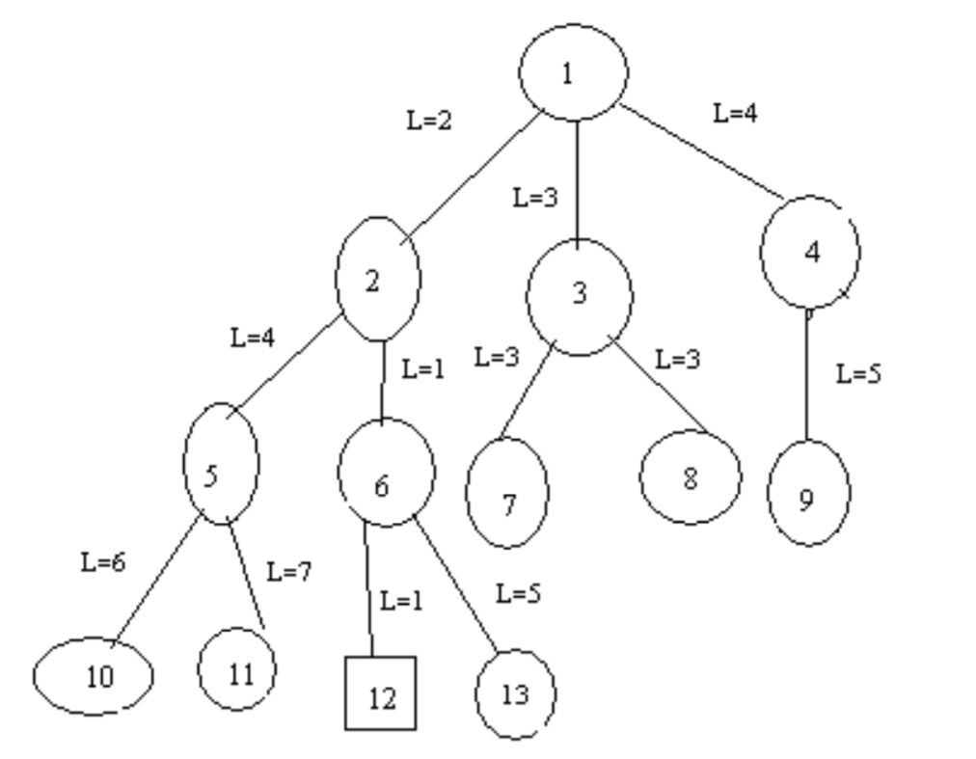
Example: LC Search
Initially node 1 is chosen as E-node.
Generate children of node 1.
By using ranking function,
calculate the cost of nodes2, 3, 4
ĉ =2, ĉ =3, ĉ =4 respectively.
Select a node with minimum cost
i.,e node 2.
For node 2, the children are 5, 6.
Between 5 and 6,select the node 6
since its cost minimum.
Generate children of node 6 i.,e 12 and 13.
Select node 12 since its cost (ĉ =1) is minimum.
Terminate search process

Slide 10
Requirements for LC Search
Branching: A set of solutions, which is represented by a node, can be partitioned into mutually exclusive sets. Each subset in the partition is represented by a child of the original node.
Lower bounding: An algorithm is available for calculating a lower bound on the cost of any solution in a given subset.

Slide 11
Cost and approximation: LC Search
Let t be a state space tree and c() a cost function for the nodes in t.
If x is a node in t, then c(x) is the minimum cost of any answer node in the sub tree with root x. Thus, c(t) is the cost of a minimum-cost answer node in t.
LC search uses ĉ to find an answer node.

Slide 12
Bounding
A branch and bound method searches a state space tree using any search mechanism in which all the children of the E-node are generated before another node becomes the Enode.
A good bounding helps to prune the tree efficiently, leading to a faster exploration of the solution space.
Each time a new answer node is found, the value of upper can be updated.
Branch and bound algorithms are used for optimization problem where we deal directly only with minimization problems.
A maximization problem is easily converted to a minimization problem by changing the sign of the objective function.

Slide 13
Applications
0/1 Knapsack Problem
Branch and bound problem

