Slide 1
Lecture 19
Branch and bound(0/1)

Slide 2
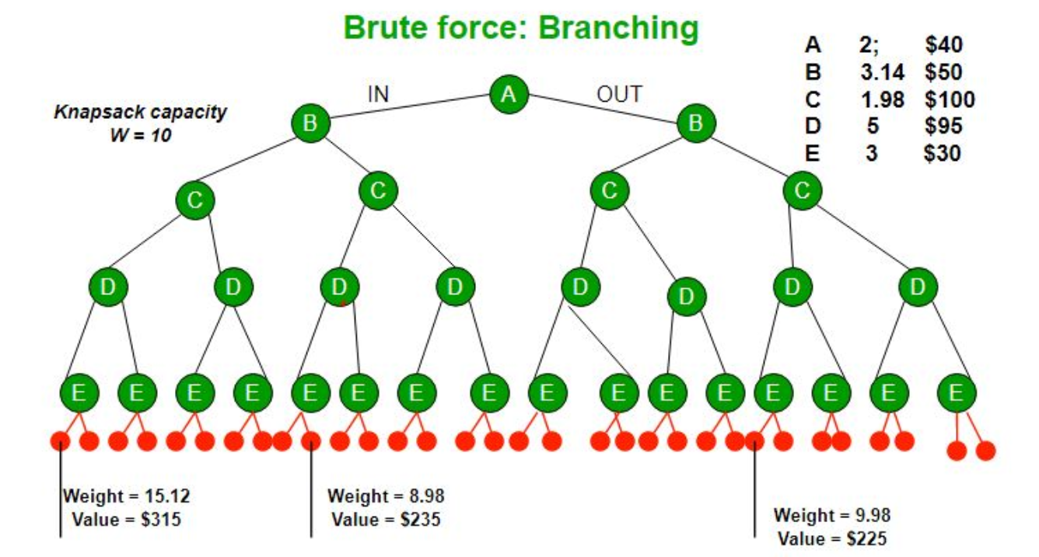
The knapsack Problem
A Greedy approach is to pick the items in decreasing order of value per unit weight. works only for fractional knapsack problem and may not produce correct result for 0/1 knapsack.
Dynamic Programming (DP) uses a 2D table of size n x W. The DP Solution doesn’t work if item weights are not integers.
Brute Force: With n items, there are 2^{n} solutions to be generated, check each to see if they satisfy the constraint, save maximum solution that satisfies constraint. This solution can be expressed as tree.

Slide 3
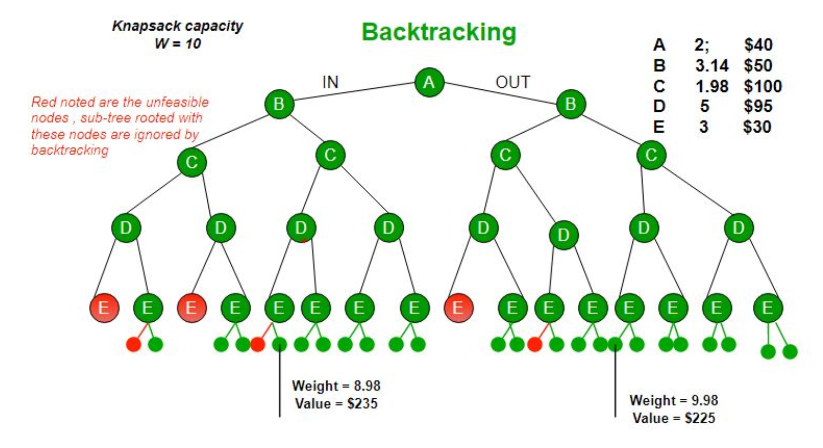
Backtracking to optimize the Brute Force solution of 0/1 knapsack: Perform DFS of tree and If a point where a solution no longer is feasible is reached, Backtrack.
Backtracking would be much more effective if we had even more items or a smaller knapsack capacity.

Slide 4
Why Branch and Bound?
Greedy solution works only for fractional knapsack problem.
Dynamic programming requires all the weight values to be integers.
Complexity for brute force solution is exponential.

Slide 5
Branch & bound approach: 0/1 knapsack problem
Uses the fact that the Greedy approach provides the best solution for Fractional Knapsack problem.
Branch and bound approach uses greedy approach to check if a particular node can give us a better solution or not and finally reaches the optimal solution.
Given: n objects with weight and profit values, and
capacity of knapsack M.
Goal: Select some objects to fill the knapsack in such a way that it should not exceed the capacity of Knapsack and maximum profit can be earned.
Maximisation Problem

Slide 6
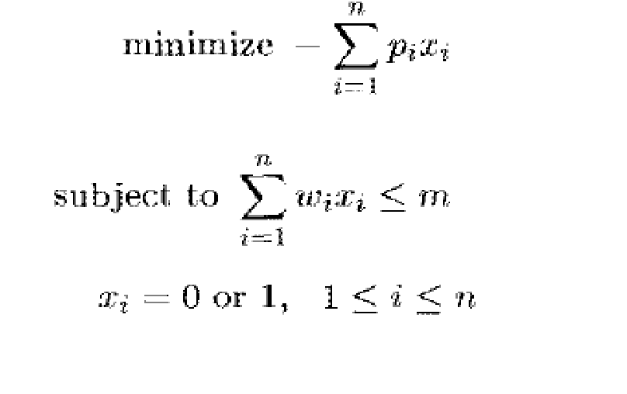
Branch & bound approach: 0/1 knapsack problem
The branch bound deals only the minimization problem and The Knapsack problem is maximization problem.
Modify the knapsack problem to the minimization problem.
p_{i} represents profit of object x_{i}
w_{i} represents weight of object x_{i}

Slide 7
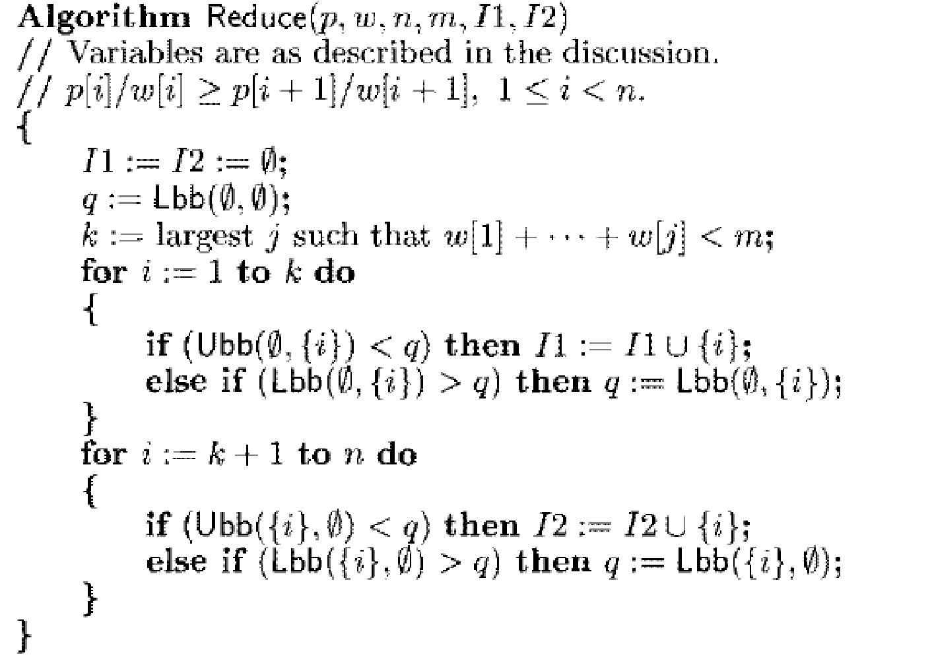
The Algorithm

Slide 8
Example: 0/1 knapsack
Given:
M=15, n=4,
(p1, p2, p3, p4) = 10, 10, 12, 18 and,
(w1, w2, w3, w4)=(2, 4, 6, 9).
Solution:
1. Arrange the item profits and weights with respect of profit by weight ratio.
2. Place the first item in the knapsack. Remaining weight of knapsack is 15 - 2=13.
3. Now, Place next item w2 in knapsack and the remaining weight of knapsack is
13 - 4=9.
4. Place next item w3, in knapsack then the remaining weight of knapsack is 9-6=3.

Slide 9
Solution
5. No fraction are allowed in calculation of upper bound so w4 cannot be placed in knapsack.
Therefore,
Profit= p1+p2+ p3,=10+10+12. So, Upper bound=32
6. To calculate Lower bound we can place w4 in knapsack since fractions are allowed in calculation of lower bound.
Lower bound=10+10+12+ (3/9*18)=32+6=38
7. In order to convert maximization problem into minimization problem, we have to take negative sign for upper bound and lower bound.
Therefore,
Upper bound (U) =-32 and Lower bound (L)=-38
8. Now we will calculate upper bound and lower bound for nodes 2, 3

Slide 10
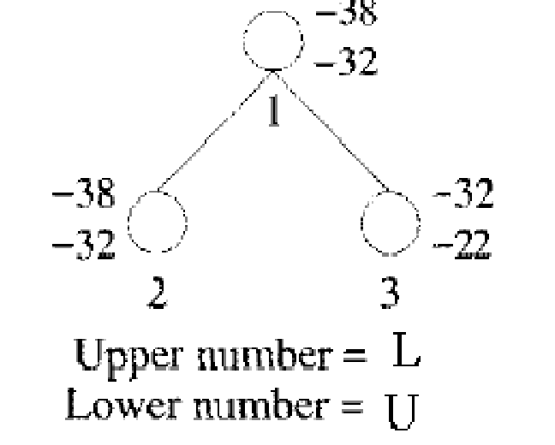
Solution
For node 2, x1=1, means we should place first item in the knapsack. U=10+10+12=32, make it as -32
L=10+10+12+ (3/9*18) = 32+6=38, we make it as -38
For node 3, x1=0, means we should not place first item in the knapsack. U=10+12=22, make it as -22
L=10+12+ (5/9*18) = 10+12+10=32, we make it as -32

Slide 11
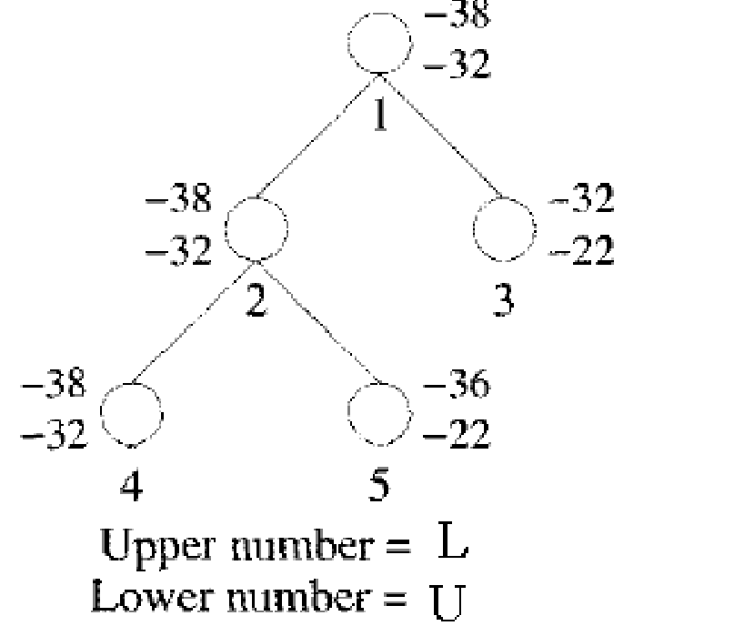
Solution
9. Next, calculate difference of upper bound and lower bound for nodes 2, 3
For node 2, U-L=-32+38=6
For node 3, U-L=-22+32=10
Choose node 2, since it has minimum difference value of 6.
10. calculate lower bound and upper bound of node 4 and 5
11. Calculate difference of lower and upper bound of nodes 4 and 5. For node 4, U-L=-32+38=6 For node 5,
U-L=-22+36=14
Choose node 4, since it has minimum difference value of 6

Slide 12
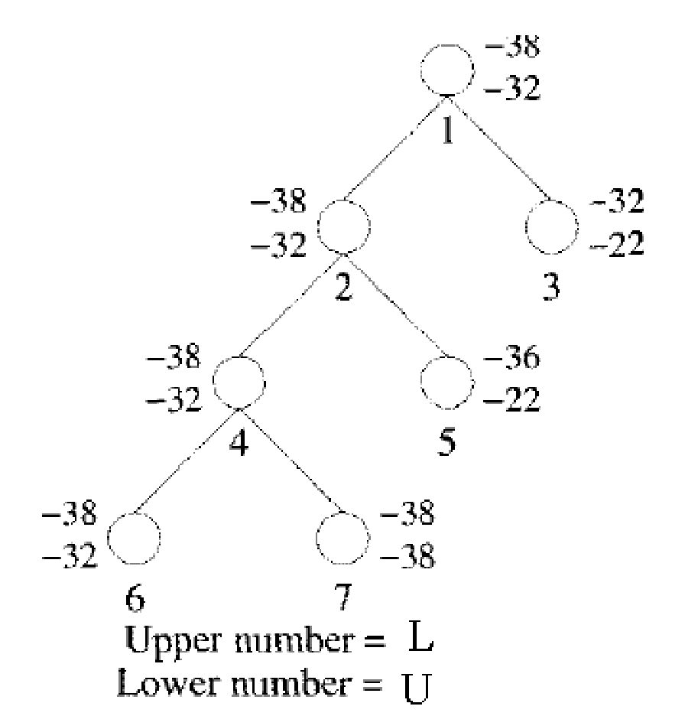
Solution
Calculate difference of lower and upper bound of
nodes 6 and 7.
For node 6, U-L=-32+38=6
For node 7, U-L=-38+38=0
Choose node 7, since it has minimum difference
value of 0.

Slide 13
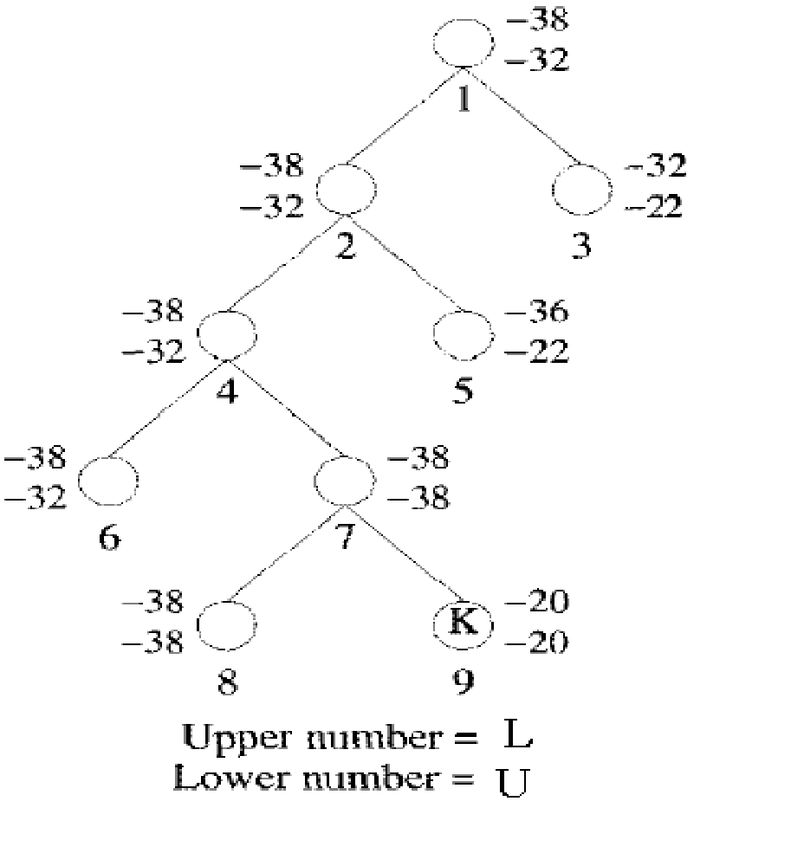
Solution
Calculate lower bound and upper bound of node 8 and 9.
Calculate difference of lower and upper bound of nodes 8 and 9.
For node 8, U-L=-38+38=0
For node 9, U-L=-20+20=0
Here, the difference is same, so compare upper bounds of
nodes 8 and 9. Discard the node, which has maximum upper
bound.
Choose node 8, discard node 9 since, it has maximum
upper bound.

Slide 14
Solution
Consider the path from 1 2 4 7 8
X1=1
X2=1
X3=0
X4=1
The solution for 0/1 knapsack problem is ( x1, x2, x3, x4)=(1, 1, 0, 1)
Maximum profit is:
∑pixi =10*1+10*1+12*0+18*1
=10+10+18
=38.

