Slide 1
Lecture 20
Branch and bound(TSP)

Slide 2
TRAVELLING SALES PERSON PROBLEM
Input:
G = (V', E) be a directed graph
Cij is the cost of edge (i, j),
Cij = ∞ if (i, j) != E
Goal:
To find the shortest possible tour that visits every node exactly once and returns to the starting point.

Slide 3
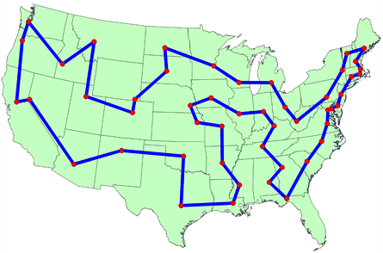
Approaches to Solve TSP
Naive Solution
Dynamic Programming
Branch and Bound

Slide 4
Naïve’s/ Brute Force Approach
Consider city 1 as the starting and ending point.
2) Generate all (n-1)! Permutations of cities.
3) Calculate cost of every permutation and keep track of minimum cost permutation.
4) Return the permutation with minimum cost.
Time Complexity: Θ(n!)

Slide 5
Dynamic Programming
To calculate cost(i) using Dynamic Programming, we need to have some recursive relation in terms of sub-problems.
There are at most O(n*2^{n}) subproblems, and each one takes linear time to solve.
The total running time is therefore O(n²*2^{n}).
The time complexity is much less than O(n!), but still exponential.
Space required is also exponential.
So this approach is also infeasible even for slightly higher number of vertices.

Slide 6
Branch and Bound
Cost through a node includes two costs:
1) Cost of reaching the node from the root (When we reach a node, we have this cost computed) 2) Cost of reaching an answer from current node to a leaf (We compute a bound on this cost to decide whether to ignore subtree with this node or not).

Slide 7
Procedure
Reduce the given cost matrix.
Row Reduction
Column Reduction
2. Calculate the reduced cost matrix for every node.
If path (i,j) is considered then change all entries in row i and column j of A to α.
Set A(j,1) to α.
Apply row reduction and column reduction except for rows and columns containing only α. Let r is the total amount subtracted to reduce the matrix.
Find ĉ(S)= ĉ(R)+A(i,j)+r.
Repeat step 2 until all nodes are visited.

Slide 8
Row Reduction
Take the minimum element from first row, subtract it from all elements of first row, next take minimum element from the second row and subtract it from second row. Similarly apply the same procedure for all rows.
Find the sum of elements, which were subtracted from rows.
Apply column reductions for the matrix obtained after row reduction.

Slide 9
Column Reduction
Take the minimum element from first column, subtract it from all elements of first column, next take minimum element from the second column and subtract it from second column. Similarly apply the same procedure for all columns.
Find the sum of elements, which were subtracted from columns.
Obtain the cumulative sum of row wise reduction and column wise reduction.
Cumulative reduced sum=Row wise reduction sum + Column wise reduction sum.
Associate the cumulative reduced sum to the starting state as lower bound and α as upper bound.

Slide 10
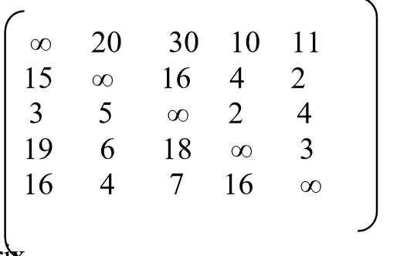
Example: TSP
Find the LC branch and bound solution for the travelling sales person problem whose cost matrix is as follows

Slide 11
Solution
Step 1: Find the reduced cost matrix
Apply now reduction method:
Deduct 10 (which is the minimum) from all values in the 1st row.
Deduct 2 (which is the minimum) from all values in the 2nd row.
Deduct 2 (which is the minimum) from all values in the 3rd row.
Deduct 3 (which is the minimum) from all values in the 4th row.
Deduct 4 (which is the minimum) from all values in the 5th row.

Slide 12
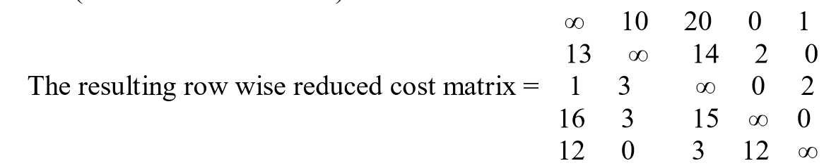
Solution
Row wise reduction sum = 10+2+2+3+4=21.

Slide 13
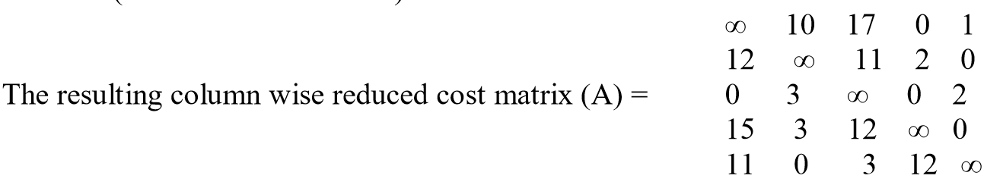
Solution
Now apply column reduction for the above matrix:
Deduct 1 (which is the minimum) from all values in the 1st column.
Deduct 3 (which is the minimum) from all values in the 2nd column.
Column wise reduction sum = 1+0+3+0+0=4.

Slide 14
Solution
Cumulative reduced sum = row wise reduction + column wise reduction sum. = 21+ 4 =25.
This is the cost of a root i.e. node 1, because this is the initially reduced cost matrix.
The lower bound for node is 25 and upper bound is ∞.
Starting from node 1, we can next visit 2, 3, 4 and 5 vertices.
So, consider to explore the paths (1, 2), (1,3), (1, 4), (1,5).

Slide 15
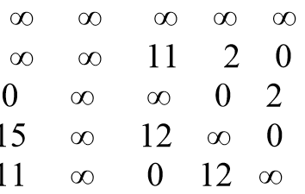
Solution
Step 2: Now consider the path (1, 2)
Change all entries of row 1 and column 2 of A to ∞ and also set A (2, 1) to ∞.
Apply row and column reduction for the rows and columns whose rows and column are not completely ∞.

Slide 16
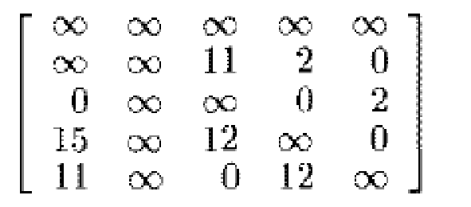
Solution
Then the resultant matrix is
Row reduction sum = 0 + 0 + 0 + 0 = 0
Column reduction sum = 0 + 0 + 0 + 0= 0
Cumulative reduction(r) = 0 + 0=0
Therefore, as ĉ(S)= ĉ(R)+A(1,2)+r
ĉ(S)= 25 + 10 + 0 = 35.

Slide 17
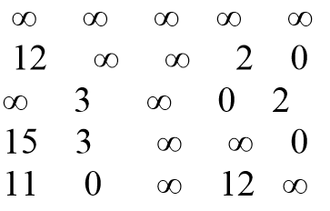
Solution
Now consider the path (1, 3)
Change all entries of row 1 and column 3 of A to ∞ and also set A (3, 1) to ∞.
Apply row and column reduction for the rows and columns whose rows and column are not completely ∞

Slide 18
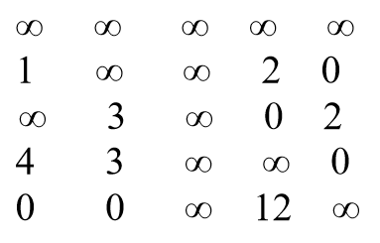
Solution
Then the resultant matrix is =
Row reduction sum = 0
Column reduction sum = 11
Cumulative reduction(r) = 0 +11=11
Therefore, as ĉ(S)= ĉ(R)+A(1,3)+r
ĉ(S)= 25 + 17 +11 = 53.

Slide 19
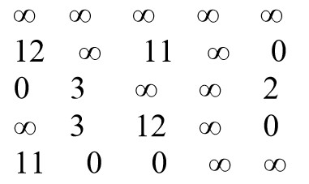
Solution
Now consider the path (1, 4)
Change all entries of row 1 and column 4 of A to ∞ and also set A(4,1) to ∞.
Apply row and column reduction for the rows and columns whose rows and column are not completely ∞

Slide 20
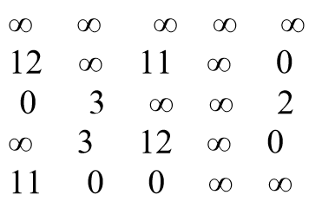
Solution
Then the resultant matrix is =
Row reduction sum = 0
Column reduction sum = 0
Cumulative reduction(r) = 0 +0=0
Therefore, as ĉ(S)= ĉ(R)+A(1,4)+r
ĉ(S)= 25 + 0 +0 = 25.

Slide 21
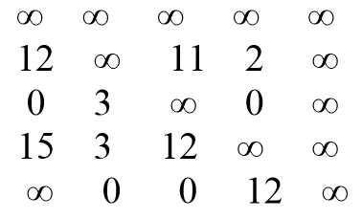
Solution
Now Consider the path (1, 5)
Change all entries of row 1 and column 5 of A to ∞ and also set A(5,1) to ∞.
Apply row and column reduction for the rows and columns whose rows and column are not completely ∞

Slide 22
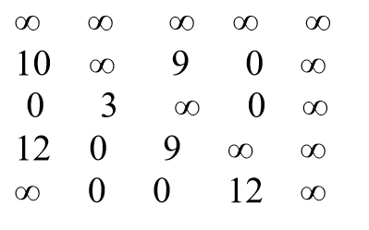
Solution
Then the resultant matrix is =
Row reduction sum = 5
Column reduction sum = 0
Cumulative reduction(r) = 5 +0=0
Therefore, as ĉ(S)= ĉ(R)+A(1,5)+r
ĉ(S)= 25 + 1 +5 = 31.

Slide 23
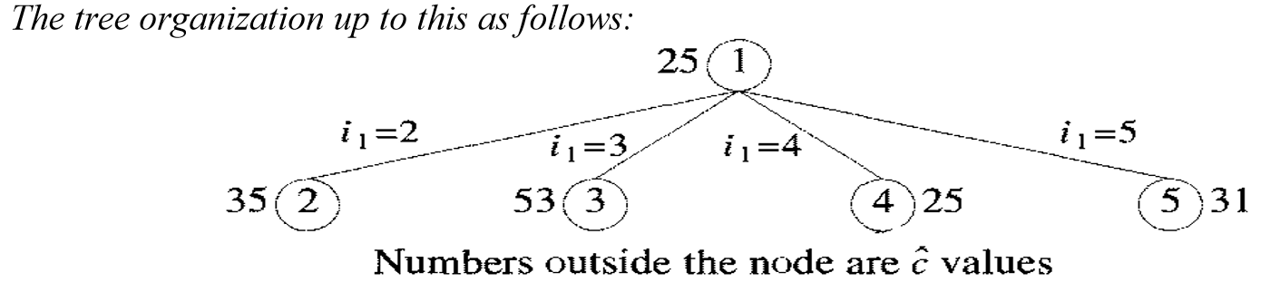
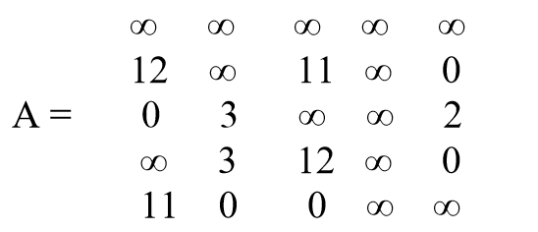
Solution
The cost of the between (1, 2) = 35, (1, 3) = 53, ( 1, 4) = 25, (1, 5) = 31.
The cost of the path between (1, 4) is minimum.
Hence the matrix obtained for path (1, 4) is considered as reduced cost matrix.

Slide 24
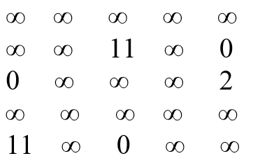
Solution
The new possible paths are (4, 2), (4, 3) and (4, 5).
Now consider the path (4, 2)
Change all entries of row 4 and column 2 of A to ∞ and also set A(2,1) to ∞.

Slide 25
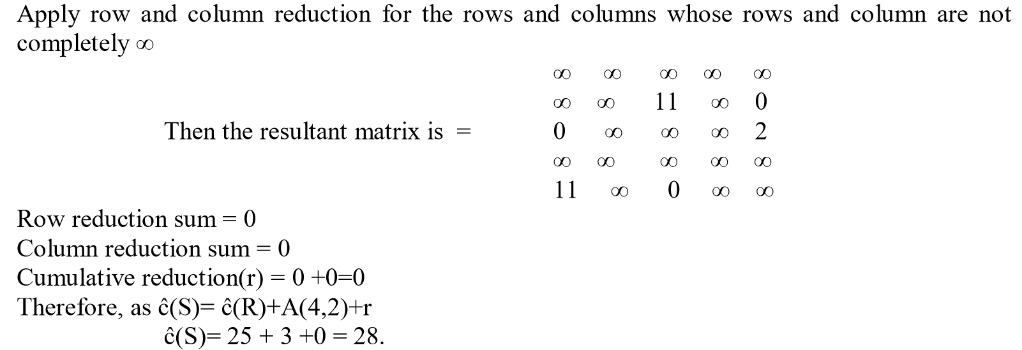
Solution

Slide 26
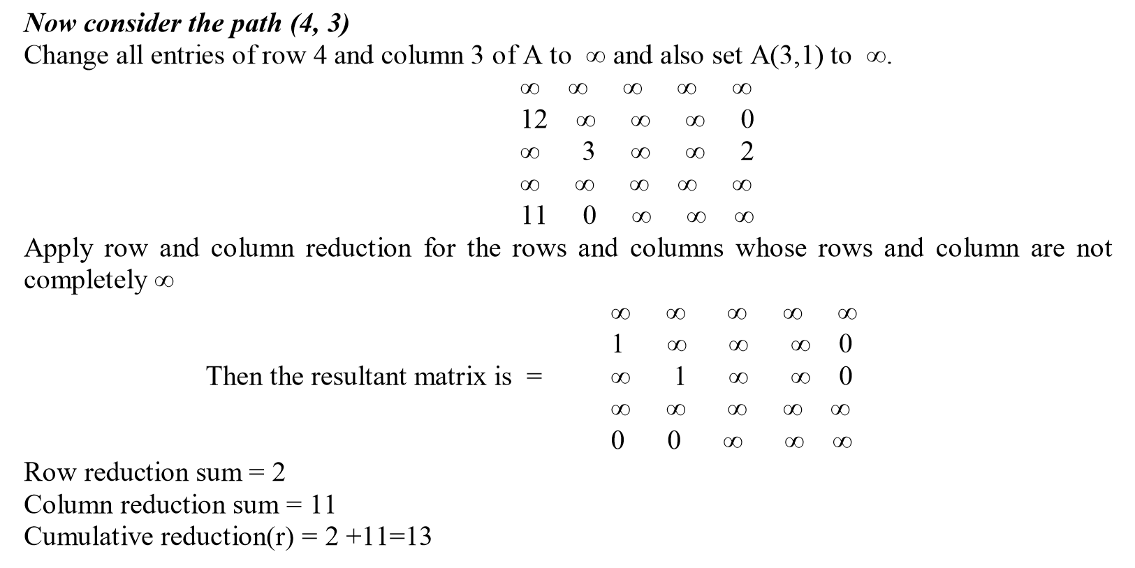
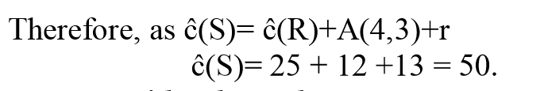
Solution

Slide 27
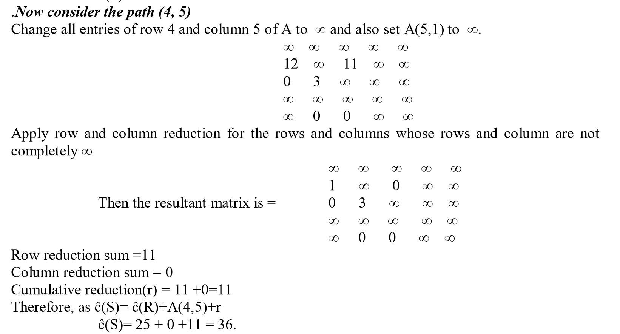
Solution

Slide 28
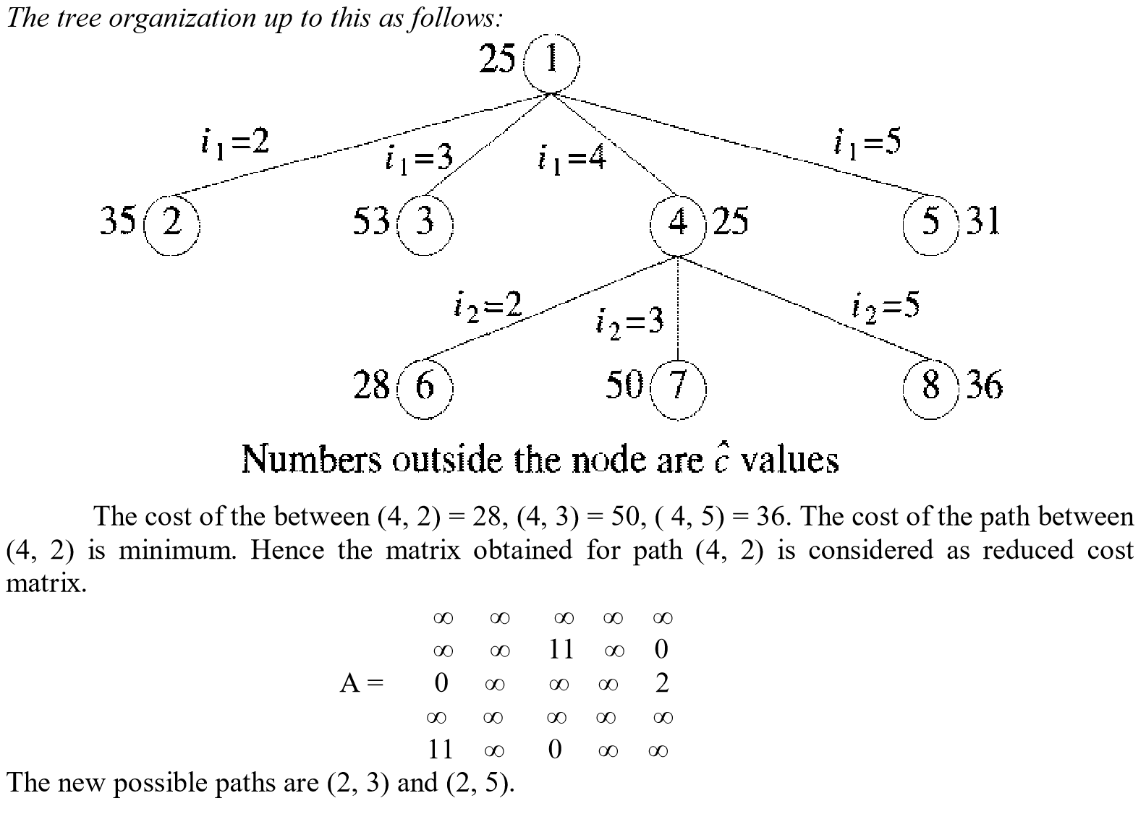
Solution

Slide 29
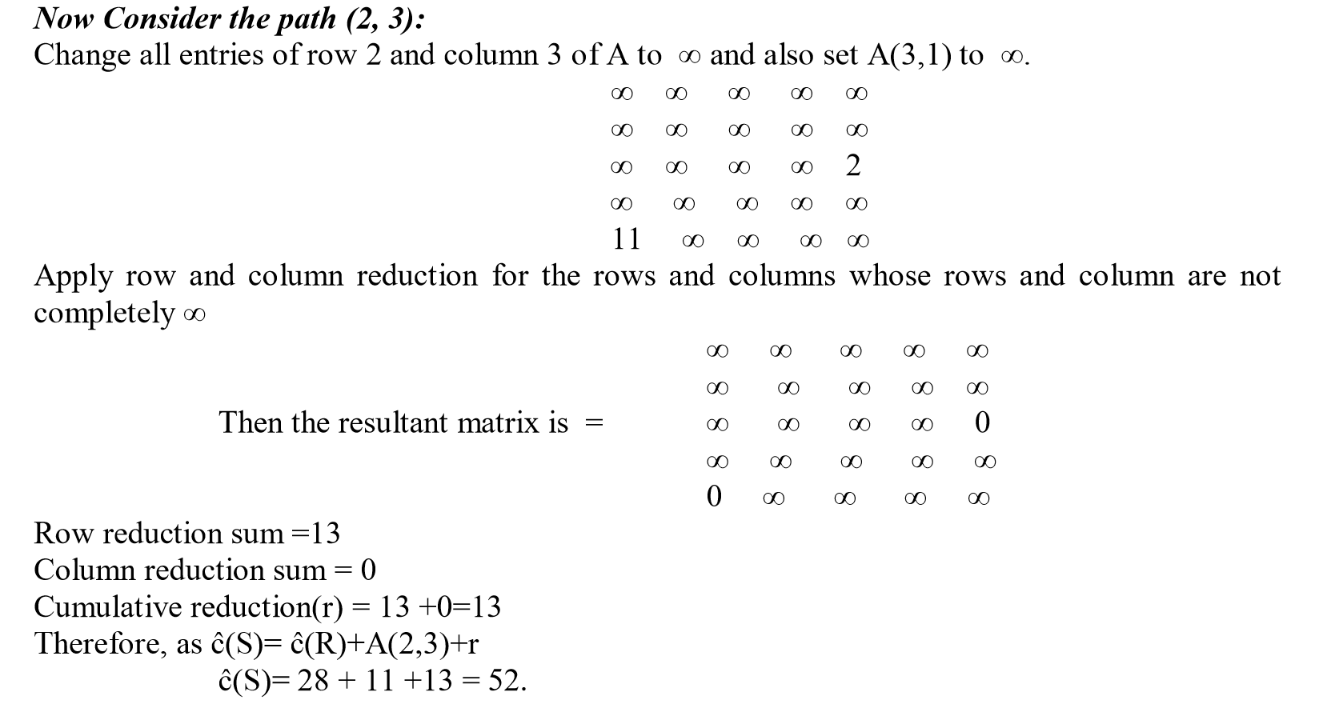
Solution

Slide 30
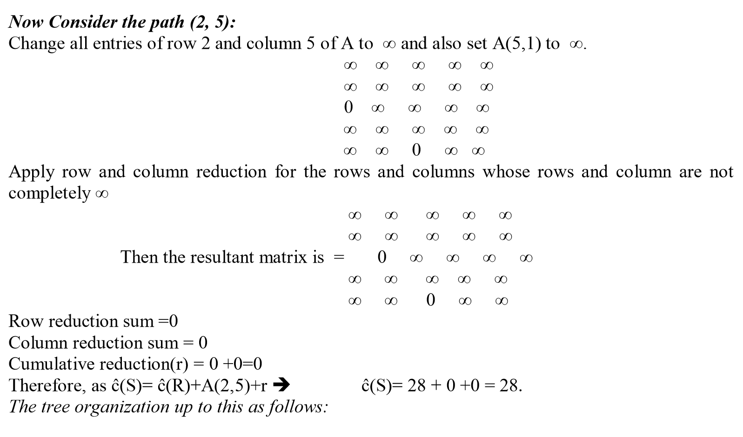
Solution

Slide 31
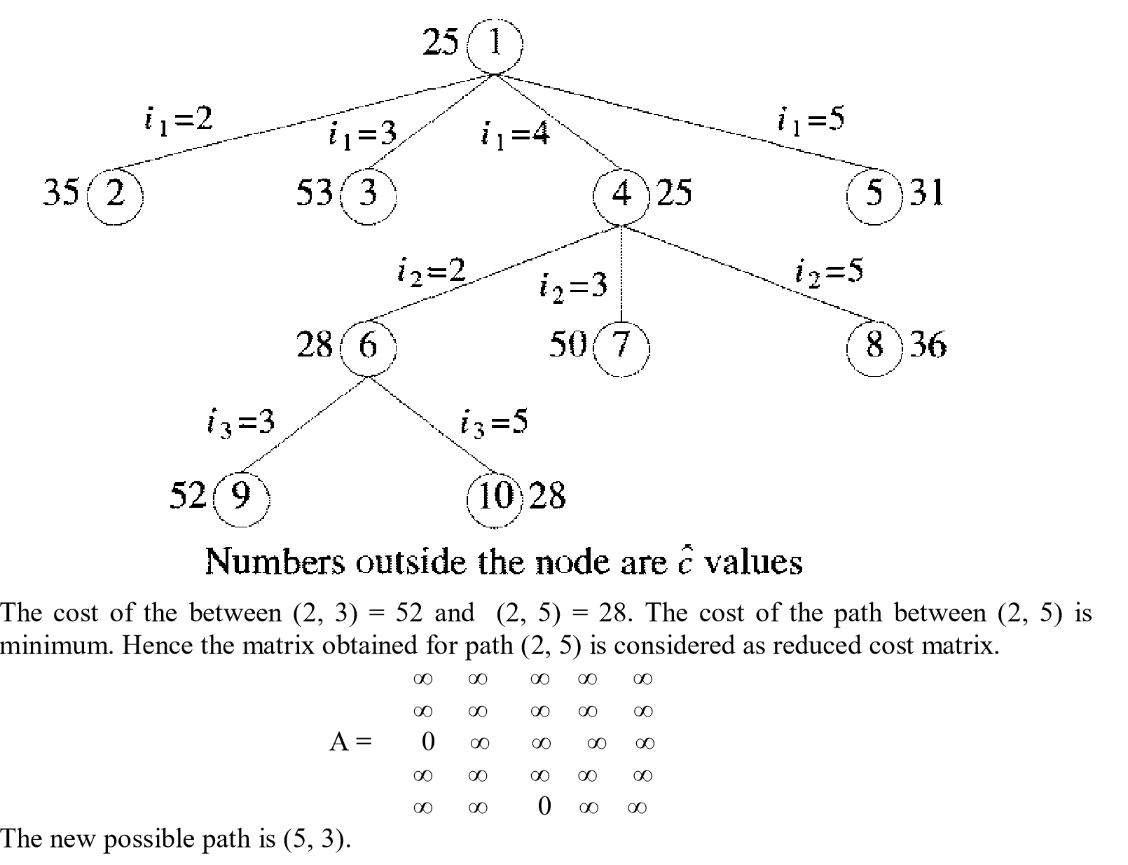
Solution

Slide 32
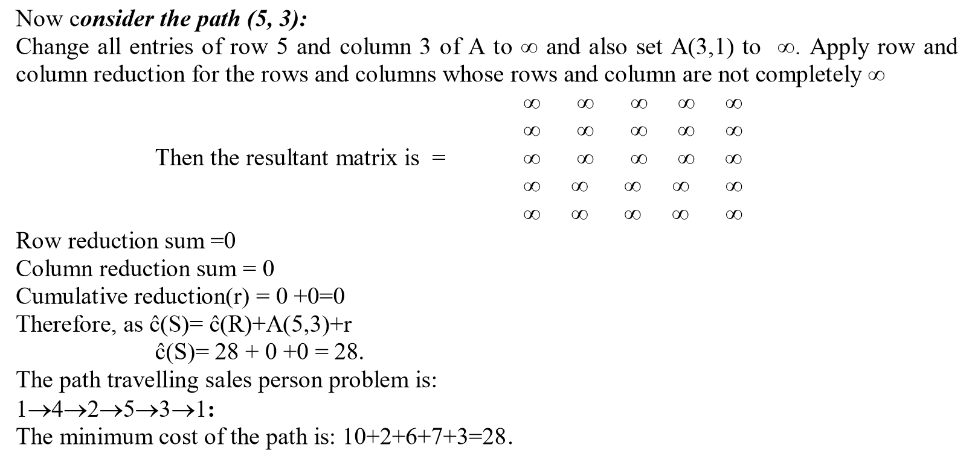
Solution

Slide 33
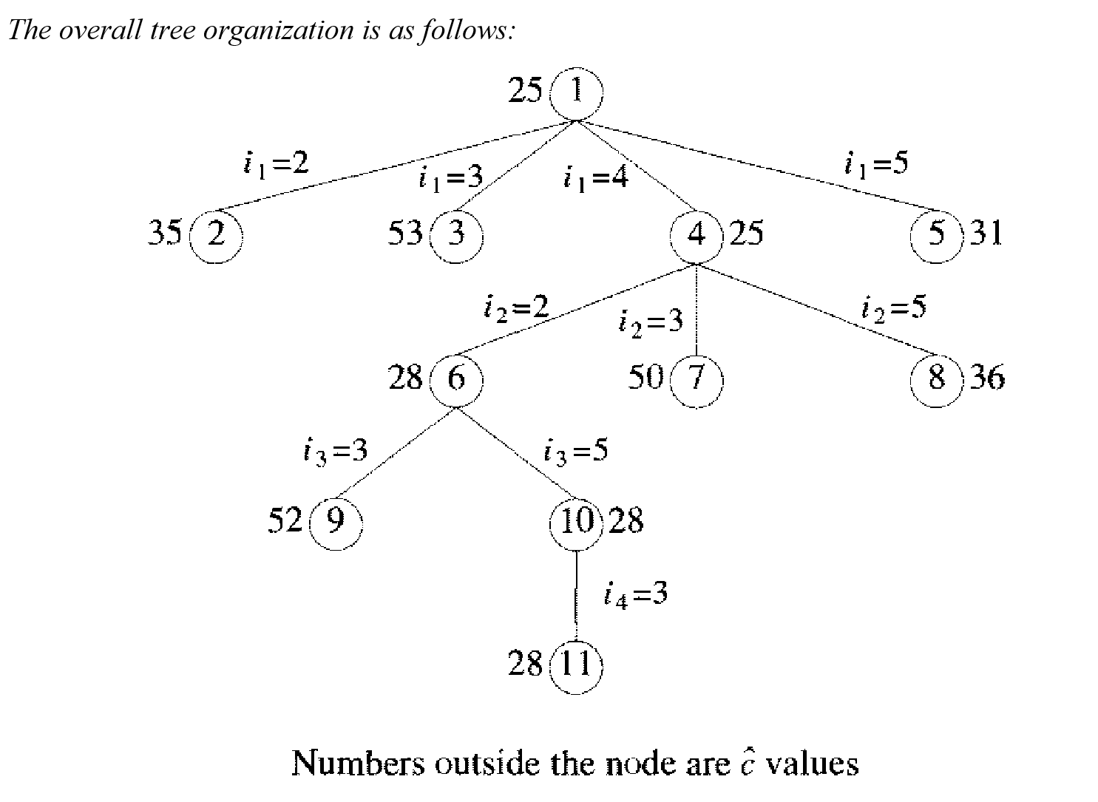
Final Solution

Slide 34
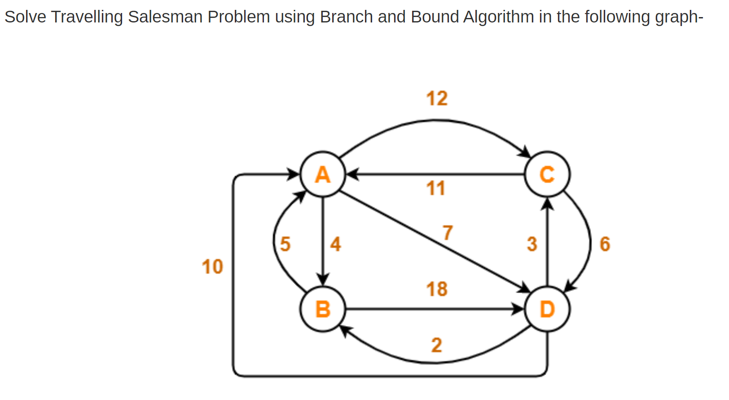
Practice Question

Slide 35
Solution
Optimal path is: A → C → D → B → A
Cost of Optimal path = 25 units
Link to check stepwise solution: https://www.gatevidyalay.com/travelling-salesman-problem-using-branch-and-bound-approach/

