Slide 1
Lecture 11
Dynamic Programming

Slide 2
Dynamic Programming
An algorithm design technique (like divide and conquer).
Applicable when sub-problems are not independent.
Technique for problems with:
Optimal substructure
Overlapping sub-problems

Slide 3
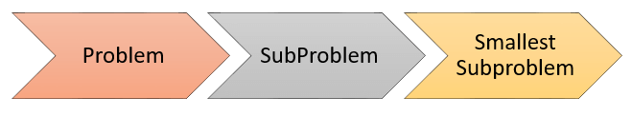
Dynamic Programming
The basic idea of dynamic programming is to use a table to store the solutions of solved sub-problems.
If you face a sub-problem again, you just need to take the solution in the table without having to solve it again.

Slide 4
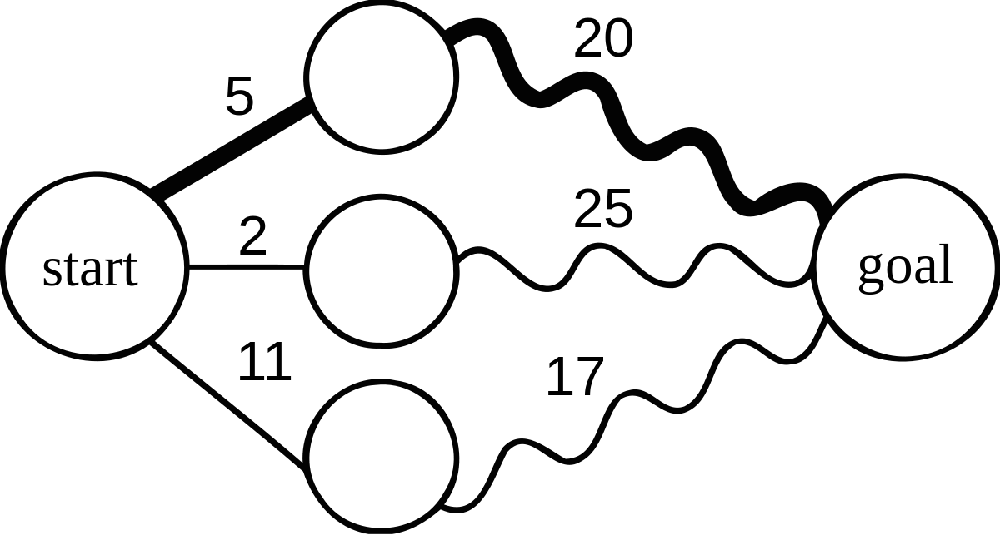
Optimal sub-structure
An optimal solution to a problem contains optimal solutions to sub-problems.
This doesn't necessarily mean that every optimal solution to a sub-problem will contribute to the main solution.
.

Slide 5
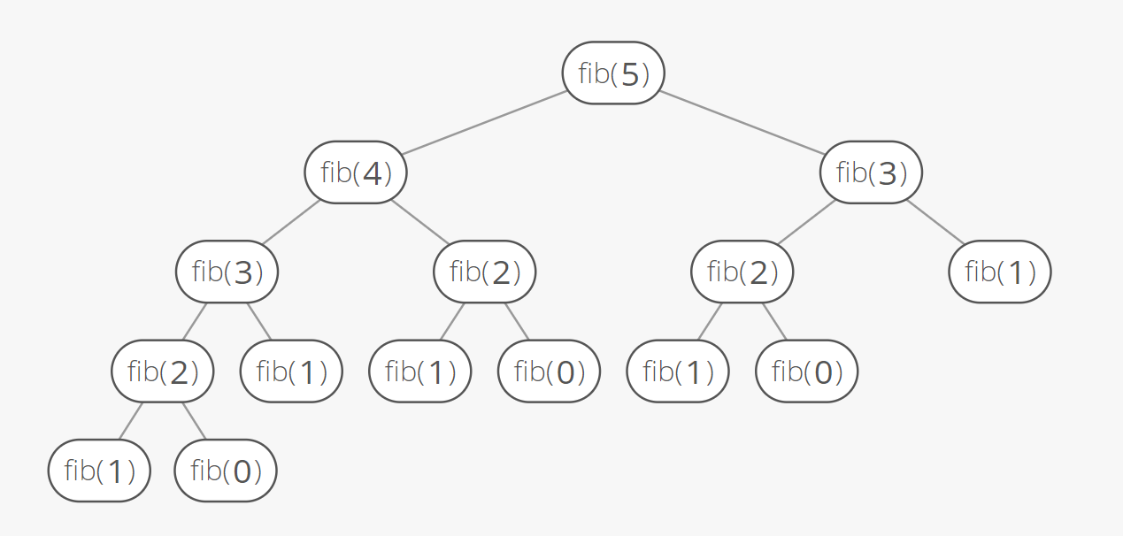
Overlapping Sub-problems
If a recursive algorithm revisits the same sub-problems over and over ⇒ the problem has overlapping sub-problems.

Slide 6
Dynamic Programming: General method
Characterize the structure of an optimal solution.
Recursively define the value of an optimal solution.
Compute the value of an optimal solution in a bottom-up fashion.
Construct an optimal solution from computed information (not always necessary).

Slide 7
A comparison
.
Divide and Conquer
Top Down Approach
Greedy Algorithm
Bottom up Approach
Dynamic Programming
Sub-problems are independent so we can solve them in any order.
We can always choose the "right" sub-problem by a greedy choice.
Not all of them will contribute to solving the larger problem.
We solve many sub-problems and store the results.

Slide 8
0/1 Knapsack problem
Given:
A knapsack with maximum capacity W, and a set S consisting of n items.
Each item i has some weight w_{i} and benefit value b_{i}
Items are indivisible, You either take an item or not.
Problem: How to pack the knapsack to achieve maximum total value of packed items?
The problem is called a “0-1” problem, because each item must be entirely accepted or rejected.
Can we Solve this problem using Greedy?

Slide 9
Brute Force Approach
Problem, in other words, is to find:
Brute-force approach : Since there are n items, there are 2^{n} possible combinations of items. Running time will be O(2^{n}).

Slide 10
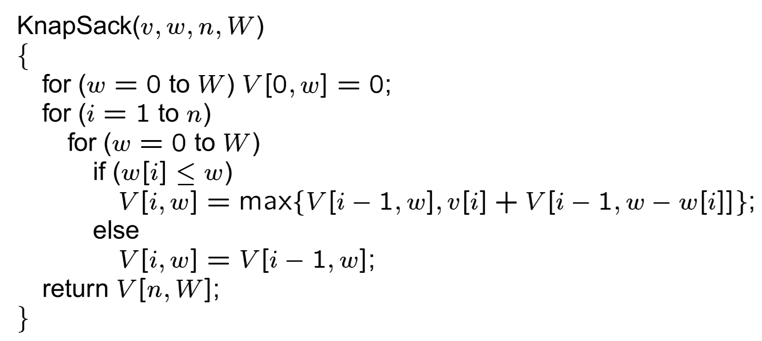
Algorithm: 0/1 Knapsack

Slide 11
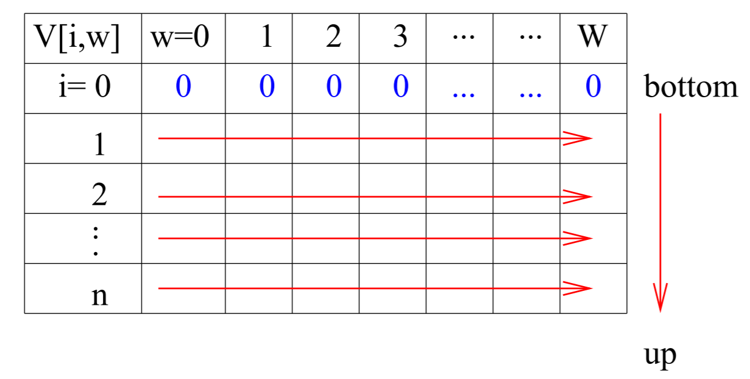
Dynamic Programming: 0/1 Knapsack
Output Function:
V(i,w)=Max[ xi + V(i-1,w-wi) ; V(i-1,w) ]
No Item i + optimum combination items
1 to i-1
One Item i + optimum combination of
weight w-wi

Slide 12
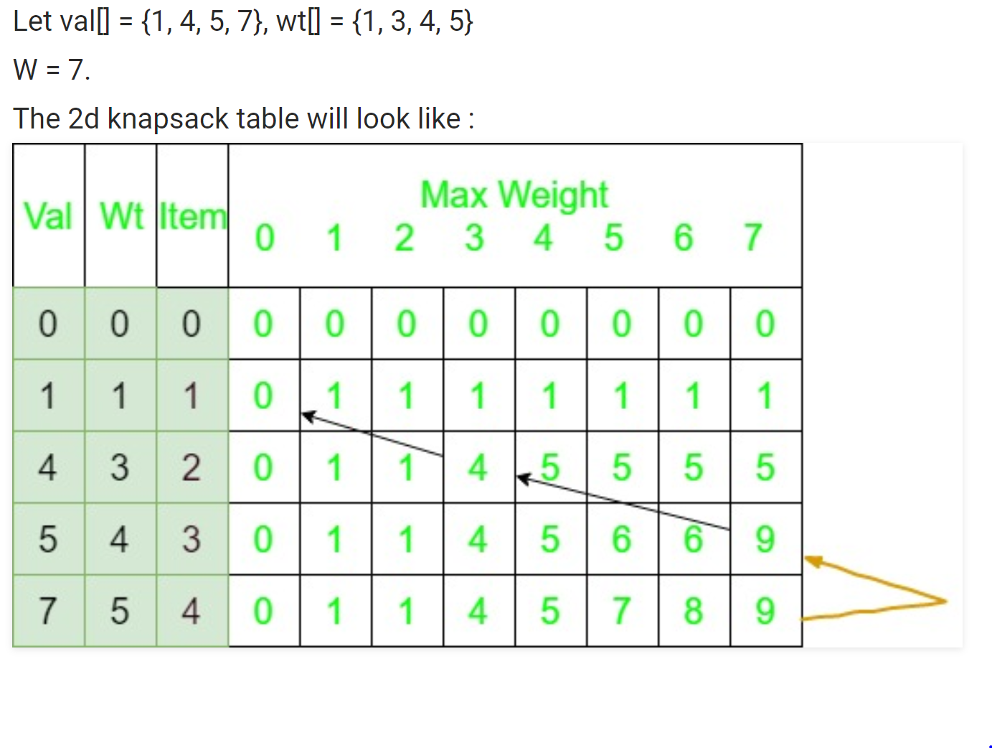
Solution

Slide 13
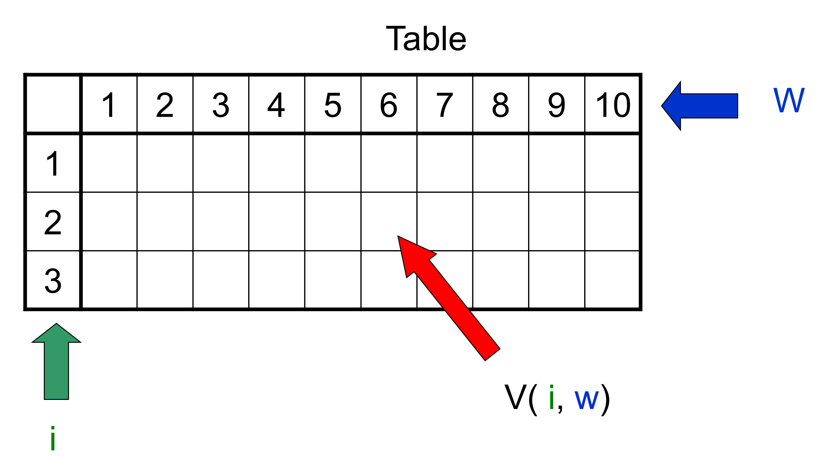
Solution

Slide 14
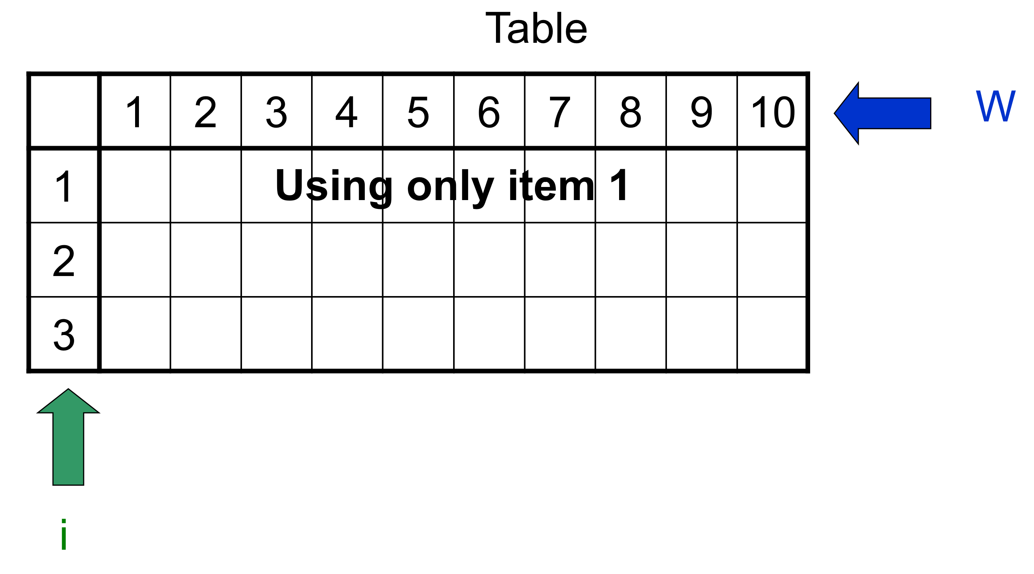
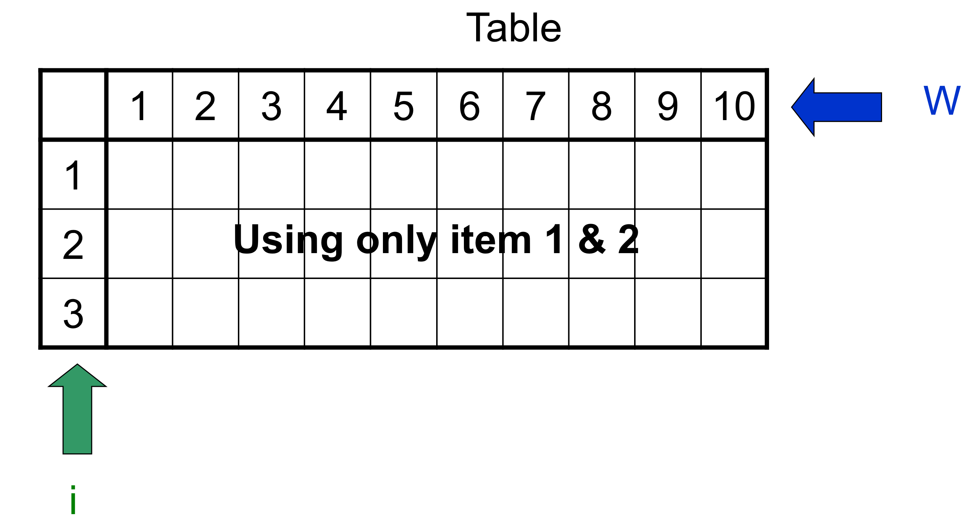
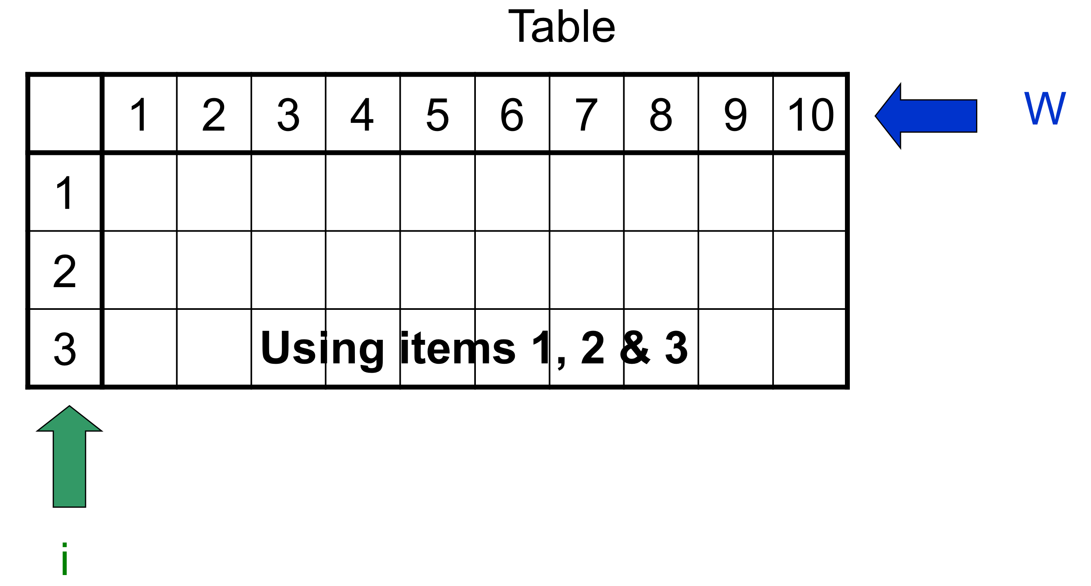
Solution

Slide 15
Complexity Analysis
O(nW)

Slide 16
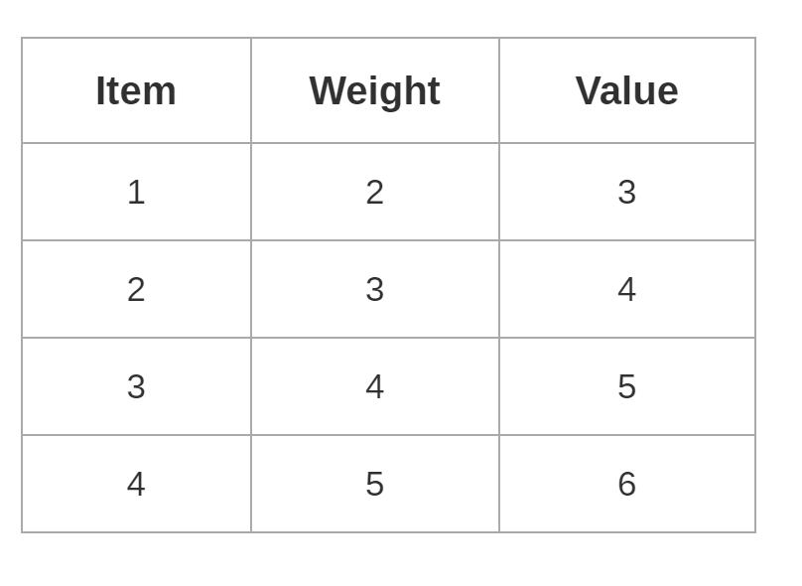
In Class Practice
Ques: For the given set of items and knapsack capacity = 5 kg, find the optimal solution for the 0/1 knapsack problem making use of dynamic programming approach

Slide 17
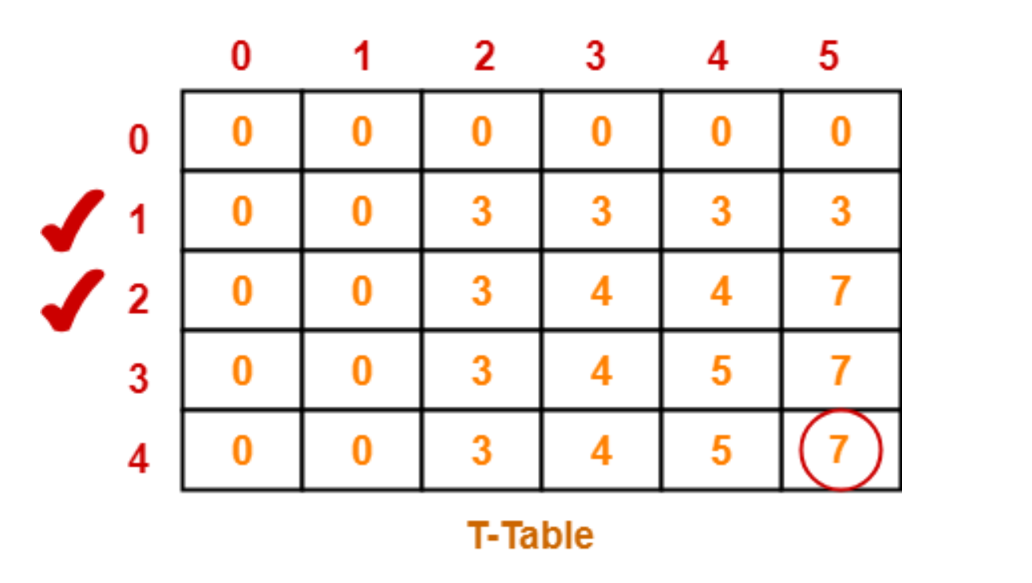
Solution
Thus, items that must be put in the knapsack to obtain the maximum value 7 are-
Item-1 and Item-2

