Slide 1
Lecture 6
Greedy algorithms

Slide 2

The Jumping Frog
The frog begins at position 0 in the river.
Its goal is to get to position n.
There are lily pads at various positions.
There is always a lily pad at position 0
and position n.
The frog can jump at most r units at a
time.
Goal: Find the path the frog should take to
minimize jumps, assuming a solution exists.

Slide 3
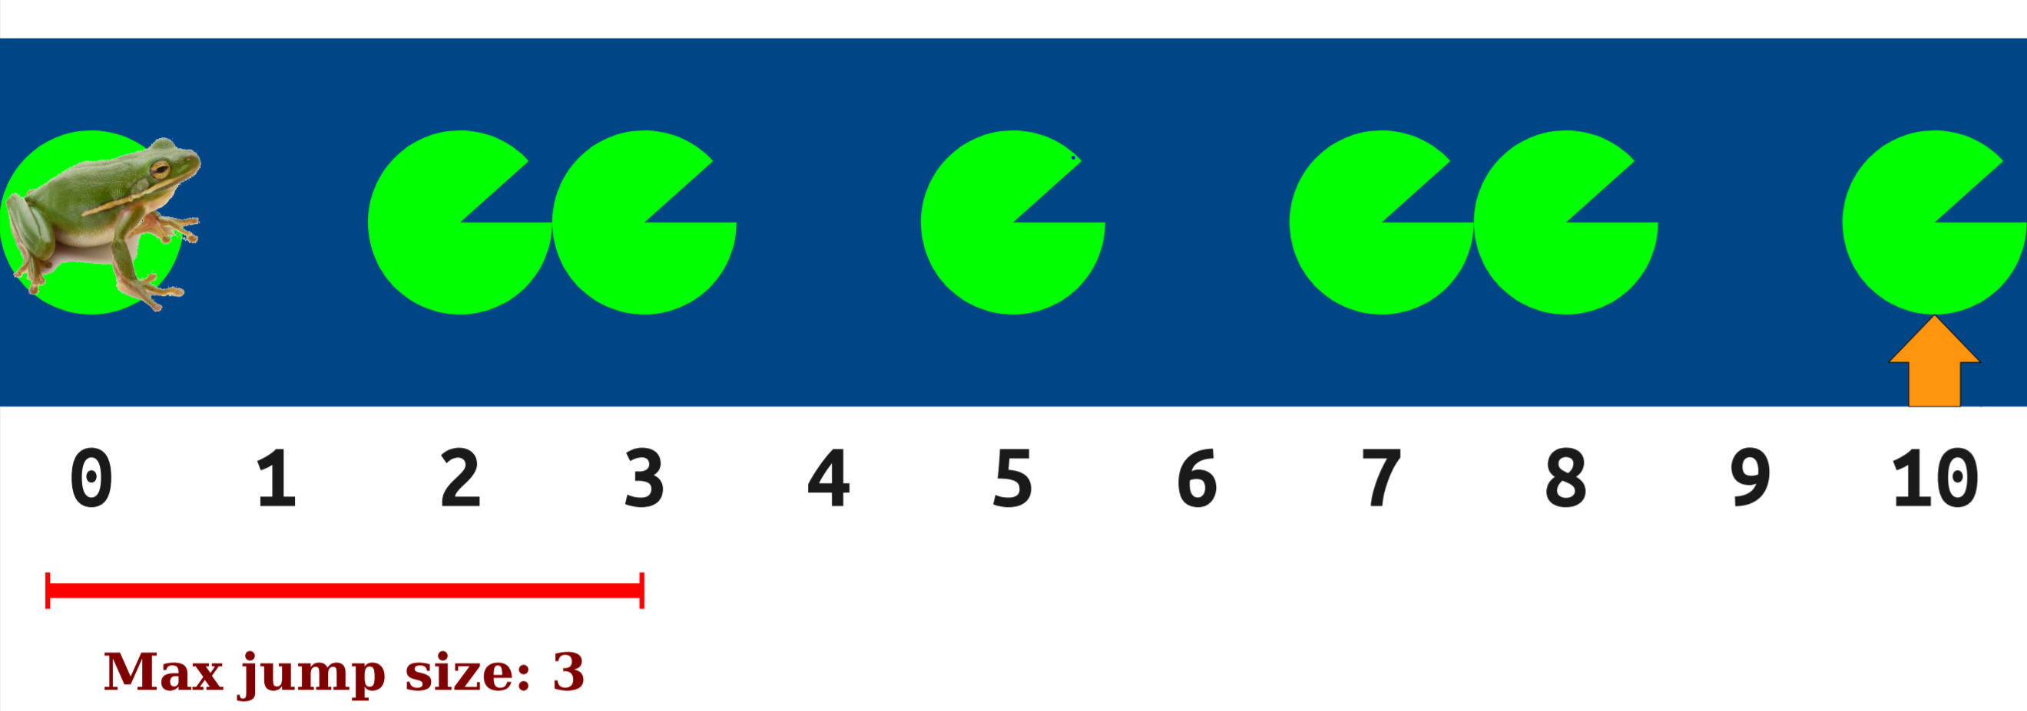
The Approach
Always jump as far forward as possible.

Slide 4
The Algorithm
Let J be an empty series of jumps.
Let our current position x = 0.
While x < n:
Find the furthest lily pad l reachable from x that is not after position n.
Add a jump to J from x to l's location.
Set x to l's location.
4. Return J.

Slide 5
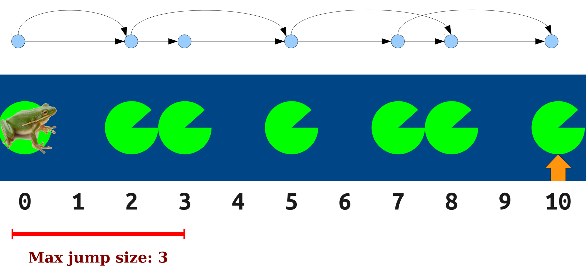
The Solution

Slide 6
Optimisation Problem
An optimization problem is one in which you want to find, not just a solution, but the best solution.
Example: Suppose you want to count out a certain amount of money, using the fewest possible bills and coins. How will you approach it?
At each step, take the largest possible bill or coin that does not overshoot.
$6.39 = $5 bill + $1 bill + 25¢ coin + 10¢ coin + 1¢ coin

Slide 7
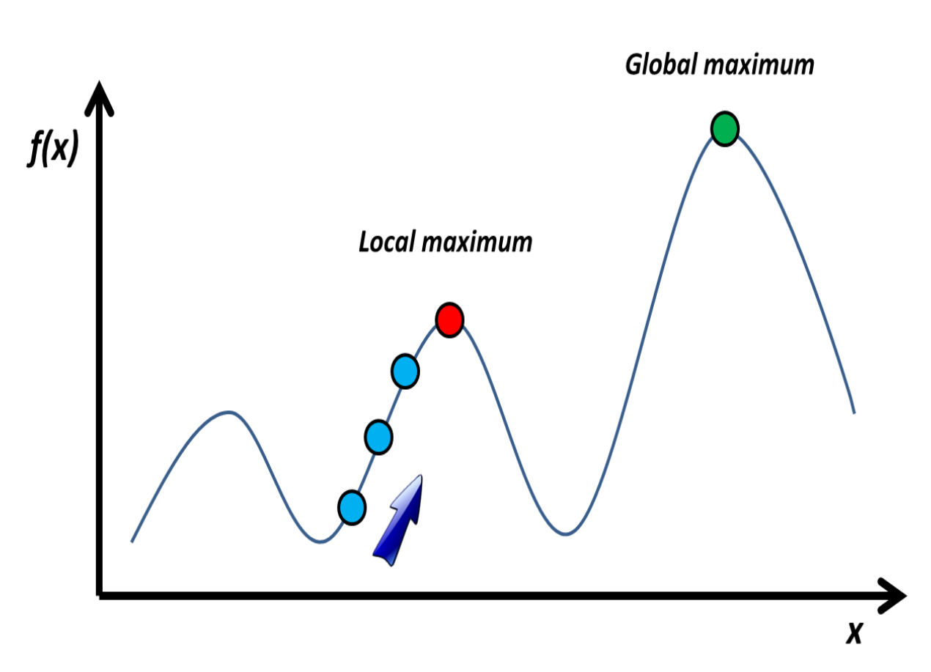
Greedy Algorithms
A greedy algorithm is an algorithm that constructs an object X one step at a time, at each step choosing the locally best option.
At each phase:
You take the best you can get right now, without regard for future consequences.
You hope that by choosing a local optimum at each step, you will end up at a global optimum.

Slide 8
Greedy Advantages
Simplicity
It is quite easy to come up with a greedy algorithm for a problem.
Analyzing the run time for greedy algorithms will generally be much easier than for other techniques
Easy to Analyse

Slide 9

Greedy Challenges
Hard to verify : Proving that a greedy algorithm is correct is more of an art than a science.

Slide 10

Where to use Greedy?
Optimal
Sub-structure
Greedy Choice Property

Slide 11
OPTIMAL SUB-STRUCTURE: A problem exhibits optimal substructure if an optimal solution to the problem contains within its optimal solutions to subproblems.
Ex: That is, if the shortest route from Seattle to Los Angeles passes through Portland and then Sacramento, then the shortest route from Portland to Los Angeles must pass through Sacramento too.
GREEDY CHOICE PROPERTY: A globally optimal solution can be arrived at by making a locally optimal (greedy) choice.

Slide 12
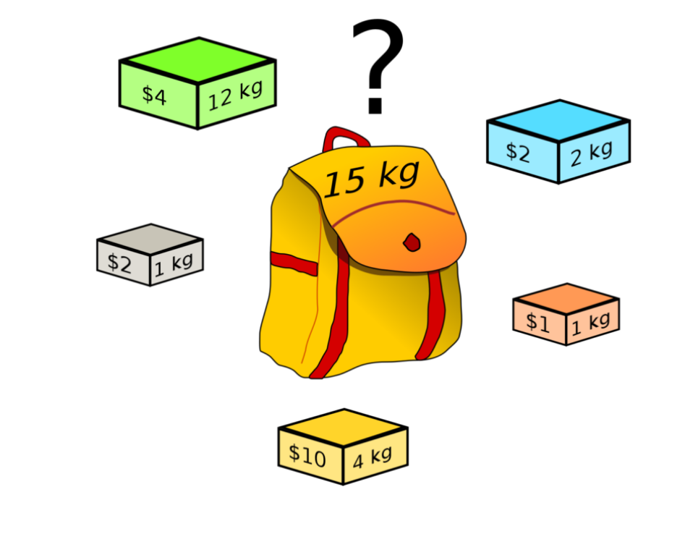
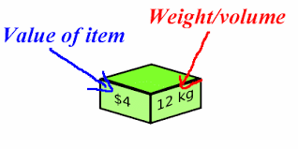
Knapsack Problem
Given: 1) A set of items, each with a weight and a value.
2) Capacity/weight of Knapsack.
Goal: Determine a subset of items to include in a collection so that the total weight is less than or equal to a given limit and the total value is as large as possible.

Slide 13
Greedy approach to Knapsack Problem
First approach
Sort in non-increasing order of values.
Second approach
Sort the objects based on increasing weight values.
Third approach
Sort the objects based on decreasing Profit/weight values.

Slide 14
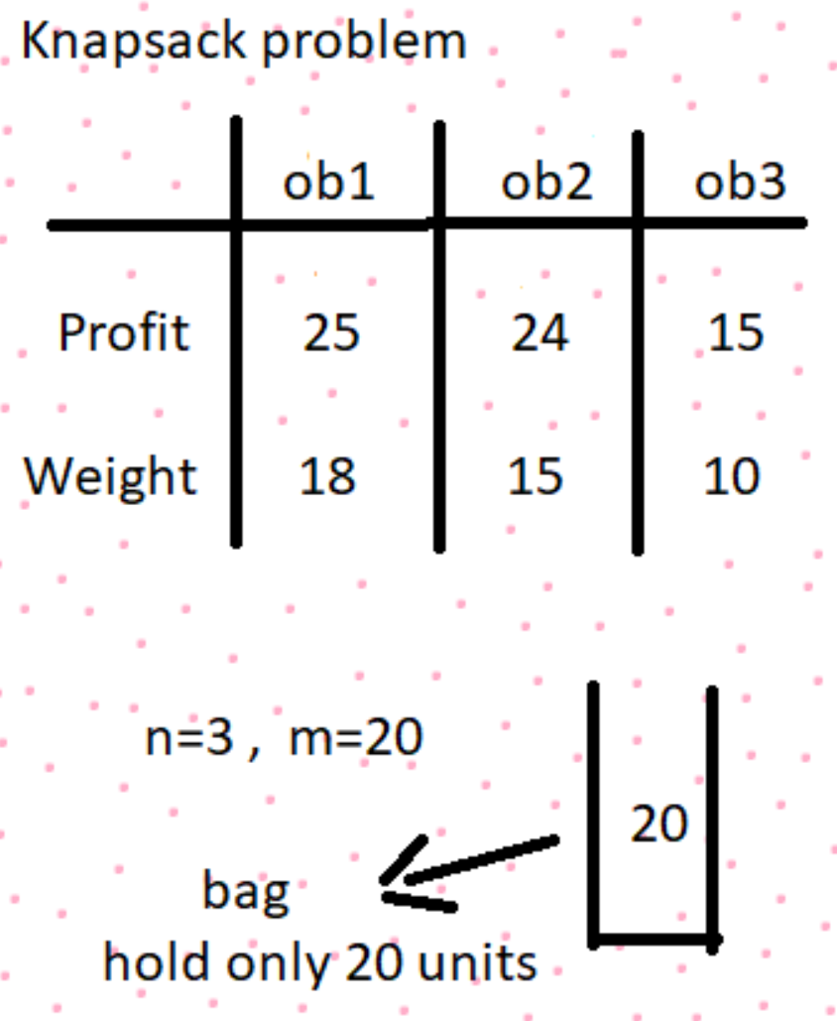
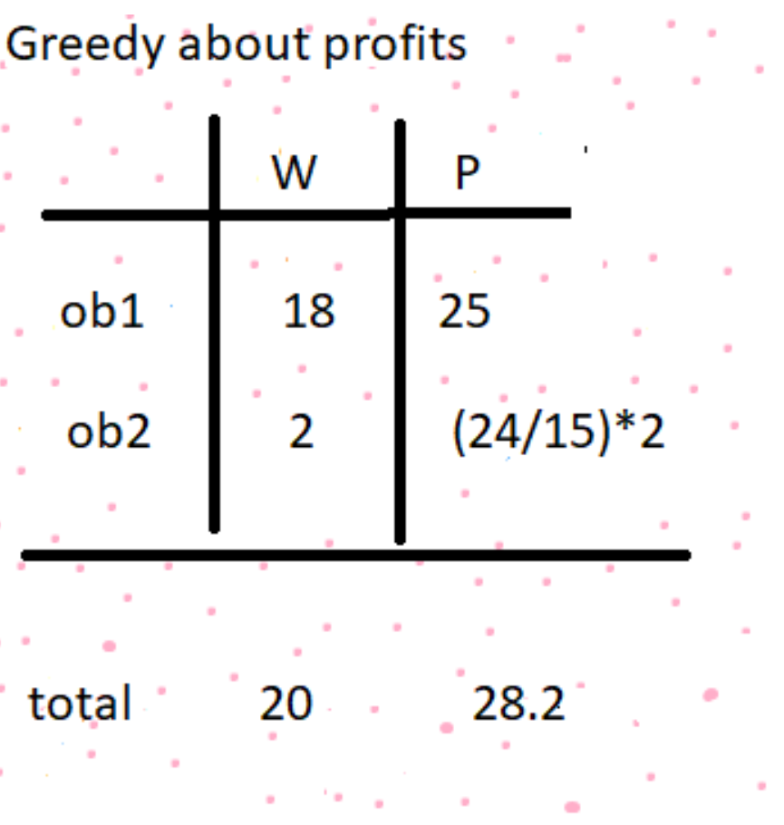
First Greedy approach

Slide 15
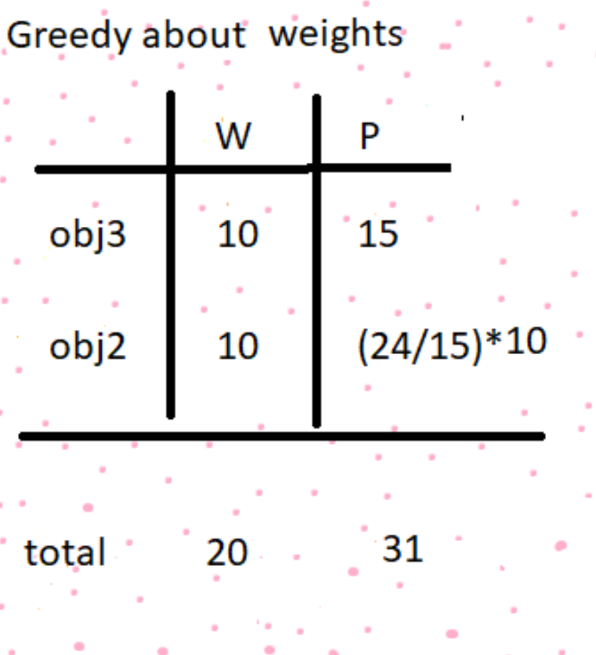
Second Greedy approach

Slide 16
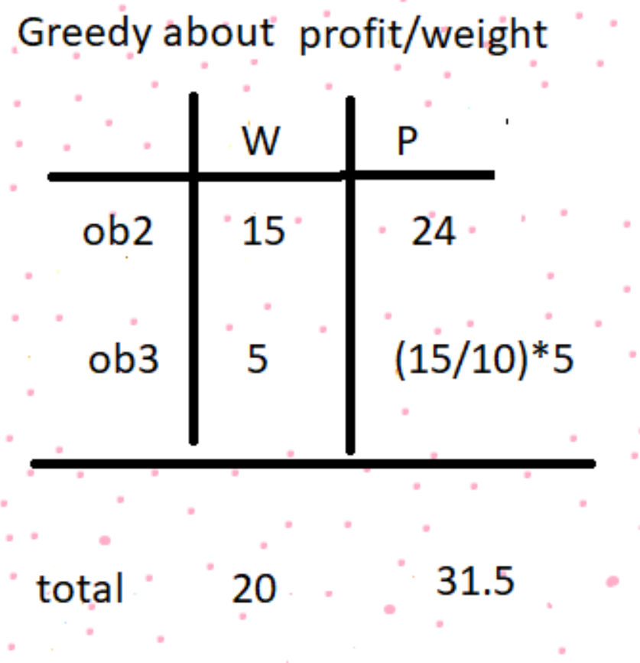
Third Greedy approach

Slide 17
Comparison of profits
Approach | Description | Profit value obtained
First | Greedy for Profits | 28.2
Second | Greedy for Weights | 31
Third | Greedy for Profit/Weights | 31.5
Maximum Profit

Slide 18
Fractional Knapsack algorithm
Fractional Knapsack (Array W, Array V, int M)
for i 1 to size (V)
calculate cost[i] V[i] / W[i]
Sort-Descending (cost)
i ← 1
while (i <= size(V))
if W[i] <= M
M ← M – W[i]
total ← total + V[i];
if W[i] > M
i ← i+1

Slide 19
Complexity Analysis
The main time taking step is the sorting of all items in the decreasing order of their value / weight ratios.
If using a simple sort algorithm (selection, bubble…) then the complexity of the whole problem is O(n²).
If using quick sort or merge sort then the complexity of the whole problem is O(nlogn).
If the items are already arranged in the required order, the while loop takes O(n) time.

Slide 20
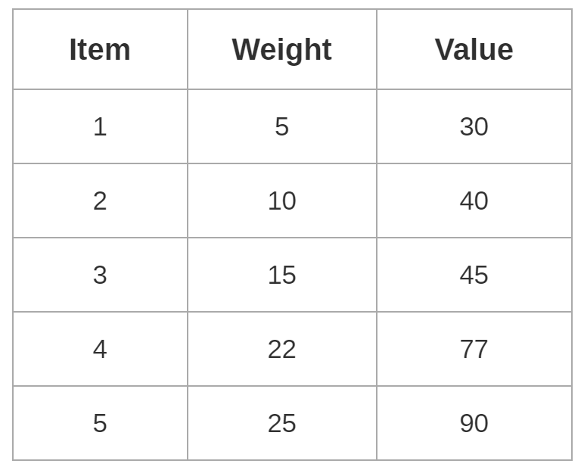
In Class Practice
Q. For the given set of items and knapsack capacity = 60 kg, find the optimal solution for the fractional knapsack problem making use of greedy approach.

Slide 21
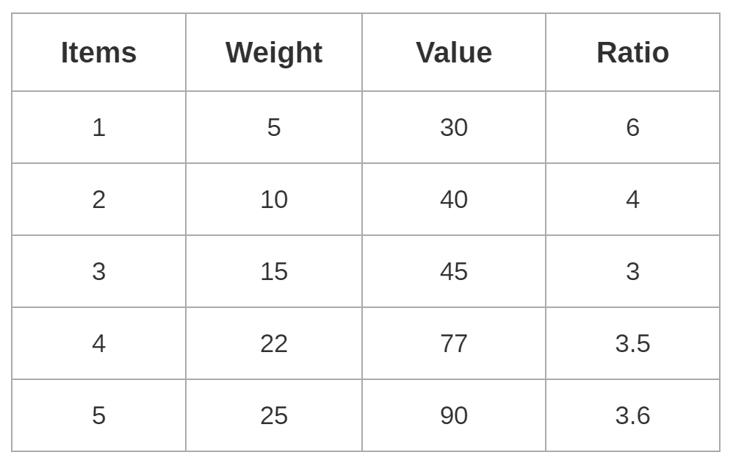
Solution
Step 1: Compute the value / weight ratio for each item-

Slide 22
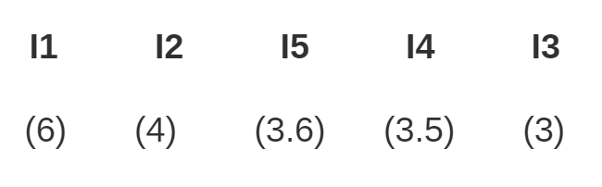
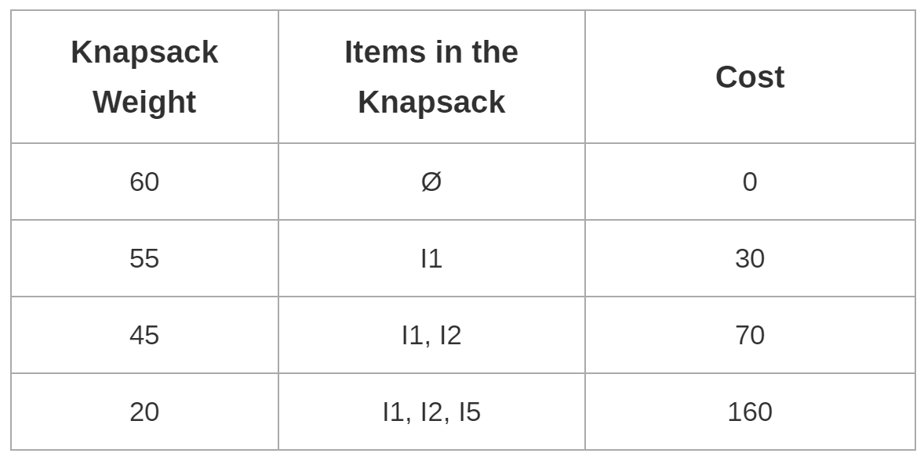
Step 2: Sort all the items in the decreasing order of their value / weight ratios-
Step 3: Start filling the knapsack by putting the items in it one by one.

Slide 23
Knapsack weight left to be filled is 20 kg but item-4 has a weight of 22 kg.
But because in fractional knapsack problem, we can even take the fraction of any item.
So, our knapsack will contain the items-
[ I1 , I2 , I5 , (20/22) I4 ]
Total Profit = = 160 + (20/27) x 77 = 230 Units

Slide 24
Quiz Questions
1. What is the objective of the knapsack problem? a) To get maximum total value in the knapsack b) To get minimum total value in the knapsack c) To get maximum weight in the knapsack d) To get minimum weight in the knapsack
2.Fractional knapsack problem can be solved in time O(n). a) True b) False

Slide 25
Quiz Questions
3. Time complexity of fractional knapsack problem is ____________ a) O(n log n) b) O(n) c) O(n²) d) O(nW)
4.Given items as {value,weight} pairs {{40,20},{30,10},{20,5}}. The capacity of knapsack=20. Find the maximum value output assuming items to be divisible. a) 60 b) 80 c) 100 d) 40

Slide 26
Quiz Questions
5. The main time taking step in fractional knapsack problem is ___________ a) Breaking items into fraction b) Adding items into knapsack c) Sorting d) Looping through sorted items
6. In Greedy method we get ________ Feasible solutions.
one
more than one
zero
hundred

Slide 27
Solutions
a)
a)
a)
a)
Explanation: The value/weight ratio are-{2,3,4}. So we include the second and third items wholly into the knapsack. This leaves only 5 units of volume for the first item. So we include the first item partially. Final value = 20+30+(40/4)=60.
5. c)
6. a)

