Slide 1
Lecture 11
BFS and DFS traversal

Slide 2
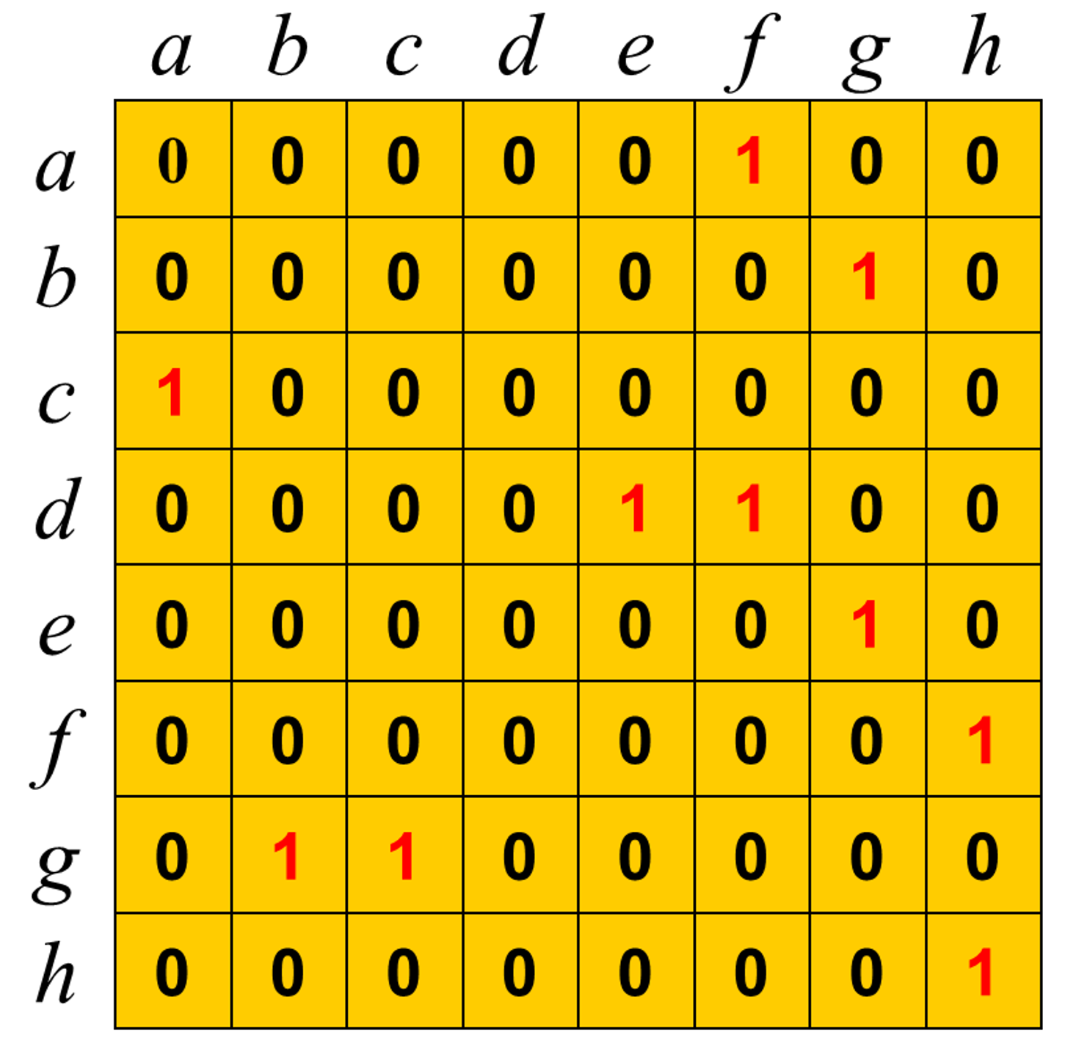
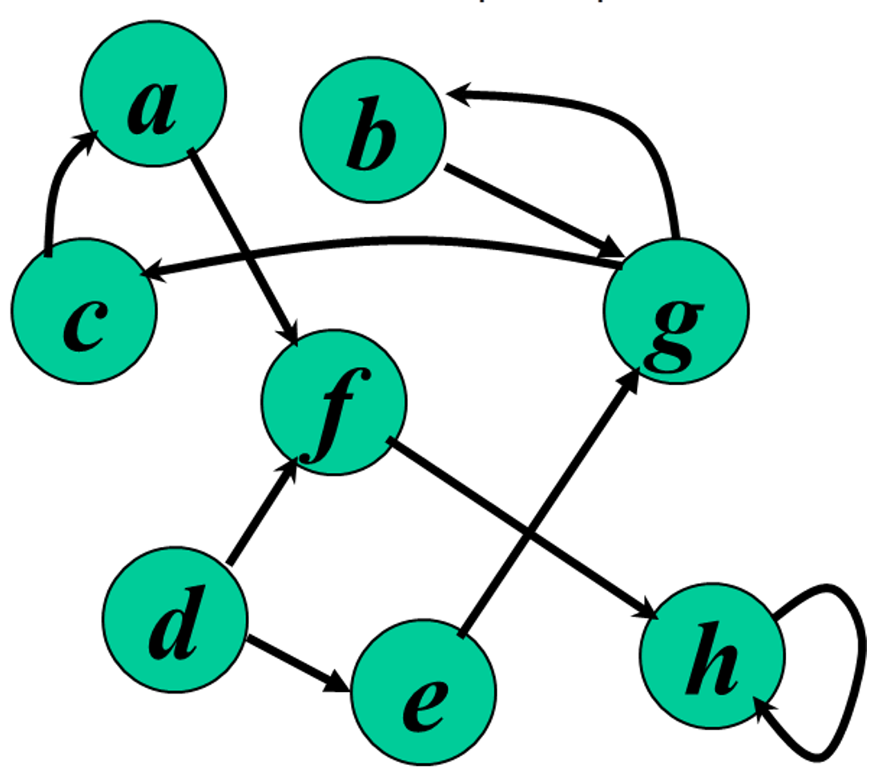
Representing graphs
Adjacency matrix

Slide 3
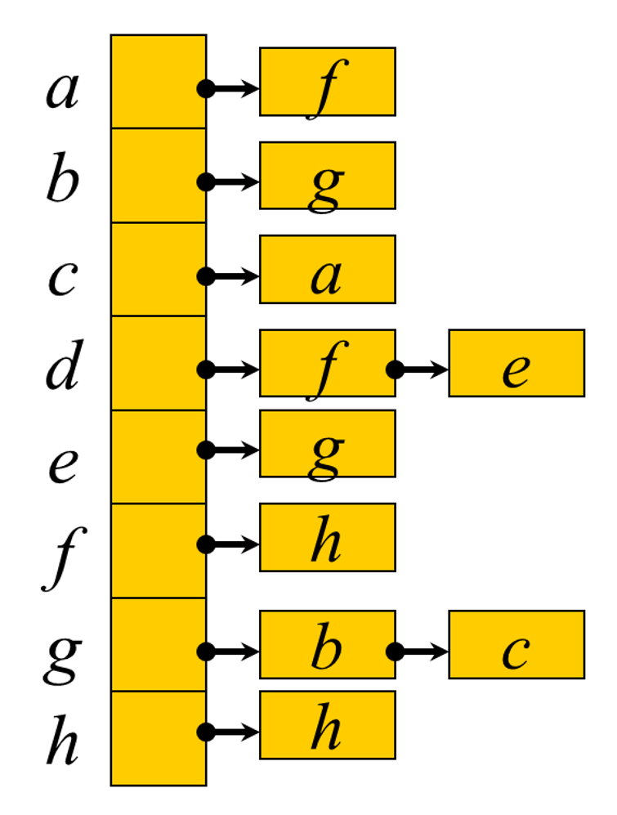
Adjacency list

Slide 4
Breadth First Search
BFS(G,s)
for each vertex u in V[G] – {s}
do color[u] ← white
d[u] ← ∝
π[u] ← null
color[s] ← gray
d[s] ← 0
π[s] ← null
Q ← Φ
enqueue(Q,s)
while Q ≠ Φ
do u ← dequeue(Q)
for each v in Adj[u]
do if color[v] = white
then color[v] ← gray
d[v] ← d[u] + 1
π[v] ← u
enqueue(Q,v)
color[u] ← black
white: undiscovered
gray: discovered
black: finished
Q: a queue of discovered vertices
color[v]: color of v
d[v]: distance from s to v
π[u]: predecessor of v

Slide 5

Example (BFS)
r
s
t
u
∞
0
∞
∞
∞
∞
∞
∞
v
w
x
y
Q: s
0

Slide 6
Example (BFS)
r
s
t
u
1
0
∞
∞
∞
1
∞
∞
v
w
x
y
Q: w r
1 1

Slide 7
Example (BFS)
r
s
t
u
1
0
2
∞
∞
1
2
∞
v
w
x
y
Q: r t x
1 2 2

Slide 8
Example (BFS)
r
s
t
u
1
0
2
∞
2
1
2
∞
v
w
x
y
Q: t x v
2 2 2

Slide 9
Example (BFS)
r
s
t
u
1
0
2
3
2
1
2
∞
v
w
x
y
Q: x v u
2 2 3

Slide 10
Example (BFS)
r
s
t
u
1
0
2
3
2
1
2
3
v
w
x
y
Q: v u y
2 3 3

Slide 11
Example (BFS)
r
s
t
u
1
0
2
3
2
1
2
3
v
w
x
y
Q: u y
3 3

Slide 12
Example (BFS)
r
s
t
u
1
0
2
3
2
1
2
3
v
w
x
y
Q: y
3

Slide 13
Example (BFS)
r
s
t
u
1
0
2
3
2
1
2
3
v
w
x
y
Q: ∅

Slide 14
Example (BFS)
r
s
t
u
1
0
2
3
2
1
2
3
v
w
x
y
BFS Tree

Slide 15
Depth First Search Traversal
DFS(G)
1. for each vertex u ∈ V[G]
2. do color[u] ← white
3. π[u] ← NULL
4. time ← 0
5. for each vertex u ∈ V[G]
6. do if color[u] = white
7. then DFS-Visit(u)
DFS-Visit(u)
color[u] ← GRAY
time ← time + 1
d[u] ← time
for each v ∈ Adj[u]
do if color[v] = WHITE
then π[v] ← u
DFS-Visit(v)
color[u] ← BLACK
time ← time + 1
f[u] ← time

Slide 16
Example (DFS)
u
v
w
1/
x
y
z

Slide 17
Example (DFS)
u
v
w
1/
2/
x
y
z

Slide 18
Example (DFS)
u
v
w
1/
2/
3/
x
y
z

Slide 19
Example (DFS)
u
v
w
1/
2/
4/
3/
x
y
z

Slide 20
Example (DFS)
u
v
w
1/
2/
B
4/
3/
x
y
z

Slide 21
Example (DFS)
u
v
w
1/
2/
B
4/5
3/
x
y
z

Slide 22
Example (DFS)
u
v
w
1/
2/
B
4/5
3/6
x
y
z

Slide 23
Example (DFS)
u
v
w
1/
2/7
B
4/5
3/6
x
y
z

Slide 24
Example (DFS)
u
v
w
1/
2/7
F
B
4/5
3/6
x
y
z

Slide 25
Example (DFS)
u
v
w
1/8
2/7
F
B
4/5
3/6
x
y
z

Slide 26
Example (DFS)
u
v
w
1/8
2/7
9/
F
B
4/5
3/6
x
y
z

Slide 27
Example (DFS)
u
v
w
1/8
2/7
9/
F
B
C
4/5
3/6
x
y
z

Slide 28
Example (DFS)
u
v
w
1/8
2/7
9/
F
B
C
4/5
3/6
10/
x
y
z

Slide 29
Example (DFS)
u
v
w
1/8
2/7
9/
F
B
C
4/5
3/6
10/
B
x
y
z

Slide 30
Example (DFS)
u
v
w
1/8
2/7
9/
F
B
C
4/5
3/6
10/11
B
x
y
z

Slide 31
Example (DFS)
u
v
w
1/8
2/7
9/12
F
B
C
4/5
3/6
10/11
B
x
y
z

