Slide 1
Lecture 15
Backtracking: 8 Queens Problem

Slide 2
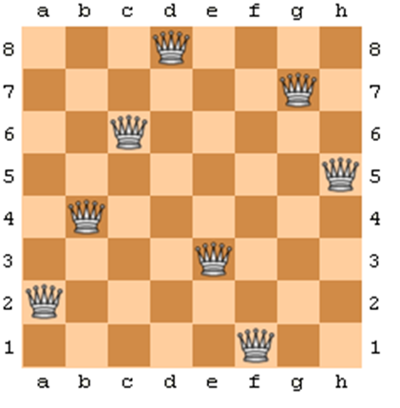
The N Queens Problem
Find an arrangement of N queens on a single chess board such that no two queens are attacking one another.

Slide 3

What can queen capture?
If the queen is at row r and column c, then it can attack any square (r', c') such that:
r' = r (horizontal movement)
c' = c (vertical movement)
r'+c' = r+c (northwest-southeast movement)
r'-c' = r-c (northeast-southwest movement)

Slide 4
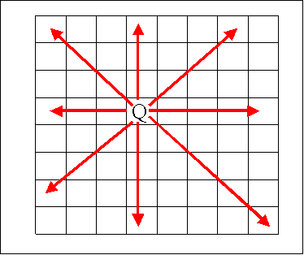
The N Queens Problem
In chess, queens can move all the way down any row, column or diagonal (so long as no pieces are in the way).
Due to the first two restrictions, it's clear that each row and column of the board will have exactly one queen.

Slide 5
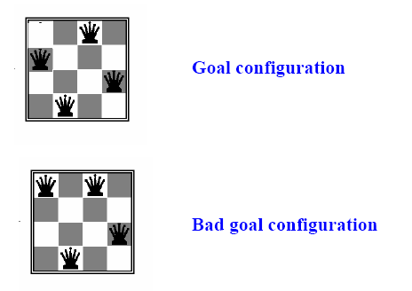

N-Queens Problem
We can generalize the 8-Queens problem to be the N-Queens problem.
Lets try for n=4

Slide 6
Search Space Tree for 4 Queens Problem
Q
Q
Q
Q
Q
Q
Q
Q
Q
Q
Q
Q
Q
Q
Q
Q
Q
Q
Q
Q
Q
Q
Q
Q
Q
Q
Q
Q
Q
Q
Q
Q
Q
Q
Q
Q

Slide 7
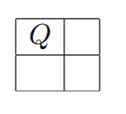
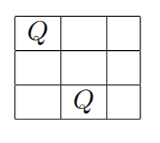
N-Queens Problem
Trying a few small values of n, we find that no solutions exist for n = 2 or n = 3.
n = 2: n = 3:

Slide 8
Possible arrangements: 8 Queens
How many placements are possible for 8 Queens on an 8 by 8 chessboard so that none of them can attack each other???
= 64 * 63 * 62 * 61 * 60 * 59 * 58 * 57 /8! = 178,462, 987, 637, 760 / 8!
= 4,426,165,368
Around 4.5 billion potential arrangements

Slide 9
8 Queens Problem
There are 92 distinct solutions.
There are 12 unique solutions discounting symmetrical answers (rotations / reflections)

Slide 10
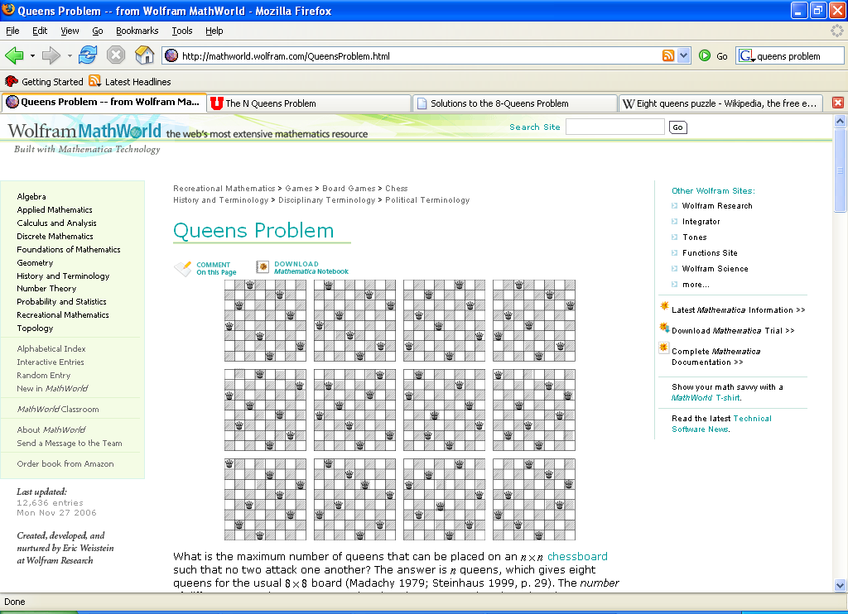
8 Queens Solutions

Slide 11
Algorithm : N Queens
1) Start in the leftmost column
2) If all queens are placed return true.
3) Try all rows in the current column.
Do following for every tried row.
a) If the queen can be placed safely in this row then mark this [row, column] as
part of the solution and recursively check if placing queen here leads to a solution.
b) If placing the queen in [row, column] leads to a solution then return true.
c) If placing queen doesn't lead to a solution then unmark this [row, column] (Backtrack)
and go to step (a) to try other rows.
3) If all rows have been tried and nothing worked, return false to trigger backtracking.

Slide 12
Pseudo Code
Algorithm NQueens ( k, n)
{
for i := 1 to n do
{
if Place (k, i) then
{
x[k] := i;
if ( k = n) then write ( x [1 : n]
else NQueens ( k+1, n);
}
}
}
Algorithm Place (k, i)
{
for j := 1 to k-1 do
if (( x[ j ] = i)) or
(Abs( x [ j ] - i) =Abs ( j – k )))
then return false;
return true;
}

Slide 13
Complexity Analysis
Place method takes O(N) time as it iterates through the array every time.
For each invocation of the NQueens method, there is a loop which runs for O(N) time. In each iteration of this loop, there is Place invocation which is O(N) and a recursive call with a smaller argument.
If we add all this up and define the run time as:
T(N) = O(N²) + N*T(N-1)
Using this recurrence, the final term will be something like n³+ n!

Slide 14
Quiz
How many fundamental solutions are the for 3 queens on a 3*3 board? a) 1 b) 12 c) 3 d) 0
In how many directions do queens attack each other? a) 1 b) 2 c) 3 d) 4
Of the following given options, which one of the following is a correct option that provides an optimal solution for 4-queens problem? a) (3,1,4,2) b) (2,3,1,4) c) (4,3,2,1) d) (4,2,3,1)

Slide 15
Quiz
4. Which of the following methods can be used to solve n-queen’s problem? a) greedy algorithm b) divide and conquer c) iterative improvement d) backtracking
5. Of the following given options, which one of the following does not provides an optimal solution for 8-queens problem? a) (5,3,8,4,7,1,6,2) b) (1,6,3,8,3,2,4,7) c) (4,1,5,8,6,3,7,2) d) (6,2,7,1,4,8,5,3)

Slide 16
Solutions
1. d
2. c
3. a
4. d
5. b

