Slide 1
Lecture 12
Travelling Salesman Problem

Slide 2

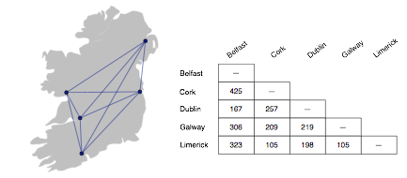
Traveling Salesman Problem
The traveling salesman problem consists of a salesman and a set of cities.
The salesman has to visit each one of the cities starting from a certain one
(e.g. the hometown) and returning to the same city.
The challenge of the problem is that the traveling salesman wants
to minimize the total length of the trip.

Slide 3
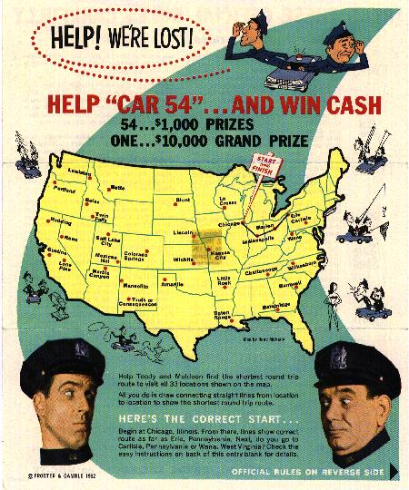
TSP Contest
In 1962 a TSP contest was held

Slide 4
Traveling Salesman Problem
The traveling salesman problem can be described as follows:
TSP = {(G, f, t): G = (V, E) a complete graph,
Where,
f is a function V×V → Z, t ∈ Z,
G is a graph that contains a traveling salesman tour with cost that does not exceed t}.

Slide 5
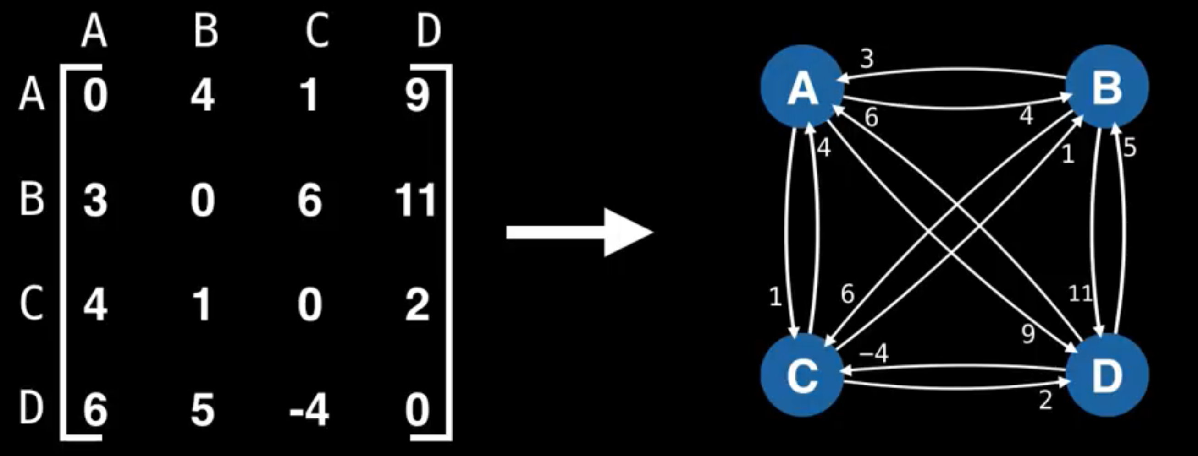
Traveling Salesman Problem
INPUT:
N cities, NxN symmetric matrix D,
D(i,j) = distance between city i and j
OUTPUT:
The shortest tour visiting all the cities

Slide 6
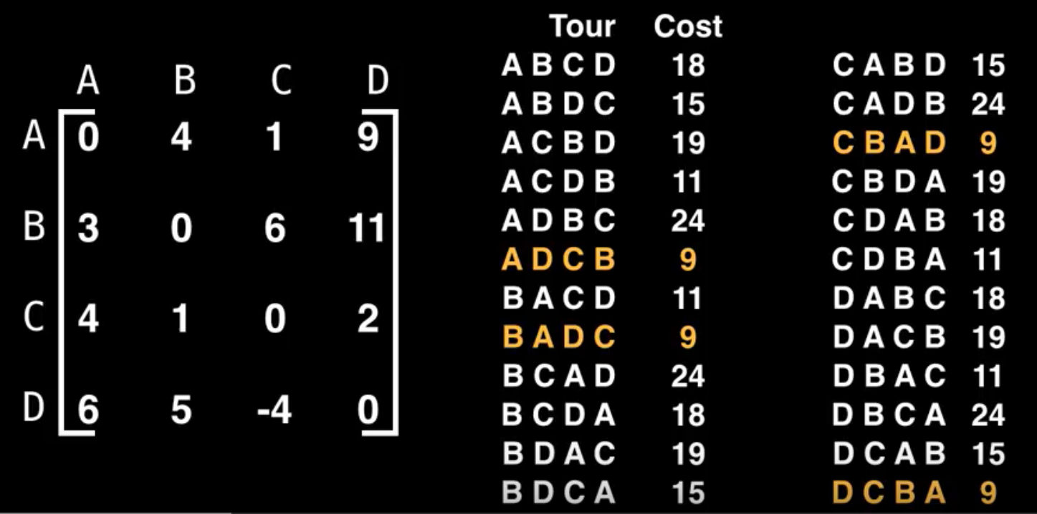
Brute Force Solution

Slide 7
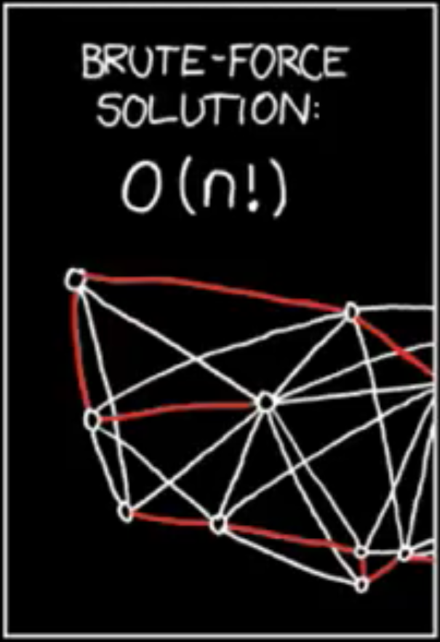
Brute Force Solution
Try all possibilities for each permutation π of {1,...,n}.
Visit the cities in the order π, compute distance travelled and pick the best solution

Slide 8
Dynamic Programming: TSP
Choose an arbitrary starting vertex s ∈ V.
For each non-empty U ⊂ V and e ∈ U we compute OPT[U,e], the length of the shortest tour starting in s, visiting all vertices in U and ending in e.
For |U| = {e} we trivially set OPT[U,e] = d(s,e)
For |U| > 1, u ∈ U \ {e}, if a tour containing the edge (u,e) is optimal, the tour on U \ {e} ending in u mustbe optimal as well.
Thus, for |U| > 1, OPT[U,e] is the minimum of OPT[U \ {e},u] + d(u,e) over all u ∈ U \ {e}

Slide 9
Algorithm: TSP
C ({1}, 1) = 0
for s = 2 to n do
for all subsets S Є {1, 2, 3, … , n} of size s and containing 1
C (S, 1) = ∞
for all j Є S and j ≠ 1
C (S, j) = min {C (S – {j}, i) + d(i, j) for i Є S and i ≠ j}
Return min j C ({1, 2, 3, …, n}, j) + d(j, i)

Slide 10
Example: TSP
Distance matrix
0 2 9 10
C= 1 0 6 4
15 7 0 8
6 3 12 0

Slide 11
Solution
g(2,Ø) = c21 = 1
g(3, Ø) = c31 = 15
g(4,O/) = c41 = 6

Slide 12
k = 1, consider sets of 1 element
Set {2}:
g(3,{2}) = c₃₂ + g(2, Ø) = c₃₂ + c₂₁ = 7 + 1 = 8, p(3,{2}) = 2
g(4,{2}) = c₄₂ + g(2, Ø) = c₄₂ + c₂₁ = 3 + 1 = 4, p(4,{2}) = 2
Set {3}:
g(2,{3}) = c₂₃ + g(3, Ø) = c₂₃ + c₃₁ = 6 + 15 = 21, p(2,{3}) = 3
g(4,{3}) = c₄₃ + g(3, Ø) = c₄₃ + c₃₁ = 12 + 15 = 27, p(4,{3}) = 3
Set {4}:
g(2,{4}) = c₂₄ + g(4, Ø) = c₂₄ + c₄₁ = 4 + 6 = 10, p(2,{4}) = 4
g(3,{4}) = c₃₄ + g(4, Ø) = c₃₄ + c₄₁ = 8 + 6 = 14, p(3,{4}) = 4

Slide 13
k = 2, consider sets of 2 elements
Set {2,3}:
g(4,{2,3}) = min {c₄₂ + g(2,{3}), c₄₃ + g(3,{2})} = min {3+21, 12+8}= min {24, 20}= 20, p(4,{2,3}) = 3
Set {2,4}:
g(3,{2,4}) = min {c₃₂ + g(2,{4}), c₃₄ + g(4,{2})} = min {7+10, 8+4}= min {17, 12} = 12, p(3,{2,4}) = 4
Set {3,4}:
g(2,{3,4}) = min {c₂₃ + g(3,{4}), c₂₄ + g(4,{3})} = min {6+14, 4+27}= min {20, 31}= 20, p(2,{3,4}) = 3

Slide 14
Length of an optimal tour
f = g(1,{2,3,4})
= min { c12 + g(2,{3,4}), c13 + g(3,{2,4}), c14 + g(4,{2,3}) }
= min {2 + 20, 9 + 12, 10 + 20}
= min {22, 21, 30}
= 21
Successor of node 1: p(1,{2,3,4}) = 3
Successor of node 3: p(3, {2,4}) = 4
Successor of node 4: p(4, {2}) = 2

Slide 15

Optimal Solution
Optimal TSP tour:
1 3 4 2 1

Slide 16
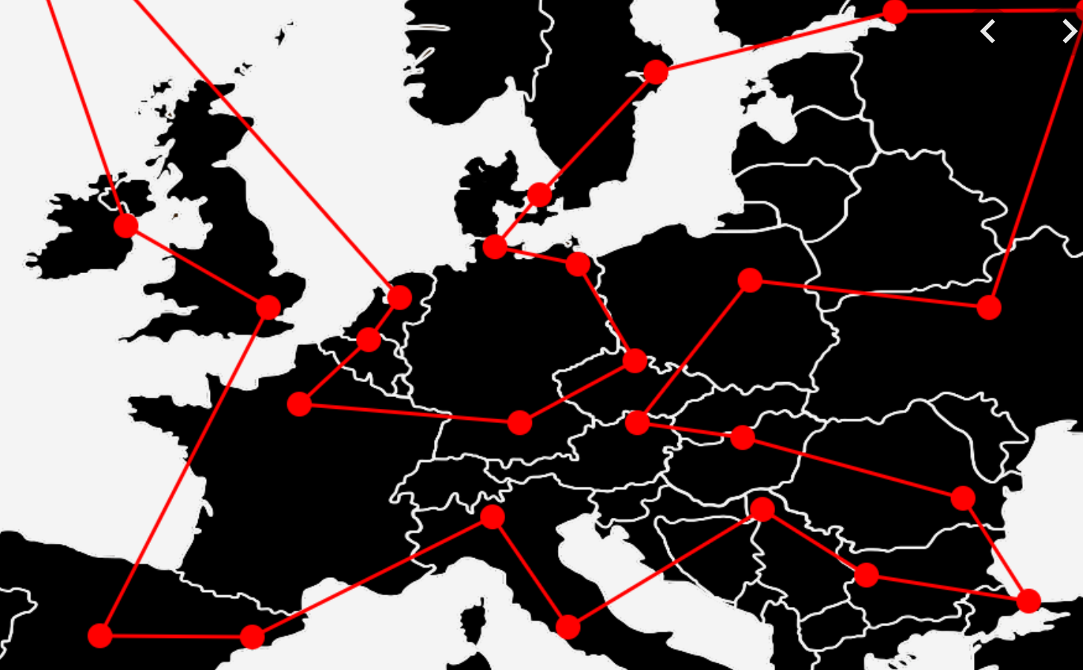
Applications: TSP
Manufacturing
Plane routing
Telephone routing
Networks
Traveling salespeople
Structure of crystals

Slide 17

Analysis
There are at most O(n*2^{n}) sub-problems.
Each one takes linear time to solve.
The total running time is therefore O(n²*2^{n}).
The time complexity is much less than O(n!), but still exponential.

Slide 18
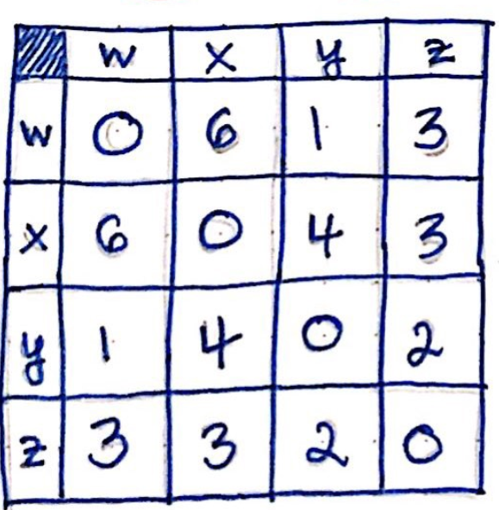
In Class Practice
Find the shortest path using TSP using Dynamic approach

Slide 19
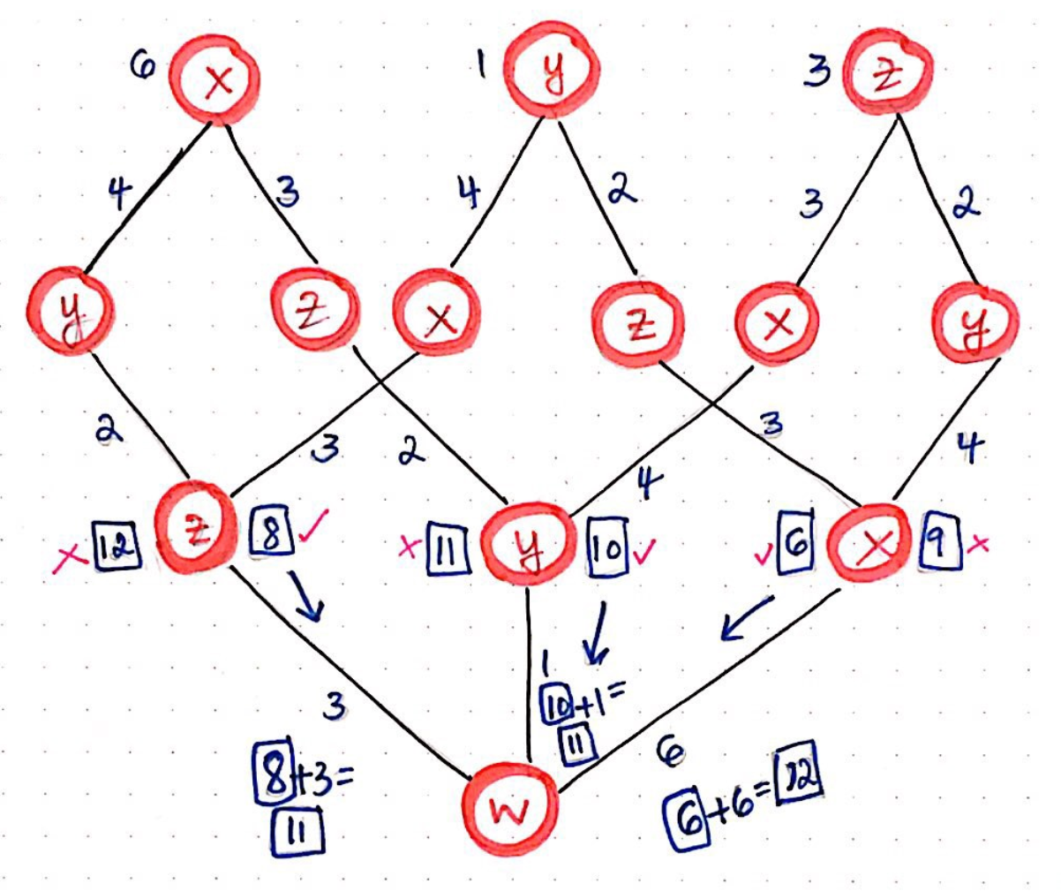
Solution
The shortest cost for our traveling salesman is 11.
There are two possible paths that would allow for them to achieve that lowest cost.

