Slide 1
Lecture 9
Bellman Ford

Slide 2
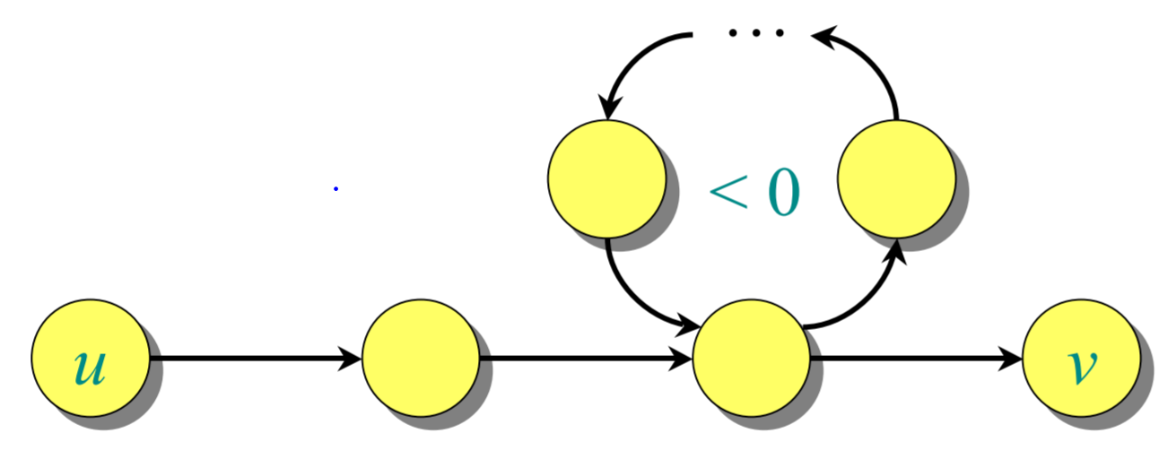
Why Bellman Ford Algorithm?
If a graph G = (V, E) contains a negative weight cycle, then some shortest paths may not exist.
Dijkstra’s algorithm cannot be used, as weights must be nonnegative.

Slide 3
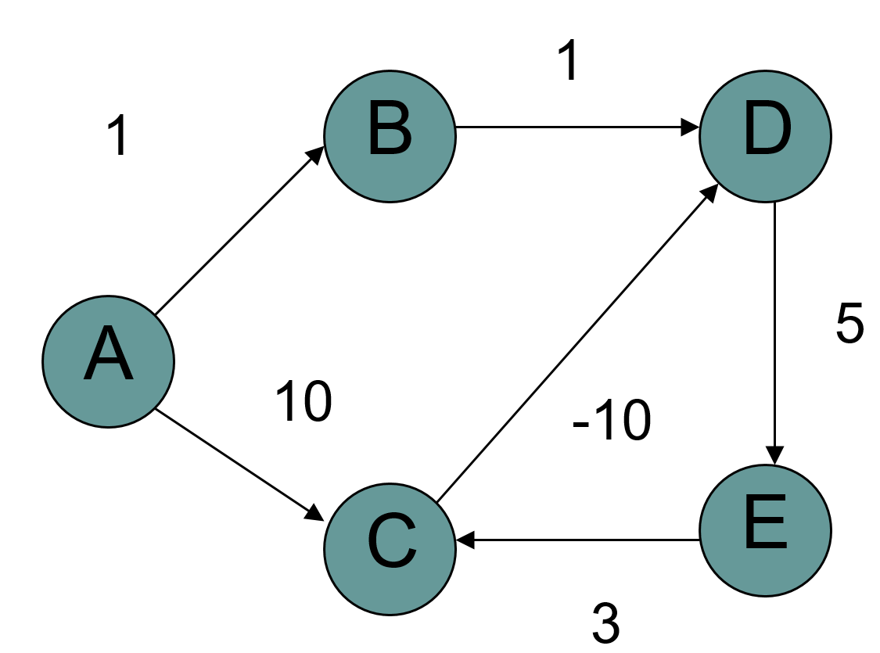
Bellman Ford algorithm
Bellman-Ford algorithm: Finds all shortest-path lengths from a source s ∈ V to all v ∈ V or determines that a negative-weight cycle exists.
What is the shortest path from a to e?

Slide 4
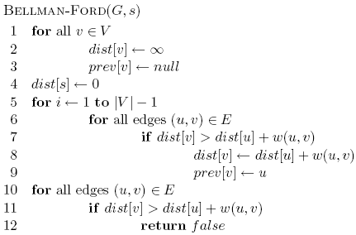
Bellman-Ford algorithm
Initialize all the distances

Slide 5
Bellman-Ford algorithm
Iterate over all edges/vertices and apply update rule

Slide 6
Bellman-Ford algorithm

Slide 7
Bellman-Ford algorithm
check for negative cycles

Slide 8
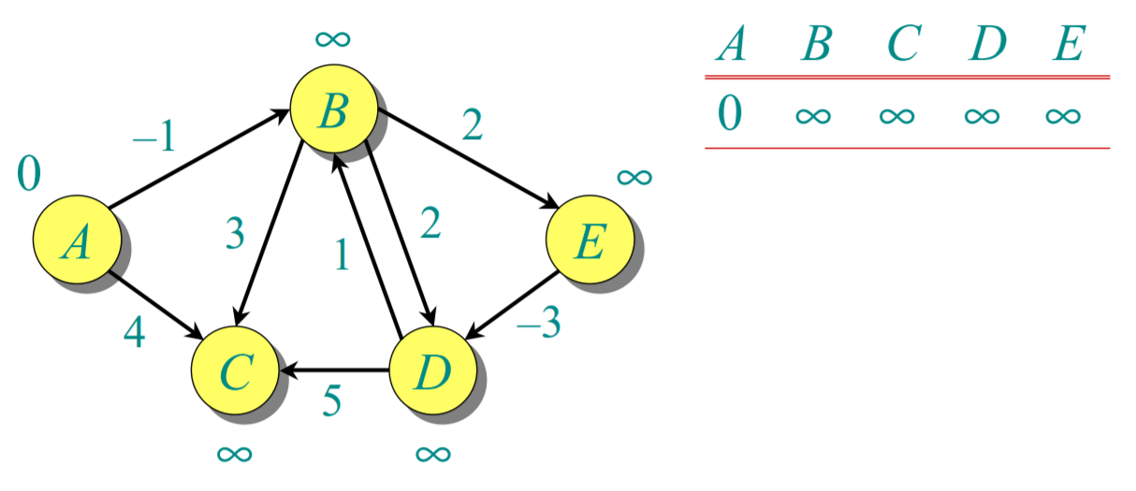
Example: Bellman Ford
Order of edges: (B,E), (D,B), (B,D), (A,B), (A,C), (D,C), (B,C), (E,D)
Initialisation

Slide 9
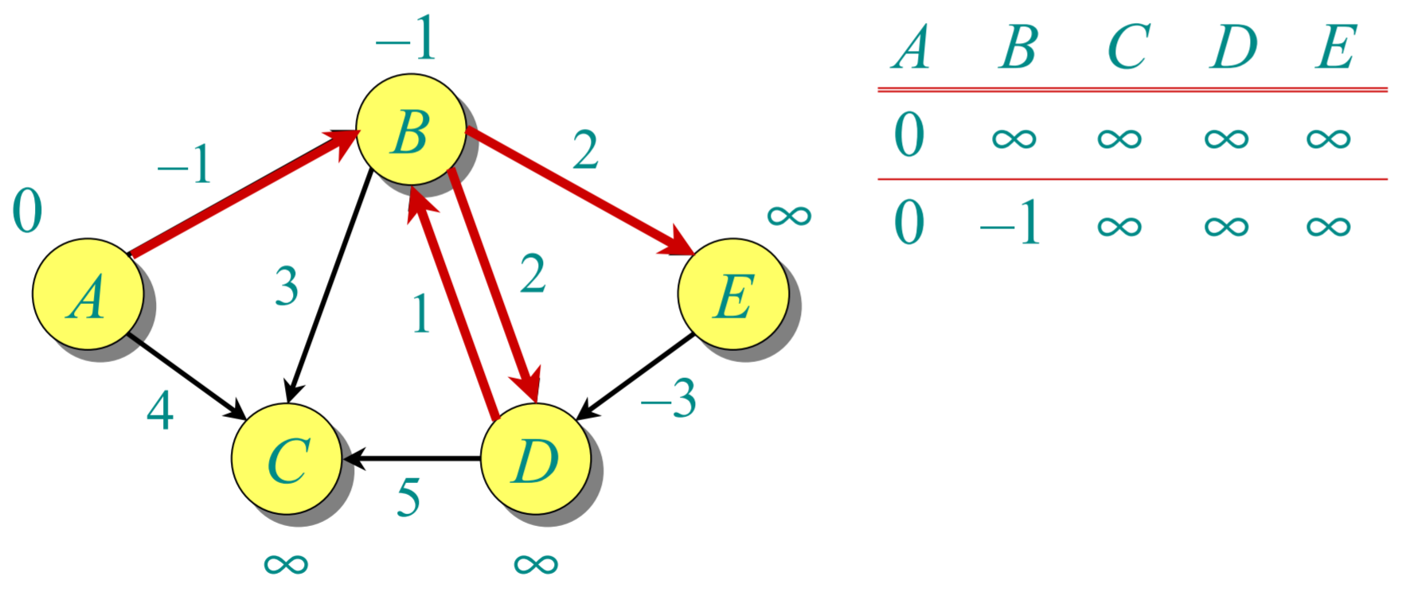
Order of edges: (B,E), (D,B), (B,D), (A,B), (A,C), (D,C), (B,C), (E,D)

Slide 10
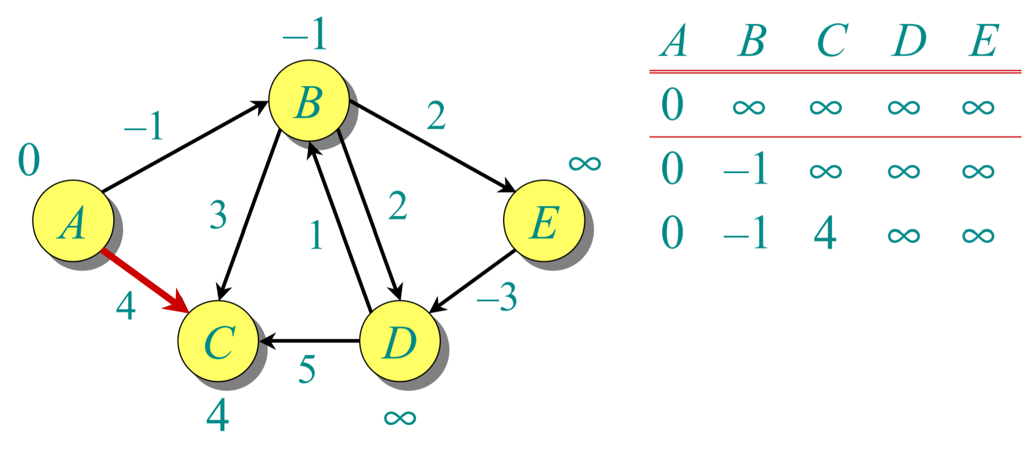
Order of edges: (B,E), (D,B), (B,D), (A,B), (A,C), (D,C), (B,C), (E,D)

Slide 11
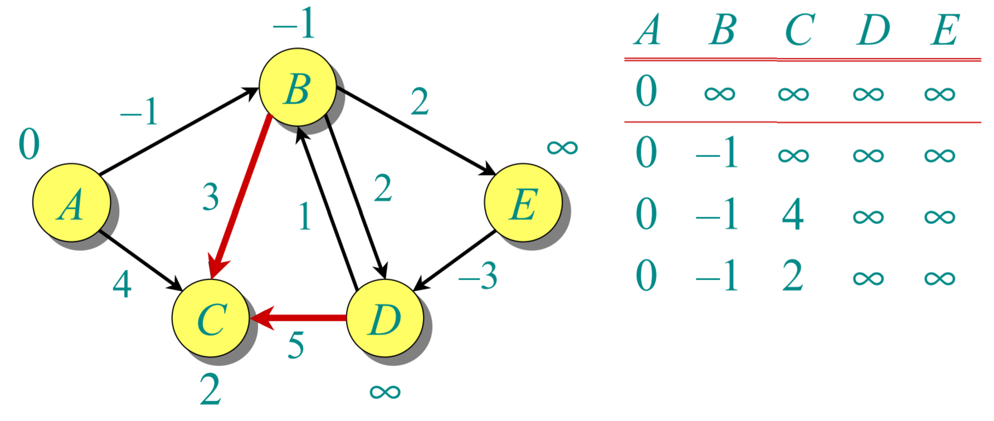
Order of edges: (B,E), (D,B), (B,D), (A,B), (A,C), (D,C), (B,C), (E,D)

Slide 12
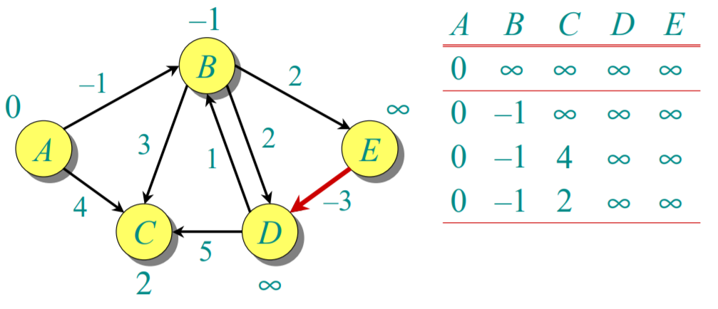
Order of edges: (B,E), (D,B), (B,D), (A,B), (A,C), (D,C), (B,C), (E,D)

Slide 13
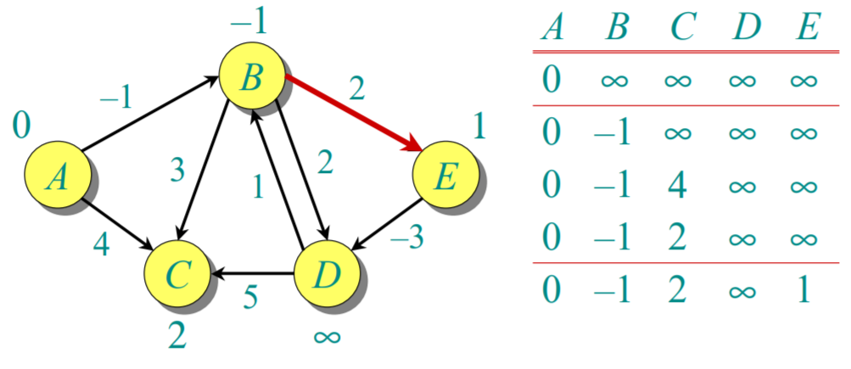
Order of edges: (B,E), (D,B), (B,D), (A,B), (A,C), (D,C), (B,C), (E,D)

Slide 14
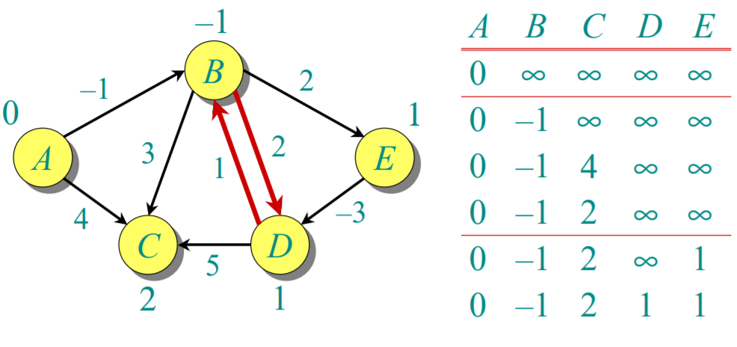
Order of edges: (B,E), (D,B), (B,D), (A,B), (A,C), (D,C), (B,C), (E,D)

Slide 15
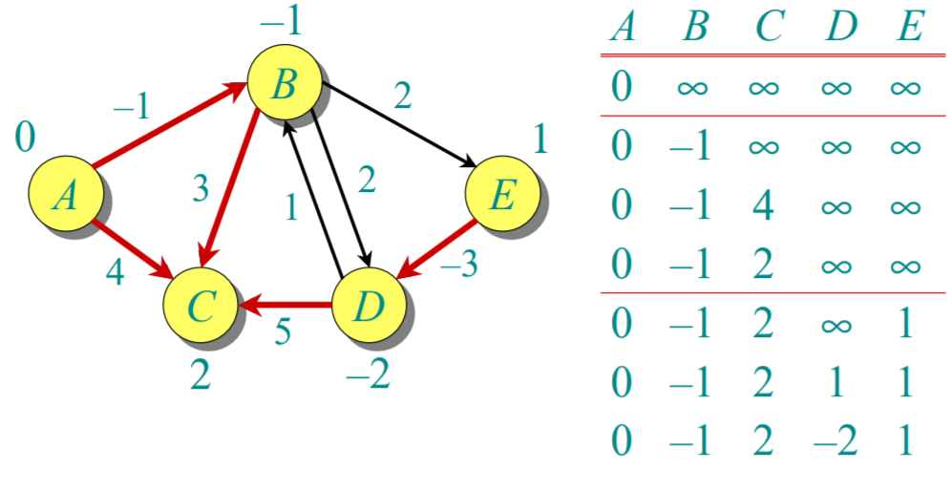
Order of edges: (B,E), (D,B), (B,D), (A,B), (A,C), (D,C), (B,C), (E,D)

Slide 16
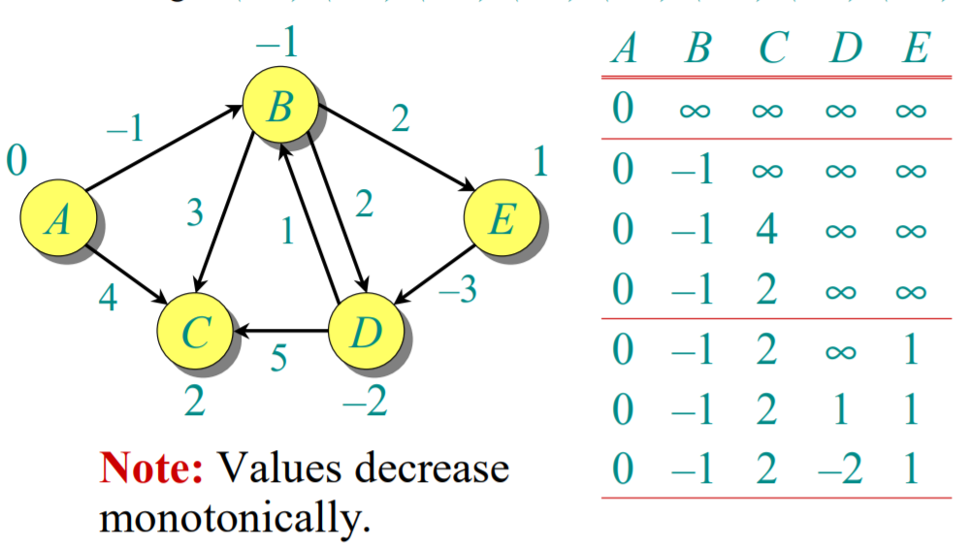
Order of edges: (B,E), (D,B), (B,D), (A,B), (A,C), (D,C), (B,C), (E,D)

Slide 17
Complexity analysis: Bellman Ford Algorithm
O(V)
O(VE)
O(E)

Slide 18
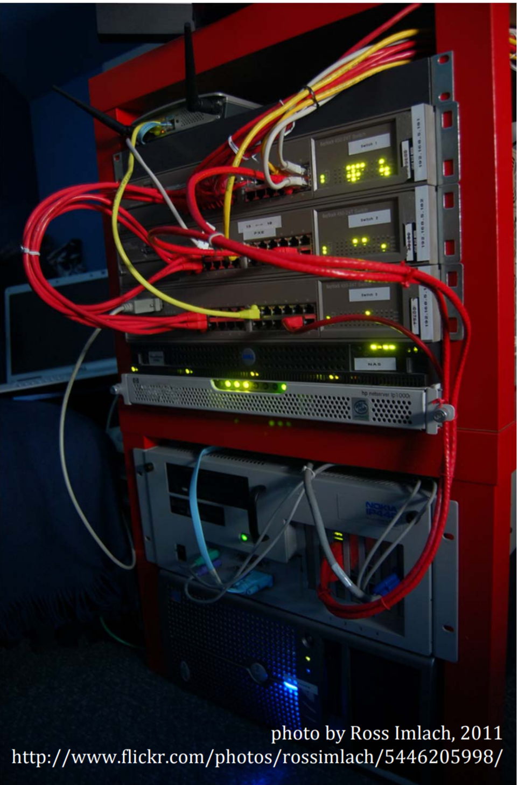
Bellman‐Ford in Practice
Distance‐vector routing protocol
– Repeatedly relax edges until convergence
– Relaxation is local!
• On the Internet:
– Routing Information Protocol (RIP)
– Interior Gateway Routing Protocol (IGRP)

Slide 19
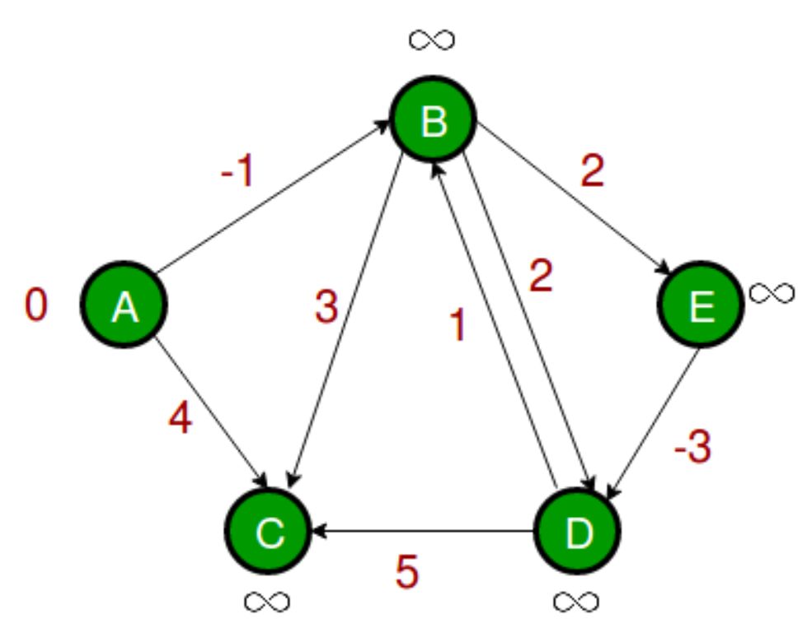
In Class Practice
Ques: Find the shortest path for the graph given below assuming the order of edges as: (B, E), (D, B), (B, D), (A, B), (A, C), (D, C), (B, C), (E, D)

Slide 20
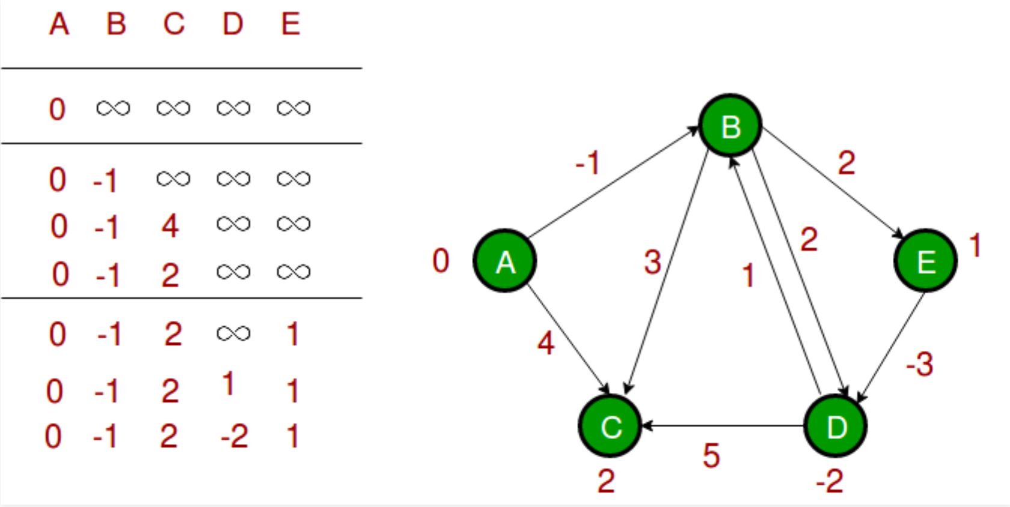
Solution

