Slide 1
Normalization
Lecture 8

Slide 2

Canonical Form/ Minimal FD Set
A set of FDs is minimal if it satisfies the following conditions:
Every dependency in F has a single attribute for its RHS.
We cannot remove any dependency from F and have a set of dependencies that is equivalent to F.
No extraneous attribute

Slide 3
Canonical Form (Cont.)
Every set of FDs has an equivalent minimal set
There can be several equivalent minimal sets
Example:
F = {A → B, B → C, A → C, AB → A, AC → B}
From transitivity property A → C
Thus, A → C is redundant
Trivial FD,
always implied
A → B
From augmentation property
AC → BC
From split rule
AC → B, AC → C
Thus, AC → B is redundant
∴ Fm = { A → B, B → C }

Slide 4


Extraneous Attribute
If XY → Z and X+ determines Y or Z in FD set F,
then “ Y ” is extraneous in XY → Z
Example:
F = { XY → Z, X → Y }
Here, Y is extraneous attribute
Thus, Fm = { X → Z, X → Y }
Check if F and Fm are equivalent?

Slide 5
Extraneous Attribute Example
F = { ABCD → E, AB → F, F → C }
Find extraneous attribute?
A+ = A AB+ = A, B, F, C
B+ = B AD+ = A, D
C+ = C BD+ = B, D
D+ = D ABD+ = A, B, C, D, E, F ∴ C is extraneous

Slide 6

Extraneous Attribute Drill
Find extraneous attribute in the below FD set
F = { PQRS → T, QR → U, U → P, R → U }

Slide 7
Solution Extraneous Attribute Drill
F = { PQRS → T, QR → U, U → P, R → U }
P+ = P
Q+ = Q
R+ = R, U, P
S+ = S
QR+ = Q, R, U, P
RS+ = R, S, U , P
QS+ = Q, S
QR → U
R → U
∴ Q is Extraneous
Also, P is Extraneous

Slide 8

Steps for Canonical Cover
Split FDs such that RHS of every FD has single attribute.
Discard trivial FDs
Remove extraneous attributes from LHS of every FD
i.e. if XY → Z and X+ determines Y or Z in FD set F,
then “ Y ” is extraneous in XY → Z
Remove redundant FDs
i.e. F – { X → Y} = F

Slide 9
Canonical Cover Example (Cont.)
Given FD set F = { a, b, c → c, d, e, f ; c → e; a → b; d → f }
Solution
a,b,c → c
a,b,c → d
a,b,c → e
a,b,c → f
Remove a,b,c → c (trivial FD)
Now, F ={ a,b,c → d ; a,b,c → e; a,b,c → f; c → e; a → b; d → f }
Finding extraneous attributes:
B is extraneous in a,b,c → d and a,b,c → e and a,b,c → f as a → b
A is extraneous in a,c → e as c → e
Thus, F= {a,c → d; c → e; a,c → f ; c → e; a → b; d → f}
Remove a,c → f (since it is implied by a,c → d and d → f)
F= {a,c → d; c → e; a → b; d → f}

Slide 10

Canonical Cover Drill
Consider the following set F of functional dependencies: F= { A → BC, B → C, A → B, AB → C }
Consider the following set F of functional dependencies: F= { AB → C, BC → D, A → BCD, BC → BCD }

Slide 11

Solution Canonical Cover Drill
1. F= { A → BC, B → C, A → B, AB → C }
A → B is redundant in A → BC
Now, F = { A → B, A → C, B → C, AB → C}
A is extraneous in AB → C as B → C
F = { A → B, A → C, B → C}
A → C is redundant since because of transitivity property in A → B and B → C, A → C is already implied.
Thus, Fm = { A → B, B → C }

Slide 12
Solution Canonical Cover Drill
2. F= { AB → C, BC → D, A → BCD, BC → BCD }
BC → BC is trivial in BC → BCD
F= { AB → C, BC → D, A → BCD, BC → D }
BC → D is redundant
F= { AB → C, BC → D, A → B, A → C, A → D }
B is extraneous in AB → C as A → B
F = {A → C, BC → D, A → B, A → D}
A → D is redundant as A → C, A → B, BC → D (property of transitivity)
∴ Fm = { A → BC, BC → D }

Slide 13

Normalization
Normalization: The process of decomposing unsatisfactory "bad" relations by breaking up their attributes into smaller relations
Denormalization: the process of storing the join of higher normal form relations as a base relation—which is in a lower normal form

Slide 14
Normalization (Cont.)
Redundancy
Non-trivial FDs
X → Y
Non-trivial
Multi-valued Dependency
X → → Y

Slide 15
Normal Forms
Levels of normalization based on the amount of redundancy in the database.
Various levels of normalization are:
First Normal Form (1NF)
Second Normal Form (2NF)
Third Normal Form (3NF)
Boyce-Codd Normal Form (BCNF)
Fourth Normal Form (4NF)
Fifth Normal Form (5NF)
Decreasing Redundancy
Decreasing Number of Tables
Most databases should be 3NF or BCNF in order to avoid the database anomalies.

Slide 16
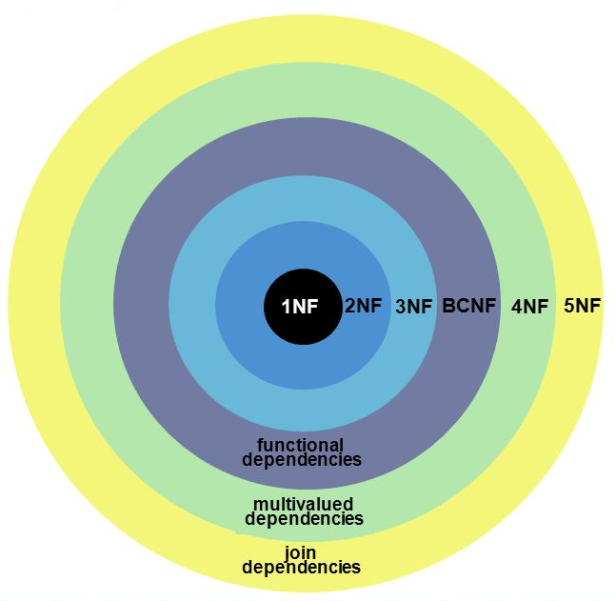
Hierarchy of Normal Forms
Weakest
Strongest

Slide 17
Normalization
1NF
a relation in BCNF, is also in 3NF
a relation in 3NF is also in 2NF
a relation in 2NF is also in 1NF
2NF
3NF
BCNF

Slide 18
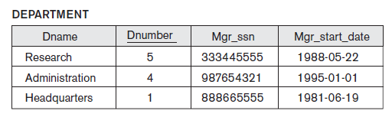
First Normal Form
A relation is in 1NF if all values stored in the relation are single-valued and atomic.
i.e. 1NF places restrictions on the structure of relations. Values must be simple.
It implies no multi-valued dependencies allowed.
All single valued attributes

Slide 19
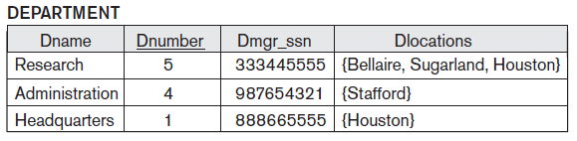
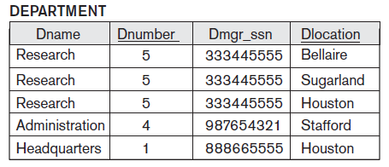
Normalization into 1NF
Multi – valued entries changed to single valued

Slide 20
Second Normal Form
A relation is in 2NF if it is in 1NF, and every non-key attribute is fully dependent on each candidate key i.e. no partial FD.
Partial Dependency
X: any candidate key
Y: proper subset of candidate key
A: non-prime attribute
Y → A is partial dependency
X
Y
A

Slide 21

Second Normal Form Example
{SSN, PNUMBER} → HOURS is a full FD
∵ neither SSN → HOURS
nor PNUMBER → HOURS hold
{SSN, PNUMBER} → ENAME is PD
∵ SSN → ENAME holds

Slide 22
Third Normal Form
A relation R is in 3NF iff every non-trivial FD X → Y in R
X is superkey (or)
Y is prime attribute
Superkey (or) Prime Attribute
X
Y

Slide 23
BCNF Normal Form (Boyce-Codd Normal Form)
A relation schema R is in Boyce-Codd Normal Form (BCNF) if whenever an FD X → A holds in R, then X is a superkey of R
There exist relations that are in 3NF but not in BCNF
The goal is to have each relation in BCNF (or 3NF)
X
Y
Superkey

Slide 24
Practice Drill
Consider the following four relational schemas. For each schema, all non-trivial functional dependencies are listed, The underlined attributes are the respective primary keys.
Schema I:
Registration (rollno, courses) rollno → courses
Schema II:
Registration (rollno, coursid, email) rollno, courseid → email email → rollno

Slide 25
Practice Drill (Cont.)
Schema III:
Registration (rollno, courseid, marks, grade) rollno, courseid, → marks, grade marks → grade
Schema IV:
Registration (rollno, courseid, credit) rollno, courseid → credit courseid → credit
Which one of the relational schemas above is in 3NF but not in BCNF?

Slide 26
Solution Practice Drill
Schema I:
Registration(rollno, courses) rollno → courses
Since, rollno is primary key, so this relation is in BCNF as well as 3 NF.
Schema II:
Registration (rollno, coursid, email) rollno, courseid → email email → rollno
{rollno, coursid} is primary key so rollno and coursid are prime attributes. email is non-prime attribute.
FD rollno, courseid → email is in BCNF and 3NF,
FD email → rollno violates the rule of BCNF as email is not superkey, but 3NF is satisfied because rollno is prime attribute.
Thus, overall this relation is in 3 NF but not in BCNF.

Slide 27
Solution Practice Drill (Cont.)
Schema III:
Registration (rollno, courseid, marks, grade) Non-trivial functional dependencies: rollno, courseid, → marks, grade marks → grade
rollno, courseid is primary key, so rollno and courseid are prime attributes and marks and grade are non-prime attributes.
FD rollno, courseid, → marks, grade satisfies BCNF as well as 3NF.
FD marks → grade does not satifies 3 NF because nither marks is superkey nor grade is prime-attribute.. So, overall this relation is not in 3 NF and not in BCNF but it does not violates rule of 2 NF, so can be only in 2 NF.

Slide 28
Solution Practice Drill (Cont.)
Schema IV:
Registration (rollno, courseid, credit) rollno, courseid → credit courseid → credit
rollno, courseid is primary key, so rollno and courseid are prime-attributes and credit is non-prime attribute.
FD rollno, courseid → credit satifies BCNF as well as 3 NF.
FD courseid → credit violates rule of 2 NF, so can not be in 2NF. So, overall this is not in 2 NF, 3 NF, and BCNF. But it is only in 1 NF.

Slide 29
Practice Drill
Relation R has eight attributes ABCDEFGH. Fields of R contain only atomic values.
F = { CH→G, A→BC, B→CFH, E→A, F→EG } is a FD set
- i) How many candidate keys does the relation R have?
(a) 3 (b) 4 (c) 5 (d) 6
ii) The relation R is in which normal form?
(a) in 1NF, but not in 2NF.
(b) in 2NF, but not in 3NF.
(c) in 3NF, but not in BCNF.
(d) in BCNF.

Slide 30

Practice Drill Solution
Ans i): Option (b)
A+:ABCFHGE B+: BCFHEGA C+:C
D+:D E+: EABCFHG F+:FEGABCH
G+:G H+ : H
A+,B+,E+,F+ contains all attributes except D. Thus there are 4 candidate keys DA,DB,DE and DF.
Ans ii) Option (a)
-
F → G; G is a non-prime attribute and F is a proper subset of a candidate key. This is a case of partial dependency. Hence 2NF condition is violated.
A →C and B → CH also violates 2NF condition, hence R is not in 2NF. -
Since attributes of relation R has only atomic values, R is in 1NF.

Slide 31

Practice Drill
Find the highest normal form of a relation R(A,B,C,D,E) with FD set as { BC → D, AC → BE, B → E }
Find the highest normal form of a relation R(A,B,C,D) with FD set as { AB → C, BC → D }
Find the highest normal form of a relation R(A,B,C,D,E,F) with FD set as
{ AB → C, C → D, D → AE, E → F, F → B }

Slide 32
Solution Practice Drill
1. F = { BC → D, AC → BE, B → E }
(AC)+ ={A,C,B,E,D} but none of its subset can determine all attribute of relation, So AC will be candidate key. A or C can’t be derived from any other attribute of the relation, so there will be only 1 candidate key {AC}.
{A,C} – Prime and {B,D,E} – Non-prime
The relation is in 2nd normal form because BC → D is in 2nd normal form (BC is not proper subset of candidate key AC)
AC → BE is in 2nd normal form (AC is candidate key)
B → E is in 2nd normal form (B is not a proper subset of candidate key AC).
The relation is not in 3rd normal form because in BC → D (neither BC is a super key nor D is a prime attribute) and in B → E (neither B is a super key nor E is a prime attribute). So the highest normal form of relation will be 2nd Normal form.

Slide 33
Solution Practice Drill (Cont.)
2. { AB → C, BC → D }
AB+ = A, B, C, D
A+ = A
B+ = B
BC+ = B, C
Prime – A, B Non-prime – C, D
Thus, because of BC → D this relation is not in BCNF and neither in 3NF
Thus, the relation is in 2NF

Slide 34
Solution Practice Drill (Cont.)
3. { AB → C, C → D, D → AE, E → F, F → B }
AB+ = A, B, C, D, E, F A+ = A B+ = B
AF+ = A, B, C, D, E, F F+ = F, B
AE+ = A, B, C, D, E, F E+ = E, F, B
AD+ = A, B, C, D, E, F D+ = A, B, C, D, E, F
C+ = A, B, C, D, E, F
Prime - A, B, C, D, E, F
Because of E → F and F → B relation is not in BCNF
Thus, the relation is in 3NF

Slide 35
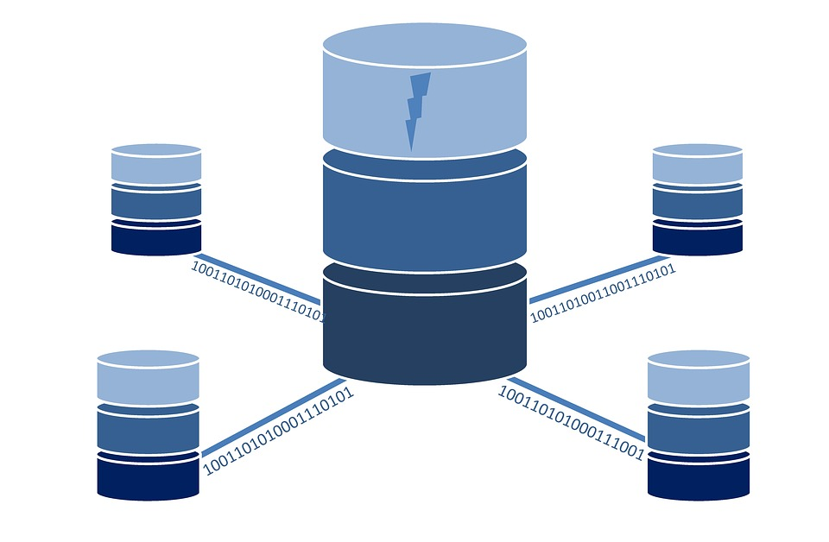
DECOMPOSING RELATIONS TO ACHIEVE HIGHER NORMAL FORMS

Slide 36

Properties of Relational Decompositions
Attribute preservation condition: Each attribute in R will appear in at least one relation schema R_{i} in the decomposition so that no attributes are “lost”.
Another goal of decomposition is to have each individual relation R_{i} in the decomposition D be in BCNF or 3NF.

Slide 37
Dependency Preservation Property of Relational Decompositions
Let R be a relation with FD set F, decomposed into R1, R2,….Rn with FD sets F1, F2,…Fn
Case 1: If all FDs of F are implied in
{ F1 U F2 U F3…. U F4 },
decomposition is dependency preserving
Case 2: If all FDs of F are not implied in
{ F1 U F2 U F3…. U F4 },
decomposition is not dependency preserving
R with FD set F
R1 with FD set F1
R2 with FD set F2

Slide 38

Dependency Preservation Example
Let a relation R(A,B,C,D) and a set FDs
F = { A → B , A → C , C → D}
A relation R is decomposed into –
R₁ = (A, B, C) with FDs F₁ = {A → B, A → C}
R₂ = (C, D) with FDs F₂ = {C → D}.
F' = F₁ ∪ F₂ = {A → B, A → C, C → D}
F' = F.
Thus, the decomposition is dependency preserving decomposition.

Slide 39

Practice Drill
Relation R ( ABCDE ) with FD set
F = { A → B, B → C, C → D, D → E, D → B}
D = { AB, BC, CD, DE }
Relation R ( ABCD ) with FD set
F = { AB → CD, D → A}
D = { ABC, BCD, AD }
Relation R ( ABCDEF ) with FD set
F = { A → BCDEF, BC → ADEF, D → E, B → F}
D = { ABCD, DE, BF }
Relation R ( ABCDE ) with FD set
F = { A → BC, CD → E, B → D, E → A }
D = { ABCE, BD }

Slide 40
Solution Practice Drill
F = { A → B, B → C, C → D, D → E, D → B}
D = { AB, BC, CD, DE }
Finding non-trivial FDs of decomposed relations in D
F1 = { A → B}
F2 = { B → C, C → B}
F3 = { C → D, D → C }
F4 = { D → E}
Check all FDs of F are implied in { F1 U F2 U F3 U F4 } - YES
Thus, decomposition is dependency preserved

Slide 41

Solution Practice Drill
2. F = { AB → CD, D → A}
D = { ABC, BCD, AD }
Finding non-trivial FDs of decomposed relations in D
F1 = { AB → C}
F2 = { BD → C}
F3 = { D → A }
Check all FDs of F are implied in { F1 U F2 U F3 } - NO
Thus, decomposition is not dependency preserved

Slide 42
Solution Practice Drill
3. F = { A → BCDEF, BC → ADEF, D → E, B → F}
D = { ABCD, DE, BF }
Finding non-trivial FDs of decomposed relations in D
F1 = { A → BCD, BC → AD}
F2 = { D → E}
F3 = { B → F }
Check all FDs of F are implied in { F1 U F2 U F3 } - YES
Thus, decomposition is dependency preserved

Slide 43

Solution Practice Drill
4. F = { A → BC, CD → E, B → D, E → A }
D = { ABCE, BD }
Finding non-trivial FDs of decomposed relations in D
F1 = { A → BCE, E → ABC, BC → AE }
F2 = { B → D}
Check all FDs of F are implied in { F1 U F2 U F3 } - NO
Thus, decomposition is not dependency preserved

Slide 44
Thanks!!

