Slide 1
RECOVERY SYSTEM
Lecture 24

Slide 2
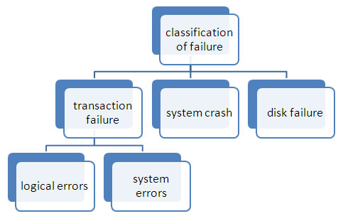
FAILURE CLASSIFICATION

Slide 3
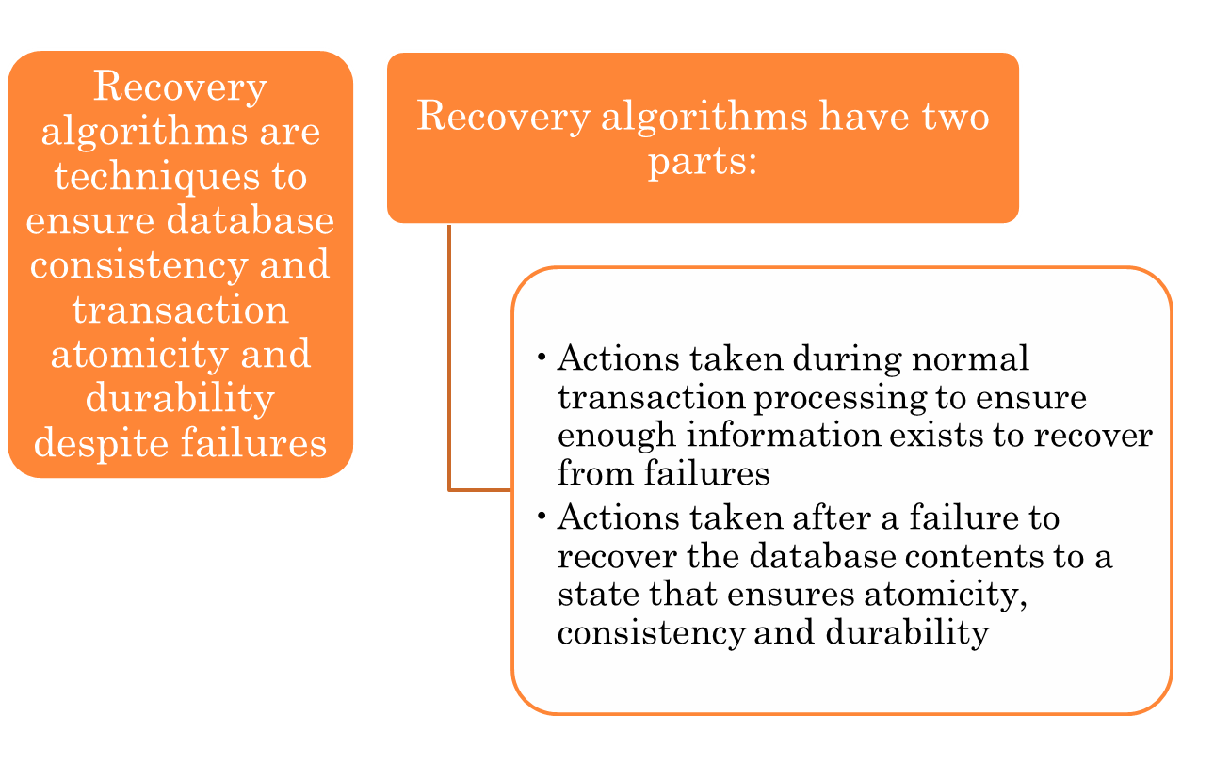
RECOVERY ALGORITHMS

Slide 4
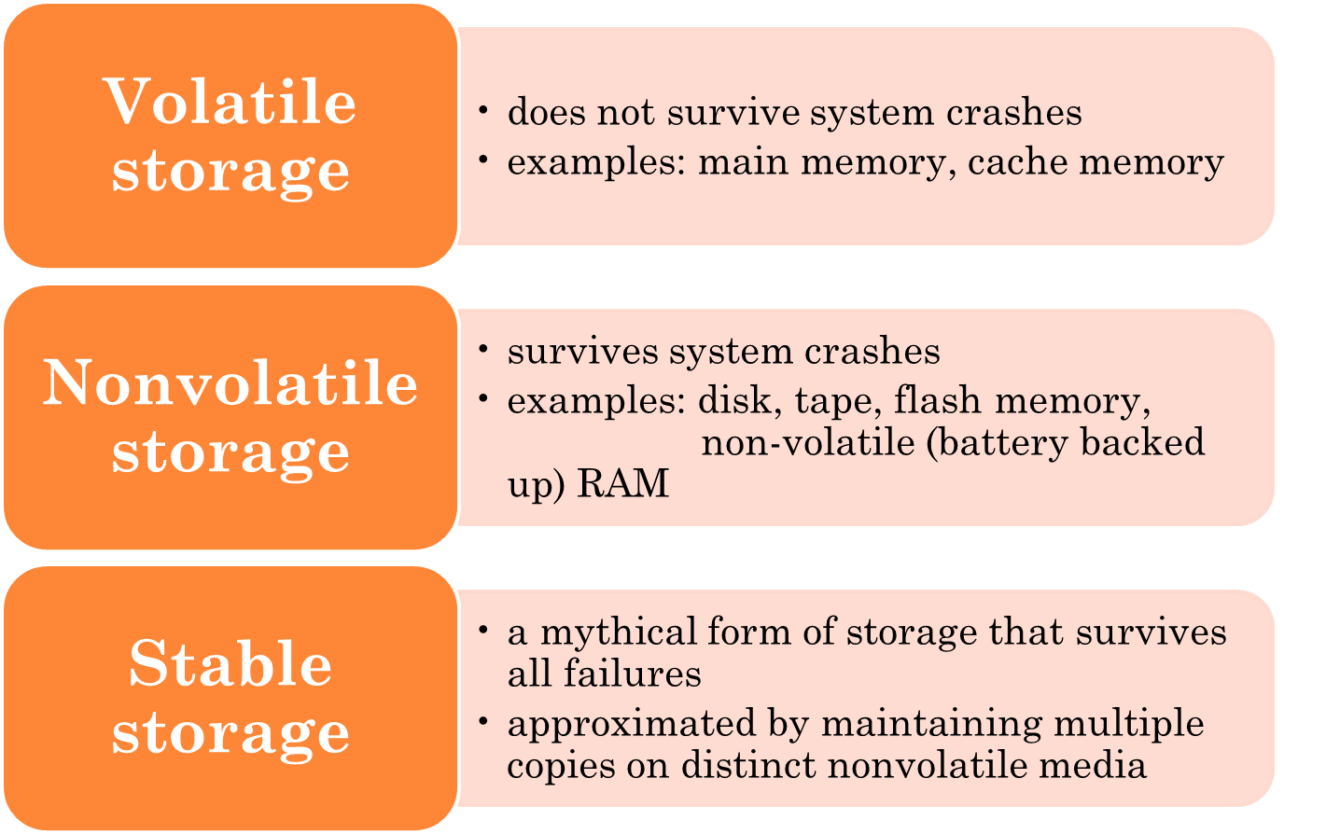
STORAGE STRUCTURE

Slide 5
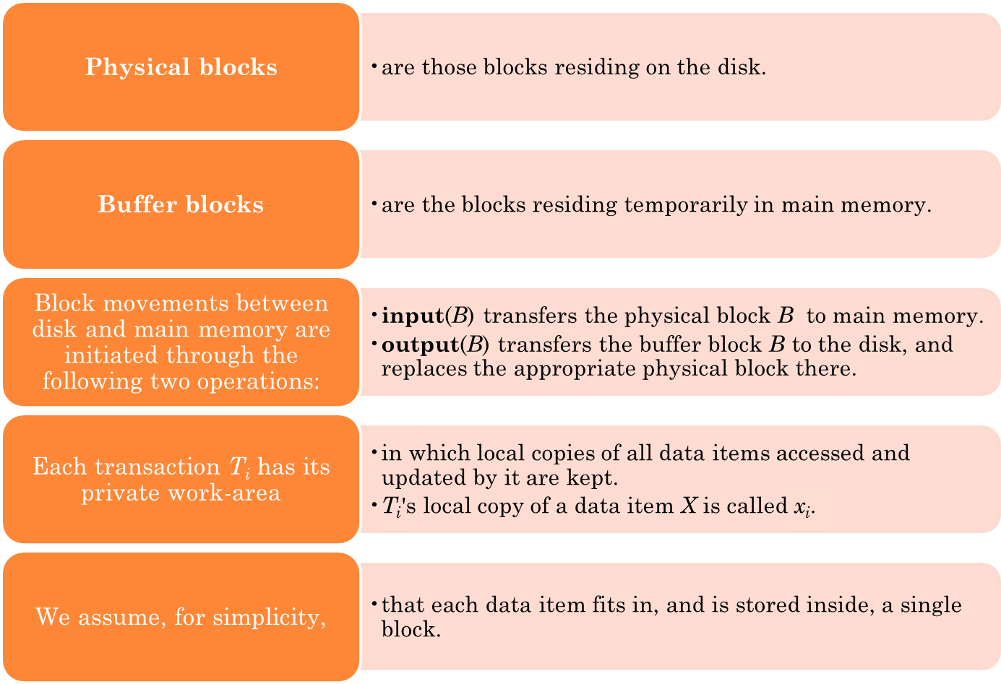
DATA ACCESS

Slide 6
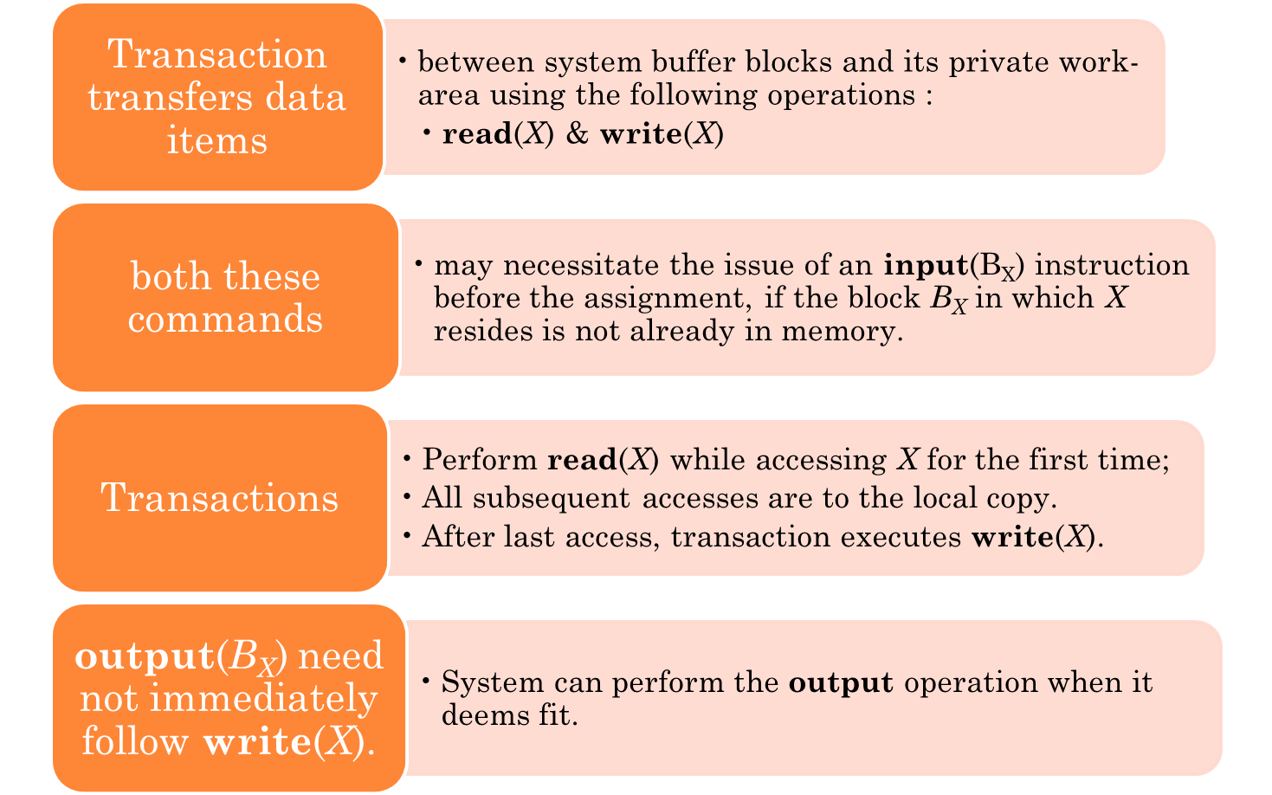
DATA ACCESS (CONT.)

Slide 7
EXAMPLE OF DATA ACCESS
buffer
Buffer Block A
input(A)
X
A
Buffer Block B
Y
B
output(B)
read(X)
write(Y)
x₂
x₁
y₁
work area
of T₁
work area
of T₂
memory
disk

Slide 8
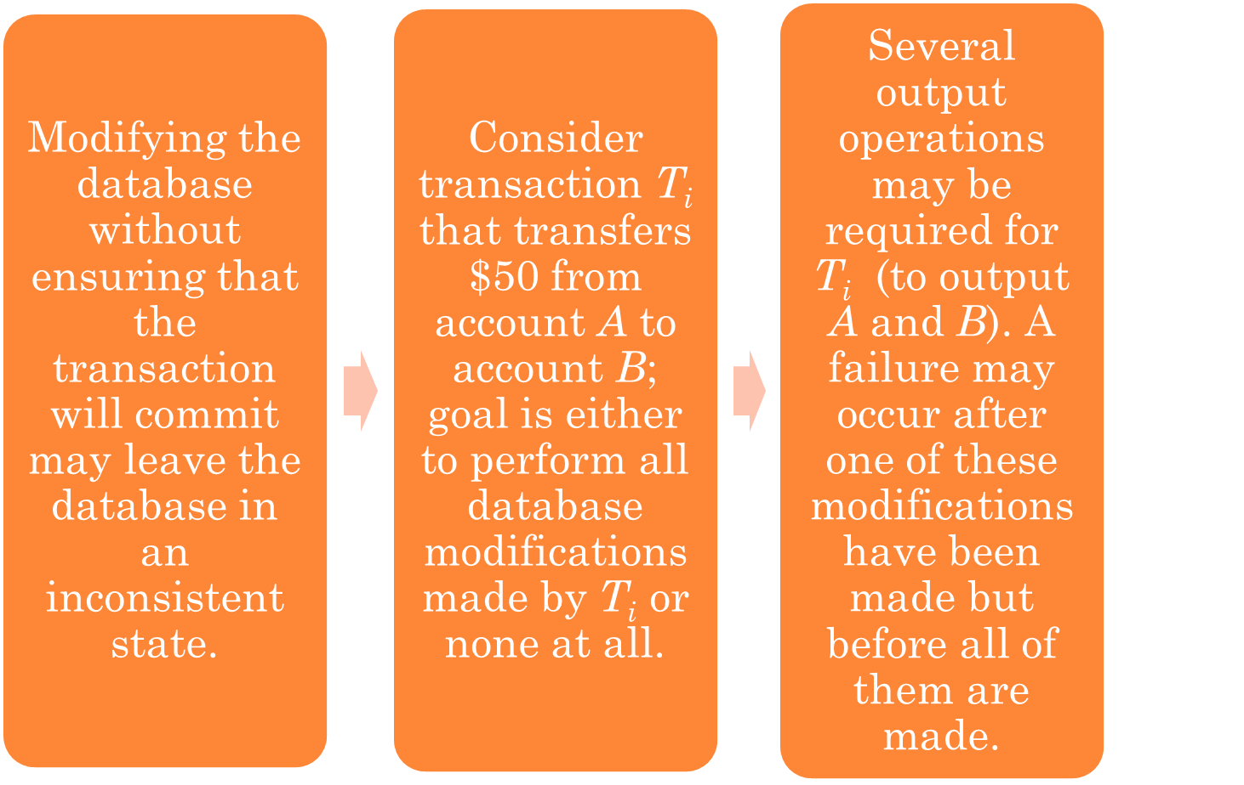
RECOVERY AND ATOMICITY

Slide 9
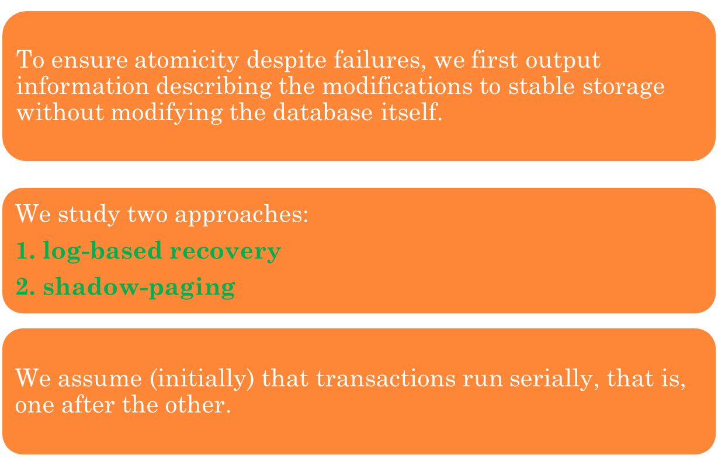
RECOVERY AND ATOMICITY (CONT.)

Slide 10
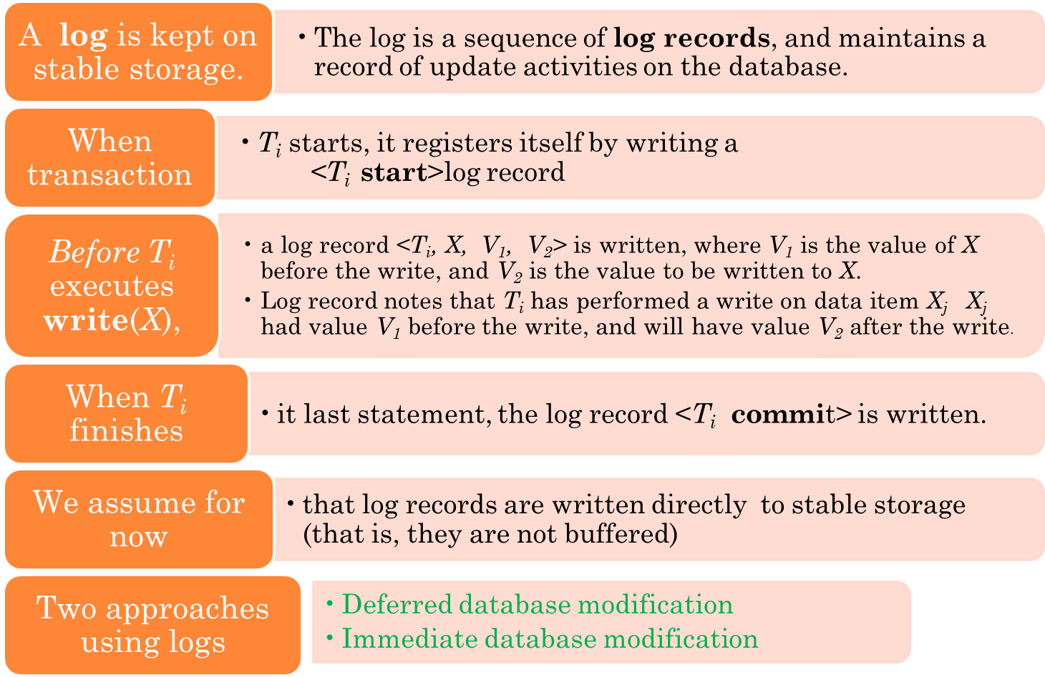
LOG-BASED RECOVERY

Slide 11
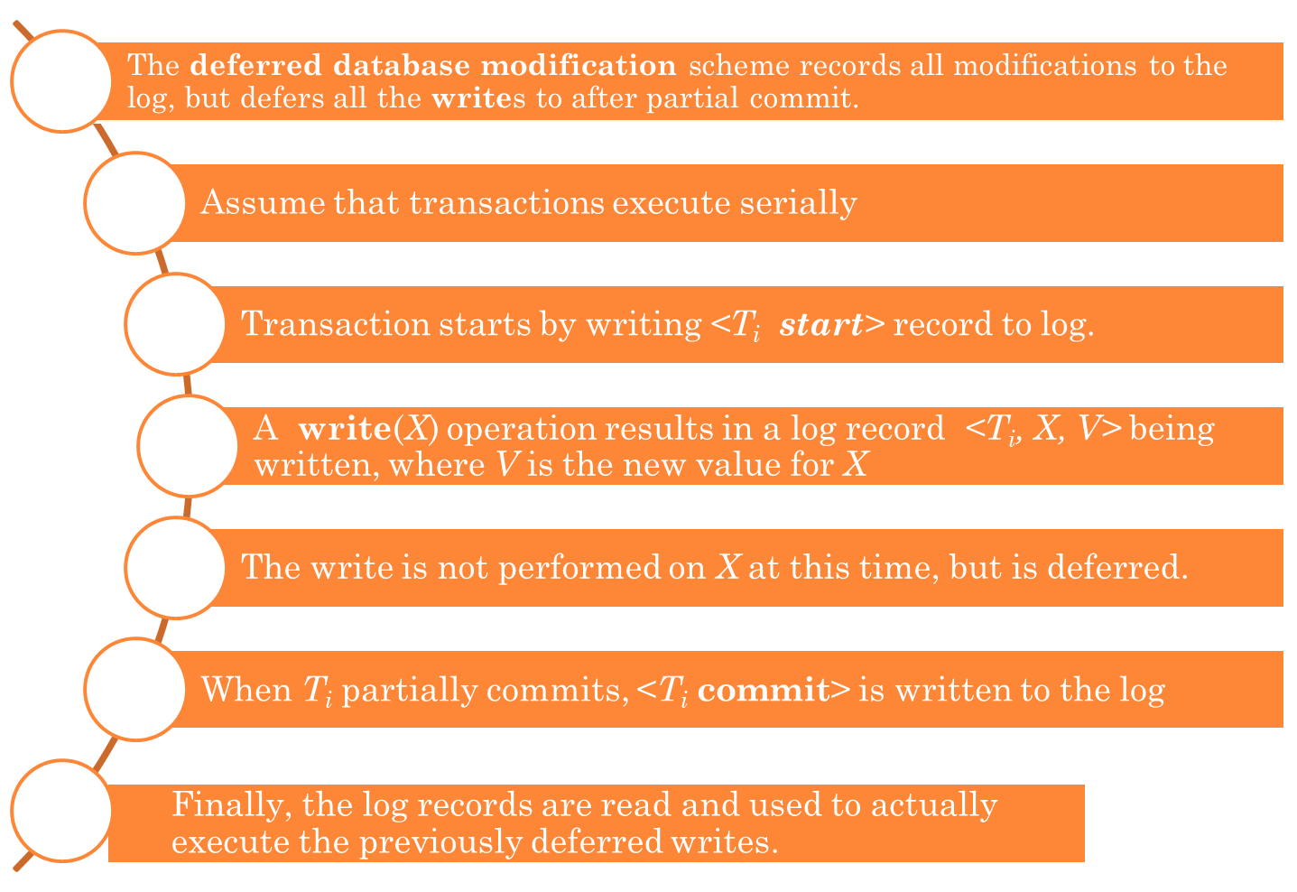
DEFERRED DATABASE MODIFICATION

Slide 12
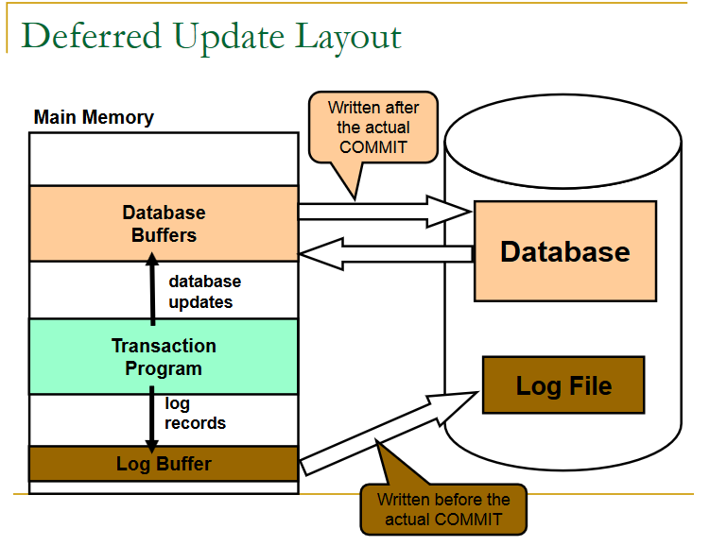

Slide 13
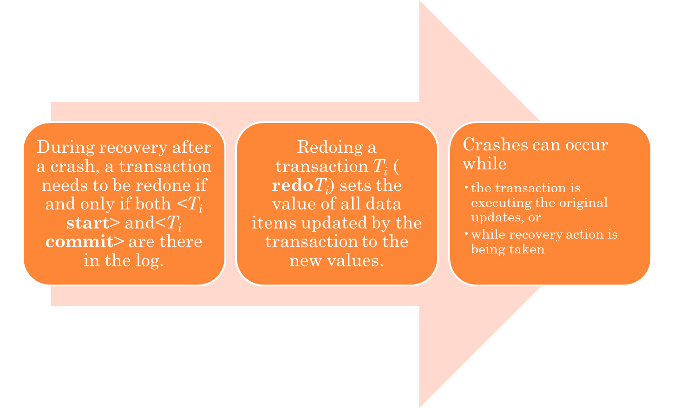
DEFERRED DATABASE MODIFICATION (CONT.)

Slide 14
DEFERRED DATABASE MODIFICATION (CONT.)
example transactions T₀ and T₁ (T₀ executes before T₁):
To | T1
read (A) | read (C)
A: - A - 50 | C:-C- 100
Write (A) | write (C)
read (B)
B:- B + 50
write (B)

Slide 15

PRACTICE QUESTION
Question: Below we show the log as it appears at three instances of time.
Explain recovery action for each of the above case.

Slide 16
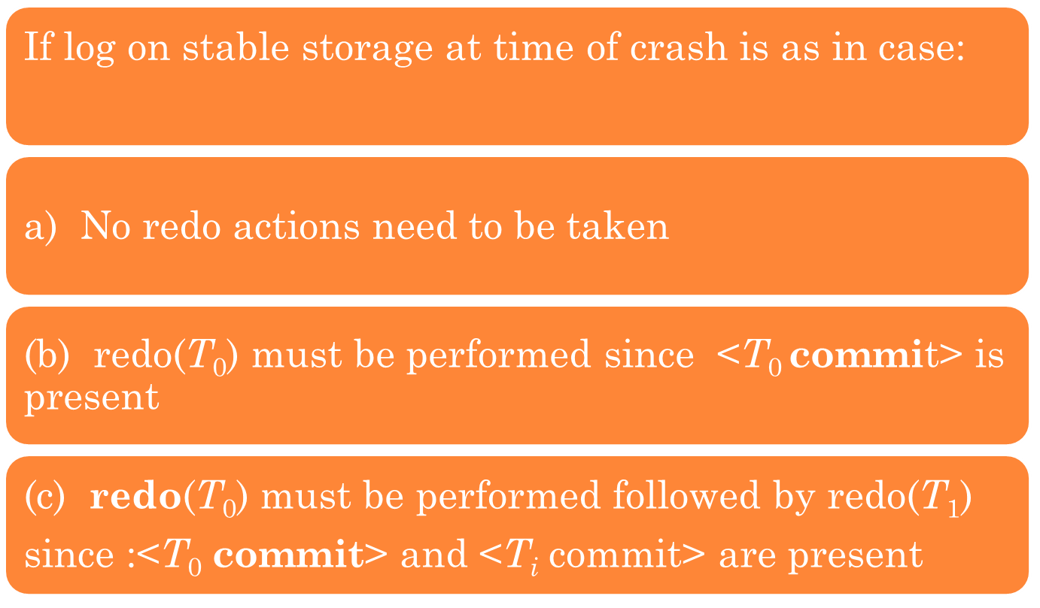
PRACTICE QUESTION SOLUTION

Slide 17
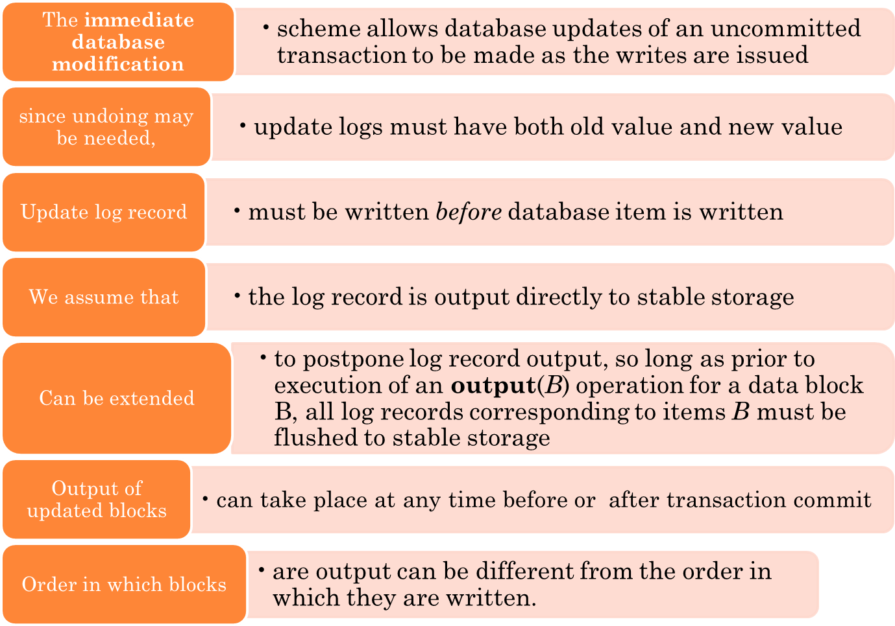
IMMEDIATE DATABASE MODIFICATION

Slide 18
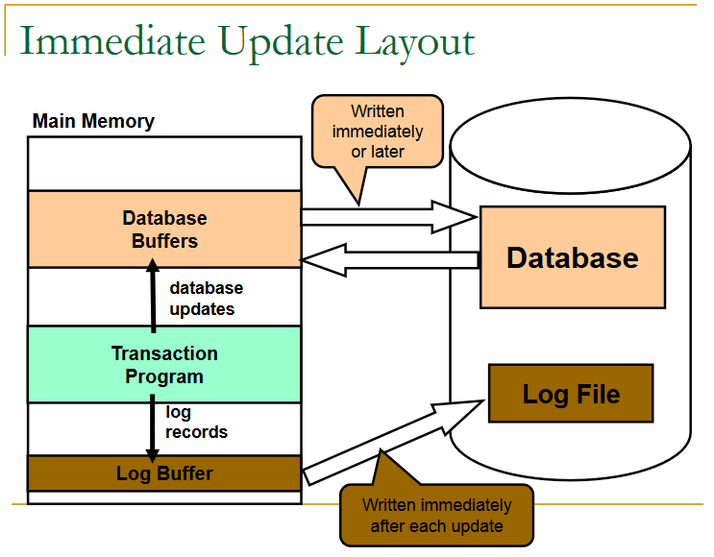

Slide 19
IMMEDIATE DATABASE MODIFICATION EXAMPLE
Log Write Output
<T₀ start>
<T₀, A, 1000, 950>
T_{o}, B, 2000, 2050
A = 950
B = 2050
<T₀ commit>
<T₁ start>
<T₁, C, 700, 600>
C = 600
B_{B}, B_{C}
<T₁ commit>
B_{A}
Note: B_{X} denotes block containing X.
x₁

Slide 20
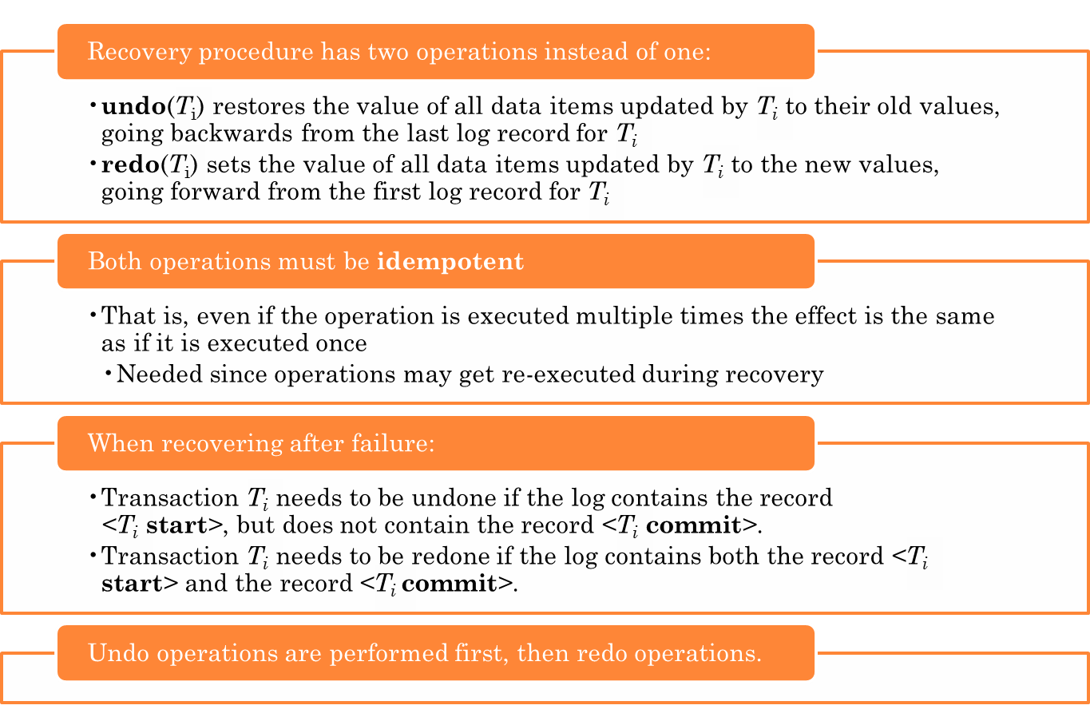
IMMEDIATE DATABASE MODIFICATION (CONT.)

Slide 21

PRACTICE QUESTION
Question: Below we show the log as it appears at three instances of time.
Explain recovery action for each of the above case.

Slide 22
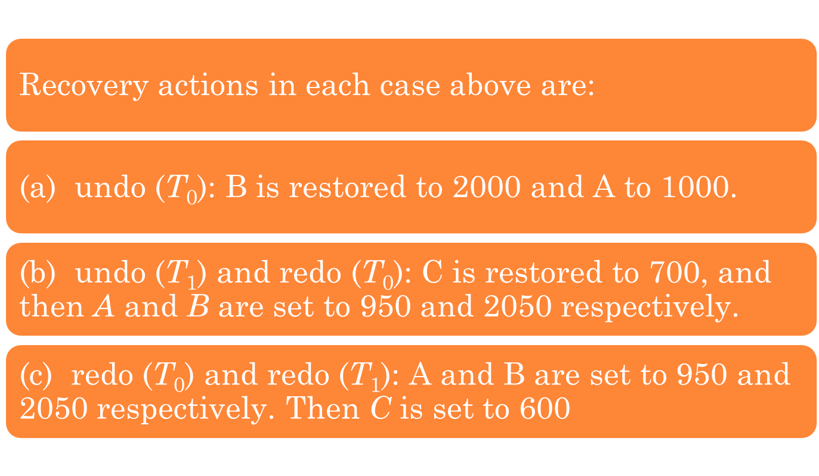
PRACTICE QUESTION SOLUTION

Slide 23
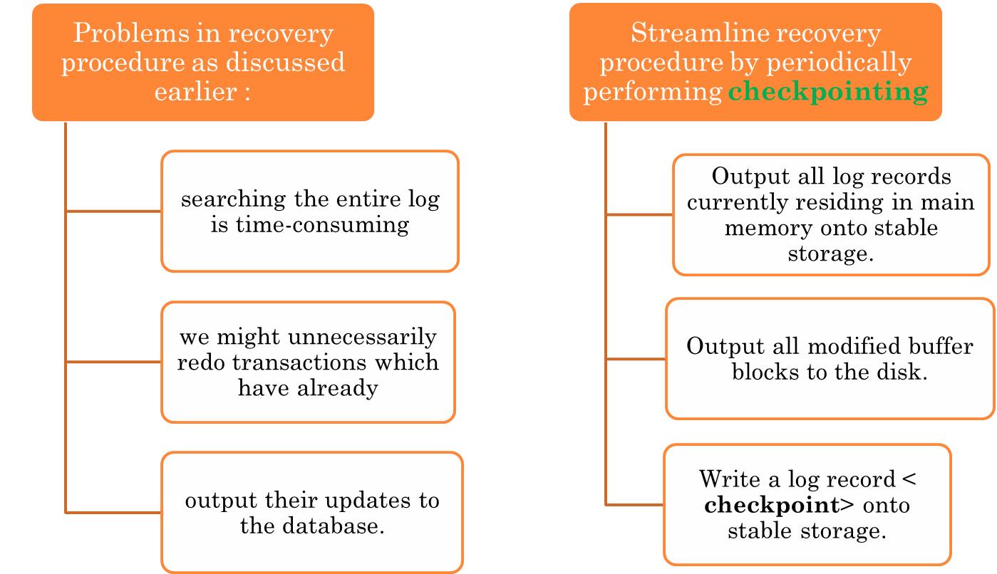
CHECKPOINTS

Slide 24
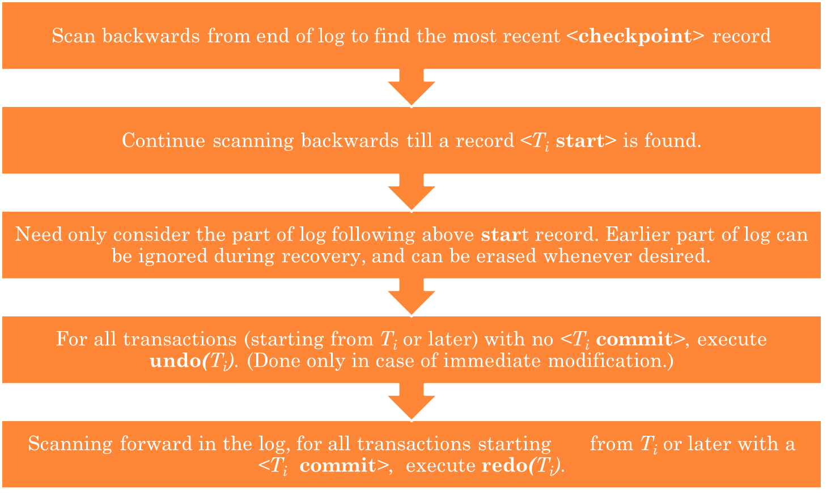
DURING RECOVERY WE NEED TO CONSIDER ONLY THE MOST RECENT TRANSACTION T_{I} THAT STARTED BEFORE THE CHECKPOINT, AND TRANSACTIONS THAT STARTED AFTER T_{I}.

Slide 25
EXAMPLE OF CHECKPOINTS
T_{c}
T_{f}
T₁ can be ignored (updates already output to disk due to checkpoint)
T₂ and T₃ redone.
T₄ undone
T₁
T₂
T₃
T₄
checkpoint
system failure

Slide 26
EXAMPLE OF RECOVERY
Go over the steps of the recovery algorithm on the following log:
        <T₀ start>
        <T₀, A, 0, 10>
        <T₀ commit>
        <T₁ start> /* Scan at step 1 comes up to here */
        <T₁, B, 0, 10>
        <T₂ start>
        <T₂, C, 0, 10>
        <T₂, C, 10, 20>
        <checkpoint {T₁, T₂}>
        <T₃ start>
        <T₃, A, 10, 20>
        <T₃, D, 0, 10>
        <T₃ commit>

Slide 27
THANKS!!

