Slide 1




Web Server Load Balancer
with Shared NFS/NAS Storage
High-availability Apache web tier behind an HAProxy load balancer, backed by shared NFS/NAS storage.
Apache x3
HAProxy
Shared NFS/NAS
SFTP/SCP Server
Madhu R

Slide 2





Network Architecture
Three-tier topology — client access, load-balanced compute, shared storage
IP Address mapping Apache1:- 192.168.1.191
Apache2:- 192.168.1.192
Apache3:- 192.168.1.193
SCP Host:- 192.168.1.194
GLB Host:- 192.168.1.195
CLIENT ZONE
Client
HAProxy (GLB)
192.168.1.195
LOAD-BALANCED WEB TIER
Components
GLB (HAProxy)
SFTP/SCP Server
Apache-1
Apache-2
Apache-3
Round-robin load balancing
Apache-1 / 2 / 3
192.168.1.194
192.168.1.191
192.168.1.192
192.168.1.193
Serve website content
NFS/NAS Server
SHARED STORAGE TIER
Shared storage across all web nodes
SFTP/SCP
Upload website content
NFS/NAS Server
192.168.1.130:/nfs/shared
Web Server Load Balancer with Shared NFS/NAS Storage
2

Slide 3





Upload Flow
STEP 1 OF 3
Step 1 — Content Upload
Website files are uploaded via SCP/SFTP (192.168.1.194) directly onto the shared NFS/NAS Server.
3
Client
HAProxy GLB
192.168.1.195
1
2
SCP/SFTP
Apache-1
Apache-2
Apache-3
NFS/NAS Server
Content Upload
/nfs/shared
Web Server Load Balancer with Shared NFS/NAS Storage
3

Slide 4


Shared to WebSevers
STEP 2 OF 3
Step 2 — Shared Distribution
All three Apache nodes mount the same NFS/NAS path (192.168.1.130:/nfs/shared) — every server serves identical content instantly.
3
Client
HAProxy GLB
Browser
192.168.1.195
1
2
SFTP
Apache-1
Apache-2
Apache-3
NFS Server
Content Upload
/nfs/shared
Web Server Load Balancer with Shared NFS/NAS Storage
4

Slide 5


Download or Access Flow
STEP 3 OF 3
Step 3 — Load-Balanced Serving
Clients browse to http://192.168.1.195; HAProxy round-robins each request across Apache-1/2/3.
3
Client
HAProxy GLB
Browser
192.168.1.195
1
2
SFTP
Apache-1
Apache-2
Apache-3
NFS/NAS Server
Content Upload
/nfs/shared
Web Server Load Balancer with Shared NFS/NAS Storage
5

Slide 6
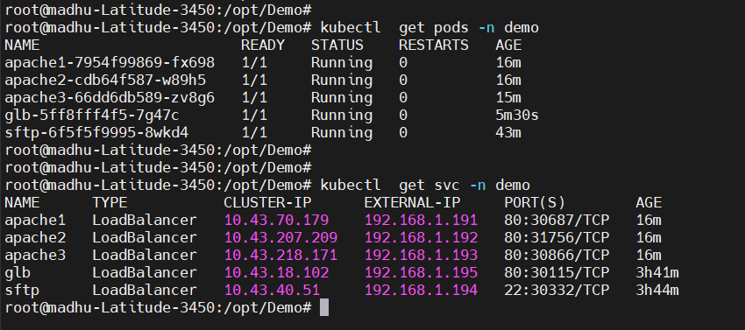
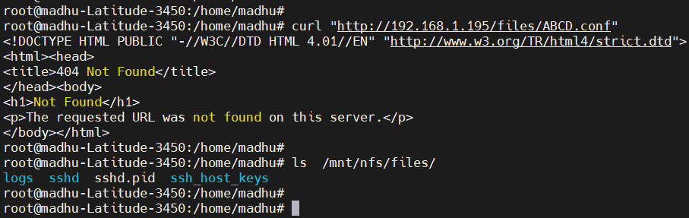
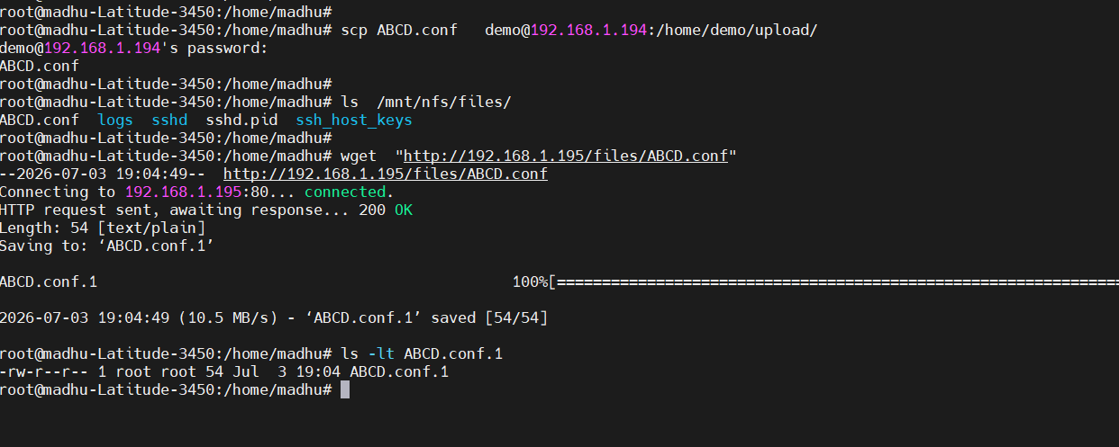
Live Screenshots
1. Nodes and IP’s
2. Verify Before Uploading
3. Upload using SCP and Verify
Host | Hostname | IP Address
Apache1 | apache1-7954f99869-fx698 | 192.168.1.191
Apache2 | apache2-cdb64f587-w89h5 | 192.168.1.191
Apache3 | apache3-66dd6db589-zv8g6 | 192.168.1.191
SCP Host | glb-5ff8fff4f5-7g47c | 192.168.1.191
GLB Host | sftp-6f5f5f9995-8wkd4 | 192.168.1.191
Web Server Load Balancer with Shared NFS/NAS Storage
6

Slide 7


Why This Design Works
High Availability
Instant Consistency
Three independent Apache nodes behind a load balancer eliminate single points of failure.
Shared NFS/NAS storage means every node serves identical content the moment it's uploaded.

Slide 8
Thank you

