Slide 1

Walchand College Of Engineering,Sangli
Department Of Information Technology
Mini-Project

Slide 2
Literature to Visual Story Convertor
A PROJECT BY :
MADHURA VAIDYA [2015BIT003]
KRISHNA KABRA [2015BIT011]
KAUSTUBH JOSHI [2015BIT018]
Under the Guidance of
Ms. A. M. Khot

Slide 3
Introduction :
An application software focussing on conversion of a text story to image
Based on concepts of natural language processing in python
Uses NLTK package , Web-Crawling , Convolutional Neural Network and Recurrent Neural Network

Slide 4
Problem Statement
To convert an input text story to image story and make this tool available as an application software.

Slide 5
Objectives:
To learn Natural Language Processing
To learn Python programming language
To convert the text into most optimized images
To apply engineering knowledge for betterment of society

Slide 6
Methodology:
Keywords extraction using natural language toolkit in python
Parsing those keywords for image extraction using Beautisul Soup
Parse images to convolutional and recurrent neural network for image captioning
Checking semantic similarity of captured captions and keywords
Output the appropriate images with highest semantic similarity index

Slide 7
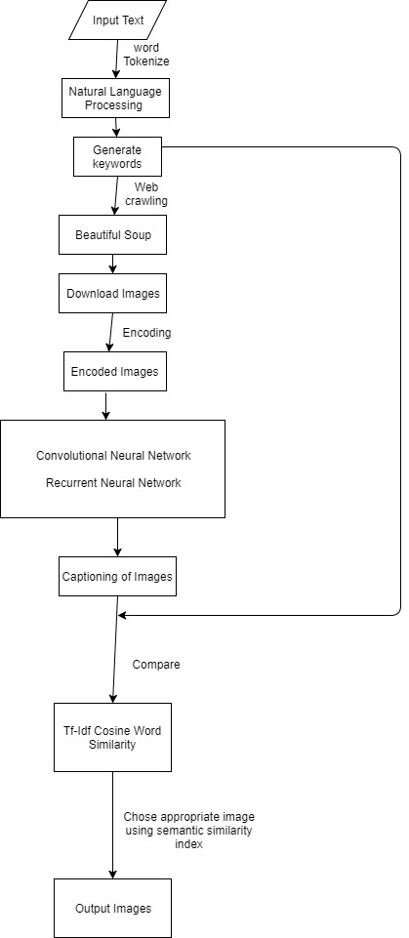
Fig. Flow Chart depicting complete functioning of system

Slide 8
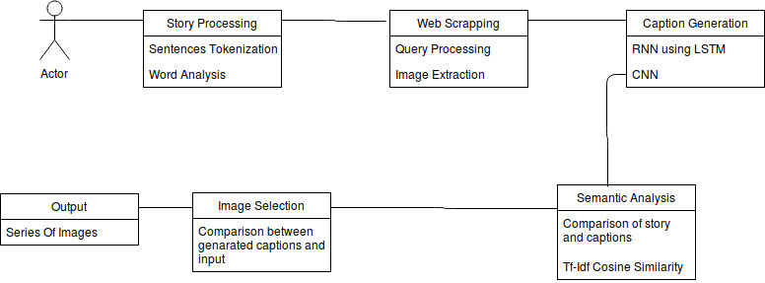

Slide 9
Applications:
Conversion of literature to visual formatted story
Create an easement towards understanding a concept
Erase the language barrier between the reader and the author
Provide a simple medium for illiterate to understand text story

Slide 10
References:
www.pythonprogramming.org
www.newboston.com
www.stackoverflow.com
www.w3schools.com
www.nltkbook.org
6) Oriol Vinyals, Alexander Toshev, Samy Bengio, Dumitru Erhan. [Show and Tell: A Neural Image Caption Generator]
7) A Text to Image Story Teller Specially Challenged
Children - Natural Language Processing Approach.

