Slide 1

Placement
Prediction

Slide 2
Objective and Scope of the Study
The goal of this project is to predict the placement status of students based on various academic, skill-based, and extracurricular features such as CGPA, internships, projects, workshops/certifications, aptitude test scores, soft skills rating, extracurricular activities, and placement training.
This aims to help students, training coordinators, and placement officers make informed and data-driven decisions to improve placement outcomes.
Perform Exploratory Data Analysis (EDA) to understand trends, distributions, and relationships in the dataset.
Analyze how different student attributes impact placement outcomes using visual and statistical methods.
Generate actionable insights to assist in targeted training programs, skill development, and overall placement strategy.
Lay the groundwork for building a machine learning model to accurately predict whether a student is likely to get placed.

Slide 3
Analytics Approach
Checked dataset for missing values, duplicate records, and generated descriptive statistics.
Analyzed distributions of key numerical features such as CGPA, aptitude score, and communication skills.
Studied categorical features like gender, stream, and specialization to understand their influence on placement outcomes.
Identified and treated outliers in important variables like CGPA and test scores.
Examined correlations between academic performance, skills, and placement status.
Extracted meaningful insights to understand which features contribute most towards predicting student placements.

Slide 4
Tools and Techniques
We used Python as our analytics tools.
Python have many libraries like Pandas, NumPy, Matplotlib, and Seaborn for data analysis and visualization.
We applied techniques like data cleaning, exploratory data analysis (EDA), outlier detection, and correlation analysis to understand the factors affecting used car prices.

Slide 5
Column description
StudentID: Unique identifier for each student (not useful for prediction ,just indexing).
CGPA: Cumulative: Grade Point Average(Out of 10). Reflects overall academic performance.
Internship: Number of Internships completed. Demonstrates practical experience.
Projects: Number of projects completed. Shows Technical and application skills.
Workshops/Certifications: Count of workshops or certifications attended.
AptitudeTestScore: Score in aptitude test (out of 100).
SoftskillsRating: Rating of soft skills like communication, leadership, etc.
ExtracurricularActivities: Object participation in extracurricular activities.
PlacementTraining: Whether the student attended placement training.
SSC_Marks: Marks Obtained in secondary School certificate (10th standard).
HSC_Marks: Marks obtained in Higher Secondary Certificate.
PlacementStatus: Target variable. Indicates placement outcome (Placed / NotPlaced).

Slide 6
Visualization(EDA)
PlacementStatus vs CGPA
PlacementStatus vs Internships
PlacementStatus vs Projects
PlacementStatus vs Workshops/Certificate
PlacementStatus vs AptitudeTestScore
PlacementStatus vs Extracurricular Activies
PlacementStatus vs PlacementTraining
PlacementStatus vs SSC_Marks
PlacementStatus vs HSC_Marks

Slide 7
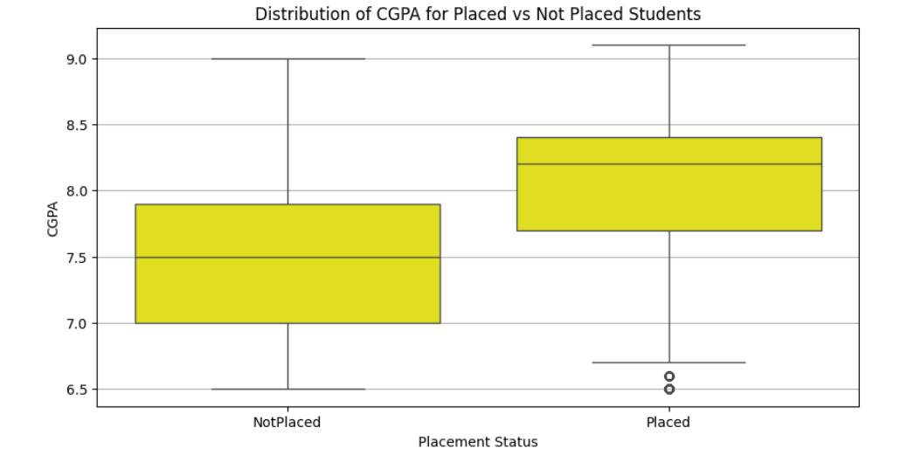
PlacementStatus vs CGPA
Students who have CGPA between less than 7 and less than 8 are not placed.
Students who have CGPA greater than 7.5 and less than 8.5 are placed.

Slide 8
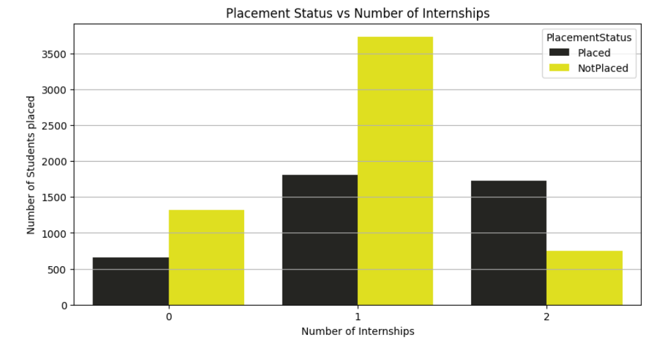
PlacementStatus vs Internships
Majority of students had completed only one internship in both Placed and Not Placed groups.
One internship is common but does not guarantee placement.
Other factors like CGPA, skills, and projects play a crucial role in placement success.

Slide 9
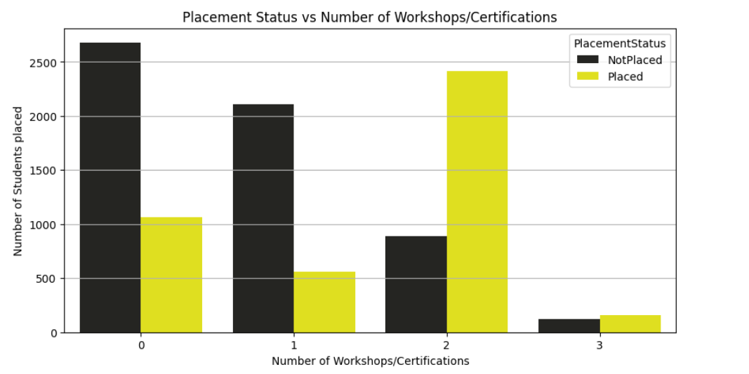
PlacementStatus vs Projects
Most students with 0 or 1 certification are not placed.
Students with 2 certifications have the highest placement rate.
Very few students with 3 certifications, but placements are slightly better then 0 or 1.

Slide 10
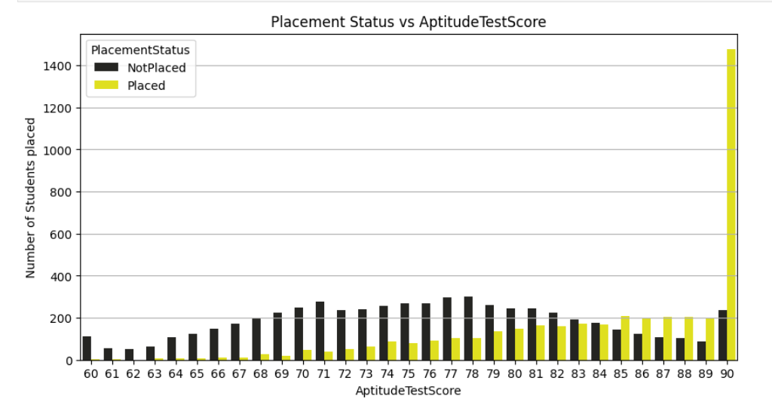
PlacementStatus vs AptitudeTestScore
Students with Aptitude Test Score around 90 are more likely to be placed.
Students with scores below 62 are mostly not placed.
Higher aptitude scores show a strong positive impact on placement chances.

Slide 11
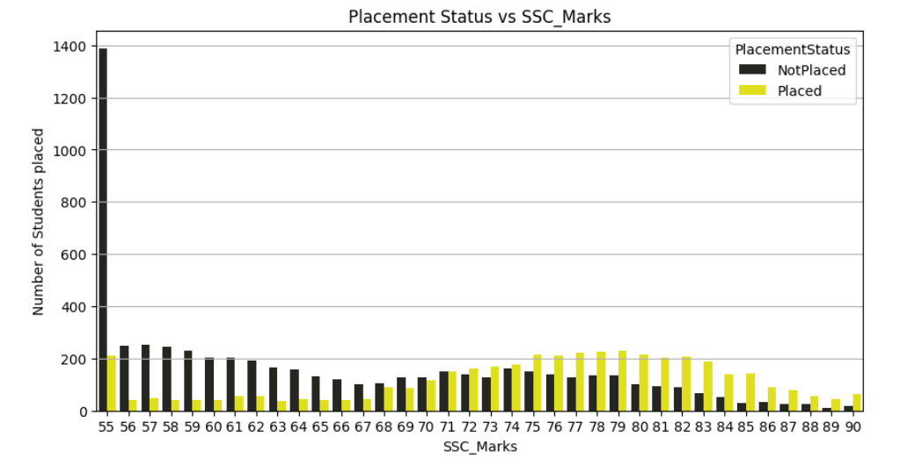
PlacementStatus vs SSC_Marks
Students with SSC score below 64 have fewer chances of placement.
Students with SSC score between 71 and 85 have higher chances of placement.
Placement likelihood increass with better SSC performance.

Slide 12
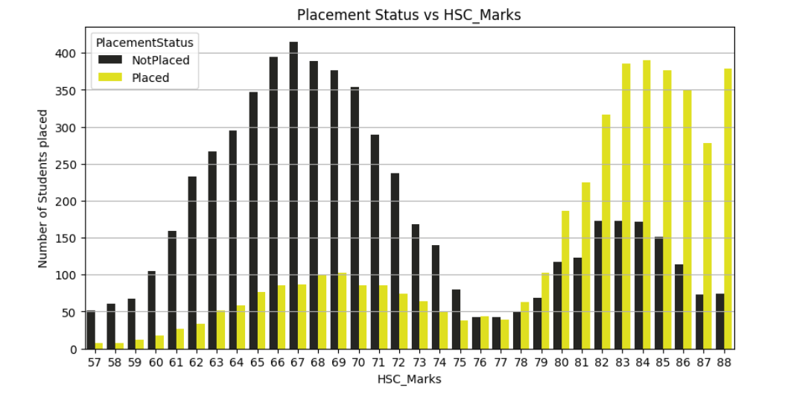
PlacementStatus vs HSC_Marks
Students with HSC percentage below 75 have lower chances of placement.
Students with HSC percentage above 79 have higher chances of placement.
Higher HSC performance positively impacts placement outcome.

Slide 13
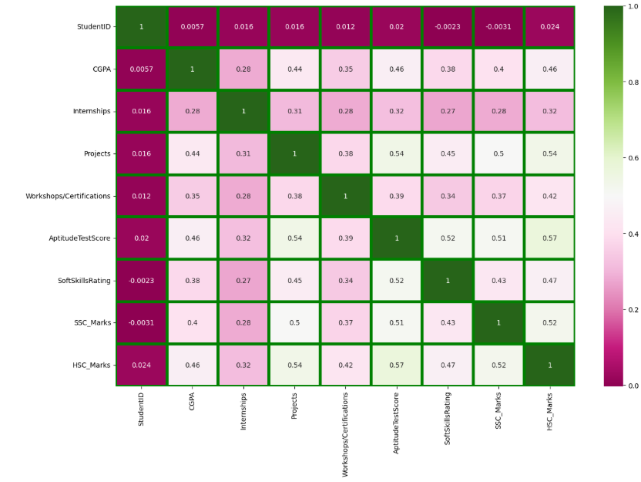
Correlation
There is a high correlation between CGPA and HSC_Marks.

Slide 14
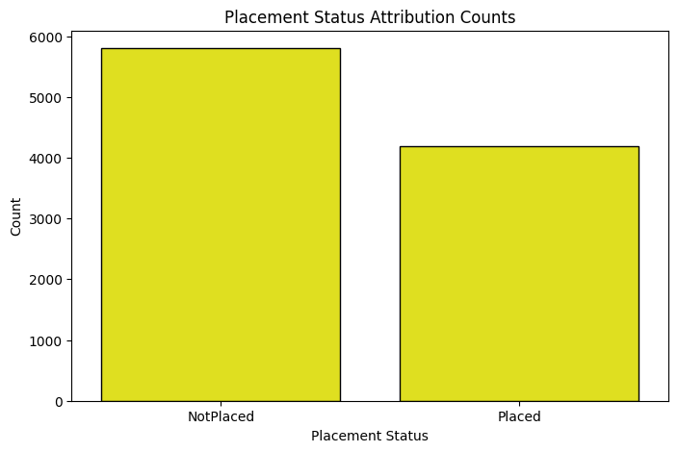
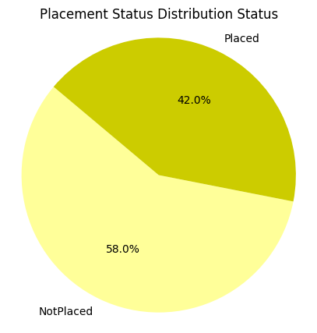
Placement Status Attribution

Slide 15
Machine Learning Packages
from sklearn.model_selection train_test_split
from sklearn.metrics import r2_score
from sklearn.metrics import mean_squared_error
from sklearn.metrics import confusion_matrix
from sklearn.metrics import classification_report
from sklearn.metrics import accuracy_score
from sklearn.tree import DecisionTreeClassifier
from sklearn.ensemble import RandomForestClassifier
from xgboost import XGBClassifier
from catboost import CatBoostClassifier

Slide 16
Score of all ML Models
 | Algorithm | Precision | Recall | f1-score | Accuracy_score
1 | Decision Tree | 0.76 | 0.76 | 0.76 | 0.73
2 | Random Forest | 0.80 | 0.82 | 0.81 | 0.79
3 | XGBoost | 0.80 | 0.81 | 0.80 | 0.78
4 | CatBoost | 0.81 | 0.83 | 0.82 | 0.79

Slide 17
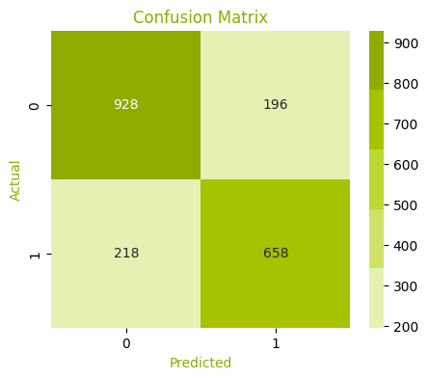
We use both CatBoost and XGBoost for Placement Prediction because both gives same accuracy

Slide 18
Overall Observation
Decision Tree and Random Forest models showed good classification capability, but Random Forest performed more consistently on both training and testing datasets.
XGBoost achieved slightly better accuracy and generalization compared to traditional tree-based models, indicating strong performance on complex data patterns.
CatBoost also delivered competitive results, handling categorical variables efficiently with minimal preprocessing.
Accuracy, precision, and recall values varied slightly across models, with ensemble methods (Random Forest, XGBoost, CatBoost) outperforming single classifiers.
The confusion matrix visualizations confirmed that most models correctly classified the majority of test samples, with only minor misclassifications.
Feature correlation analysis indicated that certain predictors had a stronger influence on the target variable, improving model interpretability.
Data preprocessing, including handling of missing values and outliers, improved the dataset’s quality and ensured more reliable model outcomes.
Overall, XGBoost and Random Forest emerged as the most effective algorithms for achieving balanced accuracy and robustness across the dataset.
Thank You….

