Slide 1
GPS TOLL BASED SYSTEM SIMULATION USING PYTHON
Problem Statement

Slide 2
Table of contents
01
05
Architecture Diagram
Unique idea (Solution)
02
Features Offered
06
Demo
03
Technologies Used
07
Future work
04
Process Flow
08
Conclusion

Slide 3
Unique idea solution
Concept:
Enhance the existing GPS toll-based system simulation by incorporating real-time traffic conditions into the toll calculation. This addition will make the simulation more realistic and reflective of real-world scenarios where traffic congestion can affect travel time and costs.
1. Real-time Traffic Data Integration:
Utilize an API (e.g., Google Maps Traffic API or any open traffic data API) to fetch real-time traffic conditions.
Adjust the toll rates based on the traffic conditions. For instance, higher tolls during peak hours and congested routes to encourage drivers to choose less congested paths.
2.Traffic Visualization:
Integrate traffic layers into the Folium map to visualize the traffic conditions along the route.
Display different colors or markers on the map to indicate traffic severity (e.g., green for smooth
traffic, yellow for moderate traffic, red for heavy traffic).

Slide 4
3.Dynamic Toll Calculation Method
Implement a dynamic toll calculation method that considers not only the distance but also the current traffic conditions.
Define different toll rates for peak and off-peak hours. For example, a base rate of $0.1 per km during off-peak hours and $0.2 per km during peak hours .
4. User Notifications and Route Suggestions:
Notify users about the traffic conditions and the expected impact on their travel time and toll costs.
Provide alternative route suggestions with comparative tolls and travel times, allowing users to make informed decisions.
5.Enhanced Transaction History:
Record additional details in the transaction history, such as traffic conditions during the journey and the chosen route.
Visualize the impact of traffic conditions on toll costs over time using Plotly.

Slide 5
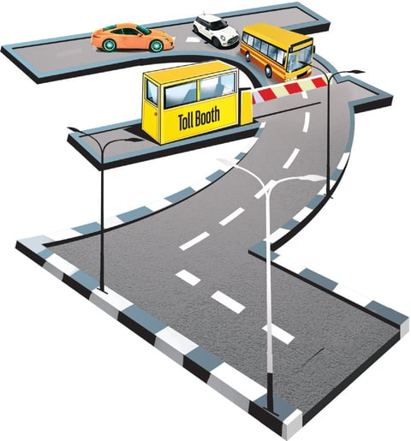
Features Offered
1.User Registration
2. Geocoding and Distance Calculation
3. Route Simulation
4. Toll Calculation
5. Transaction History
6. User Interface
7. Error Handling

Slide 6
Install and requirements
Usage
Streamlit
Folium
streamlit-folium
Pandas
Numpy
Geopy
1. Start the application
2. Enter Email
3. Simulation
4. Transaction history

Slide 7

Technologies Used
Streamlit: For creating the web interface.
Folium: For generating interactive maps.
Geopy: For geocoding addresses and
calculating distances.
Plotly: For visualizing data with interactive charts.
SQLite: For storing user information and
transaction history.
PIL: For handling images, like a welcome image.
Python: For developing application logic
and integrating libraries.

Slide 8

Process flow
1. Initialization and
Database Setup
2. Get Started Page
3. Enter Email Page
4. Simulation Page
5.Enter User Information
6. Enter Starting and Destination
Address
7. Route Simulation
8. Transaction Recording
9. Transaction History
10.Error Handling and Feedback

Slide 9
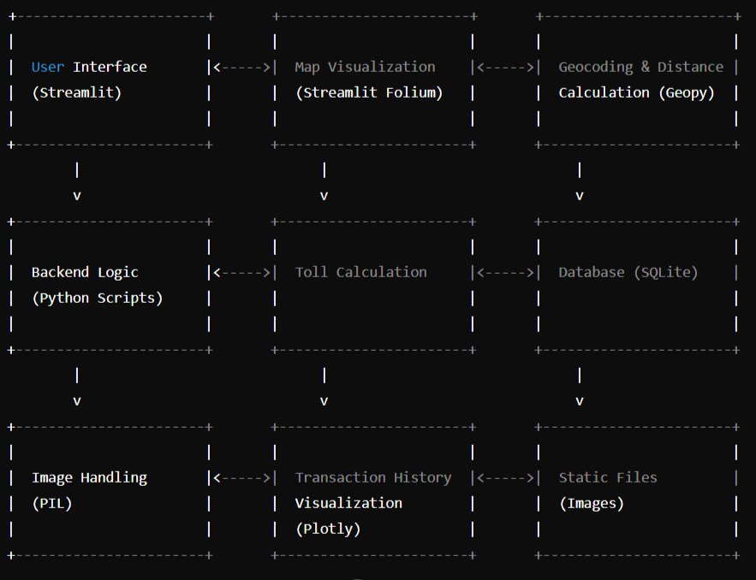
Architecture diagram

Slide 10
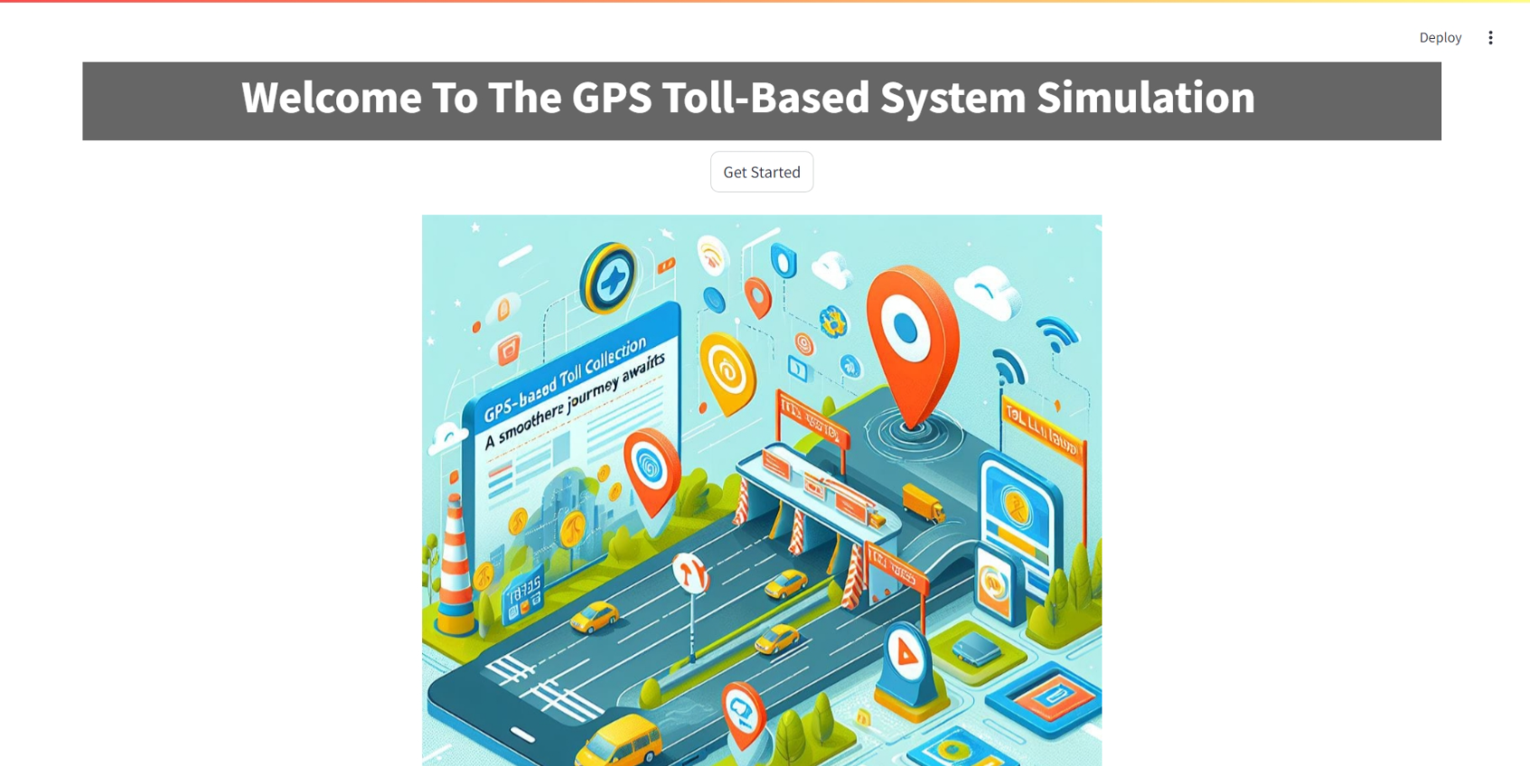

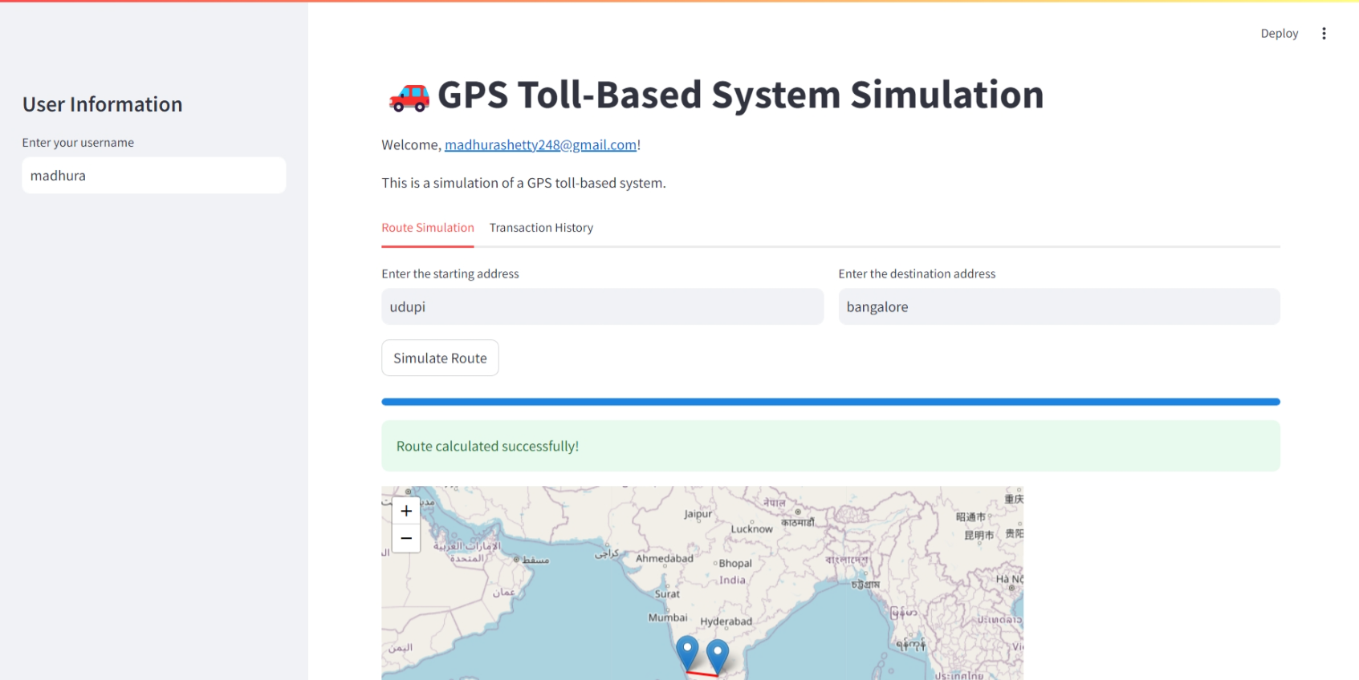
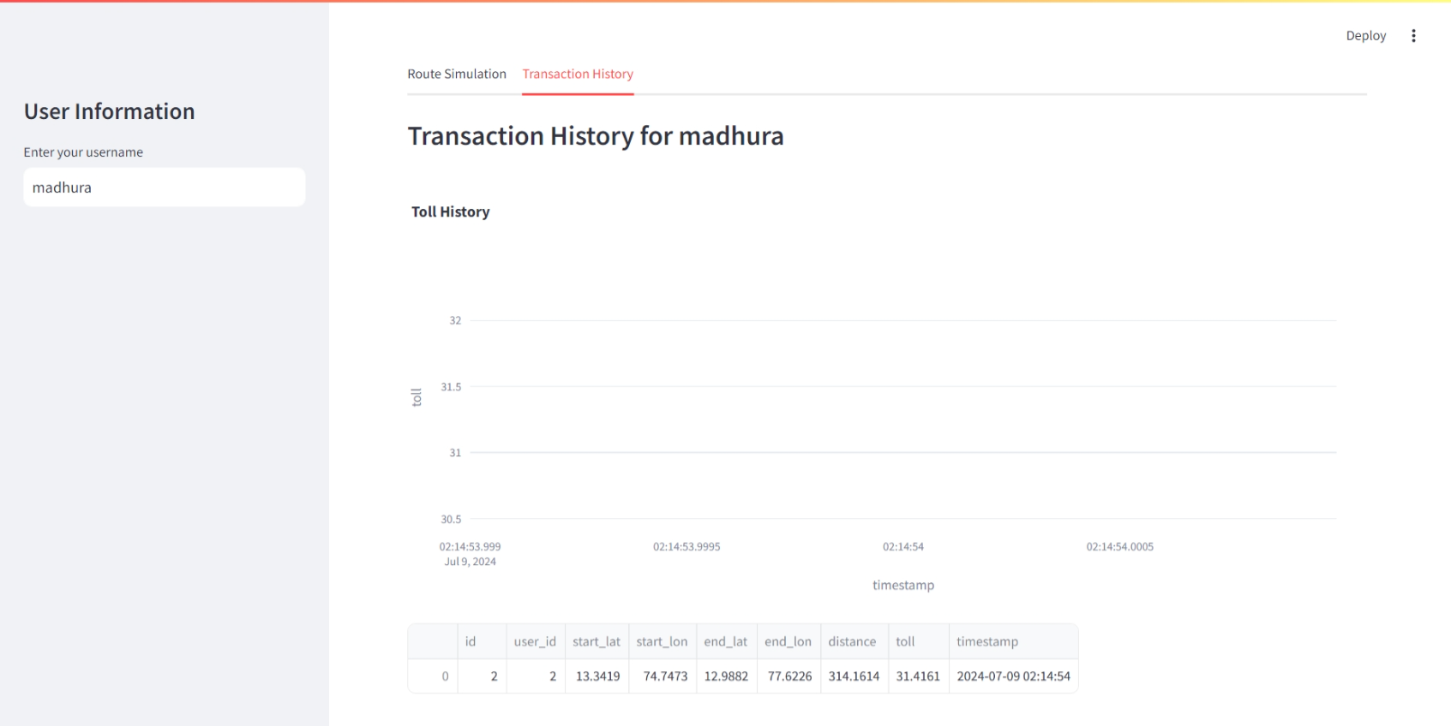
DEMO

Slide 11

Future work
Improving User Experience
Enhanced Geocoding and Routing
Advanced Toll Calculation
Data Visualization and Analytics
Mobile Responsiveness
Performance Optimization
Scalability and Deployment
Integration with Payment Gateways
Environmental Impact Calculation
Accessibility Improvements

Slide 12
Conclusion
The GPS Toll-Based System Simulation using Python is an advanced web application designed to calculate toll costs based on GPS data, visualize routes on an interactive map, and maintain a detailed user transaction history. The application provides a robust and user-friendly platform for simulating toll-based travel expenses while offering opportunities for future enhancements in user experience, performance optimization, and additional features like dynamic toll rates and real-time traffic integration.

