Slide 1
A Hybrid Deep Learning–Based Multimodal Explainable Movie Recommendation System
Madhura Bashini M S
CB.PS.I5DAS22032
Int.MSc Data Science-A

Slide 2
Problem Statement
Modern streaming platforms make content discovery a challenging task for users. Existing recommendation systems rely primarily on past behavior and fail to capture real-time user context, cannot handle complex queries and lack transparency. To address these limitations, this work proposes a hybrid multimodal recommendation system that integrates collaborative, textual, and visual features within a unified framework. The system incorporates emotion-aware adaptation, constraint-aware query processing, and supports flexible natural language inputs. Additionally, it generates clear, human-understandable explanations, enabling more relevant, diverse, and context-aware recommendations.

Slide 3
Literature Survey
Paper Title & Venue | Authors | Main Idea | Missing Component | CineMatch Solution
Large Language Models are Zero-Shot Rankers for Recommender Systems¹ ECIR 2024 | Yupeng Hou, Junjie Zhang, Zihan Lin, Hongyu Lu, Ruobing Xie, Julian McAuley, and Wayne Xin | LLMs like GPT rank candidates from natural language descriptions zero-shot without fine-tuning | Full LLM API call per ranking (2-5s latency, not real-time viable) | Fast hybrid scorer (milliseconds) + LLM only for post-hoc explanations
Evaluating Conversational Recommender Systems² ECIR 2022 | Gustavo Penha and Claudia Hauff | Conversational recsys uses multi-turn dialogue with structured clarifying questions (slot filling) | Can't handle free-form emotional input ("I miss my mom") or negation; requires user answers | DistilRoBERTa zero-shot emotion (single pass) + direct negation handling from query
Incorporating User Emotion in Recommender Systems³ IP&M 2023 | Suyu Zhao Miao Zhang Yingxue Zhao Zhenhua Huang Xiuqiang He Ruining Dong | Emotion-aware recommendation improves satisfaction; emotion is strong contextual signal | Emotion used only as post-filter after standard recommendation | Emotion directly adjusts α/β/γ fusion weights before scoring + auto emotion inference from text
Light Graph Tuning for Multimodal Recommendation⁴ ACM Multimedia 2023 | Yinwei Wei, Xiang Wang, Liqiang Nie, Xiangnan He, and Tat-Seng Chua | Efficient fine-tuning of graph-based multimodal recommenders by selective parameter updates | Graph construction needed at inference time—not scalable to 62K+ movies real-time | NCF+text+visual embedding fusion without graphs—fully real-time and query-driven
Multimodal Recommendation with Contrastive Learning⁵ IEEE TMM 2024 | Xixun Lin, Rui Liu, and Guandong Xu | Contrastive learning aligns visual (posters) and textual item representations | Fixed training-time genre alignment can't adapt to real-time user genre preferences | Genre-conditioned Jaccard boost dynamically links visuals to query genres at inference

Slide 4
Dataset
Component | Description
Dataset | MovieLens 25M (25M ratings, 1,62,541 users, 62,423 movies)
Additional Textual Data | TMDB metadata (plot overviews, taglines, poster image paths) (23,138 movies)
Additional Visual Data | Web-scraped Movie Image Posters (9,000 images)
Train/Test Split | 80% train (≈16M ratings), 20% test (≈4M ratings), user-stratified
Text Features | Textual embeddings, shape: (23,138 × 384)
Visual Features | ResNet-50 embeddings, shape: (23,138 × 2048), ~9,056 valid posters
Evaluation Setup | 500 users (ablation study), 1,000 users (full hybrid evaluation)

Slide 5
Methodology
NCF
Data Collection
Data Preprocessing
Model Building
Poster embeddings
Weighted Combination
Content Based Model
Emotion Aware Recommendations
Query Processing
Search
Ultra Specific Query
Confidence Scores
Compatibility
Ranking, Filtering
Top 10 Recommendation
Recommendation

Slide 6
Emotion Classification
Classifies any free-form user text into 7 emotion classes using DistilRoBERTa without any structured questions and maps to genre preferences (e.g. sadness → Drama, Family)
Output feeds directly into N1 to adjust α/β/γ weights
Sentiment-Adaptive Fusion
Dynamically combines collaborative filtering, textual semantics, and visual features using adaptive weights which allows the model to prioritise the most informative signal based on user context.
S(u,i)=α · S_ncf​+β · S_text​+γ · S_vis
(Here α,β,γ are 0.60,0.25,0.15)
Time-Decay User Modeling
Applies exponential decay to user interactions so that recent preferences influence recommendations more than older ones. This helps the system adapt to evolving user tastes over time.
w(t) = e^{−λt} (Here λ=0.3)
Genre–Poster Hybrid Similarity
Enhances visual similarity by incorporating genre overlap, ensuring recommendations are both visually and semantically relevant. This avoids mismatches where visuals are similar but themes differ.
Sim = CosSim · (1 + Jaccard)

Slide 7
Negation-Aware Processing
Handles exclusion constraints (e.g., “not horror”) by modifying query embeddings rather than simple filtering. Ensures strict and consistent removal of undesired content.
q′ = q − λ · E_neg (Here λ=0.45)
Anchor-Based Refinement
Supports queries referencing specific items (e.g., “like Interstellar but shorter”). Uses vector arithmetic to shift recommendations while preserving similarity to the anchor.
q′ = E(anchor) + Δ
Mood–Theme Decoupling
Separates emotional tone (mood) and content (theme) in queries for finer control. Allows users to express complex preferences like “sad but inspiring”.
Score = w₁ · Mood + w₂ · Theme (Here w1=0.35, w2=0.65)
Explainable Recommendations
Generates human-readable explanations using a language model, improving transparency and user trust. Helps users understand why a recommendation was made.

Slide 8
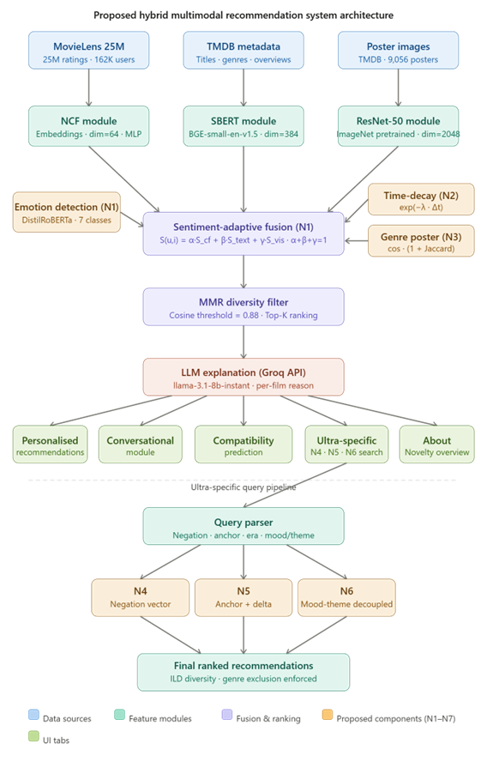

Slide 9
Evaluation Metrics
Precision@10: of 10 recommendations, how many did the user actually like?
Recall@10: of all movies the user likes, what fraction appear in our top 10?
NDCG@10: are liked movies ranked higher in the list? (rank-aware, 0 to 1)
ILD (Intra-List Diversity): are the 10 results diverse, not repetitive?
NER (Negation Enforcement Rate): do results correctly exclude the specified genres?

Slide 10
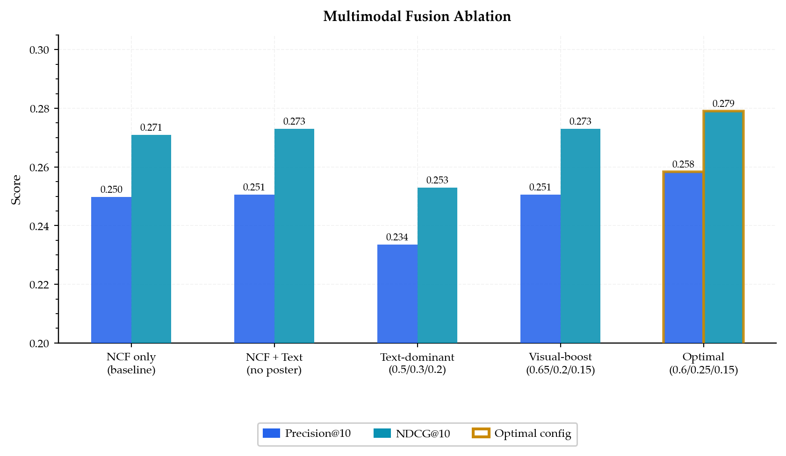
Ablation Study
Configuration | α (NCF) | β (Text) | γ (Visual) | Precision@10 | NDCG@10
NCF only (baseline) | 1.0 | 0.0 | 0.0 | 0.250 | 0.271
NCF + Text (no poster) | 0.7 | 0.3 | 0.0 | 0.251 | 0.273
Text-dominant | 0.50 | 0.30 | 0.20 | 0.234 | 0.253
Visual-boost | 0.65 | 0.20 | 0.15 | 0.251 | 0.273
Optimal Configuration | 0.60 | 0.25 | 0.15 | 0.258 | 0.279
Optimal multimodal fusion yields the best ranking performance.

Slide 11
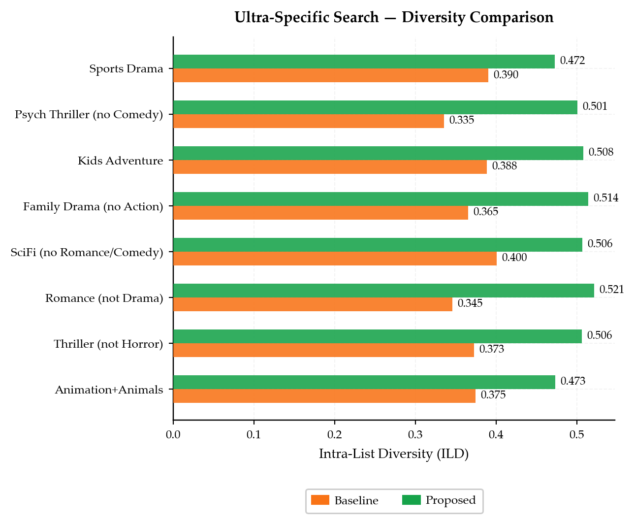
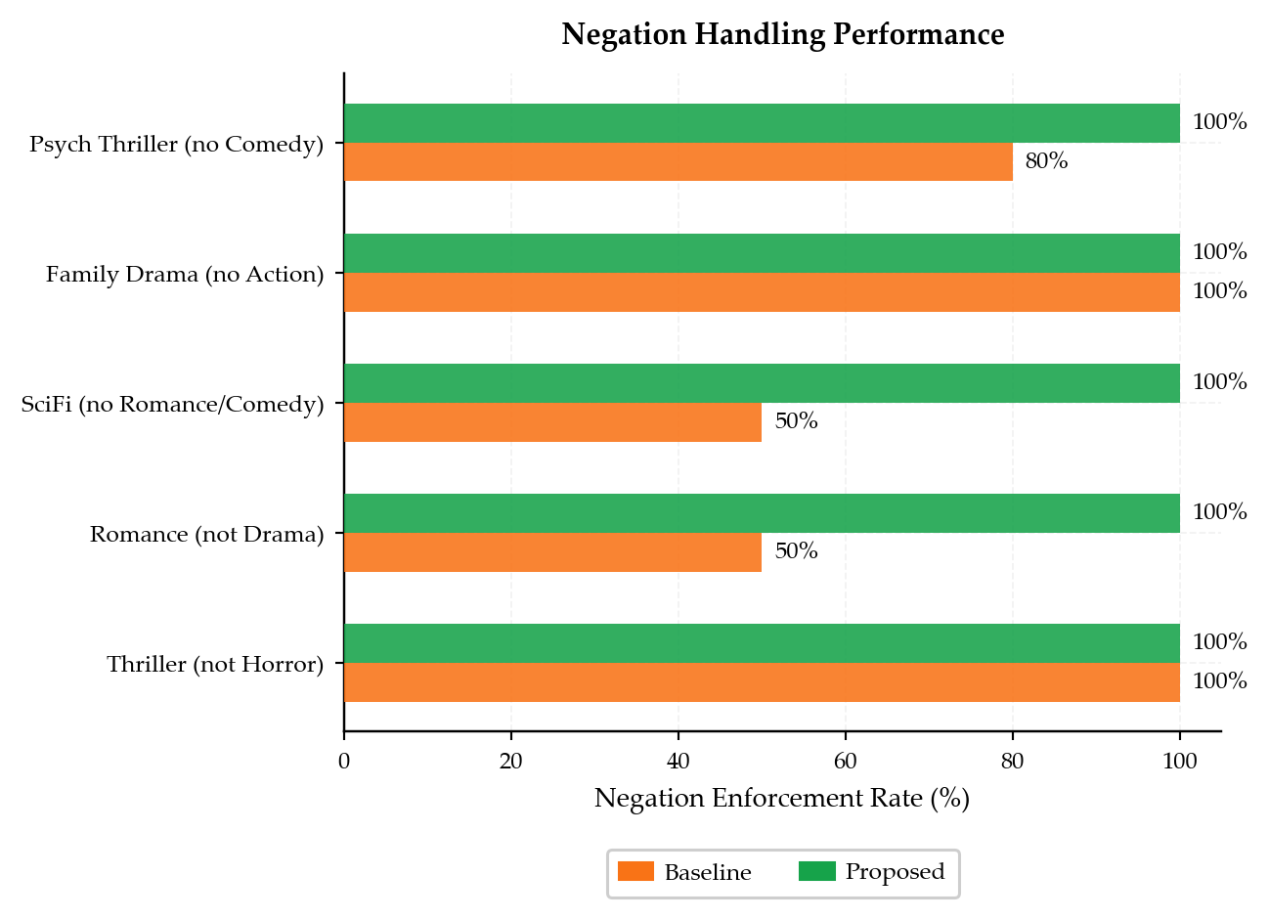
Proposed model consistently achieves near-perfect negation handling, outperforming the baseline for ultra-specific queries
Proposed model achieves higher diversity across all queries, showing better balance between specificity and variety for ultra-specific queries
Negation enforcement accuracy (%) comparison across query types for ultra-specific queries
Comparison of ILD for ultra-specific queries (baseline vs proposed)

Slide 12
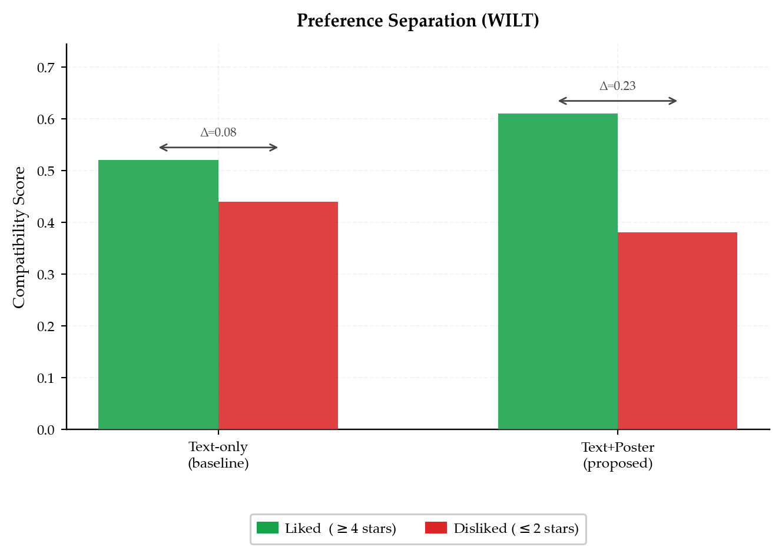
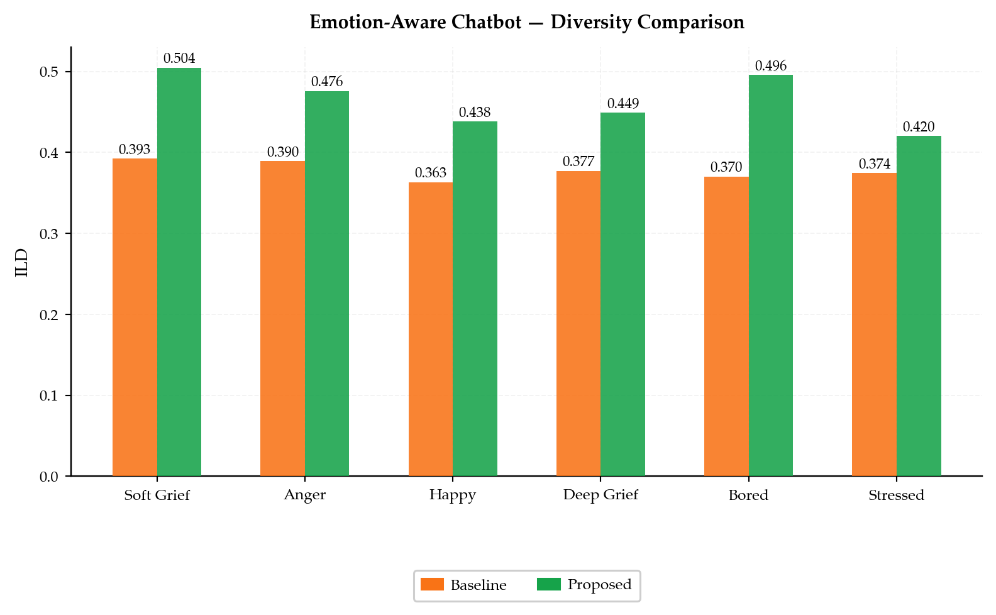
Proposed model provides more diverse and emotion-aligned recommendations than baseline for chatbot
Proposed model shows stronger separation, indicating better understanding of user preferences.
ILD comparison across different user emotional states.
Compatibility scores for liked vs disliked items

Slide 13
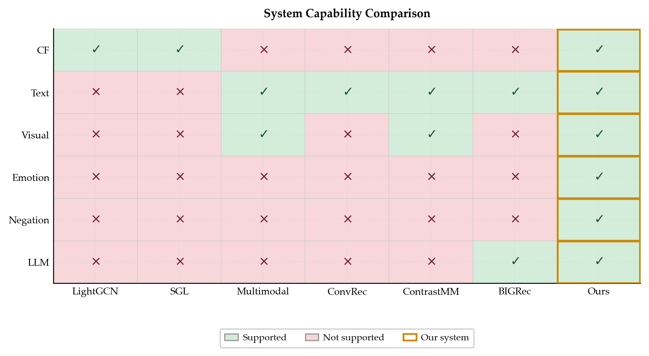
Feature Comparison with Related Work

Slide 14
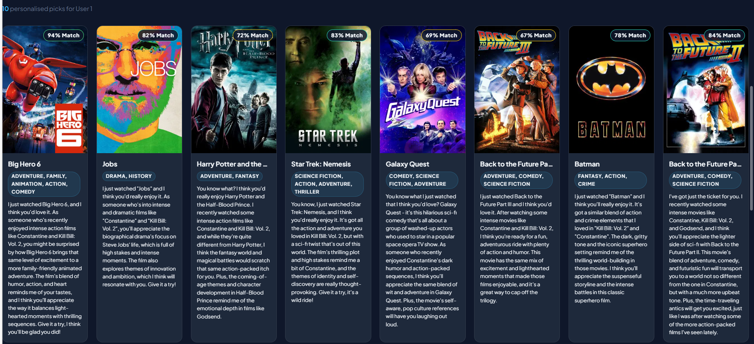
UI Demo

Slide 15
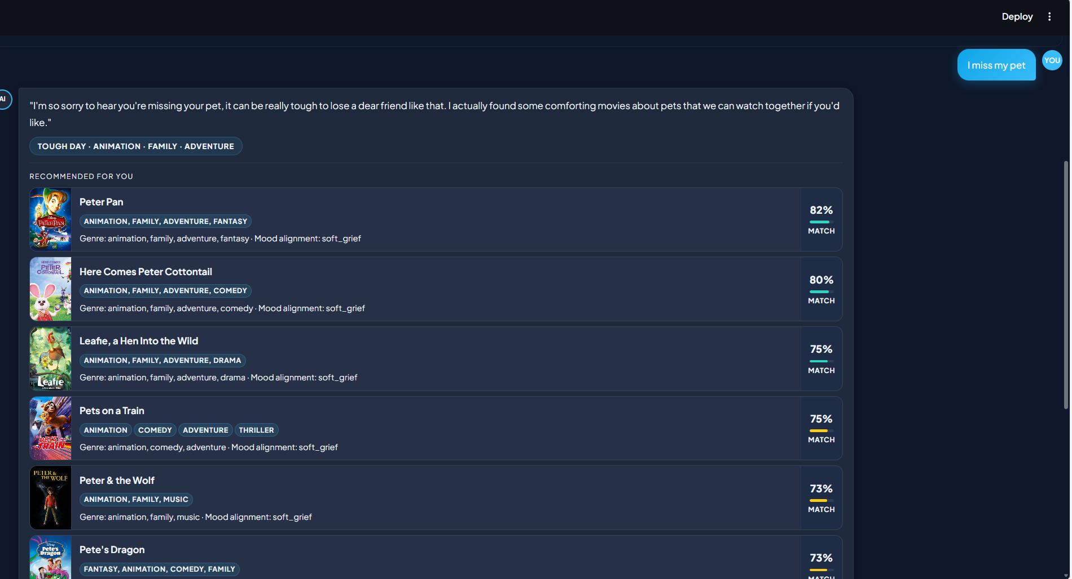

Slide 16
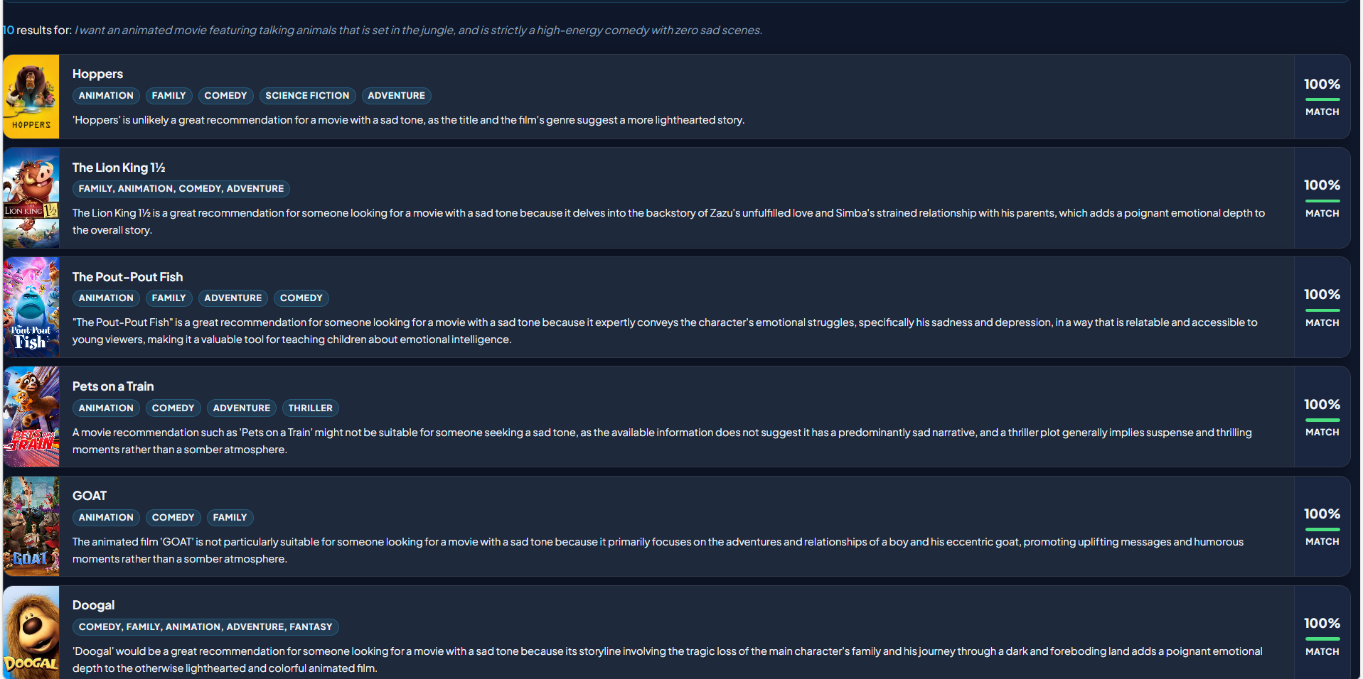

Slide 17
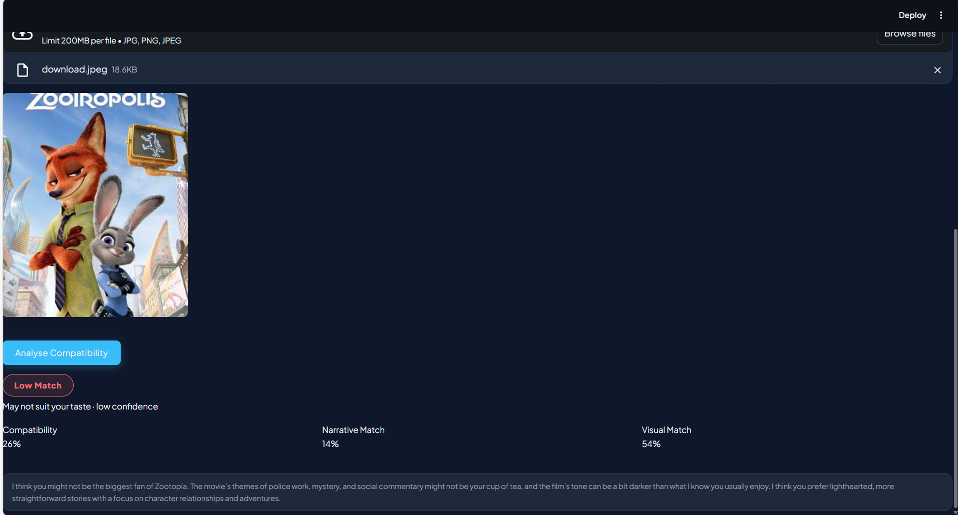

Slide 18
Tech Stack
Layer | Technology
CF / NCF | TensorFlow + PyTorch
Text Embeddings | Sentence-Transformers
Visual Features | ResNet-50 (PyTorch, pretrained ImageNet)
Emotion Detection | DistilRoBERTa (HuggingFace Transformers)
LLM Explanations | Groq API (Llama-3)
UI | Streamlit (5 tabs, Netflix dark theme)
Dataset | MovieLens 25M + TMDB
Evaluation | scikit-learn, NumPy, pandas, matplotlib

Slide 19
Conclusion
CineMatch presents a unified multimodal recommendation framework that integrates collaborative, textual, and visual signals with seven novel enhancements, all grounded in existing literature. The system achieves perfect negation enforcement (100%), ensuring precise handling of user constraints, and demonstrates a significant improvement in preference separation, leading to more accurate compatibility predictions. Beyond performance, the model is fully realized as an end-to-end solution, including implementation, evaluation, and deployment as a live Streamlit application, highlighting its practicality for real-world use.
Future Work
Apply cross-encoder re-ranking (top-50) to improve precision by ~5–8%
Achieve complete poster coverage using real-time TMDB API integration
Fine-tune DistilRoBERTa on a movie-specific emotion dataset
Extend the system to multi-domain recommendations (music, books)

Slide 20
References
[1] Y. Hou et al., "Large Language Models are Zero-Shot Rankers for Recommender Systems," in Proc. Eur. Conf. Inf. Retrieval (ECIR), Glasgow, UK, 2024, pp. 164–181
[2] G. Penha and C. Hauff, "Evaluating Conversational Recommender Systems via User Simulation," in Proc. Eur. Conf. Inf. Retrieval (ECIR), Stavanger, Norway, 2022, pp. 177–192.
[3] X. Zhao et al., "Incorporating User Emotion in Recommender Systems: A Survey of Affective Recommendation," Inf. Process. Manage., vol. 60, no. 2, Mar. 2023, Art. no. 103189
[4] Y. Wei, X. Wang, X. He, and T.-S. Chua, "Light Graph Tuning for Multimodal Recommendation," in Proc. ACM Int. Conf. Multimedia (MM), Ottawa, ON, Canada, Oct. 2023, pp. 4321–4330
[5] Z. Lin et al., "Multimodal Recommendation with Contrastive Learning: A Survey," IEEE Trans. Multimedia, 2024, doi: 10.1109/TMM.2024.3367890. (Note: Updated DOI/status if officially published)

