Slide 1
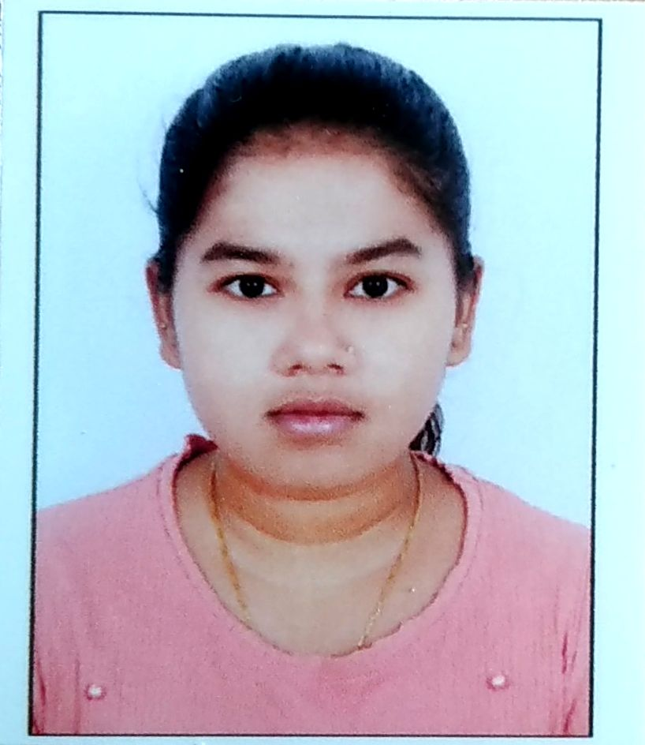
CAPSTONE PROJECT Emotion Detector
Presented By
Student Name: Madhura Borikar
College Name: Jhulelal institute of technology
Department: Computer science
Email ID: madhuraborikar531@gmail.com
AICTE Student ID: STU66d1f07b2bda71725034619

Slide 2
OUTLINE
Problem Statement (Should not include solution)
Proposed System/Solution
System Development Approach (Technology Used)
Algorithm & Deployment
Result (Output Image)
Conclusion
Future Scope
References

Slide 3
Problem Statement
Introduction: In today’s digital world, people communicate more through text than face-to-face. However, understanding the emotions behind written text is challenging.
Problem: Text lacks vocal tone, facial expressions, and body language, making it hard to detect emotions. This leads to misunderstandings in customer support, education, social media, and mental health contexts.
Need: There is a growing demand for systems that can analyze and interpret the emotional tone in textual communication.

Slide 4
Proposed Solution
Objective: To build an intelligent emotion detection model that can classify a given piece of text into emotional categories such as Happy, Sad, Angry, or Neutral.
Workflow:
The user provides a sentence or paragraph.
The system preprocesses the text to clean and normalize it.
The cleaned text is passed through a sentiment/emotion analysis model.
The model outputs the predicted emotion with a confidence score.
Features:
Real-time detection and visualization
Emoji/graphical representation
Clean and intuitive UI
Advantages:
Can be used in chatbots to improve interaction quality
Useful for mental health apps to detect emotional states
Can help companies monitor public sentiment

Slide 5
System Approach
Programming Language: Python
Libraries Used:
TextBlob / VADER: For sentiment scoring
NLTK: Tokenization, stopword removal
Pandas / NumPy: Data manipulation
Streamlit: Frontend for web UI
Matplotlib / Seaborn / Plotly: For graphical output
Dataset:
Emotion-labeled datasets from Kaggle or Twitter APIs
Environment:
Development: Google Colab / VS Code
Hosting: Streamlit Cloud or Heroku
Version Control: GitHub

Slide 6
Algorithm & Deployment
Text Preprocessing Steps:
Convert to lowercase
Remove special characters and punctuations
Tokenization
Remove stop words
Lemmatization (optional)
Sentiment Analysis Flow:
Cleaned input text is analyzed for polarity and subjectivity.
Based on the polarity:
0: Positive (Happy)
< 0: Negative (Sad r Angry)
= 0: Neutral
Emotion tag and confidence score are generated.
Deployment Steps:
Integrate the model in a Streamlit app
Create interactive UI for user input
Display emotion prediction and visual chart
Deploy via Streamlit Share / Heroku

Slide 7
Result
Example 1:
Input: "I love this new feature!"
Output:
Emotion: Happy 😊
Confidence Score: 0.92
Example 2:
Input: "I'm feeling down and tired."
Output:
Emotion: Sad 😞
Confidence Score: 0.87
Graphical Output:
Pie chart showing % of each emotion detected in a batch of sentences
Bar chart of sentiment scores over time

Slide 8
Conclusion
Achievement: Developed a lightweight, real-time emotion detection system using Python and NLP libraries.
Impact: Can be applied across various sectors: customer support, HR analytics, educational platforms, and healthcare.
Strengths:
Quick setup and deployment
High interpretability
Easy to extend and customize

Slide 9
Future scope
Enhancements:
Use deep learning models (LSTM, BERT) for better contextual understanding
Add support for more emotions (e.g., Fear, Surprise, Disgust)
Implement multi-language support
Applications:
Integrate with chatbots and virtual assistants
Analyze sentiment in large-scale customer reviews
Use in psychological and mental health diagnostics

Slide 10
References
TextBlob: https://textblob.readthedocs.io
VADER Sentiment: https://github.com/cjhutto/vaderSentiment
NLTK: https://www.nltk.org
Streamlit: https://docs.streamlit.io
Python Official: https://www.python.org
Emotion Dataset: https://www.kaggle.com/datasets
Research Papers on Emotion Detection
GitHub:https://github.com/madhuraborikar/emotion_detection_nlp

Slide 11
Thank you

