Slide 1
Catch a Bird

Slide 2
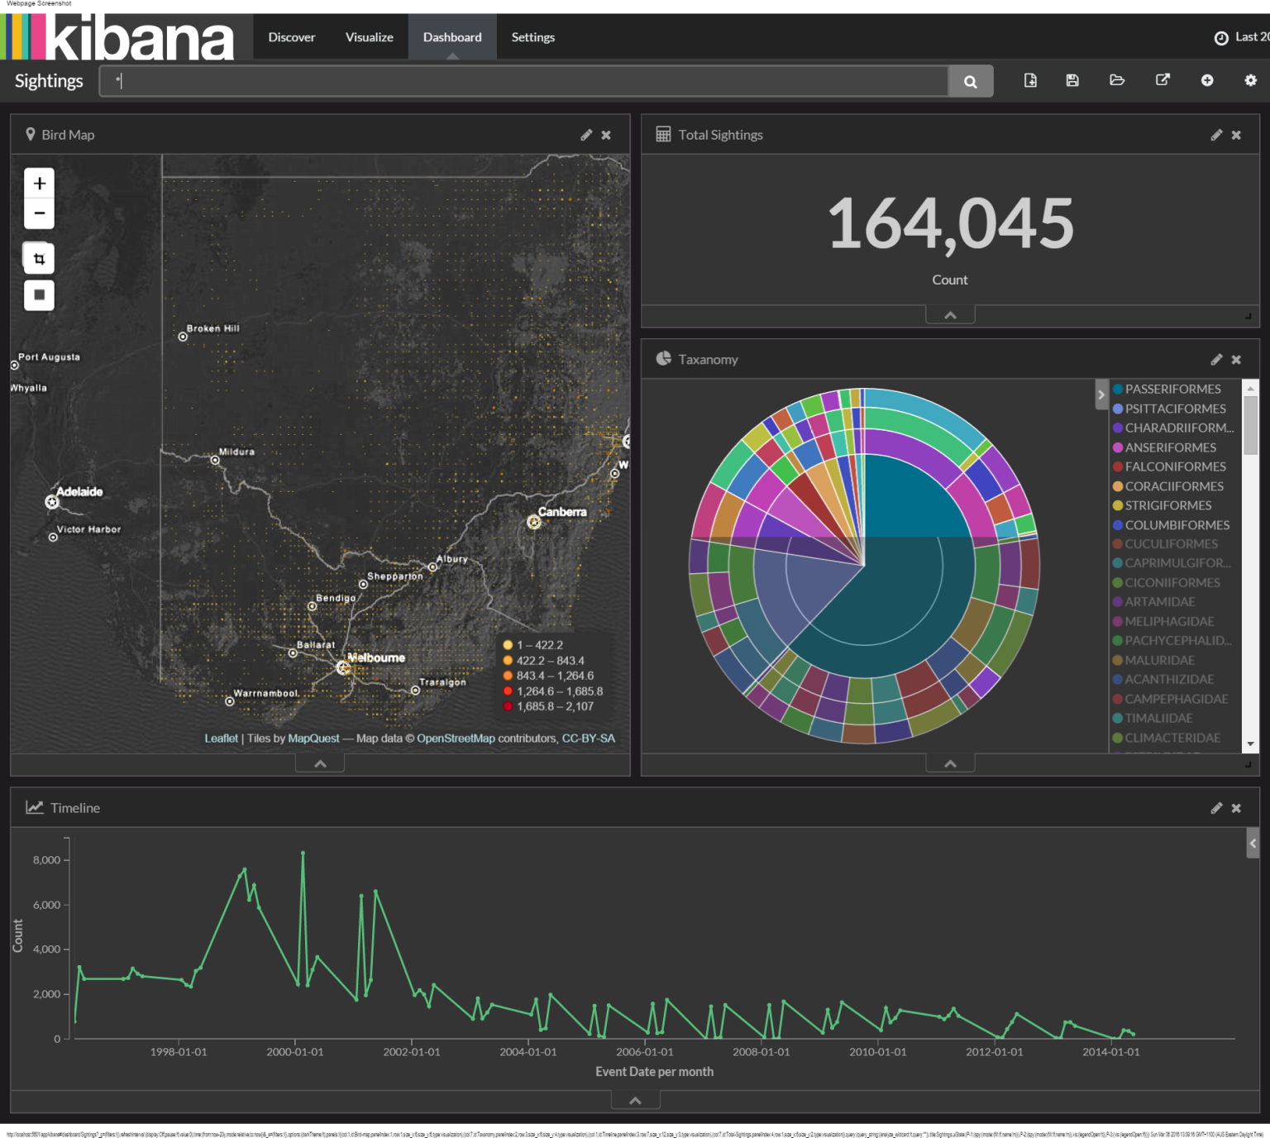
Visualize sighting data

Slide 3
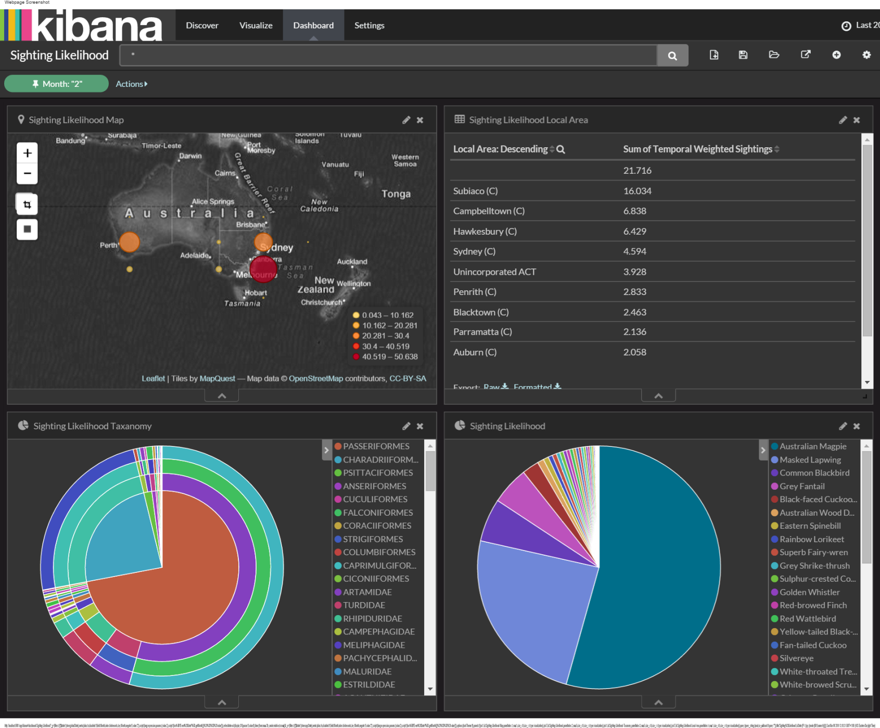
Visualize likelihood

Slide 4
Future work
Normalize by population
Mash up with land use

