Slide 1
IBM University Engagement Project Submission
“Exploring the Power of Agentic AI with IBM Granite and LangFlow”

Slide 2

Project Tile – HopeGuard AI – An Agentic, Retrieval‑Augmented Mental‑Health Awareness
Domain of Project –
Mental‑Health Technology
Student Name | Recent Passport Photo | Email ID | Mobile number [WhatsApp]
MADHURA BABAN GUNJAL |  | madhuragunjal35@gmail.com | 9175969951

Slide 3
Problem Statement -
Millions of people worldwide suffer from depression, anxiety, and suicidal ideation, yet:
Stigma & low awareness keep many from seeking help.
Access gaps – professional care is costly, geographically limited, or delayed.
Reactive systems only intervene after a crisis has already escalated.
Early‑signal detection in free‑form text (chat, journal, social posts) is technically difficult and risky without proper safeguards.
A solution is needed that educates, detects early distress, offers empathetic support, predicts risk, and connects users to human help – all while being safe, transparent, and privacy‑preserving.

Slide 4
Proposed Solution -
Layer | Function | Key Features
Awareness & Education | Pushes curated, evidence‑based content (mindfulness exercises, coping‑toolkits, self‑care checklists). | ✅ Daily “Wellness Tip” cards ✅ Interactive CBT‑style worksheets ✅ Multi‑language resource library
Early Detection (RAG) | Retrieves relevant mental‑health literature & prior user entries, then analyses incoming text for distress signals using a fine‑tuned LLM + sentiment/psycholinguistic models. | 🔎 Retrieval from a private vector store of trusted resources (WHO, NAMI, APA) 🔍 Real‑time signal scoring (sadness, hopelessness, suicidal ideation) ⚠️ Tiered risk levels (low/medium/high)
Empathetic Support & Risk Management | Generates compassionate replies, offers coping suggestions, and, when risk crosses a threshold, initiates safe‑action protocols. | 🤝 Active‑listening prompts, reflective mirroring 🛑 Built‑in “Safety‑Net” (disclaimer, de‑escalation script) 🔗 With user consent, auto‑shares helpline numbers, schedules a human‑counselor chat, or sends an alert to a trusted contact
Agentic Planning | The AI can self‑orchestrate actions (e.g., fetch a specific coping module, schedule a follow‑up reminder, call an external API for a crisis‑line). | 🧭 Goal‑oriented planner (detect → inform → intervene) 🔧 Tool‑use: calendar, SMS/WhatsApp API, secure messaging platform
Feedback Loop | Captures user‑feedback on helpfulness, updates risk‑scoring models, and continuously expands the resource base. | 📊 Adaptive learning (no‑personal‑data retraining) 🗂️ Periodic human‑review of anonymised logs for quality control

Slide 5
Technology Used
Langflow Node | Role in HopeGuard AI
Prompt Template | Stores system‑prompt with empathy guidelines, disclaimer, and risk‑level instructions
Retriever | Connects to the vector DB, fetches top‑k relevant resources per user query
LLM | Generates responses (empathetic, educational, or safety‑net)
Conditional Router | Branches workflow based on risk‑score (low → education; medium → coping suggestions; high → emergency protocol)
Tool Invocation (API Call) | Calls external helpline API, schedules calendar reminders, sends SMS
Memory / Session Store | Persists conversation context & user‑risk history across sessions
Evaluation / Post‑Processor | Runs profanity and trigger‑word filters before delivering output
Human‑in‑the‑Loop | Optional hand‑off node for a live counselor when risk is high or user requests
Category | Tools / Libraries
LLM Core | OpenAI GPT‑4o (or Anthropic Claude 3) – for generation & reasoning
Retrieval‑Augmented Generation | LangChain + FAISS / ChromaDB vector store (encrypted at rest) containing vetted mental‑health documents
Distress‑Signal Detection | Fine‑tuned RoBERTa‑based sentiment model + LIWC‑style psycholinguistic features; threshold calibrated on public suicide‑prevention datasets (e.g., Reddit r/SuicideWatch)
Agentic Planner | LangChain “Agents” (OpenAI Functions/Tool calls) + ReAct loop for tool selection
Conversation Management | Langflow UI for rapid workflow building; state‑machine for risk‑level transitions
Safety & Compliance | OpenAI Moderation API, custom profanity/trigger word filter, GDPR‑compliant data handling, HIPAA‑level encryption for any PHI
Helpline Integration | Twilio Programmable SMS/Voice, or local crisis‑line APIs (e.g., 988 US, Samaritans UK)
Deployment | Docker + Kubernetes (auto‑scale), CI/CD via GitHub Actions, monitoring with Prometheus/Grafana
Analytics & Monitoring | Elastic Stack for anonymised log analysis, model drift detection

Slide 6
Langflow component Used -
Langflow Node | Role in HopeGuard AI
Prompt Template | Stores system‑prompt with empathy guidelines, disclaimer, and risk‑level instructions
Retriever | Connects to the vector DB, fetches top‑k relevant resources per user query
LLM | Generates responses (empathetic, educational, or safety‑net)
Conditional Router | Branches workflow based on risk‑score (low → education; medium → coping suggestions; high → emergency protocol)
Tool Invocation (API Call) | Calls external helpline API, schedules calendar reminders, sends SMS
Memory / Session Store | Persists conversation context & user‑risk history across sessions
Evaluation / Post‑Processor | Runs profanity and trigger‑word filters before delivering output
Human‑in‑the‑Loop | Optional hand‑off node for a live counselor when risk is high or user requests

Slide 7
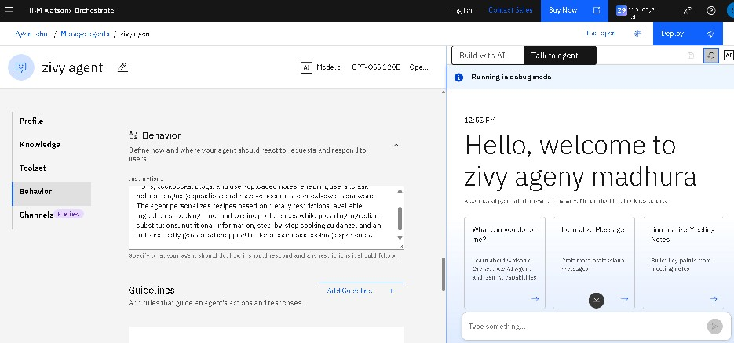
Langflow workflow -

Slide 8
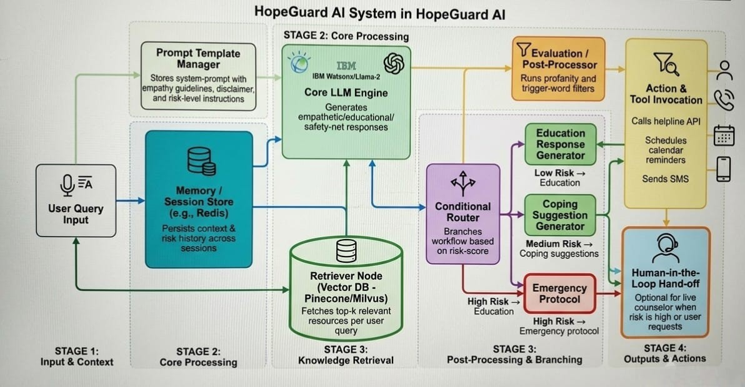
Architecture blueprint

Slide 9

Role of Agentic AI in the solution
Autonomous Goal Management – The agent sets a high‑level goal (“keep user safe”) and decomposes it into sub‑tasks (detect, inform, intervene).
Tool Use & Planning – Dynamically decides when to fetch a coping module, schedule a reminder, or invoke a crisis‑line API.
Self‑Monitoring – Continuously evaluates its own confidence in risk predictions; if confidence falls below a threshold, it escalates to a human moderator.
Adaptive Learning – Uses reinforcement signals from user feedback to adjust prompting strategies and risk thresholds (without storing raw personal data).
Safety‑First Loop – Implements a “ReAct” style reasoning loop: Think → Retrieve → Act → Observe with mandatory safety checks after each act.

Slide 10
Novelty and Uniqueness
Aspect | What Makes HopeGuard AI Unique
Hybrid RAG + Psycholinguistic Scoring | Combines knowledge retrieval with a dedicated distress‑signal model, enabling context‑aware, evidence‑backed replies.
Agentic Planning for Crisis Intervention | Not just a static chatbot; it can autonomously decide to call a helpline, set reminders, or transfer to a human based on real‑time risk assessment.
Transparent Risk Tiering & Consent Workflow | Users see their current risk level, can opt‑in/out of auto‑escalation, and receive clear explanations of each action.
Langflow‑Powered Visual Safety Pipeline | Allows mental‑health professionals to edit, audit, and certify each node (e.g., updating the disclaimer or adding new resources) without code changes.
Privacy‑Centric Retrieval | Vector store is encrypted, never leaves the host environment; only anonymised embeddings are used for similarity search.
Continuous Education Loop | After each interaction the system pushes a tailored micro‑learning tip based on the user’s current emotional state.

Slide 11
Git Hub Link
GITHUB URL - https://github.com/madhuragunjal35-cyber/Ibm-project.
files upload on GitHub
1.zivy.html
2.madhura_IBM project
3.
Github URL –https://github.com/jangidvasudev03-coder
The Files Uploaded on Github repository 1) app.json file ,
2) yourproblemstatement.pdf file
3) your projectpresntation.pptx file
4)any other files

Slide 12
Future Scope
Multimodal Input – Add voice sentiment analysis and affect detection from facial expressions (with explicit consent).
Community‑Driven Resource Curation – Enable vetted peer‑support groups and moderated forums that the RAG engine can pull from.
Personalized Therapy Pathways – Integrate with licensed tele‑therapy platforms to schedule professional sessions automatically.
Cross‑Cultural & Language Expansion – Fine‑tune models for additional languages and culturally specific coping strategies.
Predictive Analytics Dashboard for Caregivers – Aggregate anonymized risk trends to inform public‑health interventions.
Regulatory Certification – Pursue FDA/EMA Digital Therapeutic designation and CE‑Mark compliance for clinical use.
Research Collaboration – Share de‑identified interaction logs with academic partners to improve early‑detection algorithms while respecting privacy.
·
·
·

Slide 13
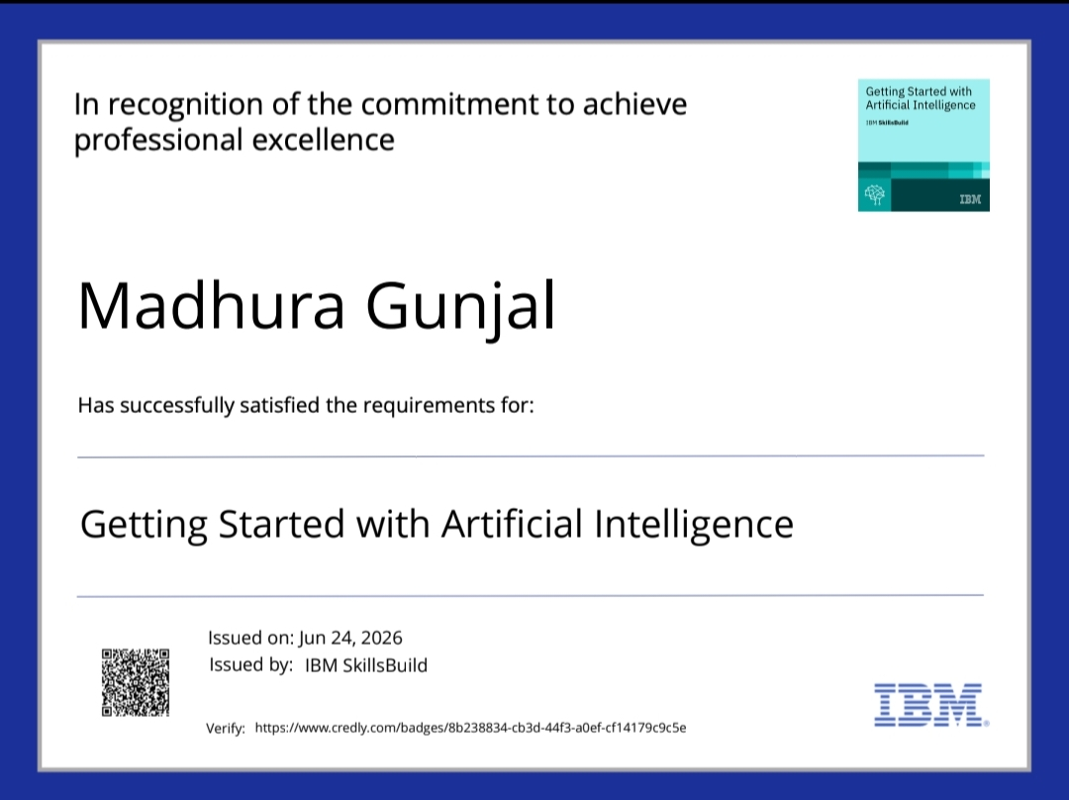
Certificates Earned:
Please add your credly certificate

Slide 14

Certificates Earned:​
Add your IBM BOB Certificate

Slide 15


