Slide 1



SMART INDIA HACKATHON 2026
Problem Statement ID – SIH26021
Problem Statement Title- Honey Chain: A block chain-based system for honey traceability and smart beekeeping management.
Theme- Agriculture, FoodTech & Rural Development
PS Category- Software
Team ID- SIH26-A0H-T275
Team Name - Tech Indians

Slide 2
HoneyChain: Blockchain-Powered Honey Traceability, HoneyDNA Authentication and Smart Beekeeping Intelligence Platform
💡 Our Solution
This three-tier ecosystem directly connects remote forest apiaries to consumers. First, ESP32-powered smart hives collect real-time microclimate and weight data. Then, an immutable Polygon Blockchain ledger permanently secures this data, while a mobile app lets customers track the entire supply chain via QR codes.
🚨 The Problem
This system addresses major beekeeping issues by stopping food adulteration and eliminating blind beekeeping. It prevents the addition of cheap sugar syrups by verifying honey quantities against secure sensor logs. Additionally, it provides rural operators with instant hive health metrics without causing any physical disruptions.
✨ The Uniqueness
HoneyDNA Fingerprinting and an Automated Fraud Engine. The fingerprinting system uses a custom SHA-256 backend hashing function to lock environmental parameters and lab values into a single digital key. Meanwhile, the fraud engine acts as an algorithmic referee to automatically reject out-of-sequence timestamps or impossible transit times.

Slide 3
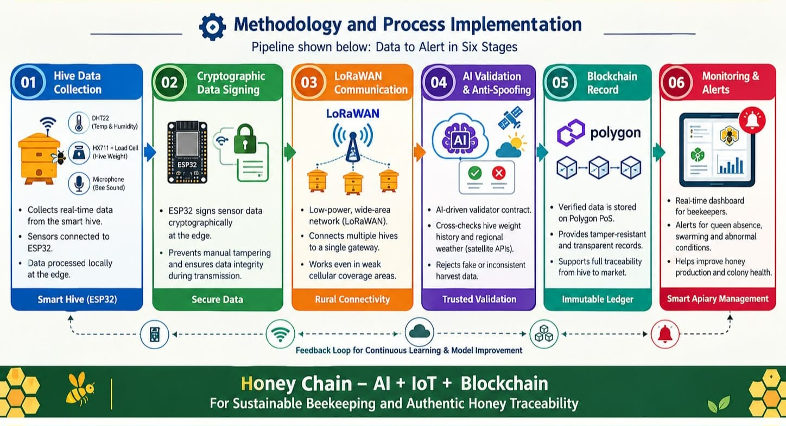
TECHNICAL APPROACH
💡 Technologies to be Used
Sensing & Edge: ESP32 Microcontrollers, DHT22 (Climate), HX711 Load Cells (Mass Metrics), LoRaWAN,Tiny-ML Analyser.
Trust Ledger: Solidity Contracts, Polygon PoS Network, IPFS (Decentralized Report File Storage).
Core Infrastructure: Node.js, Express Framework, PostgreSQL Database, Flutter (Cross-Platform UI App).
✨ Methodology and Process implementation - Pipeline shown below: data to alert in six stages

Slide 4
FEASIBILITY AND VIABILITY
💡 Feasibility of the idea
Uses affordable IoT sensors, ESP32, cloud storage, QR codes and blockchain technology.
Can be developed as a working prototype with existing technologies.
Easy to scale from a few hives to large honey supply chains.
✨ Challenges and risks
Poor connectivity and sensor errors may affect data reliability.
Farmer, lab and distributor adoption may be difficult initially.
Use calibrated sensors, data validation and a simple low-cost interface to reduce risks.
🛡️ Strategic Solutions
Connect hive, laboratory and logistics data into one unified platform.
Generate HoneyDNA and use the Journey Anomaly Engine to detect fraud.
Provide consumers with a QR-based verified honey journey.

Slide 5

IMPACT AND BENEFITS
💡 Impact on the targeted audience
* Rural Beekeepers: Connects local, small-scale tribal beekeepers directly to trusted public marketplaces.
* End Consumers: Gives buyers absolute verification that the honey they purchase matches safety standards.
✨ Benefits of the solution
* Social: Protects indigenous agricultural livelihoods and preserves local beekeeping economies.
* Economic: Eliminates profit loss caused by cheap, counterfeit sugar syrup brands undercutting the market.
* Environmental: Helps safeguard bee colony populations through early disease and climate warning notifications.

Slide 6
RESEARCH AND REFERENCES
Reference and research work
* Blockchain Applications in Food Traceability Networks – Review of distributed architecture models for public supply chains.
* IoT sensors-Driven Remote Bee Colony Microclimate Monitoring – Technical design baselines for in-hive sensory matrices.
Industry Baselines & Technology Benchmarks
*Frontiers in Sustainable Food Systems – Analysing Blockchain Adoption in Beekeeping
*Journal of Apicultural Research – Precision Apiculture System: Honey Traceability from Hive to Spoon

