Slide 1


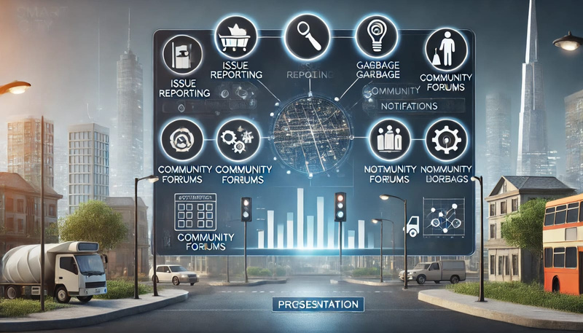
TITLE: “CIVICCONNECT”
TEAM MEMBERS:
1)P.Lahari(1602-22-737-147)
2)T.Sanjay(1602-22-737-172)
3)V.Madhurasri(1602-22-737-148)

Slide 2
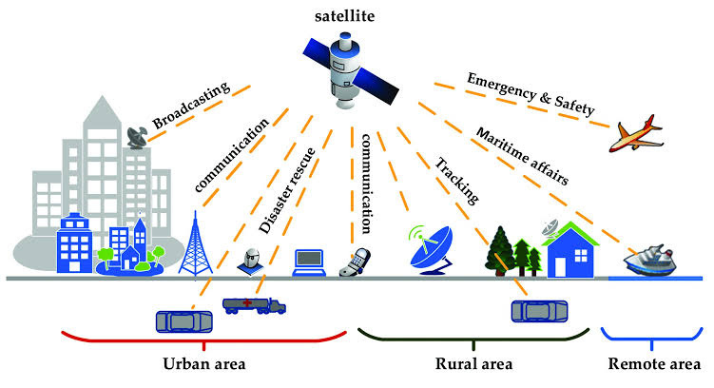
PROBLEM STATEMENT:
Civic engagement in many communities remains fragmented, with citizens facing challenges in effectively communicating local issues to authorities and receiving timely resolutions. Traditional reporting methods often lead to delayed responses, miscommunication, and a lack of transparency, hindering efficient governance and public satisfaction. Additionally, without a centralized system to prioritize incidents or track progress, both citizens and local authorities struggle to address issue in an organized and data-driven manner.

Slide 3
MOTIVATION
Inefficient Communication: Traditional methods of reporting civic issues are slow, leading to delays in responses.
Citizen Frustration: Lack of real-time updates and transparency causes frustration, making citizens feel
disconnected from authorities.
Growing Urban Issues: As cities grow, the number of civic problems increases, requiring faster and more
efficient solutions.
Need for Transparency: Citizens expect better accountability and transparency in how their issues are reported and resolved.
Opportunity for Technology: Digital platforms can improve the speed of reporting, provide real-time
updates, and enhance communication between citizens and local governments.

Slide 4
ABSTRACT:?
CivicConnect is a digital platform designed to bridge the communication gap between citizens and local governments, enabling efficient reporting, tracking, and resolution of civic issues. Through features such as real-time issue tracking, community forums, blockchain for transparency, AI-powered prioritization, and gamification for engagement, CivicConnect aims to streamline civic processes. By providing citizens with a user-friendly space for active participation and local authorities with data-driven insights, CivicConnect enhances collaboration, accountability, and overall community well-being.

Slide 5
DEMONSTRABLE FEATURES:?
Issue Reporting & Tracking: Citizens report issues with photos and location; track status in real-time
Community Forums: Discuss local issues and vote on important topics.
Trending Issues Dashboard: Displays common issues to help authorities prioritize them.
AI-Powered Incident Prioritization: AI groups similar issues and flags high-priority problems.
Blockchain for Transparency: Secure tracking of issue resolution for transparency and accountability.
Gamification for Engagement: Earn points and badges for active participation; leaderboards encourage involvement.
E-Governance Integration: Access government services like permits, taxes, and electoral rolls.

Slide 6

TECHNOLOGY STACK:
Frontend:REACT
Backend:Python(DJAN)
Database:PostgreSQL or MySQL
AI/ML Models:TensorFlow or MongoDB
Blockchain:Ethereum or Hyperledger
Geolocation:Google Maps API or Open street map

Slide 7
THANK YOU

