Slide 1

SAMSUNG PRISM
Generative AI
Hackathon
3rd Edition 2026 – 27
Theme ID - Theme 1: Agentic Code Intelligence
Project Title - Version-aware natural-language code search on CPU
Team Name - Toothpaste Eaters
College Name - SRM INSTITUTE OF SCIENCE AND TECHNOLOGY
Member Name & Email 1- Rajdeep Kulkarni · rk9127@srmist.edu.in
Member Name & Email 2- Madhur Grover · mg9251@srmist.edu.in
Member Name & Email 3- Ayush Bidwai · ab8331@srmist.edu.in
Demo Video - Google Drive folder (link)
Submission Github link -
https://github.com/madhurgrover-cs/TASIE/releases/tag/PRISM_GENAI_HACKATHON_Y2026
Notes:
Hi, we are Team Toothpaste Eaters from SRM Institute of Science and Technology: Rajdeep, Madhur and Ayush. Our project is a code search engine: you describe what you are looking for in plain English and it returns the exact functions that do it, on CPU, for whichever version of the codebase you pick.

Slide 2
Theme
Theme 1 · Agentic Code Intelligence · Code retrieval
The problem, in our words
P0
Retrieval accuracy
0.472 NDCG@10
Before an agent can fix a bug, it has to find the right code. That step is still slow and often wrong, and it gets worse as the repo grows.
Our job: take a plain-English question and thousands of code snippets, and rank the snippets that actually answer it.
It has to run on CPU, and it has to keep working when the code changes, because real repos get new commits every day.
Fine-tuned embedding model + query cleanup
P1
Retrieval across versions
45× faster rebuild
Index any commit, rebuild only what changed
B
Evolutionary retrieval
4 → 10 unique
Search every version at once, no duplicates
Notes:
The theme is code retrieval: given a question in natural language, rank the code snippets that answer it. Samsung ranked three goals: accuracy first, then retrieval across versions, then the bonus of searching all versions at once. We built all three.

Slide 3
Existing Solutions & Gaps
What people use today | How it works | Where it falls short
Keyword search (BM25, grep, IDE search) | Matches words in the query to words in the code | Code rarely uses the question's words. On APPS it scores NDCG@10 0.056
Off-the-shelf code embedding models | Trained on docstring → function pairs | Get lost in long problem statements. Base CodeRankEmbed: 0.237
Ask an LLM to rank the snippets | Paste query + code into the prompt | Thousands of snippets don't fit in the context window, and it's far too slow for a first step
Re-index the whole repo on every commit | Embed everything again from scratch | 18.9 s to rebuild psf/requests even when only 3 files changed
Search all versions as one flat index | Put every version in one index | Top 10 fills up with copies of the same function (6 of 10 on average)
The gap: nothing we found was accurate on long questions, cheap enough for CPU, and aware of code versions, all at the same time.
Notes:
Keyword search fails because problem statements and code share almost no words. Stock embedding models do better but lose track in long statements. An LLM cannot fit thousands of snippets and is too slow. And none of these handle versions: you either rebuild everything or you drown in duplicates.

Slide 4
Our Solutions & Architecture Diagram
AT QUERY TIME · CPU
Query
Clean
Prefix
Encode
Search
Group
Results
Plain English, any length
Keep description + I/O, drop samples & constraints
Add the model's query instruction
Our fine-tuned CodeRankEmbed (137M)
Cosine top-k over stored vectors
Merge copies of one function across versions
File, function, lines, GitHub link
OFFLINE · ONCE PER CORPUS OR COMMIT
Source
git diff
Chunk
Hash check
Publish
APPS corpus, or a git repo at any commit
Find which files changed since the last indexed commit
Python ast → functions, methods, classes, with line ranges
Embed a chunk only if its code is new
Index + registry pushed to Hugging Face
Mapped to the brief's suggested improvements
✓ Query pre-processing ✓ Snippet pre-processing (ast chunks) ✓ Snippet categorisation (function / method / class) ✓ Second pass: lineage grouping ○ Query categorisation: next
Notes:
Everything heavy happens offline. At query time we only clean the question, encode it on CPU and do a vector search, then group copies of the same function across versions. Offline, git diff tells us which files changed, and a content hash means unchanged code is never embedded twice.

Slide 5
Our Solutions & Architecture (contd.): model and training
Query pre-processing (desc-io)
Fine-tuning the embedding model
APPS questions are long (median ~1.6k characters). Most of that is sample tests and constraints, which tell the model nothing about what the code does.
 | Setting
Base model | nomic-ai/CodeRankEmbed (137M, MIT, CLS pooling)
Training data | 4,500 APPS train pairs (question → solution)
Validation | 500 held-out train queries over 5,000 docs
Loss | CachedMultipleNegativesRankingLoss, batch 128
Schedule | lr 2e-5, 2 epochs, max length 512
Test data used | None (no test queries or qrels)
Problem description
kept
Input format
kept
Output format
kept
Sample tests
dropped
Notes
dropped
Effect on the test split (CPU)
Constraints
dropped
Model | NDCG@10 | MRR@10
BM25 (keywords) | 0.056 | —
Base CodeRankEmbed | 0.237 | 0.207
Ours: fine-tuned + desc-io | 0.472 | 0.432
Then: prefix "Represent this query for searching relevant code:", encode, cosine search. Code snippets get no prefix.
Also fixed: transformers v5 leaves two NomicBert buffers uninitialised, which silently corrupts embeddings. We rebuild them after every load.
Notes:
Two changes gave us most of the gain. First, we clean the query: keep the description and the input and output format, and drop sample tests, notes and constraints. Second, we fine-tuned CodeRankEmbed on the APPS train split only; the test split was never used for training or picking the checkpoint. Together that doubled NDCG@10.

Slide 6
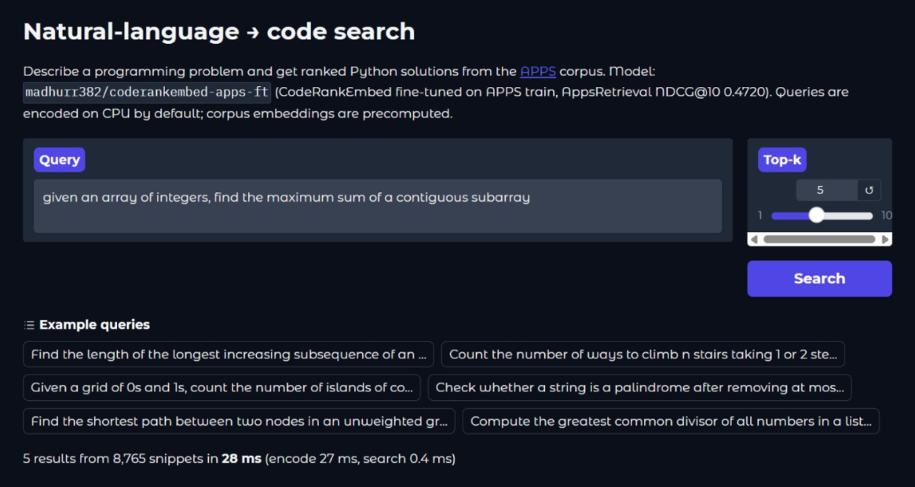
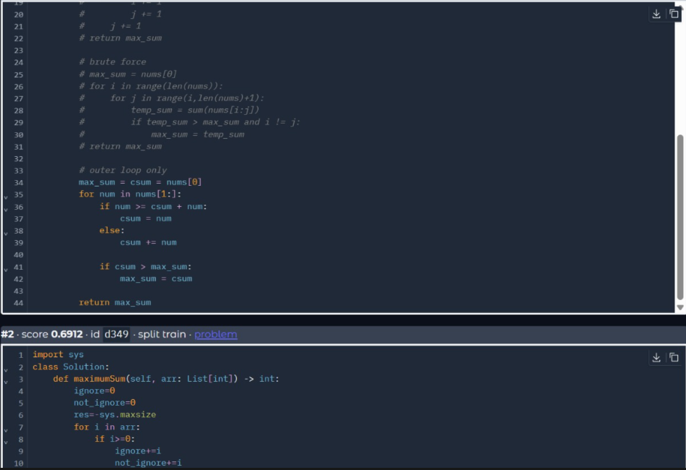
Demo & Product Walkthrough
P0 · APPS corpus (8,765 Python solutions)
Tough query: intent, not keywords
#1 (0.72): Kadane's, O(n)
28 ms on CPU
1. Type the problem in plain English, pick top-k.
2. Query is cleaned and encoded on CPU (27 ms); search takes 0.4 ms.
Demo searches the full APPS corpus; our scores are on the held-out test split only.
Query: "find the maximum sum of a contiguous subarray"
The code never says "contiguous" or "subarray" (just csum, max_sum), so keyword search misses it. #2 (0.69) is a harder variant of the same problem.
Notes:
Live demo on the APPS corpus. We type the problem in plain English, and 28 milliseconds later on CPU we get ranked solutions. For this tough query the top hit is Kadane's algorithm, even though the code never uses the words contiguous or subarray. Note: the demo searches the full APPS corpus; our benchmark numbers are on the held-out test split only.

Slide 7
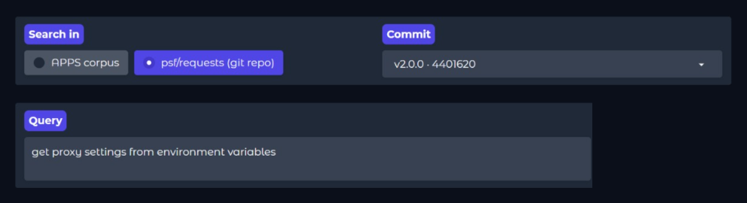
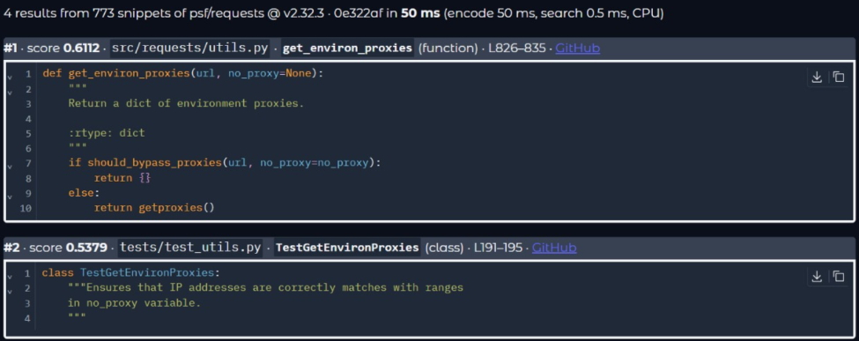
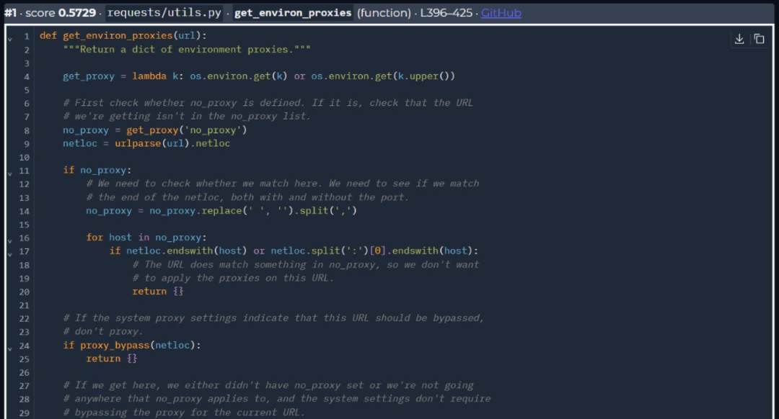
Demo & Product Walkthrough (contd.)
P1 · Same question on psf/requests, 11 years apart: "get proxy settings from environment variables"
Pick the source and any indexed commit.
v2.32.3 · 2024
v2.0.0 · 2013
 | 2013 | 2024
#1 file | requests/utils.py | src/requests/utils.py
Lines | 396–425 | 826–835
Score · time (CPU) | 0.573 · 22 ms | 0.611 · 50 ms
get_environ_proxies(), moved and rewritten: about 30 lines of hand-written parsing in 2013, 10 lines calling should_bypass_proxies() in 2024. Still the top hit, with a GitHub link to that exact commit.
Notes:
Now the same question on the requests library at two versions eleven years apart. In 2013 the function lives in requests/utils.py and is thirty lines long; in 2024 it moved under src/ and was rewritten to ten lines. It is the top result in both, because the model matches what the code does, not how it is written.

Slide 8
Tools and tech stack used
1
Model
2
Training & evaluation
3
Indexing across versions
nomic-ai/CodeRankEmbed (137M, MIT)
Fine-tuned with sentence-transformers 6.1
transformers 5.0 (with our buffer fix)
Kaggle T4 GPU for training and index builds
CachedMultipleNegativesRankingLoss
MTEB AppsRetrieval, run on CPU
Python ast for chunking
git diff for incremental rebuilds
Content-hash cache, NumPy vectors
4
Demo & hosting
5
Testing
6
Reproducibility
Gradio app on a Hugging Face Space
Indexes stored as HF datasets
Queries encoded on CPU
pytest, runs without torch
Fake embedders + a throwaway git repo
Checks that incremental = full build
Model revision pinned and checked at startup
Results JSON attached to the release
Rebuild scripts in the repo
Development help: we used Claude (Anthropic) as a coding assistant. Details are in our AI disclosure form in the repo.
Notes:
The model is CodeRankEmbed, small enough for CPU. We trained and built indexes on a free Kaggle T4, and the demo runs as a Gradio app on Hugging Face. The tests run without torch, which let us check logic on our own laptops.

Slide 9
Impact & Use case
1
Coding agents
2
Developers new to a repo
Retrieval is step one before any fix. Better top-10 results mean the agent reads the right files and sends fewer tokens to the LLM.
Ask "where is the retry logic?" and jump straight to the function and lines, instead of grepping for names you don't know yet.
3
Support on older releases
4
Teams without GPUs
Bugs are reported against the version a customer runs. Search that exact commit, not just main.
Queries run on CPU in tens of milliseconds, so it fits on a laptop, a CI runner or an on-prem server.
28 ms
0.42 s
−28%
per query on CPU
to re-index after a small release
embedding work across 4 versions
Notes:
The main user is a coding agent: if retrieval is right, everything after it gets cheaper and more accurate. It also helps people new to a codebase, support engineers working on old releases, and teams that cannot afford GPUs.

Slide 10
Innovation highlights, results and limitations
Innovation
Results
Limitations
Query cleanup (desc-io) so the model sees intent, not sample test data
Fine-tuned on APPS train only; no test data touched
Content-hash cache: unchanged or moved code is never re-embedded
Lineage grouping to search all versions at once
Function-level chunks for Python only; other files are indexed whole
Versioning tested on one real repo (psf/requests)
No query categorisation yet
Build times measured on a T4 GPU; queries run on CPU
Goal | Metric | Result
P0 | NDCG@10 (base 0.237) | 0.472
P0 | MRR@10 (base 0.207) | 0.432
Speed | Query latency on CPU | 28 ms
P1 | Rebuild after small release | 45× faster
P1 | 4 versions, 2013–2024 | 28% less work
Bonus | Unique functions in top 10 | 4.0 → 10.0
Notes:
What is new: we clean long problem statements before encoding, we never re-embed code we have already seen, and we group copies of a function across versions. Results: NDCG@10 went from 0.237 to 0.472; rebuilding after a small release is 45 times faster. We are honest about limits: only Python gets function-level chunks, and we tested versioning on one repo.

Slide 11
What’s next
1
2
3
4
5
Categorise the query
Second retrieval pass
More languages
Bigger and more repos
Plug into agents
Route short intents ("where is retry logic") and long problem statements through different cleanup steps.
Hybrid BM25 + dense recall, then a small CPU reranker on the top 50.
Tree-sitter chunking so Java, C++, Kotlin and JS get function-level chunks too.
Benchmark P1 on large monorepos and many more commits.
Expose search as a tool (e.g. an MCP server) that coding agents can call.
All of this stays on the retrieval side. Generating answers after retrieval is out of scope for this theme.
Notes:
Next we want to categorise queries, add a second retrieval pass with a small reranker, support more languages with tree-sitter, test on bigger repos, and expose the search as a tool that coding agents can call.

Slide 12
Brownie points (differentiation)
Bonus: evolutionary retrieval, search every version at once
Problem: a function exists in every version, so a flat search fills the top 10 with near-copies.
What we do: group results into lineages (same function across versions, even after requests/ → src/requests/, plus near-duplicates above 0.95 similarity) and show each once.
Cost: no re-embedding; it reuses the per-version indexes and adds 7–12 ms.
Top 10, avg over 5 queries | Flat | Grouped
Duplicates | 6.0 | 0
Unique functions | 4.0 | 10.0
Other things we are proud of
Found a silent transformers v5 bug (uninitialised NomicBert buffers) that corrupts embeddings, and fixed it
Incremental builds produce exactly the same index as a full build, and a test checks it
The Space refuses an index built with a different model revision, so results can't silently drift
Everything is public: model, both indexes, code and live demo
"check whether a URL should bypass the proxy using no_proxy"
#1 should_bypass_proxies · 0.795
v2.0.0 (absent)
v2.12.0
v2.25.0
v2.32.3
Filled dot = new or changed in that version; hollow = function not present yet.
Notes:
For the bonus, searching all versions at once normally gives you the same function six times. We group those copies into one lineage with a small timeline, so the top ten goes from four unique functions to ten. We also found and fixed a silent library bug that was corrupting embeddings.

Slide 13
Checklist- Updated on Public GitHub
Item | Status | Where
Working prototype code: public or shared GitHub repo | Y | Release tag PRISM_GENAI_HACKATHON_Y2026
README with reproducible setup instructions | Y | README.md, DEPLOY_SPACE.md, KAGGLE.md
Demo video, max 5 minutes (YouTube or Drive link) | Y | Google Drive folder (link below)
Presentation file (PPT or PDF) | Y | In the tagged commit
AppsRetrieval results JSON (MTEB) | Y | appsretrieval_results.json, attached to the release
Links
Run it yourself (CPU)
Code: github.com/madhurgrover-cs/TASIE
Demo video: Google Drive folder
Live demo: huggingface.co/spaces/madhurr382/code-search-demo
Model: huggingface.co/madhurr382/coderankembed-apps-ft
APPS index: huggingface.co/datasets/madhurr382/apps-corpus-index
Repo index: huggingface.co/datasets/madhurr382/repo-versions-index
# P0: reproduce the AppsRetrieval JSON
pip install -r requirements-retrieval.txt
python retrieval/submission.py
# P1: index a repo, update, query a version
python -m retrieval.versioned index --repo ../requests --commit v2.31.0
python -m retrieval.versioned update --repo ../requests --commit v2.32.0
python -m retrieval.versioned query --commit v2.32.0 "get proxy settings"
Notes:
Everything is in the tagged commit: code, README with setup steps, this deck, and the results JSON attached to the release. The commands on the right reproduce our benchmark result and the version search on CPU. The demo video is in the linked Google Drive folder.

Slide 14
Thank you
Team Toothpaste Eaters · SRM Institute of Science and Technology
github.com/madhurgrover-cs/TASIE · Live demo on Hugging Face · Demo video
Organised by the Language AI Team and the PRISM Team, Samsung R&D Institute India
Notes:
Closing slide. Add the Google Form URL and a contact email before sharing. Edition 2 organising team for reference: Language AI - Sourabh Tiwari, Gaurav, Sanjeeth Pothireddy, Gorang Maniar; PRISM - Binny Lakra, Prakhar Chandrakar, Vishu Kumar; Kick-off and mentors - Giridhar Jakki, Deepraj Prabhakar Patkar (Language AI), Srimanu Prasad Nagaraju, Ashish Kumar (Tech Strategy).

