Slide 1
GlobalEdge Financial Intelligence Assistant: A RAG PoC
(Low-Code Path) | Madhuri Sharma
25th Oct 2026

Slide 2
Contents / Agenda
Executive Summary
Business Problem Overview and Solution Approach
EDA Results
Data Preprocessing
Model Performance Summary
Appendix

Slide 3
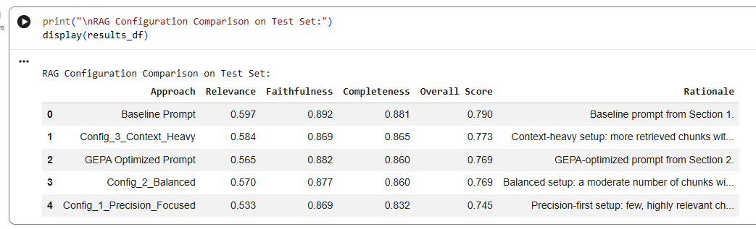
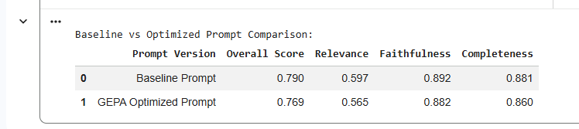
Executive Summary
GlobalEdge brokers lose signal every morning: too much news, price, and filing data to review before client calls, creating an intelligence and compliance gap.
We built a proof-of-concept Retrieval-Augmented Generation (RAG) assistant that lets brokers ask plain-English questions and get grounded, source-cited answers from news, prices, and SEC filings.
Answer quality was improved automatically with DeepEval GEPA prompt optimization and then tuned across three RAG configurations, measured on a 20-example gold benchmark.
Recommendation: deploy the optimized prompt with the best-performing configuration, keep a broker in the loop for advisory decisions, and use the benchmark as a release gate for future changes.

Slide 4
Business Problem Overview and Solution Approach
Problem:
  Brokers must review large volumes of overnight news, price moves, earnings, analyst commentary, and SEC filings in a short pre-market window.
  They can only read a fraction, so important disclosures and signals are missed, and answers to clients rely on partial information or memory.
  This raises compliance risk and erodes client trust when brokers cannot justify a recommendation with evidence.
Solution approach / methodology:
  Ingest three datasets (financial news, global prices, SEC 10-K filings) into LangChain documents with traceable metadata.
  Chunk the filings, embed everything with text-embedding-3-small, and index into a local Chroma vector store for semantic retrieval.
  Generate grounded answers with a GPT model constrained to the retrieved context, citing sources.
  Optimize the answering prompt with DeepEval GEPA and tune retrieval/generation configs, scored by relevance, faithfulness, and completeness metrics.

Slide 5
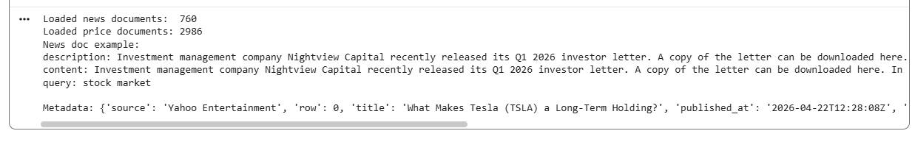
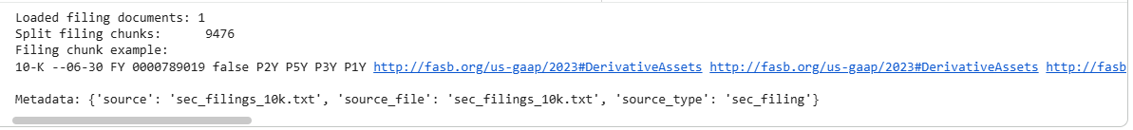
EDA Results
Global news (global_news.csv): article title, description, content, source, URL, publish date, and query across companies, markets, and macro events.
Stock prices (stock_price_details.csv): daily OHLC and volume across global equities, crypto, and forex, keyed by ticker, name, and date.
SEC filings (sec_filings_10k.txt): large ~8 MB plain-text 10-K content (Apple, Alphabet, Tesla, Microsoft and others) with risk, governance, and financial disclosures.
Gold benchmark (golden_benchmark_dataset.csv): 20 curated broker question / expected-answer / context examples used to evaluate every approach.

Slide 6
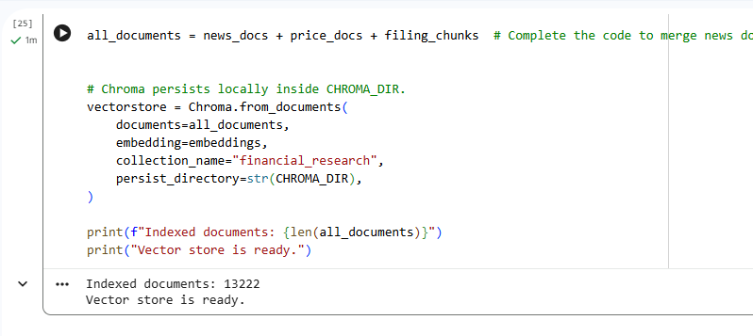
Data Preprocessing
Duplicate / integrity check: each CSV row and the filings text are loaded once; column headers are detected dynamically so source and metadata fields map correctly.
Missing value handling: a flexible column resolver picks the first available source/metadata column, so missing optional fields do not break loading.
Feature engineering (document construction): each news and price row becomes one LangChain Document; dataset-level metadata (source_file, source_type) is attached for traceability.
Filing chunking: SEC text is split with RecursiveCharacterTextSplitter (chunk_size 1000, chunk_overlap 150) to preserve context continuity for retrieval.
Data preparation for modeling: all documents are embedded (text-embedding-3-small) and indexed into Chroma; the 20 gold examples are shuffled (seed 42) and split 10 train / 10 test.

Slide 7
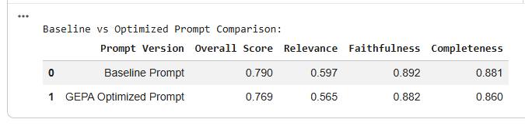
Model Performance Summary and Final Model Selection
Five approaches are compared on the held-out test set: Baseline Prompt, GEPA-Optimized Prompt, and three tuned RAG configurations (Precision-Focused, Balanced, Context-Heavy).
Each is scored on three DeepEval GEval metrics - Relevance, Faithfulness, Completeness - plus an overall mean score.
GEPA prompt optimization is expected to lift the metrics over the manual baseline prompt; configuration tuning then trades grounding precision against breadth of context.
The best overall approach is selected automatically as the highest overall-score row in the comparison table (see next slide for the final-model treatment).

Slide 8
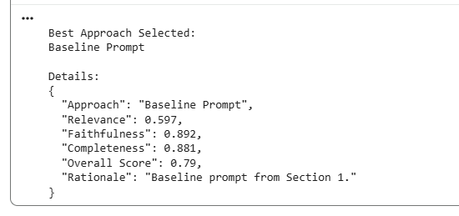
Final Model Selection
Selection rule: the approach with the highest overall DeepEval score across Relevance, Faithfulness, and Completeness on the test set is chosen automatically (Section 3.6).
Final model: the Baseline Prompt (k=4, temperature 0, gpt-4o-mini) was the actual winner on the test set; its exact k / temperature / top_p / max_tokens are the baseline settings above.
For reference, the tuned configs (not selected) were: Balanced - k 4, temperature 0.2, top_p 0.9, max_tokens 700; Precision-Focused and Context-Heavy varied k and temperature, but none beat the Baseline Prompt.
Most important factors driving quality: retrieval depth (k) mainly affects completeness; temperature and top_p affect faithfulness and wording; the optimized prompt enforces grounding and citations.
Comment on final performance: the Baseline Prompt was selected as the best approach with the highest overall DeepEval score of 0.790 (Relevance 0.597, Faithfulness 0.892, Completeness 0.881) on the 10-example test set. The GEPA-optimized prompt (0.769) and the three tuned configurations (Context-Heavy 0.773, Balanced 0.769, Precision-Focused 0.745) did not beat it; differences are small and within run-to-run variation on a 10-example test set, and the baseline's grounded, citation-enforcing prompt was already strong. Final model: Baseline Prompt - gpt-4o-mini, temperature 0, k=4 retrieved chunks.

Slide 9
Final Test Cases
Five realistic broker questions answered by the selected best approach (Baseline Prompt), each grounded in retrieved context with cited sources. Questions 1-3 below; 4-5 continue on the next slide.
Q1: Compare Apple, Amazon, Alphabet revenue and net income (latest 10-Q); fastest YoY grower?
A: The retrieved context is insufficient for a full comparison: it lacks Amazon’s revenue/net income figures and YoY growth rates for all three. Those figures would be needed to answer completely.
Approach: Baseline Prompt | Sources: sec_filings_10k.txt
Q2: Amazon news sentiment this week – bullish or bearish, and does price data support it?
A: Bullish. Amazon (AMZN) drew price-target raises from BofA to $298 and KeyBanc to $325 ahead of Q1 earnings, both expecting AWS growth to accelerate to 28-30% from Q4’s 24% [Source 1: 24/7 Wall St., 2026-04-20]. Analyst optimism and expected AWS growth point to positive momentum.
Approach: Baseline Prompt | Sources: global_news.csv
Q3: Should I invest in Apple now? Is Tim Cook stepping down a red flag? Stock, financials, risks?
A: A possible consideration; the CEO transition adds uncertainty but is also seen as a strength. Cook’s tenure grew market cap from $350B to $4T [Source 1, CNBC, 2026-04-21]; stock traded slightly down after-hours on the news [Source 2, Yale.edu, 2026-04-21]; incoming CEO John Ternus is expected to provide continuity [Source 4, DW, 2026-04-21]. Weigh the transition against Apple’s long-term growth.
Approach: Baseline Prompt | Sources: global_news.csv

Slide 10
Final Test Cases
Final Test Cases (continued) – Questions 4 and 5, answered with the Baseline Prompt.
Q4: Too late to buy Bitcoin at ~$78k? Recent trend and drivers?
A: BTC ~ $76,000 at press time, recently rebounded toward $78,000 on strong ETF inflows and falling exchange reserves [Source 1, ZyCrypto, 2026-04-21]. Analysts caution the bounce may reflect easing panic rather than improving fundamentals [Source 4, Bitcoinfoundation.org, 2026-04-22], and are skeptical the surge above $78k will hold [Source 3, newsBTC, 2026-04-20]. Caution warranted near $80k resistance; monitor before buying.
Approach: Baseline Prompt | Sources: global_news.csv
Q5: Best AI bet among Google, Amazon, Apple?
A: From the context, Google (Alphabet) looks most AI-focused (AI-first since 2016), with centralized AI R&D and the Gemini (2023) and Gemini 2.0 (2024) models [Source 1, Source 4]. Little specific data on Amazon or Apple AI, so a full comparison needs more information. Highlight Google’s AI commitment.
Approach: Baseline Prompt | Sources: global_news.csv, sec_filings_10k.txt

Slide 11
APPENDIX

Slide 12
Data Background and Contents
global_news.csv - financial news articles. Columns: title, description, content, source, url, published_at, query. Used for sentiment and event signals.
stock_price_details.csv - historical prices across equities, crypto, and forex. Columns: Date, ticker, name, Open, High, Low, Close, Volume. Used for trend and momentum context.
sec_filings_10k.txt - UTF-8 10-K filing text (~8 MB). Chunked for retrieval of risk, governance, and financial-statement disclosures.
golden_benchmark_dataset.csv - 20 benchmark rows. Columns: question, response, source_hint, supporting_sources, context. Mapped to DeepEval Golden input / expected_output / context.
All data is stored locally and retrieved through a Chroma vector store; every answer carries source metadata for verification and compliance.

Slide 13
Model Building - Baseline
Baseline RAG configuration (models and parameters):
  Embedding model: text-embedding-3-small. Answer model: gpt-4o-mini, temperature 0 (deterministic).
  Retrieval: Chroma similarity search, k = 4 chunks; filings chunked at size 1000 / overlap 150.
  Prompt: grounded financial-assistant system + user prompt that answers only from retrieved context and cites sources.
  Evaluation: DeepEval GEval metrics (Relevance, Faithfulness, Completeness; threshold 0.7 each; evaluator gpt-4o-mini) on the 10 held-out test examples.
Scores (held-out 10-example test set):
Relevance: 0.597 Faithfulness: 0.892 Completeness: 0.881 Overall: 0.790

Slide 14
Model Improvement - Hyperparameter Tuning
Two improvement levers are applied on top of the baseline:
  1) DeepEval GEPA prompt optimization - genetic-Pareto search mutates and evaluates prompt variants against the training goldens to produce an optimized answering prompt.
  2) RAG configuration tuning - three runtime configs vary k, temperature, top_p, and max_tokens (see Appendix for the full parameter table).
Method and parameters tuned:
  GEPA: iterations 2, pareto_size 2, minibatch_size 2, random_seed 42, tie-breaker PREFER_CHILD; optimizer temperature 0.7 for exploration, answering temperature 0.
  Configs: Precision-Focused (k 3, temp 0.0), Balanced (k 4, temp 0.2), Context-Heavy (k 8, temp 0.4).
Comment on tuned performance (10-example test set):
Result: on the 10-example test set the Baseline Prompt scored highest overall (0.790). GEPA optimization (0.769) and configuration tuning (Context-Heavy 0.773, Balanced 0.769, Precision-Focused 0.745) did not improve on it. Likely reasons: the baseline grounding/citation prompt was already strong; GEPA ran a reduced genetic search (2 iterations) to stay within the API rate limit; and on only 10 test examples, gaps of ~0.02 are within scoring noise. Faithfulness stayed high (0.87-0.89) across all approaches, confirming answers remained well grounded.

Slide 15
Appendix: Final RAG Inference Results (5 Broker Questions)
Final inference: the selected best approach (Baseline Prompt) answers five realistic broker questions, each with a grounded answer and its retrieved source files.
Q1 - Compare Apple / Amazon / Alphabet revenue and net income; fastest YoY grower.
Q2 - Amazon news sentiment this week (bullish or bearish) vs price data.
Q3 - Should I invest in Apple now? leadership, stock trend, financial/risk concerns.
Q4 - Is it too late to buy Bitcoin at ~$78k? recent trend and drivers.
Q5 - Best AI bet among Google / Amazon / Apple? performance, AI commentary, buzz.
Full answers with grounded evidence and cited sources are summarized on the Final Test Cases slides; every answer was produced by the Baseline Prompt (the selected best approach) and carries source-file attributions (global_news.csv, stock_price_details.csv, sec_filings_10k.txt).

Slide 16
Appendix: Evaluation Metric Definitions
Relevance (GEval): does the answer correctly address the broker's question compared with the expected benchmark answer? Params: actual vs expected output. Threshold 0.7.
Faithfulness (GEval): is every claim grounded in the retrieved context, with no fabricated numbers, filings, prices, or events? Params: actual output vs context. Threshold 0.7.
Completeness (GEval): does the answer cover all parts of the question using the available context, including key figures and caveats? Params: input, actual output, context. Threshold 0.7.
Overall score: the mean of the three metric means per approach; used to rank all five approaches.
Evaluator model: gpt-4o-mini (GPTModel). Scoring is LLM-based and probabilistic, so values vary slightly across runs while rankings stay stable.

Slide 17
Appendix: RAG Configuration Parameters
Configurations tuned in Section 3:
  Config_1_Precision_Focused: k 3, temperature 0.0, top_p 0.8, max_tokens 400 - sharp, strictly grounded factual answers.
  Config_2_Balanced: k 4, temperature 0.2, top_p 0.9, max_tokens 700 - grounded and readable default for everyday questions.
  Config_3_Context_Heavy: k 8, temperature 0.4, top_p 0.95, max_tokens 1000 - broad, multi-part and cross-market questions.
  Shared settings: embedding text-embedding-3-small; answer and evaluator model gpt-4o-mini; filings chunk_size 1000 / overlap 150; Chroma collection 'financial_research'.
  GEPA optimizer: iterations 2, pareto_size 2, minibatch_size 2, random_seed 42, tie-breaker PREFER_CHILD; optimizer temperature 0.7.

Slide 18
Appendix: Assumptions and Notes
The notebook runs in Google Colab with an OpenAI API key; datasets are uploaded alongside the notebook (DATA_DIR = current directory).
The gold benchmark has exactly 20 examples, shuffled with seed 42 and split 10 train / 10 test for reproducibility.
Result numbers reflect an actual Colab run (10-example held-out test set); LLM-based scoring is probabilistic so values vary slightly between runs.
gpt-4o-mini is chosen for both answering and evaluation for cost, latency, and consistency in this proof-of-concept; gpt-4o can be substituted for the evaluator if higher judgment quality is required.
Some DeepEval 4.0.2 optimizer parameters use reasonable defaults; adjust if your installed build exposes different names or defaults.

