Slide 1
Sinhgad College of Engineering Department of Information Technology
Project REview
On
“NGO Connect ANDROID application using cloud”
by
Roll No | Name
407003 | Ali Asghar
407032 | Balaji Davangave
407044 | Rohan Gaikwad
407011 | Madhuri Awachar
Guide
Mrs. B. P. Vasgi

Slide 2
Project Details
Project Title : NGO Connect Application
Project Domain : Cloud Computing & Android

Slide 3
Introduction
There is no proper way to communicate with different NGOs in one go.
Providing a proper way through which wasted food can be utilized.
There is no centralized way through which the government can moderate the NGO system.
Providing a digitalized system using which NGOs can recruit their volunteer and store their data.

Slide 4
Problem Statement
Developing Android application using cloud based data storage and using location based service to locate NGOs, volunteers and restaurants so that they can work together in the process of recruiting volunteers and reducing wastage of food.

Slide 5
Aim and Objectives
AIM:
To develop an android application which will become a bridge between volunteers and NGOs in any domain, with the help of cloud based easy to access database and help to reduce the wastage of food by providing it to nearby NGOs using location service
OBJECTIVES:
To provide an overview on cloud based data storage
To study location based service to search nearby locations
To develop an android application

Slide 6
Literature Survey(1/2)
S.No | Title | Year | Author Name | Description
1 | Intelligent LBS using Android with GPS and Geo-Tagging Applications | 2016 | S. K. Tiwari, G. K. Varshney, M. A. Qadeer and M. S. Umar | Retrieve information from server, Insert And Update information available on server
2 | JustIoT Internet of Things based on the Firebase Real-time Database | 2018 | W. Li, C. Yen, Y. Lin, S. Tung and S. Huang | The use of the Firebase cloud system begins with enabling user authentication and planning database

Slide 7
Literature Survey(2/2)
S.No | Title | Year | Author Name | Description
3 | Location Based Services using Android | 2009 | Sandeep Kumar, Mohammed Abdul Qadeer, Archana Gupta | Location-based service (LBS) provides a user with contents customized by the user’s current location
4 | Location based service for presence system using haversine method | 2016 | E. Winarno, W. Hadikurniawati and R. N. Rosso | Haversine formula is the method used to calculate the distance from two different points.

Slide 8
Literature Survey(2/2)
S.No | Title | Year | Author Name | Description
5 | Location Based Reminder Android Application Using Google Maps API | 2016 | Pradnya Battin, Dr. S.D.Markande | Using free public API service from Google Maps

Slide 9
Hardware and Software Requirements
Hardware Requirements:
- RAM: 8 GB and 1 GB for Android Emulator
- Hard Disk: 512 MB or higher
- A Smart Phone with android version 5.0 and above
Software Requirements
An Android studio
Java Development Kit (JDK)
Windows 7 or Later

Slide 10
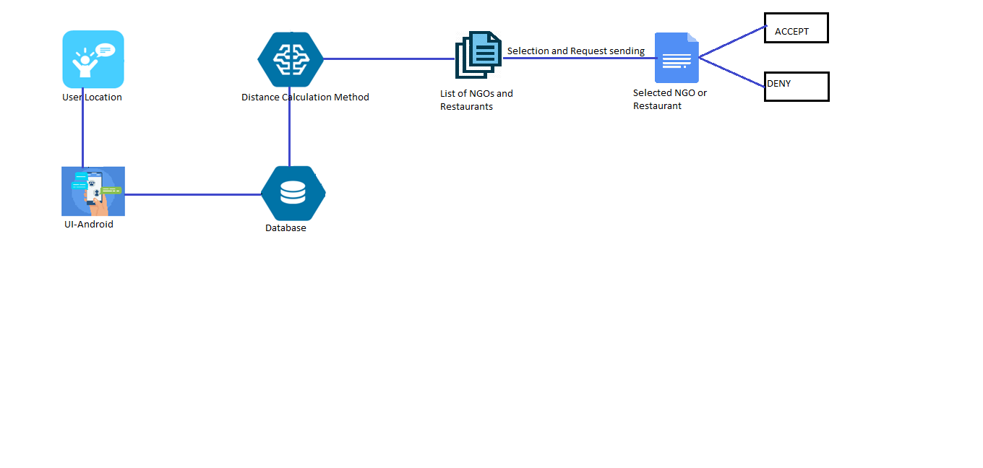
High Level Design

Slide 11
Hosting Services
Local Hosting | Cloud Hosting
Hosted on the local area network or within organization | Hosted on a third party’s network infrastructure
Lot of infrastructure is needed on client side | Very little infrastructure from the client
Administrator has full access every time | Administrator losses the control
Higher cost startup | Lower cost startup
Difficult setup and configuration | Easy setup and configuration
Higher security | Lesser security

Slide 12

Cloud Storage
Accessibility
Collaboration
Disaster Recovery
Scalable Service
Syncing

Slide 13
Comparison between Firebase and Parse Server
 | Firebase | Parse Server
General Purpose | Fast Real time updates | Real time update is not available
Hosting | Google Hosting. Free upto 100 simultaneous connection | Self Hosting and Parse hosting
Custom Code | Custom code not supported | Custom code totally supported
Database | Support model observer scheme | Has huge relationship based databases
Storage | Stores data as JSON and data can be uploaded to Google Cloud Storage | No File Storage restriction
Provider | Developed by Google | Developed by Facebook

Slide 14
Firebase Features
Real-time Database − Firebase supports JSON data and all users connected to it receive real-time updates after every change.
Authentication − We can use anonymous, password or different social authentications.
Hosting − The applications can be deployed over secured connection to Firebase servers.
Cloud Messaging - Firebase Cloud Messaging (FCM) is a cross-platform messaging solution that lets us reliably deliver messages at no cost.

Slide 15
Firebase Analytics
Google Analytics for Firebase is a free app measurement solution that provides insight on app usage and user engagement.
User Reporting
Audience Segmentation

Slide 16
Firebase Advantages
It is simple and user friendly. No need for complicated configuration.
The data is real-time, which means that every change will automatically update connected clients.
Firebase offers simple control dashboard.
There are a number of useful services to choose.

Slide 17
Firebase Products
Products | Free | $25 Per Month | Pay As We Go
Cloud Messaging | Yes | Yes | Yes
Performance Monitoring | Yes | Yes | Yes
Authentication (Without Phone Auth) | Yes | Yes | Yes
Simultaneous Connection | 100 | 100K | 100K/Database
Storage GB Stored GB Downloded | 5GB 1 GB/day | 50 GB 50 GB/day | $0.026/GB $0.12/GB
Document Writes Document Reads | 20K/day 50K/day | 100K/day 250K/day | $0.18/100K $0.06/100K
Multiple databses Per Project | No | No | Yes

Slide 18
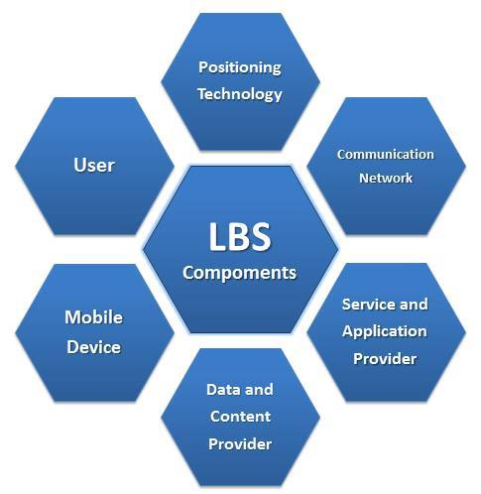
Location Based Service
An information service
Number of users in social networking
Accessible with mobile devices
Uses information on the geographical
position of the mobile device
Include services to identify the
location of a person or object,

Slide 19
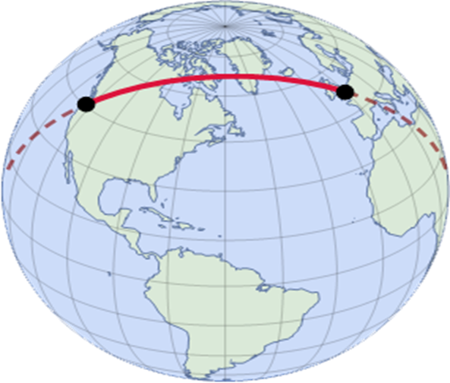
Location Based Service In Android
Location Manager: Manages all other components
Location Provider :Determine the physical location

Slide 20
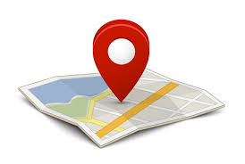
Continue…
Geocoding:
Reverse geocoding provides a way to convert geographical coordinates into street address and forward geocoding provides a mean to get geographical coordinated from street address.
Google Map in Android:
Android provides a number of objects to handle maps in LBS system like MapView which displays the map. To handle this a MapActivity class

Slide 21
Methods For Distance Calculation
Haversine Formula | Vincenty Formula
Easy To Calculate | Complex to Calculate
Less Accurate | More Accurate
Faster Calculation | Slower Calculation
Less Battery Usage | More Battery Usage

Slide 22

Haversine Method (For Distance Calculation)
Generally, Haversine is used for computing the great circle distances between two pairs of coordinates on a sphere.
There is no geometric shape that the Earth can fall perfectly under its calculations. Haversine formula perfectly applied to calculate distance on a spherical shape.
The shortest distance between two points on the surface of an earth or a sphere measured along the surface and can be displayed on the Google map.
Formula:

Slide 23
Steps:
Step 1: Express location coordinates in decimal format
Step 2: Express Longitudes and latitudes
Step 3: Express Location coordinates as radians
Step 4: Determine the initial latitude and initial longitude
Step 5: Calculate the total distance from to the optimal location using the Haversine formula.

Slide 24
Recommendation System
Recommender systems produce a list of recommendations
Collaborative Filtering
Content Based Recommendation

Slide 25
Continue…
Content-based filtering methods are based on a description of the item and a profile of the user’s preferences.
To create a user profile:
1. A model of the user's preference.
2. A history of the user's interaction with the recommender system.

Slide 26
Design and Modelling

Slide 27
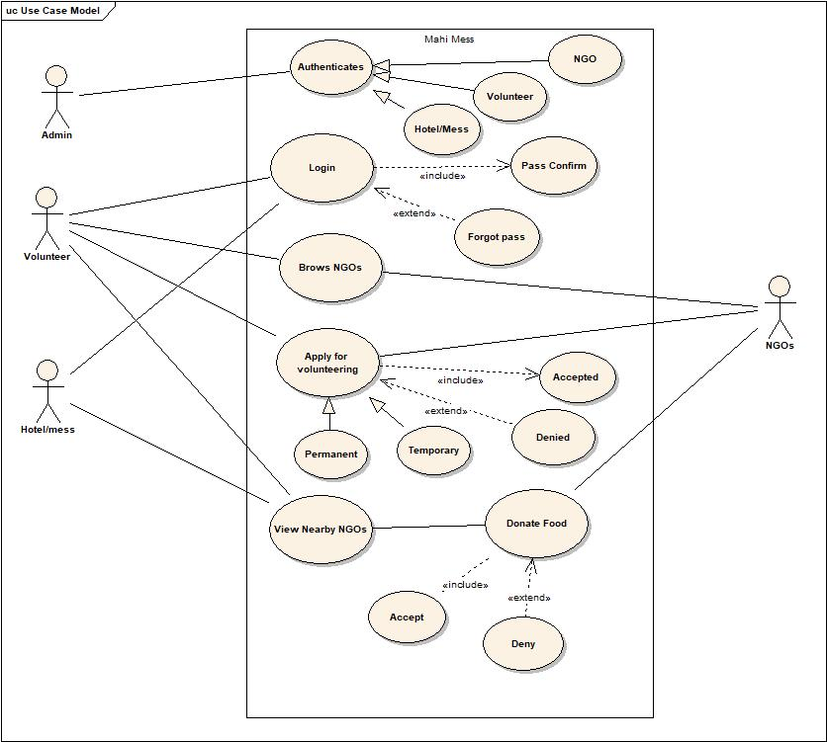
Use Case Diagram

Slide 28
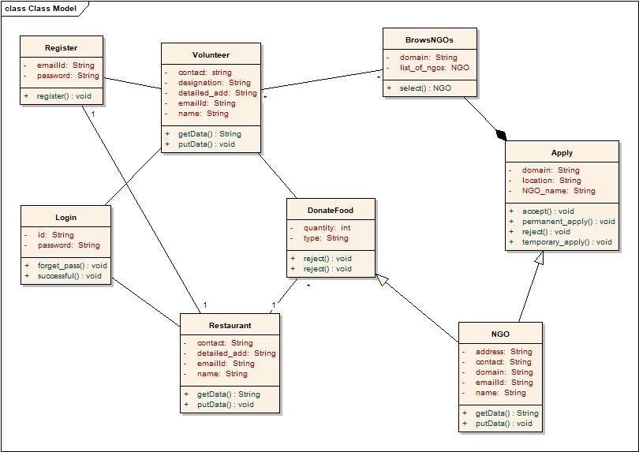
Class Diagram

Slide 29
UML Activity Diagram
Volunteers
NGOs
Restaurant
Firebase Database
Login
Login
Authorised
Browse NGOs
yes
Apply
yes
No
yes
Sucessful
Donate food
No
yes
Sucessfully donated
food

Slide 30
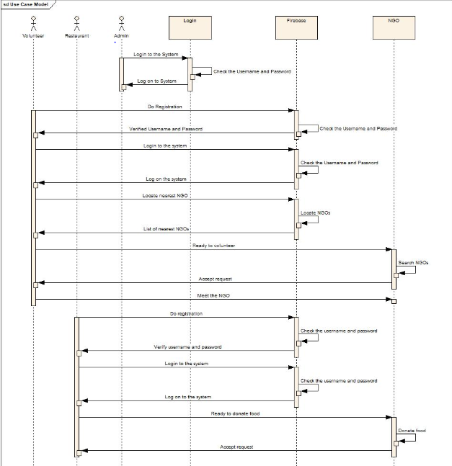
Sequence Diagram

Slide 31
Results

Slide 32
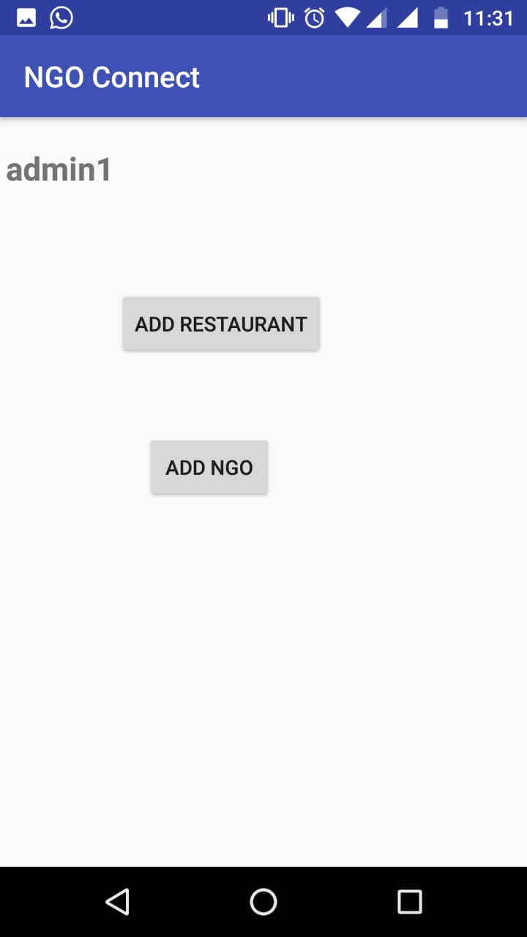
Admin Page(1/2)

Slide 33
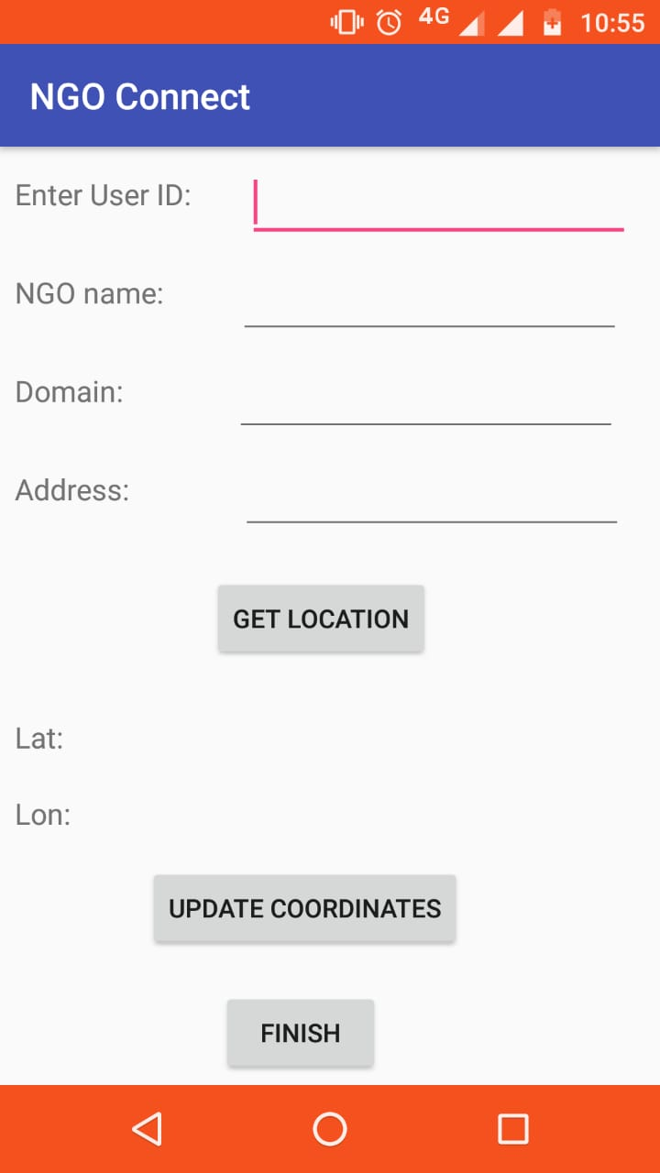
Admin Page(2/2)

Slide 34
Code(1/3)
Add Restaurant
Add NGO
Functionalities:
Get Location
String ngo_id=NGOid.getText().toString();
mUserDatabase=FirebaseDatabase.getInstance().getReference().child("admin").child("Temp_loc1");

Slide 35
Code(2/3)
Update Coordinates
String ngo_id=NGOid.getText().toString();
mUserDatabase=FirebaseDatabase.getInstance().getReference().child("admin").child("Temp_loc1");

Slide 36
Code(3/3)
Finish
finishButton.setOnClickListener(new View.OnClickListener() {
public void onClick(View view) {
String ngo_id=NGOid.getText().toString();
mRESTDatabase=FirebaseDatabase.getInstance().getReference().child("NGO_list").child(ngo_id).child("lat").setValue(NGOlat.getText().toString()); mRESTDatabase=FirebaseDatabase.getInstance().getReference().child("NGO_list").child(ngo_id).child("lon").setValue(NGOlon.getText().toString());
System.out.println(NGOlat.getText().toString()+"????????????////////");
}

Slide 37
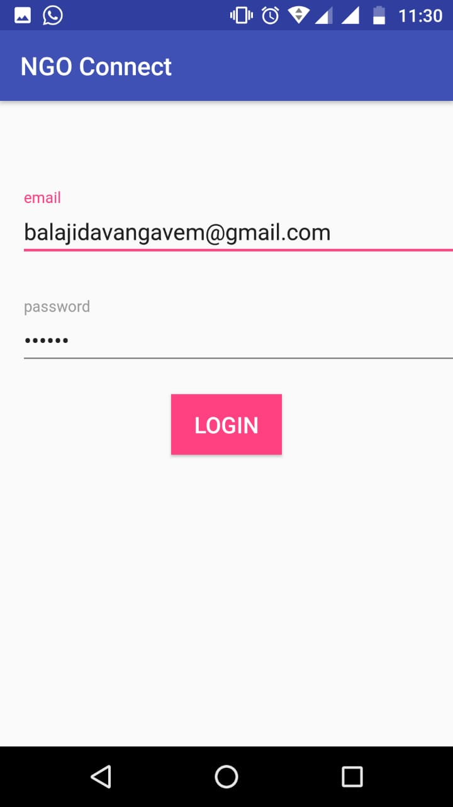
Login Page

Slide 38
Code(1/2)
public void onComplete(@NonNull Task<AuthResult> task) {
if(task.isSuccessful()){
mLoginProgress.dismiss();
Intent mainIntent=new Intent(LoginActivity.this,MainActivity.class);
mainIntent.addFlags(Intent.FLAG_ACTIVITY_NEW_TASK | Intent.FLAG_ACTIVITY_CLEAR_TASK);
startActivity(mainIntent);
finish();
}

Slide 39
Code(2/2)
else
{
mLoginProgress.hide();
Toast.makeText(LoginActivity.this,"Oops...error...please try again",Toast.LENGTH_LONG).show();
}
}

Slide 40
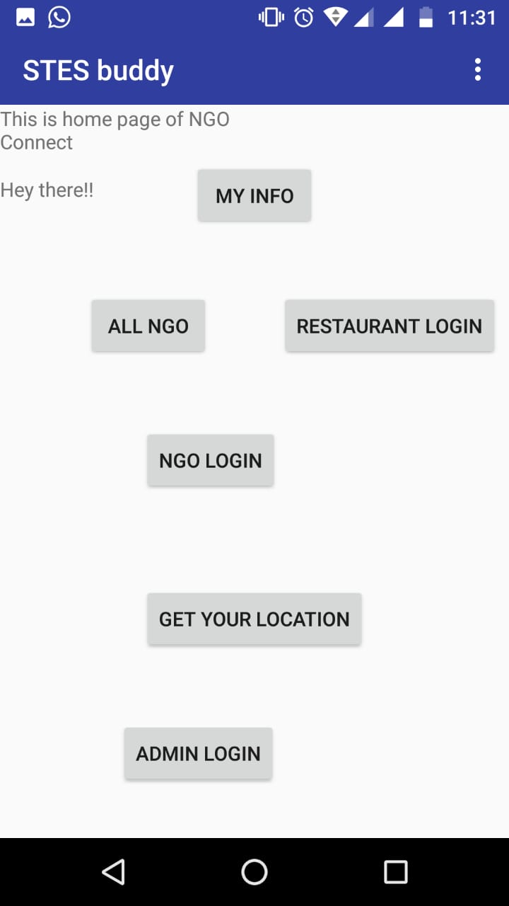
Homepage Activity

Slide 41
Code(1/5)
My Info
myInfoButton.setOnClickListener(new View.OnClickListener() {
@Override
public void onClick(View view) {
Intent login_intent=new Intent(MainActivity.this,MyInfoActivity.class);
startActivity(login_intent);
}
});

Slide 42
Code(2/5)
All NGO
mAllNGO.setOnClickListener(new View.OnClickListener() {
@Override
public void onClick(View view) {
Intent login_intent=new Intent(MainActivity.this,ShowNGOActivity.class);
startActivity(login_intent);
}
});

Slide 43
Code(3/5)
Restaurant Login
mRESTLog.setOnClickListener(new View.OnClickListener() {
@Override
public void onClick(View view) {
Intent login_intent=new Intent(MainActivity.this,MainRESTActivity.class);
startActivity(login_intent);
}
});

Slide 44
Code(4/5)
NGO Login
mNGOLog.setOnClickListener(new View.OnClickListener() {
@Override
public void onClick(View view) {
Intent mainIntent=new Intent(MainActivity.this,MainNGOActivity.class);
// mainIntent.addFlags(Intent.FLAG_ACTIVITY_NEW_TASK | Intent.FLAG_ACTIVITY_CLEAR_TASK);
startActivity(mainIntent);
// finish();
}
});

Slide 45
Code(5/5)
Admin Login
mAdminBTN.setOnClickListener(new View.OnClickListener() {
@Override
public void onClick(View view) {
Intent login_intent=new Intent(MainActivity.this,AdminLoginActivity.class);
startActivity(login_intent);
}
});

Slide 46
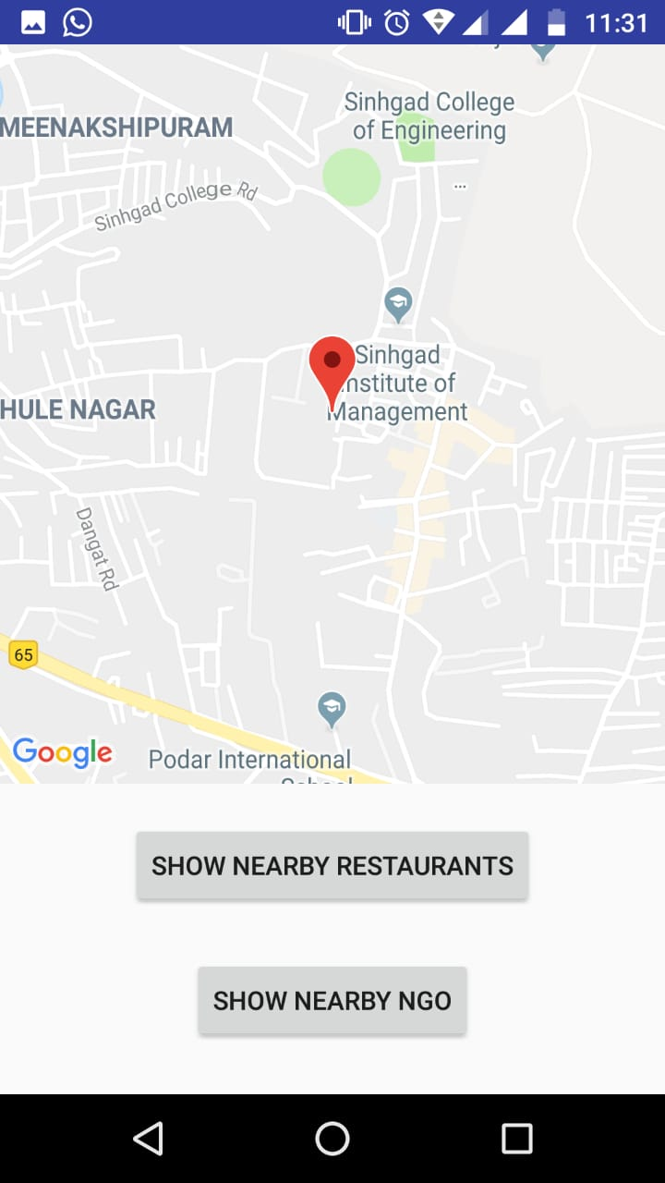
User Location Activity

Slide 47
Imported Libraries(1/2)
import com.google.android.gms.common.ConnectionResult;
import com.google.android.gms.common.api.GoogleApiClient;
import com.google.android.gms.location.LocationListener;
import com.google.android.gms.location.LocationRequest;
import com.google.android.gms.location.LocationServices;
import com.google.android.gms.maps.CameraUpdate;
import com.google.android.gms.maps.CameraUpdateFactory;
import com.google.android.gms.maps.GoogleMap;

Slide 48
Imported Libraries(2/2)
import com.google.android.gms.maps.OnMapReadyCallback;
import com.google.android.gms.maps.SupportMapFragment;
import com.google.android.gms.maps.model.LatLng;
import com.google.android.gms.maps.model.MarkerOptions;
import com.google.firebase.auth.FirebaseAuth;
import com.google.firebase.auth.FirebaseUser;
import com.google.firebase.database.DatabaseReference;
import com.google.firebase.database.FirebaseDatabase;
import java.util.HashMap;

Slide 49
Code(1/2)
For Nearby Restaurant
CameraUpdate update = CameraUpdateFactory.newLatLngZoom(latLngCurrent, 15);
mMap.animateCamera(update);
MarkerOptions options = new MarkerOptions();
options.position(latLngCurrent);
options.title("Current Location");
mMap.addMarker(options);
statusOfMap=1;

Slide 50
Code(2/2)
FirebaseUser current_user = FirebaseAuth.getInstance().getCurrentUser();
String uid=current_user.getUid();
mDatabase= FirebaseDatabase.getInstance().getReference().child("Volunteers_loc").child(uid);
HashMap<String,String> VolunteersMap= new HashMap<>();
VolunteersMap.put("Lat",Lat+"");
VolunteersMap.put("Lan",Lng+"");
//VolunteersMap.put("Email_id",email);
mDatabase.setValue(VolunteersMap);

Slide 51
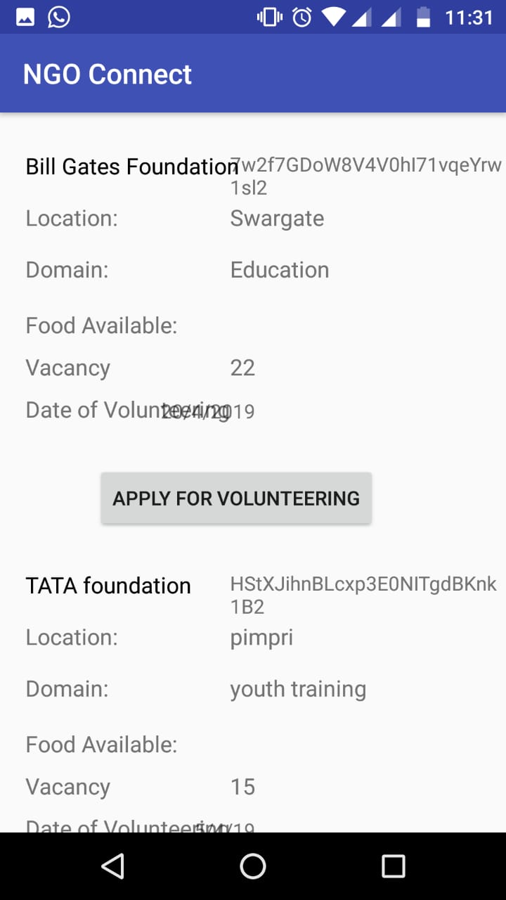
NGOs List

Slide 52
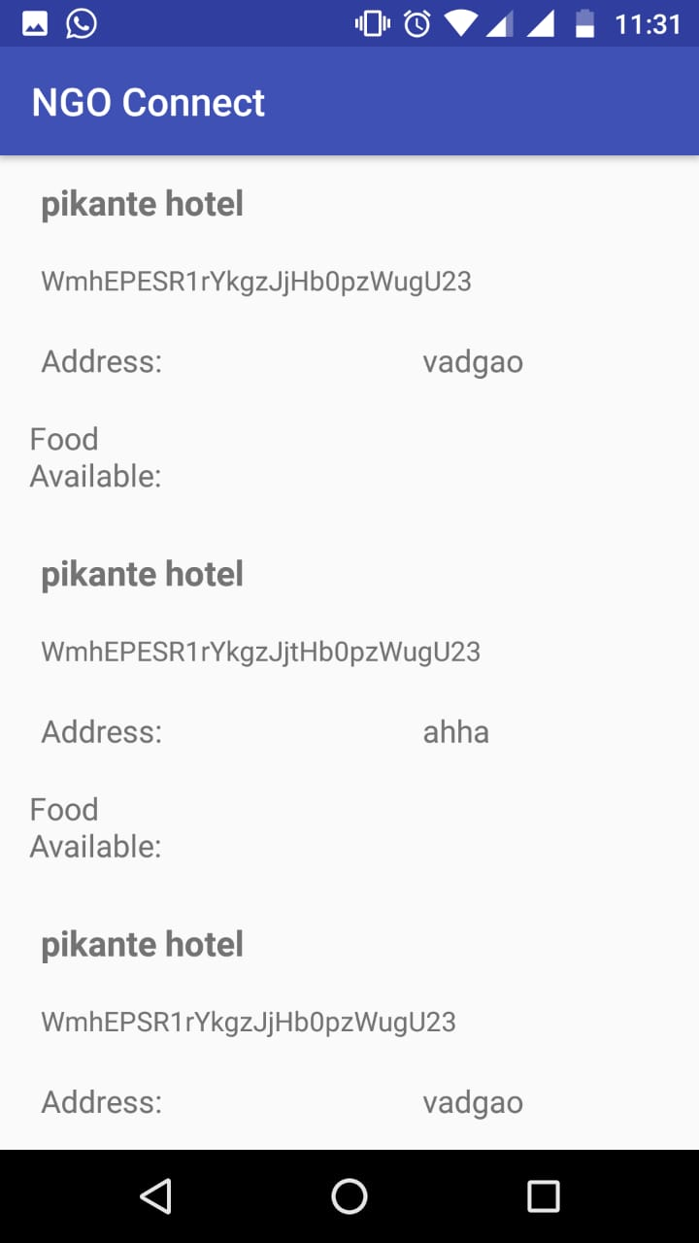
Restaurants List

Slide 53
Applications
To connect people with NGOs
To stop the wastage of food.
To get help when some natural calamity occurs somewhere
Helpful for government to track records of NGOs

Slide 54
Conclusion
The system which we have proposed An android application which connecting people, restaurants, NGOs for the purpose to improve waste food management services.
This application is based on android, cloud, location based service. For location based service we are using Haversines formula.
Android app is connected to cloud for data storage purpose. It concludes that using cloud, Haversines formula we are arranging volunteers according to shortest distance allocation to serve for the NGOs.

Slide 55
References(1/2)
[1] E. Winarno, W. Hadikurniawati and R. N. Rosso, "Location based service for presence system using haversine method," 2017 International Conference on Innovative and Creative Information Technology (ICITech), Salatiga, 2017, pp. 1-4. [2] E. Winarno, W. Hadikurniawati and R. N. Rosso, "Location based service for presence system using haversine method," 2017 International Conference on Innovative and Creative Information Technology (ICITech), Salatiga, 2017, pp. 1-4. [3] W. Li, C. Yen, Y. Lin, S. Tung and S. Huang, "JustIoT Internet of Things based on the Firebase real-time database," 2018 IEEE International Conference on Smart Manufacturing, Industrial & Logistics Engineering (SMILE), Hsinchu, 2018, pp. 43-47. [4] S. Kumar, M. A. Qadeer and A. Gupta, "Location based services using android (LBSOID)," 2009 IEEE International Conference on Internet Multimedia Services Architecture and Applications (IMSAA), Bangalore, 2009, pp. 1-5.

Slide 56
References(2/2
[5] https://firebase.google.com/
[6] https://blog.back4app.com/2016/06/15/firebase-parse/
[7] https://stackoverflow.com/questions/38248046/is-the-haversine-formula-or-the-vincentys-formula-better-for-calculating-distan
[8] https://www.milesweb.com/blog/hosting/cloud/10-benefits-data-storage-cloud/

