Slide 1

Executive Summary for Airline Fatalities
Madhuri Basava

Slide 2
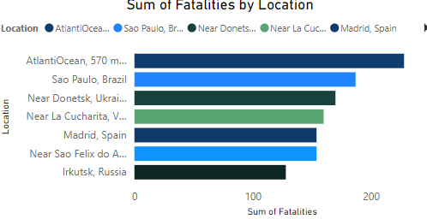
The sum of Fatalities by Location

Slide 3
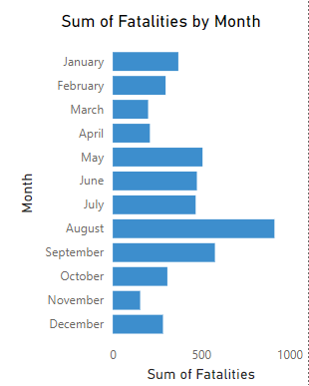
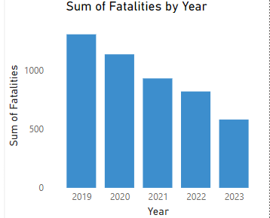
Sum of Fatalities by Year and Month

Slide 4
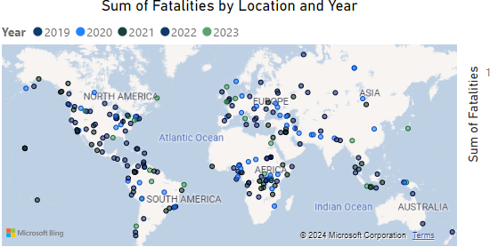
Sum of Fatalities by Location and Year

Slide 5
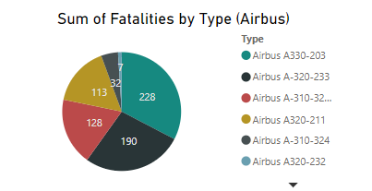
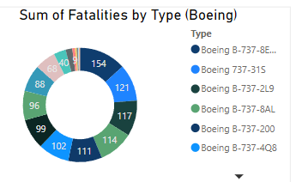
Sum of Fatalities by Type

Slide 6
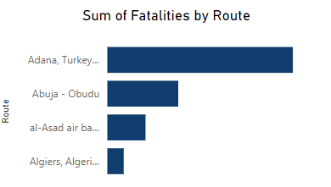
The sum of Fatalities by Route

Slide 7
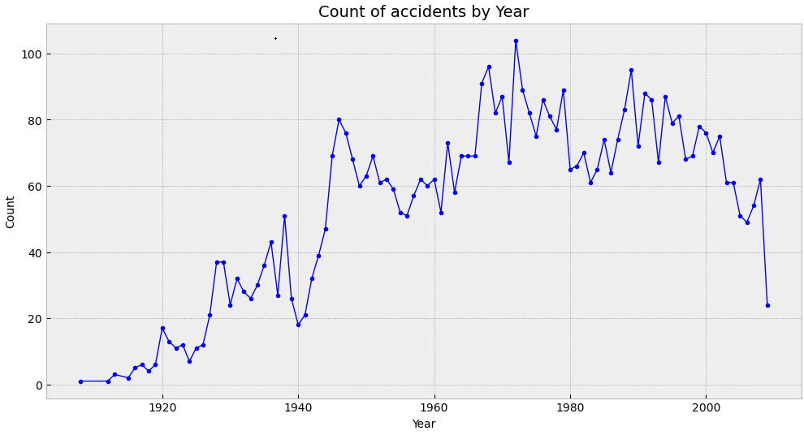
Count of Accidents by Year

Slide 8

Thank You

