Slide 1
Visualizations in Power BI and Tableau
By: Madhuri Basava
MS in Data Science, Bellevue University
DS 500 T301: Introduction to Data Science
Dr. Shankar Parajulee
July 29, 2022

Slide 2
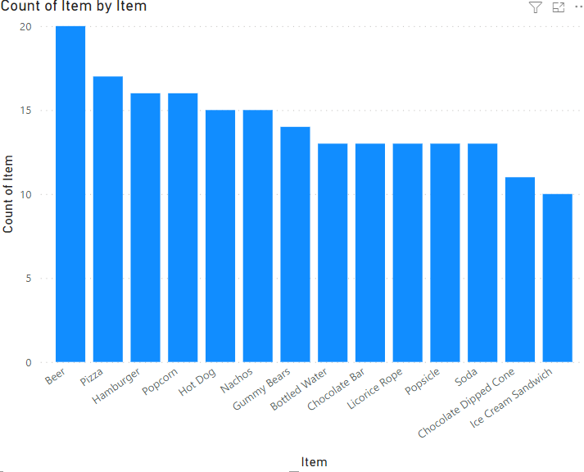
Count of Items by Item(Power-BI)
This is a bar chart that has Items on the X-axis and a count of items on the Y-axis.
Of all 14 Items, the Count of items ranged from 10 to 20.﻿﻿
﻿﻿Beer had the highest Count of Items at 20, followed by Pizza and Hamburger. Ice Cream Sandwich had the lowest Count of Items at 10.﻿﻿

Slide 3
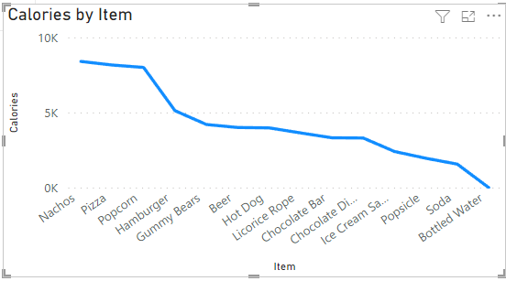
Calories by Item(Power-BI)
This is a line chart that has Items on the X-axis and Calories on the Y-axis.
﻿﻿Across all 14 Items, Calories ranged from 0 to 8400.﻿﻿
At 8400, Nachos had the highest Calories and were Infinity higher than Bottled Water, which had the lowest Calories at 0.﻿﻿
﻿﻿Nachos accounted for 14.48% of Calories.﻿﻿

Slide 4
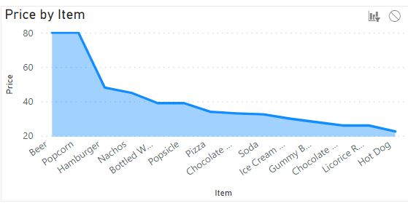
Price by Items(Power-BI)
This is an area chart that has Items on the X-axis and prices on the Y-axis.
﻿﻿Beer and Popcorn tied for highest Price at 80, followed by Hamburger. Hot Dog had the lowest Price at 22.50.﻿﻿
﻿﻿Across all 14 Items, Prices ranged from 22.50 to 80.﻿﻿﻿﻿

Slide 5
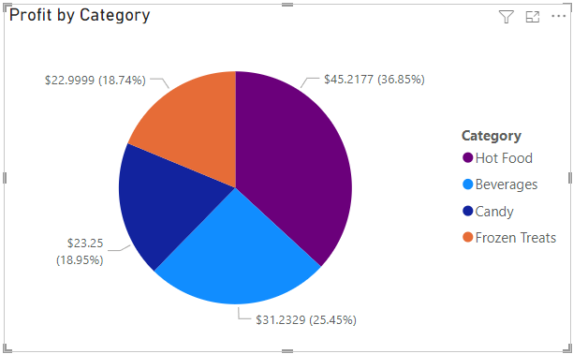
Profit by Category(Power-BI)
This is a pie chart that has profits for each category
Chose these colors to clearly depict the difference in profits for each category so that is visually easy to understand.
﻿﻿Hot Food had the highest Profit at $45.2177, followed by Beverages, Candy, and Frozen Treats.﻿﻿
Hot Food accounted for 36.85% of Profit.﻿﻿

Slide 6
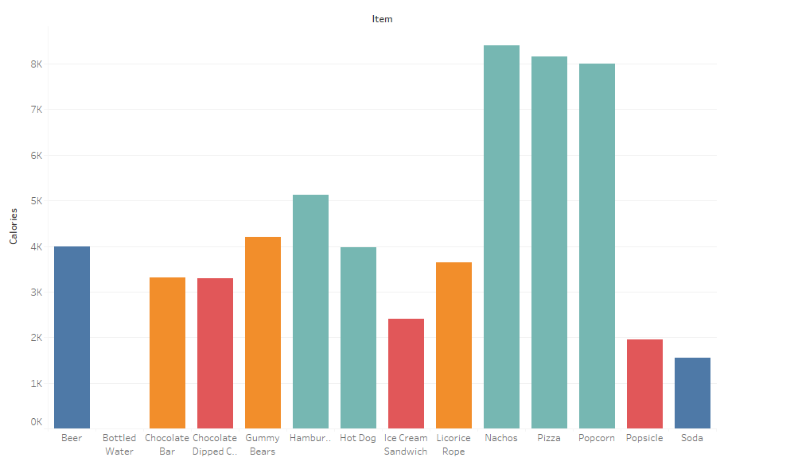
Calories by item(Tableau)
This is a bar chart that has Items on the X-axis and calories on the Y-axis.
Chose these colors to clearly depict the difference in calories for each item so that it is visually easy to understand.

Slide 7
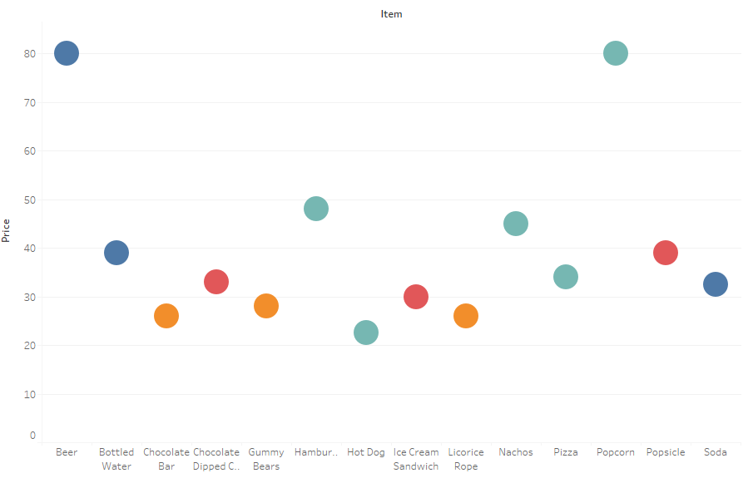
Price by Items (Tableau)
This is a circles view that has Items on the X-axis and prices on the Y-axis
Chose these colors to clearly depict the difference in price for each Item

Slide 8
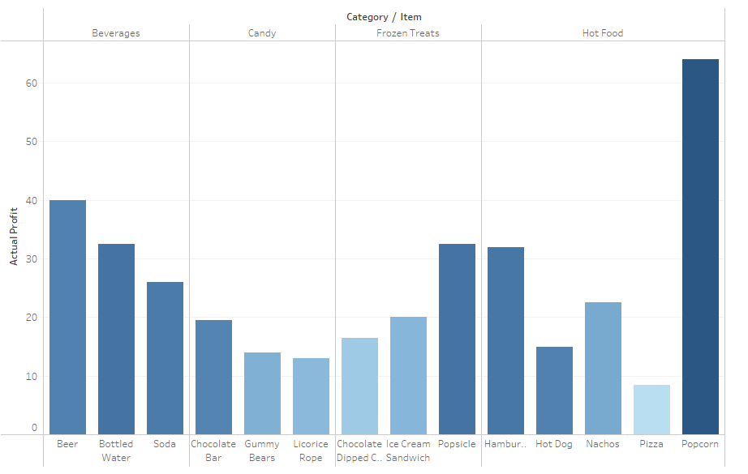
Actual Profit by Category/Item (Tableau)
This is a bar chart that has actual profits for each category/Item
So here the items are divided into four categories which are plotted against the Actual Profit

Slide 9
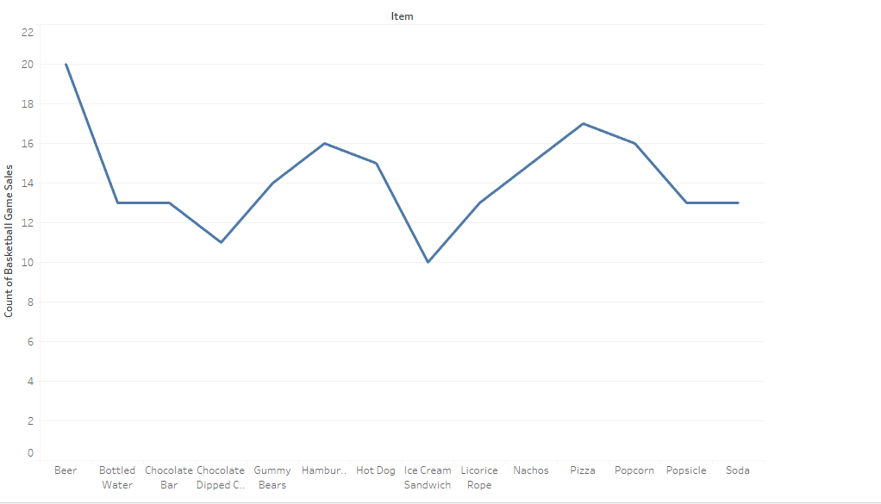
Count of Sales by Items(Tableau)
This is a Line chart that has the Count of Basketball Sales on the X-axis and the Items on the Y-axis
Total number of Beers sold was 20 and Ice cream Sandwiches were 10.﻿﻿

Slide 10
Narrative I just wanted to try both Power BI and Tableau and how the data can be visualized by using different charts and how the data can be transformed. I did a transformation in Power-BI and changed the profit values fixed to 2 decimals. I felt that I could not do too many customizations applying color theory at this point but really it is really fun to explore more. I could realize practically from this assignment that the data representation in visual format speaks more than words.

