Slide 1
Music and Mental Health
Does Music help in improving Mental health?
Hypothesis: Yes, in general, many people say that Music is soothing and calming to the brain and it improves the mental health
Null Hypothesis: Music improves mental health by more than 10%

Slide 2
Five Variables that Affect Mental Health
Five variables are Age, Hours per day, Anxiety, Depression, and Insomnia.
Age: Respondent's age
Hours per day: Number of hours the respondent listens to music per day
Anxiety: Self-reported anxiety, on a scale of 0-10
Depression: Self-reported depression, on a scale of 0-10
Insomnia: Self-reported insomnia, on a scale of 0-10

Slide 3
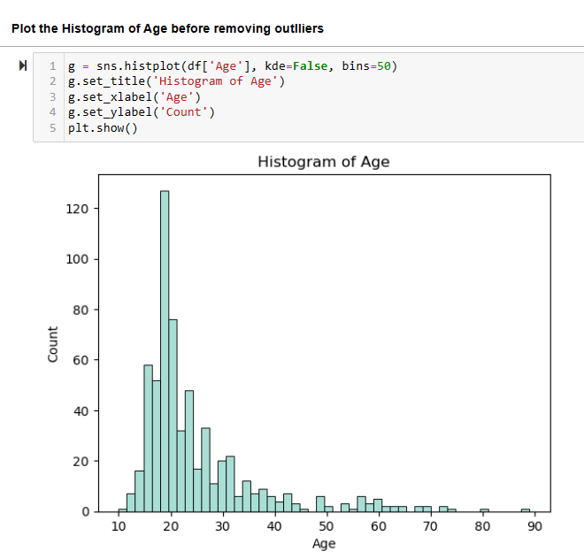
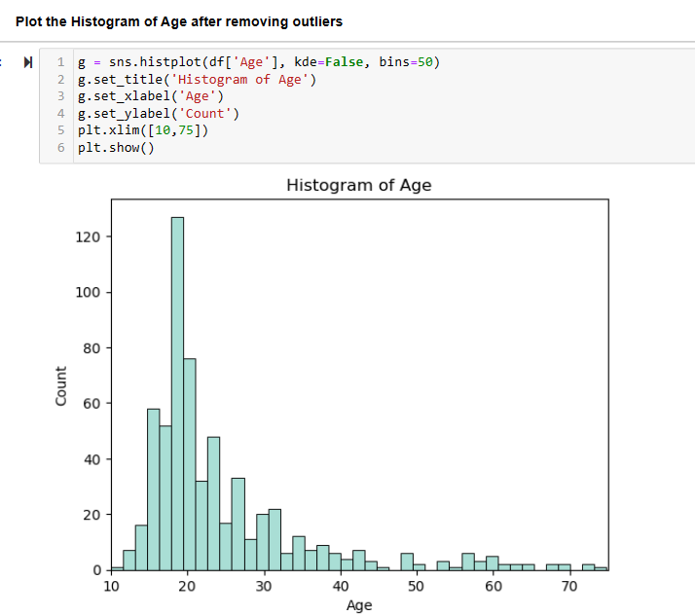
Plot the Histogram of Age
Here the age greater than 75 can be considered an outlier as there is very fewer data on ages more than 75 years. We can set plt.xlim([10,75]) before plt.show() to remove outliers

Slide 4
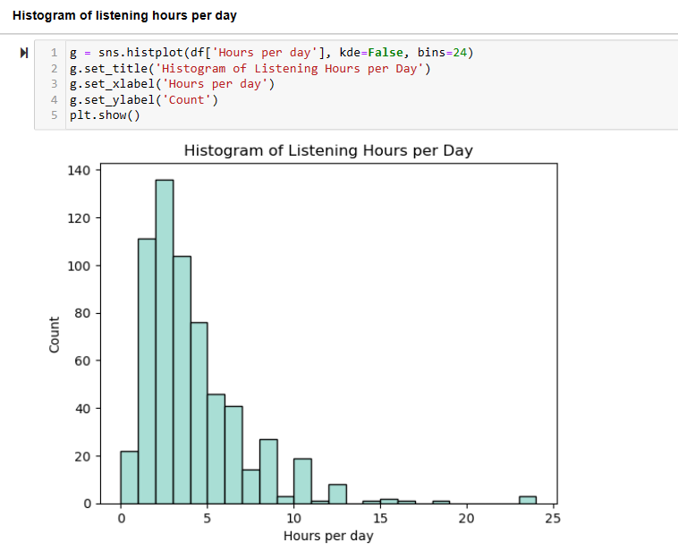
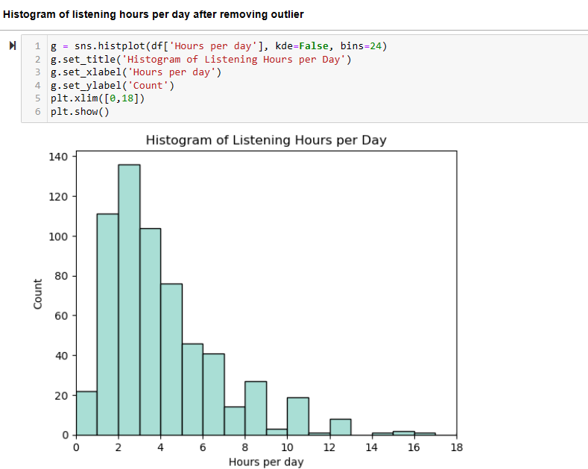
Plot the Histogram of Listening Hours per Day
Here the Listening hours greater than 18 can be considered outliers assuming it is not practically feasible to listen for more than 18 hours.

Slide 5
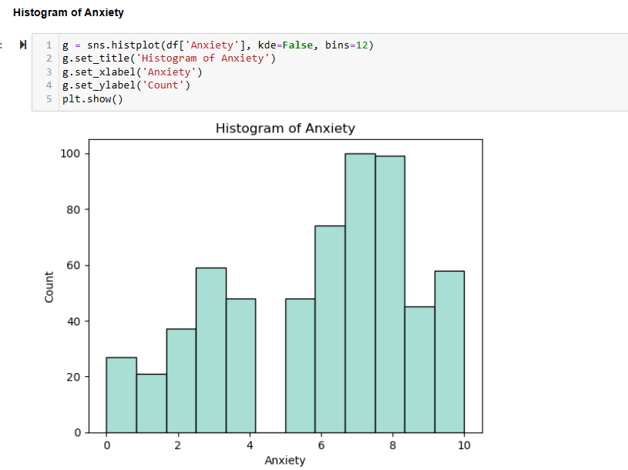
Plot the Histogram of Anxiety
In this case, there are no outliers as the scale is from 0 to 10

Slide 6
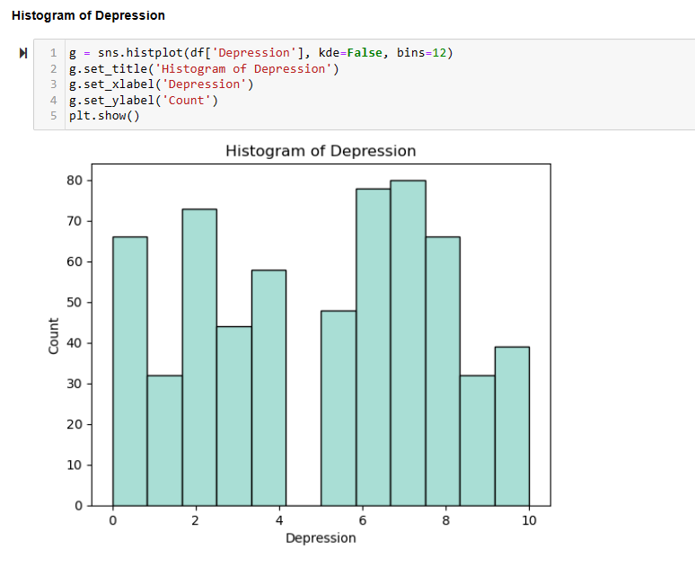
Plot the Histogram of Depression
In this case, there are no outliers as the scale is from 0 to 10

Slide 7
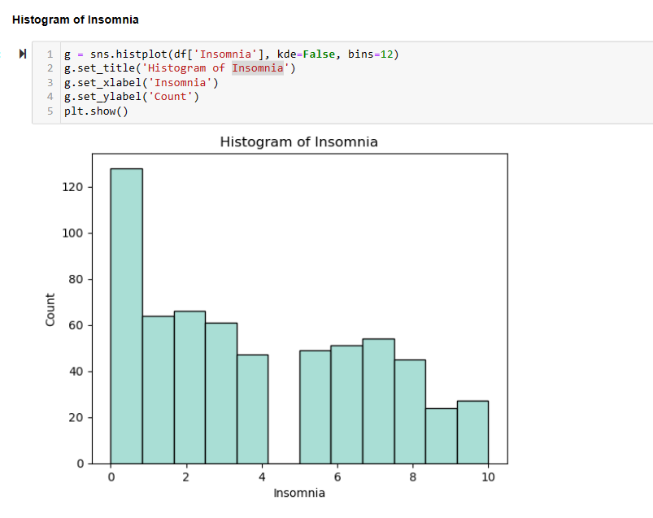
Plot the Histogram of Insomnia
In this case, there are no outliers as the scale is from 0 to 10

Slide 8
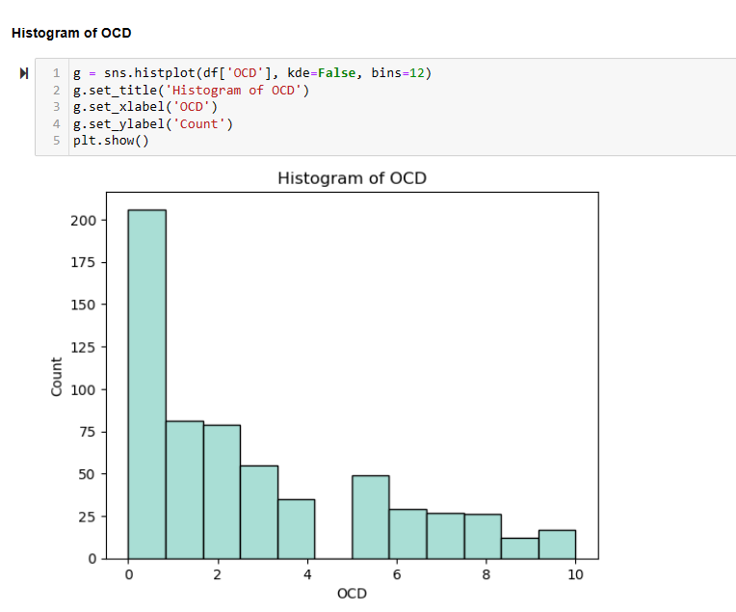
Plot the Histogram of OCD
In this case, there are no outliers as the scale is from 0 to 10

Slide 9
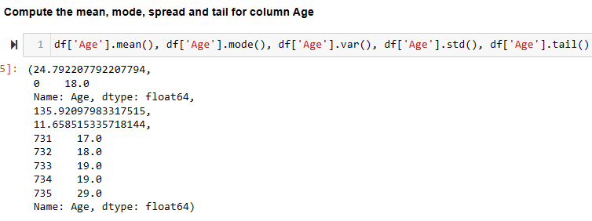
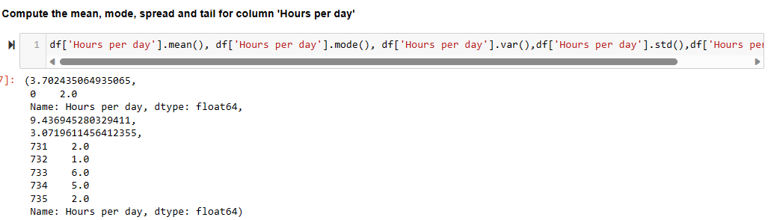
Descriptive characteristics about the variables: Mean, Mode, Spread, and Tails
From the above values, we can conclude that the average age of the individuals who listen to music is 25 years. Mode is 18 years, which means many people of age 18 listen to music. The variance or the spread is around 136. The above tails show how quickly the probability drops off as we move away from the mode. Also, we can conclude that on average, individuals listen to music for 3.7 hours per day. The mode is 2 hours. Variance or the spread is around 3 standard deviations.

Slide 10
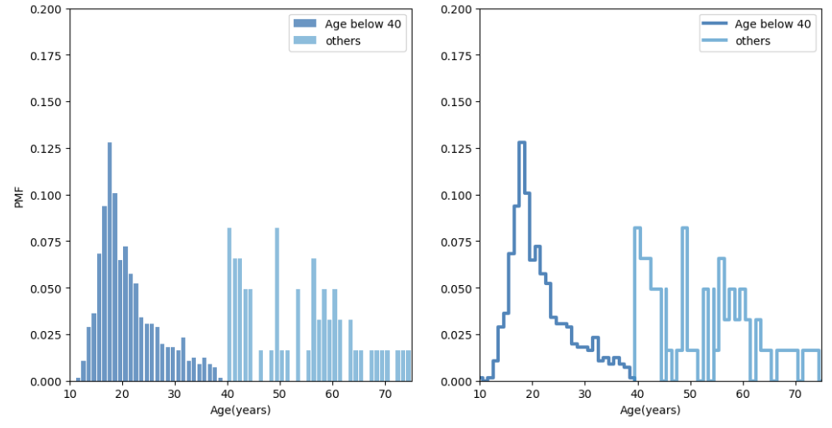
Comparing two scenarios in the data using a PMF by splitting the music data frame using Age column
From the above plots, we can conclude that the Probability mass Function among teenagers is more when compared to the pmf of others.

Slide 11
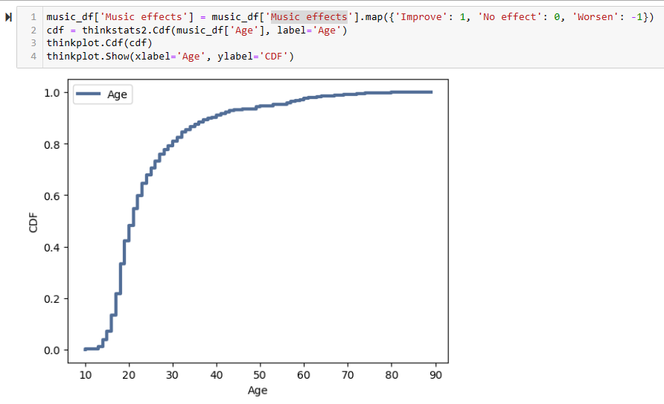
Creating 1 CDF with Age variable
As we analyze the above plot with CDF, It looks like about 80% of people are around 25 years. Here the mode is 18. There are few values below 13 years. So, the CDF in this range is flat. From this, we can conclude that people around 13 to 25 listen to more music.

Slide 12
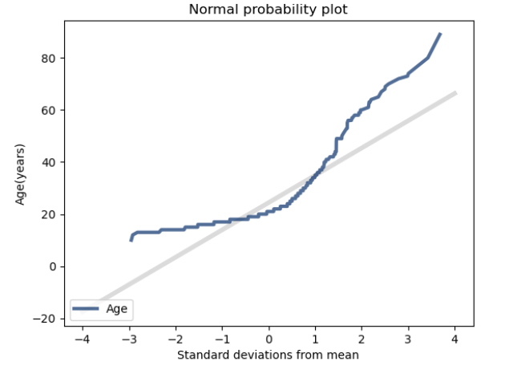
Plotting analytical distribution using Normal Distribution
When we generate a normal probability plot with Age, we can see clearly that the data deviate from the model systematically.

Slide 13
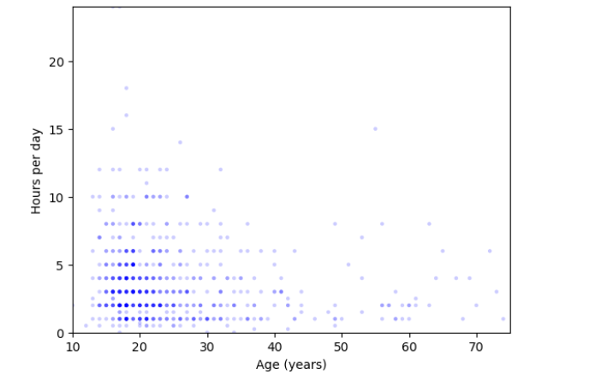
Plot the scatter plot of ages vs 'Hours per day'
Most individuals from ages 13 to 25 listen to music around 2-3 hours a day

Slide 14
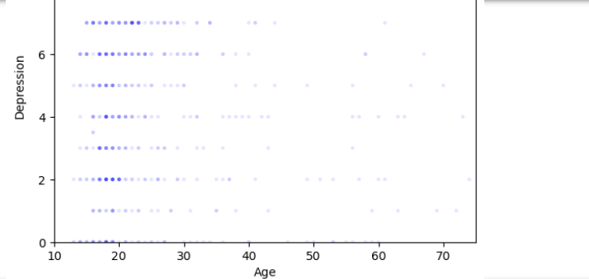
Plot the scatter plot of ages vs depression
From the above scatter plots, we can infer that individuals from 13 to 25 years are listening to music for 2-3 hours and the depression rate among them is more.

Slide 15
Analysis of Correlation and Causation
Since the correlation between age and hours per day is negative, It is inversely proportional. We cannot say that as age increases, it is the cause for the decrease in 'Hours per day'. They may have different factors causing it. Since the correlation between Anxiety and depression is positive. They are directly proportional. It makes sense as they both are mental health issues.

Slide 16
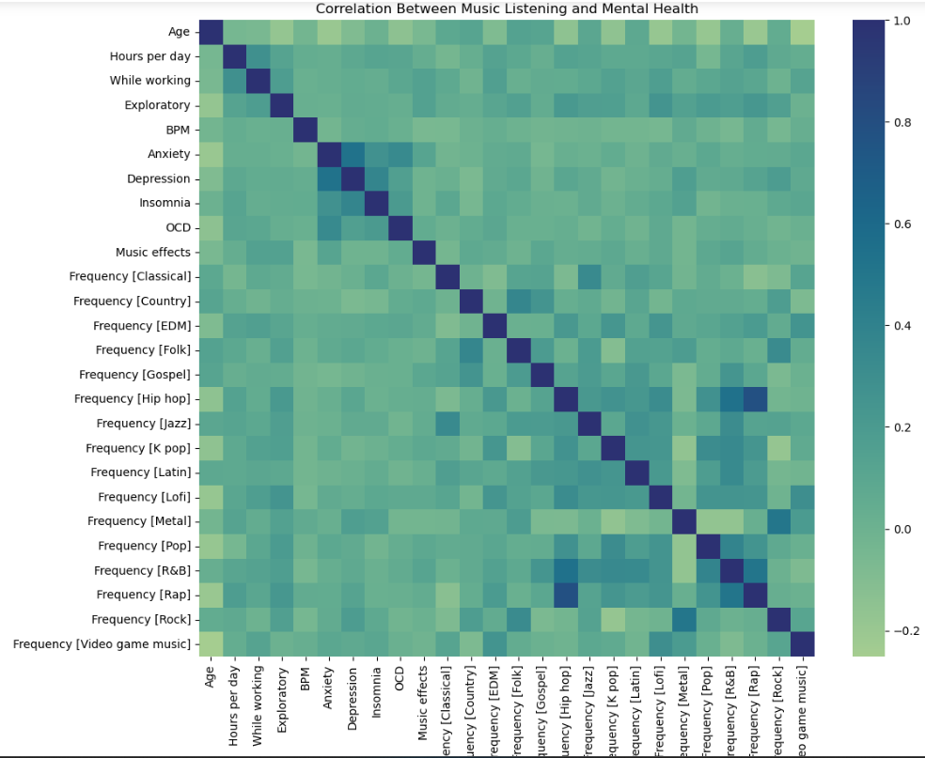
Correlation between Music Listening and Mental Health
From the above heatmap, we cannot conclude what features contribute to improving mental health (this is evaluated by the listeners). But It appears that there may be intriguing connections between various music genres. For instance, individuals who enjoy hip-hop music may have a greater inclination towards listening to rap and R&B, and metal listeners are more likely to want to listen to rock. Also, it looks like depression and anxiety are correlated which makes sense as they both are mental health issues.

Slide 17
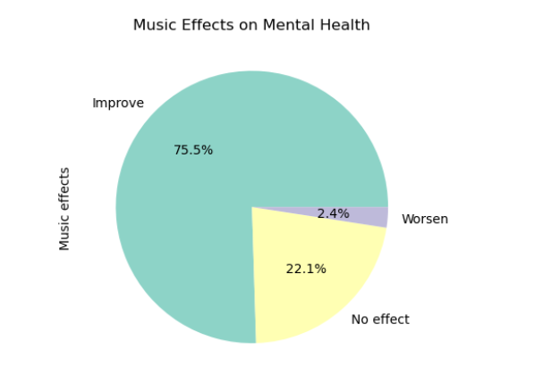
Plot the Pie chart on Music Effects Vs Mental Health
From the above pie chart, we can infer that 75.5% of individuals that listening to music improves Mental Health. 22.1% think music has no effect on mental health and only a negligible 2.4% of people think that music worsens mental health.

Slide 18
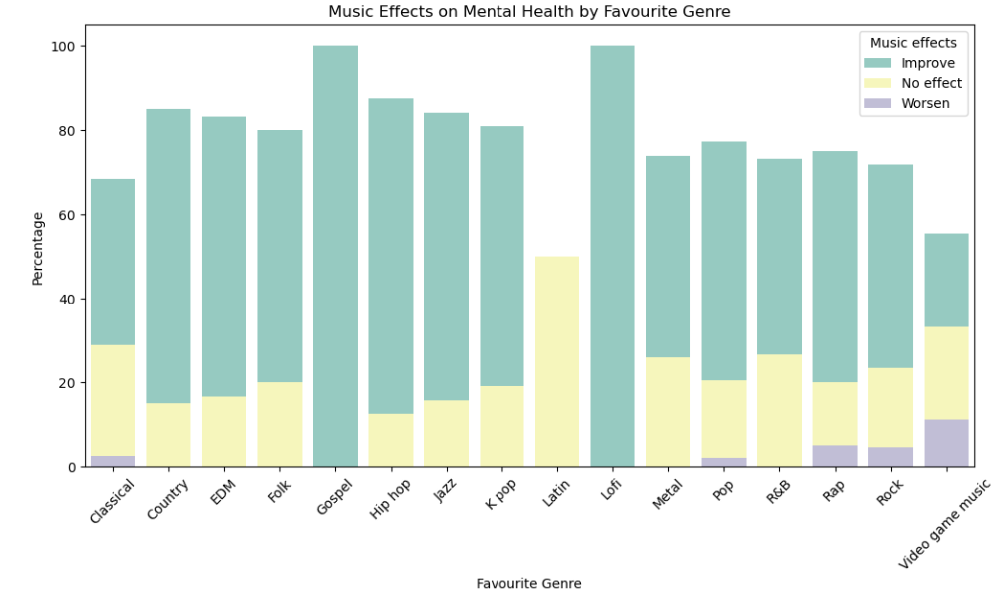
Music Effects on Mental Health by Favorite Genre
Based on the above plots, It looks like the majority of the listeners think music improves their mental health.

Slide 19
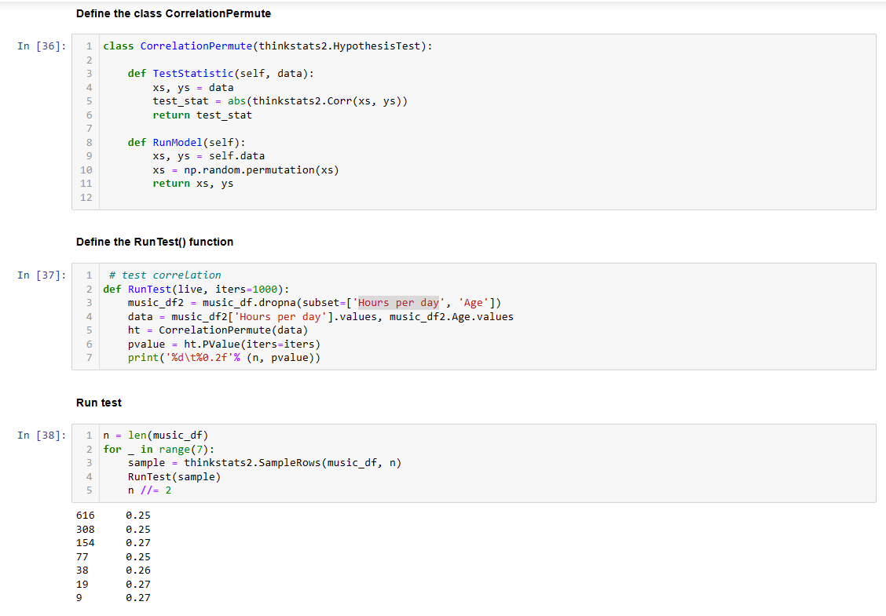
Hypothesis Test
From the above test, since the p-value is greater than 0.05, It is said to "failed to reject the null hypothesis". That means the null hypothesis is true i.e., mental health can be improved by listening to more music.

Slide 20
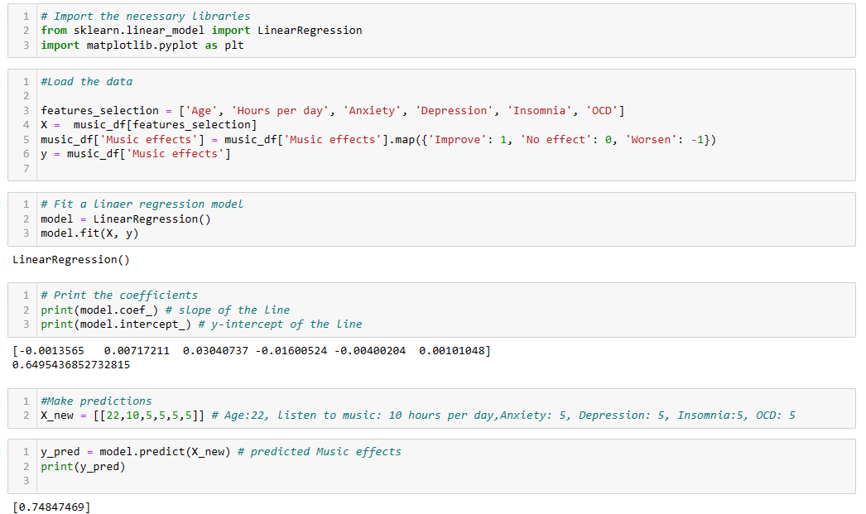
Linear Regression
From the above analysis, we can conclude that based on the linear regression, for the individual age 22, who listens to music: 10 hours per day, Anxiety: 5, Depression: 5, Insomnia:5, OCD: 5, and if the music listening is increased from an average of 2 hours per day to 10 hours per day, mental health improves from 0.65 to 0.75 which is more than 15%. So, we can say that it failed to reject the null hypothesis. So, we got our answer to our question that mental health can be improved by listening to more music.

