Slide 1
PUMA SALES ANALYSIS
CHANDRIKA MADHURI
BATCH:C8713
AF0427811

Slide 2
INTRODUCTION
It is the real time project which consists of one of the famous shoe company, overall how the business is being performed, total sales, total profit of the business, and average margin of all the products. We will show different sales by month, state and on geographical data which we will be performing.

Slide 3
DEVELOPMENT STEPS
Understand the data
Analyse data
Power query
Power Bi Modelling
Power Bi Reports.

Slide 4
BUSINESS REQUIREMENTS
Enhanced understanding of sales dynamics.
Identifications of geographical areas with high and low sales.
Insights into product performance, marketing decisions.
Informed pricing and margin strategies for improved profitability.
Actionable recommendations for optimizing sales and profit across various dimensions.

Slide 5
DASHBOARD
Power Bi dashboard is a single page and it is often called as canvas, that tells a story through visualizations. It is a well designed dashboard which contains only the highlights of the story. Readers can view related reports for the details.
We have taken examples of some charts like area chart,, donut chart, bar chart etc.

Slide 6
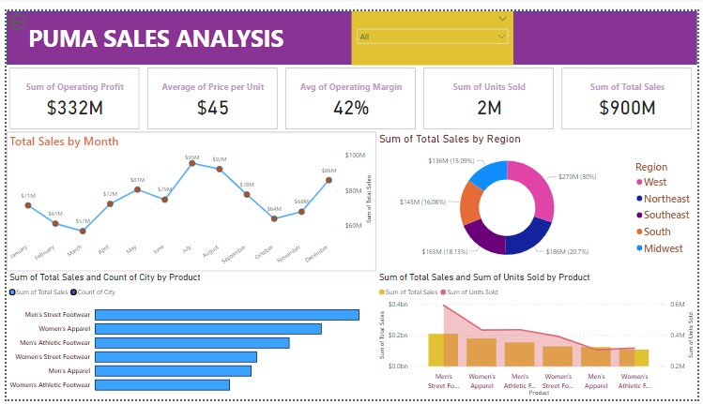

Slide 7
THANK YOU

