Slide 1

SWARNANDHRa COLLEGE OF ENGINEERING AND TECHNOLOGY
DEPARTMENT OF CYBER SECURITY
COMMUNITY SERVICE PROJECT
Aqua culture development: enhancing techniques for sustainable growth
REPORTED BY:
K.Sruthi
(23A21A4623)

Slide 2
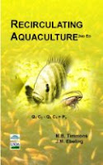
🌊 2. Recirculating Aquaculture Systems (RAS)
1. System Components (Main Parts of RAS)
✔ Fish Tanks
Where the fish are kept and grown.
✔ Mechanical Filter
Removes solid waste like fish poop and leftover feed.
✔ Biological Filter
Good bacteria break down harmful chemicals (like ammonia) into safer ones.
✔ Aeration / Oxygen System
Adds oxygen to the water so fish can breathe.
This Photo by Unknown Author is licensed under CC BY-SA

Slide 3
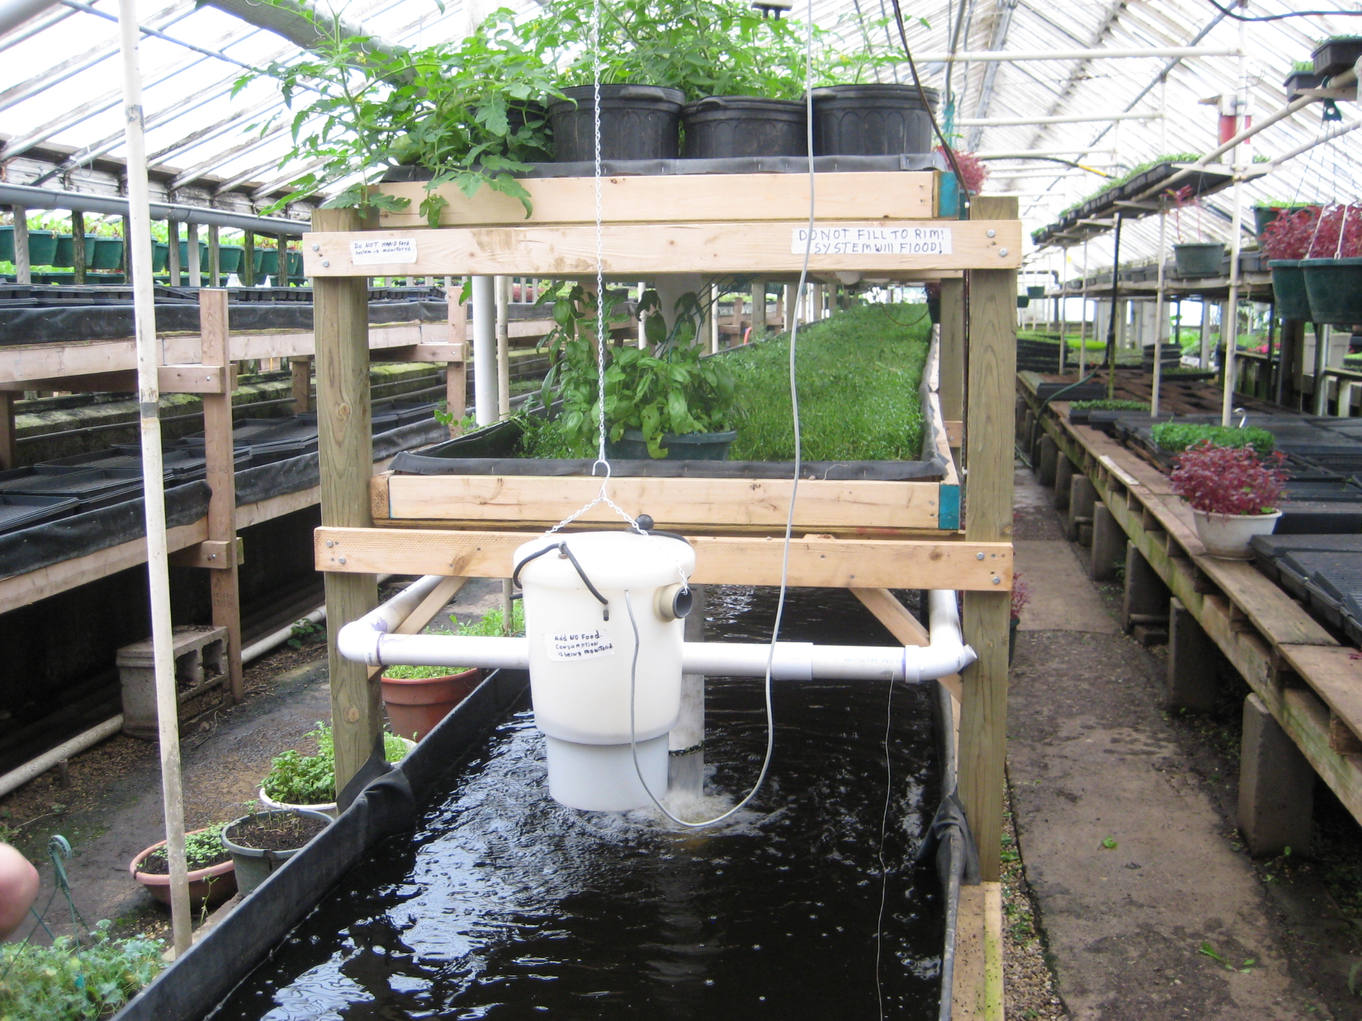
2. System Operation and Maintenance
Water flows from the fish tank to filters.
Filters remove waste and harmful chemicals.
Clean water goes back into the tank.
This cycle repeats all day.
Maintenance Includes:
Cleaning filters regularly
Checking pumps and pipes
Monitoring oxygen levels
Ensuring the system does not get clogged

Slide 4
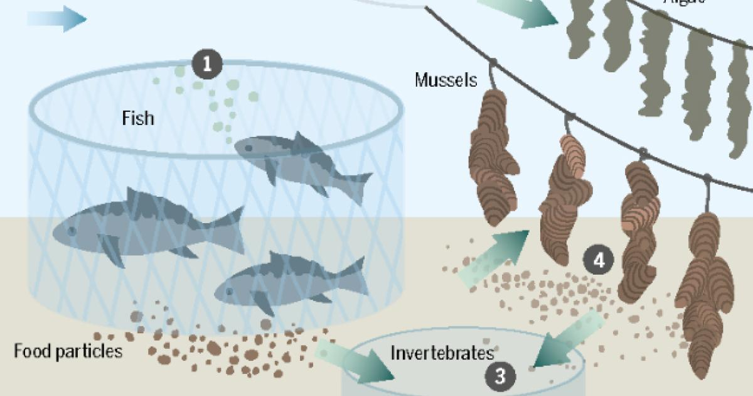
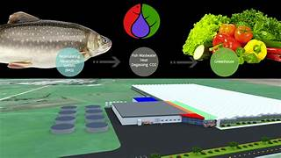
3. Fish Health Management
✔ Keeping water clean
This prevents stress and diseases.
✔ Monitoring fish behavior
Healthy fish eat well and swim actively.
✔ Quarantining new fish
New fish are kept separately for a few days to avoid spreading diseases.
✔ Avoiding overcrowding
Too many fish can cause low oxygen and fast disease spread.
✔ Feeding nutritious feed
Good feed improves immunity.
Good health management reduces fish mortality and increases production.

Slide 5

4. Water Quality Management
✔ Temperature – should be suitable for the species
✔ pH Level – balanced pH keeps fish comfortable
✔ Dissolved Oxygen (DO) – fish need enough oxygen
✔ Ammonia & Nitrite Levels – must be low to avoid poisoning
✔ Water Clarity – clear water shows clean system

Slide 6
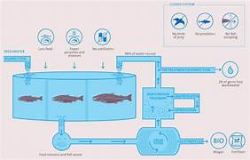
5. System Design and Management
Good RAS design includes:
Proper tank size
Efficient filters
Strong pumps
Backup power supply
Easy cleaning system
Management involves:
Daily checking of water quality
Weekly cleaning of filters
Monitoring fish growth
Adjusting feeding schedules
Ensuring safety of equipment

Slide 7
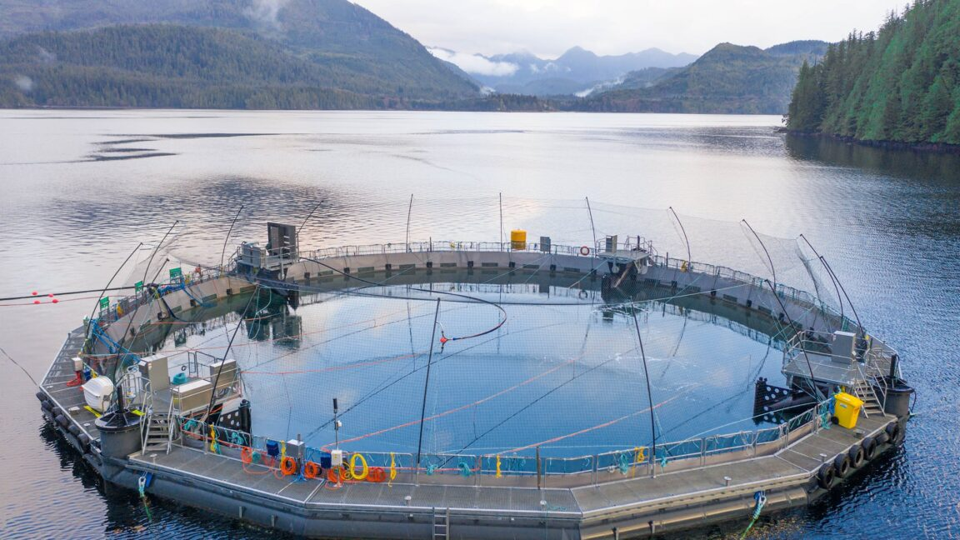
6. Benefits of RAS
✔ Saves Water
Uses 90–95% less water compared to traditional ponds.
✔ Can be used Anywhere
Even in cities, small areas, or indoors.
✔ Faster Growth
Fish grow faster because water conditions are controlled.
✔ Year-Round Production
Not affected by seasons like rain or heat.
✔ Less Pollution
Water is reused, so waste is reduced.

Slide 8
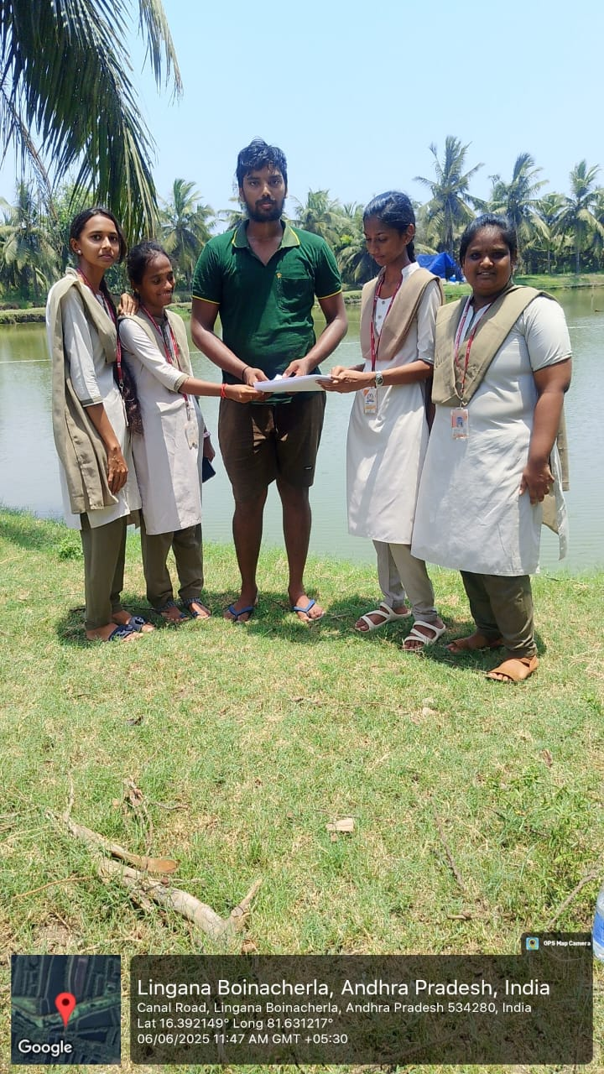
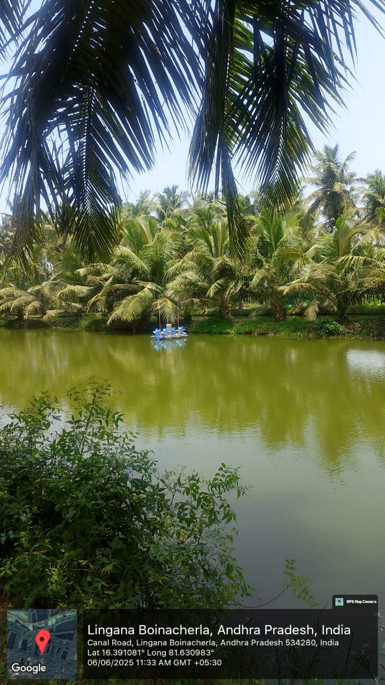
Survey Photos:

Slide 9
THANKYOU!

